Slide 1
Version Control with Git Introduction
Dr Simon Katan
www.simonkatan.co.uk
Notes:
Quick intro on who I am
They can check out my website
Overview of course 6 weeks of Git … aims

Slide 2
What is version control ?
Backup
Record changes over time
Make drafts
Collaborate
To deal with these requirements programmers developed VCSs [Version Control Systems].
Notes:
Go through alternate examples for each

Slide 3
Resources
These classes draw heavily from the resources below
http://git-scm.com/book
http://marklodato.github.io/visual-git-guide/index-en.html
http://cdn.bitbucket.org/themonkeymixer/cs133u/downloads/Git%20Internals%20-%20Scott%20Chacon.pdf

Slide 4
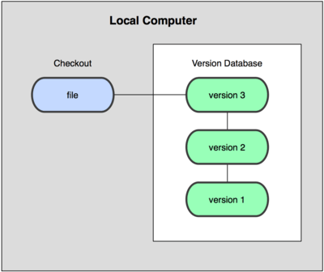
Local version control
RCS
Files only stored on hard drive.
Changes between versions (deltas) saved as patch files.
To get to a particular version. Start from v1 and add up all the patches to that point.
Notes:
Great but no collaboration
No remote back up

Slide 5

Centralised Version Control Systems CVSs
Eg. Subversion, CVS, Perforce

Slide 6
Advantages
Now collaboration is possible
All files stored on a central server
Everybody can see what everybody else is doing
Administrators can control who does what
Users checkout local versions then upload changes to the central server when ready

Slide 7
Disadvantages
Server going down stops work
No local version control
No way of viewing other changes
Vulnerability from central database corruption
The project could only partially be restored from piecing together the various local snapshots

Slide 8
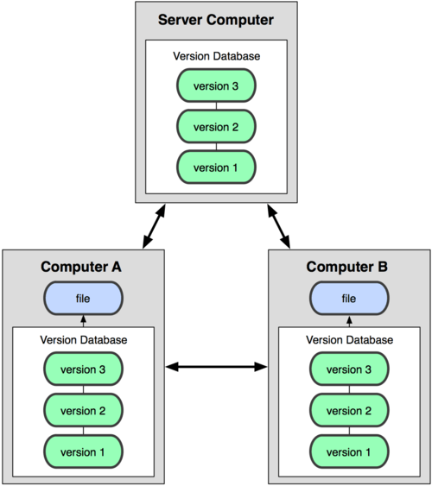
Distributed Version Control Systems DVCSs
Every checkout is really a full backup of all the data
Some DVCSs allow for multiple remote servers. New types of workflow.
Eg. Git, Mercurial, Bazaar, Darcs

Slide 9
Advantages
Less vulnerable to data corruption
Individuals can work more meaningfully offline
Allows for more fast local operations and less slow network ones
Multiple remotes means more detailed hierarchies in workflow

Slide 10
Git – A little background “I’m an egotistical bastard, and I name all my projects after myself. First Linux, now git.” – Linus
Developed by Linus Torvalds in 2005
Initially for Linux kernal developers
The project very quickly spread to other Linux projects (X.org, Fedora, Wine etc.)
Now days a very popular and mature tool
Specialised sites to host remotes such as GitHub & BitBucket

Slide 11
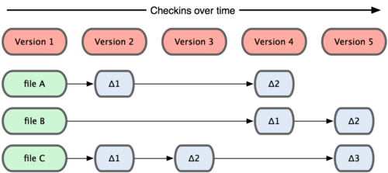
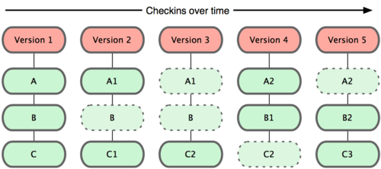
Git vs older version control systems
Older systems: record changes only (deltas)
Git: takes snapshots of whole files when they have been changed
This allows for a lot of extra functionality

Slide 12
Git Values
Mostly local operations = very fast
Check-summing (Git always knows when files have been changed)
Git generally only adds data (deleting is hard and unnecessary)
If you have used SVN before be careful … words like add and checkout don’t have the same meaning.

Slide 13

3 states
Notes:
NB. This is all on your local computer (we will be doing this for a few weeks)

Slide 14
Github for Mac
a simple GUI for GIT
http://mac.github.com/

Slide 15
Concepts from GH4Mac
Stage
Commit
Revert
Branch
Merge
Stash

Slide 16
But …
GH4Mac doesn’t give all the functionality
Slower to keep switching to GUI
You don’t really know what’s going on yet

Slide 17
Install command line git
http://code.google.com/p/git-osx-installer

