Slide 1
Git Week 3
Internals

Slide 2
Where is my data being stored ?
Check the .git folder
View hidden files for OSX users …
“defaults write com.apple.Finder AppleShowAllFiles TRUE”
Then relaunch Finder (context click icon + alt)

Slide 3
Immutable objects
Blobs
Where the contents of files are stored
NB Not file names / permissions
Only new blobs for changed files/ fragments of files
SHA name for each
Tree
A list of all the blobs for the directory
Also has a list of connected trees (i.e. sub directories)
Commit
A pointer to the root tree
Has all the other information

Slide 4
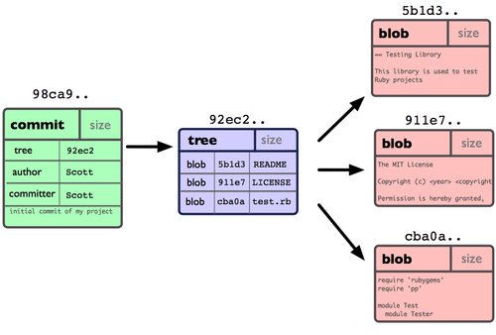
What it looks like …

Slide 5
With multiple commits
commits
1
2
3
4
}
snapshot
trees
blobs

Slide 6
More complex tree arrangements
1
2
Root tree
sub tree

Slide 7
Immutable & mutable objects
Commits, Blobs & Trees are immutable
In other words, once created they can’t be modified

Slide 8
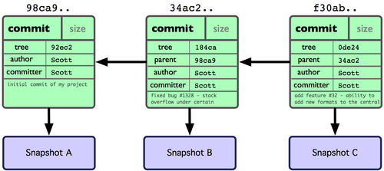
Lets ignore blobs & trees
Notes:
We will just assume that it works

Slide 9
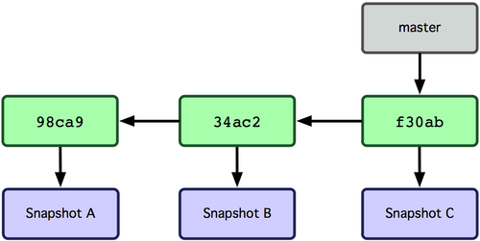
A branch is just a pointer

Slide 10
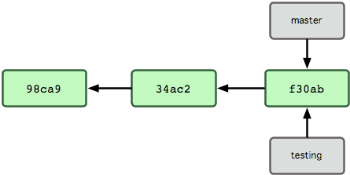
$ git branch testing
This command makes another pointer to the commit that master is on.
No new commits, blobs or trees have been created

Slide 11
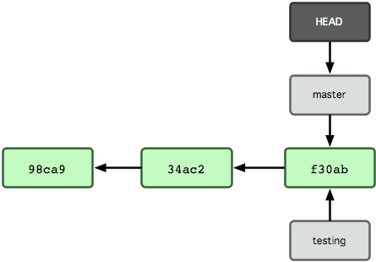
HEAD is a special pointer
It points to the branch/commit that we are on
NB. The previous command didn’t move the HEAD only create the new branch

Slide 12
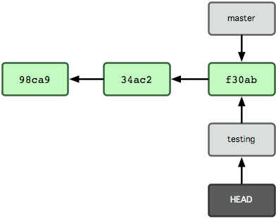
$ git checkout testing
Now HEAD is on testing branch.
We are on the testing branch

Slide 13
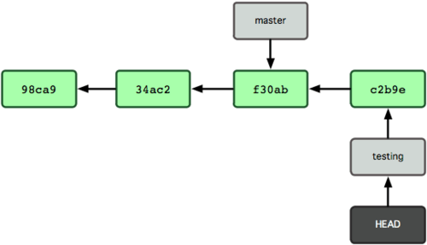
$ vim index.html $ git commit –a –m ‘made a change’
HEAD and testing are now one commit ahead of master branch

Slide 14
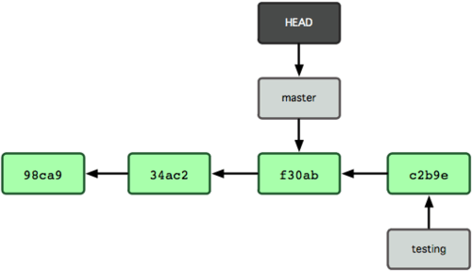
$ git checkout master
HEAD points at master branch
Files in the working directory have been reverted

Slide 15
a simple ffwd merge
HEAD
master
C1
C2
C3
C4
testing
$ git merge testing

Slide 16
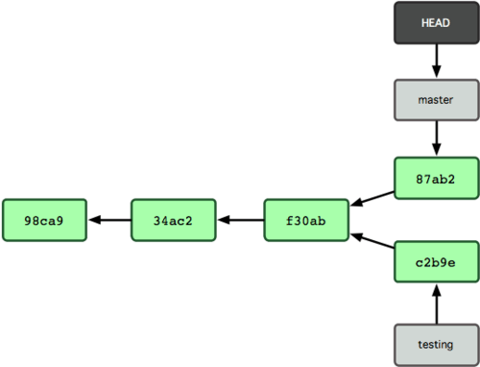
$ vim index.html $ git commit –a –m “some more changes”
Now the branches have diverged
Both master and testing branches are 1 commit away from their mutual parent
If we merged there is a possibility of conflicts

Slide 17
recursive merge
HEAD
$ git merge testing
master
C5
C6
C1
C2
C3
C4
C3 is the common ancestor
testing

Slide 18
the result
NB. Testing is still where it was
HEAD
C5
C6
master
C1
C2
C3
C4
C7
testing

Slide 19
$ git checkout develop
$ git checkout HEAD~3
This detaches the HEAD from the branch
HEAD
master
C1
C2
C3
C4
develop
$ git branch develop

Slide 20
Your turn

Slide 21
A GUI to help us
http://www.sourcetreeapp.com/
Use command line and check whats happened in the GUI
Make sure you really understand what is happening with branching, checkouts and merging

Slide 22
Research projects
Use sourcetree to work out what reset does to the repo
What’s the difference between --hard and –soft
What does --amend do to the repo
Read pro-git 3.3 and 3.4 for understanding management and work flows.
Try a branching workflow on your own project

Slide 23
Command test 1
I want to initialise a repository for a project in a directory called “myProject”.
What commands do I use ?
I need to configure a local username and email ?

Slide 24
Command test 2
If I want to check the status of my repository ?
If I want to see the history of my repository ?
the history of just the last 3 commits
each commit on one line each

Slide 25
Command test 3
Start tracking a file
Start tracking all files
Stage an individual file
Stage and commit all files that have changed
Commit staged files only

Slide 26
Command test 4
Create a new branch
Switch to a different branch
Create a new branch and switch to it at the same time

