Slide 1
Git – wk4
Collaboration

Slide 2
Cloning a remote repo
Create your own repo for online backup
Work with remote branches
Add collaborators to your projects
Keep your local repo up to date with the remote

Slide 3
Task 1
Get an account with github.com
Bitbucket is also free and allows private repos

Slide 4
$ git clone https://github.com ...etc.
Some repos to clone
EaselJS, FabricJS, jQuery
Find others to clone ...
Try these commands
git log --oneline -5
git remote (see remotes)
git branch -r (see remote branches)
git branch -a (see all branches)
git tag
git show

Slide 5
Creating a new remote for your local repo
Set up a new repo on github but don’t add any README files etc.
From your local repo ...
- $git remote add origin url
(cut and paste the url from the github repo page)
$git push –u origin master
-u means set up an association between the local and remote branch. ( only needed on each first branch push )

Slide 6
Add a second remote branch
$git push –u origin experimental
or if you want a different remote branch name ...
$git push –u origin experimental:awesomecode

Slide 7
Looking at a remote branch in a cloned repo
$git checkout origin/experimental
Results in detached head state
Remote branches are immutable on local repo
One solution is make a local branch of the same name.
$ git branch experimental
$ git push origin experimental

Slide 8
Remove old remote branch
$git push origin :experimental
(from the remote)
$git branch –r -d origin/experimental
(from the local repo)

Slide 9
Collaboration
Add a collaborator to your github project
Note :
Remote branches only move forwards

Slide 10
Syncing your master branch
$git fetch origin
Fetches all the changes from the remote
NB nothing has changed in your working directory just yet
$git merge origin/master

Slide 11
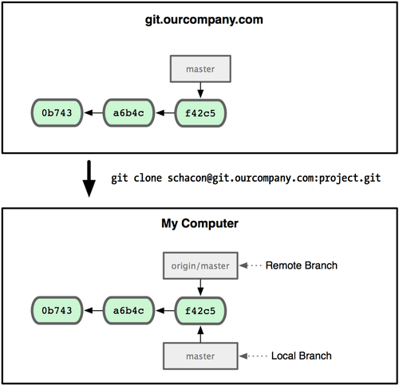
Under the hood

Slide 12
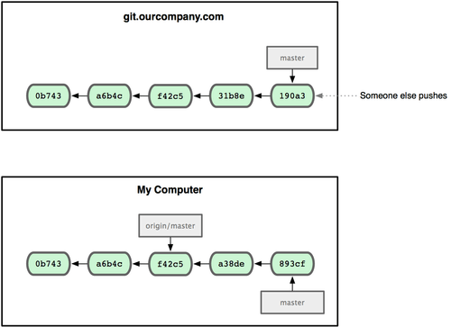
Now my local repo is 2 behind

Slide 13
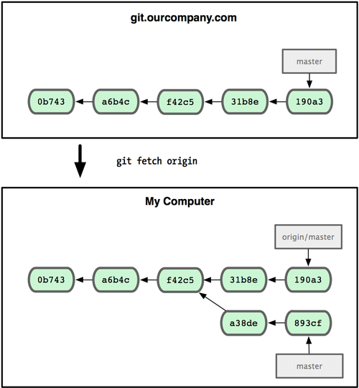
This is what happens when I fetch the changes

Slide 14
Tracking branches
Has an association with remote branch
No need reference remote address anymore
To create ...
$git checkout –b experimental origin/experimental
or
$git checkout –-track origin/experimental
Now you can update the remote with a simple $git push
You can fetch and merge changes with a simple $git pull
Note without any extra options all tracking branches will be affected

