Slide 1
MSBA382 · HEALTHCARE ANALYTICS
Global Tuberculosis Burden & Treatment Gaps
Trends, demographic disparities and geographic patterns
A decision-support dashboard for finding where burden and service-coverage gaps are concentrated.
ESTIMATED INCIDENT TB
NOTIFIED CASES
CALCULATED COVERAGE
10.55M
8.33M
78.9%
Project snapshot · 2024
WHO published rounded global headlines of 10.7M incident cases and 1.23M deaths; this dashboard aggregates the reproducible country-level extract.
[Student Name]
23 June 2026
Notes:
Tuberculosis is preventable and curable, yet it remains one of the world’s largest infectious-disease burdens. My project turns WHO-derived country-level estimates into a Streamlit decision-support dashboard. In the reproducible 2024 snapshot, about 10.55 million people developed TB, 8.33 million new and relapse cases were notified, and calculated diagnosis-and-treatment coverage was 78.9%. The purpose is to show not only where TB is high, but where the health-system response may still be incomplete.

Slide 2
WHY THIS DASHBOARD
2/7
The analytical problem
A gap can emerge between disease burden and people reached by services
Objective
Build one interactive tool that moves from description to prioritization.
Estimated incident TB
10.55M
Where is TB burden highest?
How is it changing over time?
Who and which subtypes are most affected?
Where should health systems investigate and act first?
Notified new & relapse
8.33M
Estimated notification difference
2.22M
A surveillance signal — not proof every person was untreated
Decision sequence: scale → geography → population → response
WHO-derived project snapshot; Global Tuberculosis Report 2025 context
MSBA382 · Healthcare Analytics
Notes:
The analytical problem is the gap between estimated disease burden and the people who appear in routine services. I calculate the notification difference as estimated incident cases minus notified new and relapse cases. It is deliberately labelled as an estimate and a surveillance signal, because it does not prove that every person in the difference was untreated. The dashboard answers four practical questions: where burden is highest, how trends are changing, who and which subtypes are most affected, and where a healthcare system should investigate first.

Slide 3
DATA AND METHOD
3/7
A reproducible, decision-ready data pipeline
1
2
3
4
WHO-derived public snapshots
→
Clean and integrate
→
Validate and derive
→
Publish in Streamlit
Burden, notifications, age/sex, TB–HIV, RR/MDR-TB
Standardize ISO codes, country names, years and numeric fields
Unique country-year checks; rates, coverage, gaps and shares
Filters, maps, trends, demographics, downloads and forecast
5.3K
country-year rows
217
countries / territories
25
years: 2000–2024
6
WHO regions
Methodological guardrail
Country-level aggregates can differ slightly from WHO’s rounded report headlines; the latest WHO time series supersedes earlier releases.
WHO TB data; GTB-TME official repository; reproducible project manifest and hashes
MSBA382 · Healthcare Analytics
Notes:
The workflow is reproducible from raw input to dashboard. I retained the raw snapshots, standardized identifiers and numeric fields in pandas, merged the indicators into one country-year model, and recalculated global and regional rates from the country data. Automated checks confirm unique country-year records, the 2000-to-2024 range, non-negative burden values and male/female age-sex data. The final package contains the code, raw and processed files, a data dictionary, source hashes, and validation output.

Slide 4
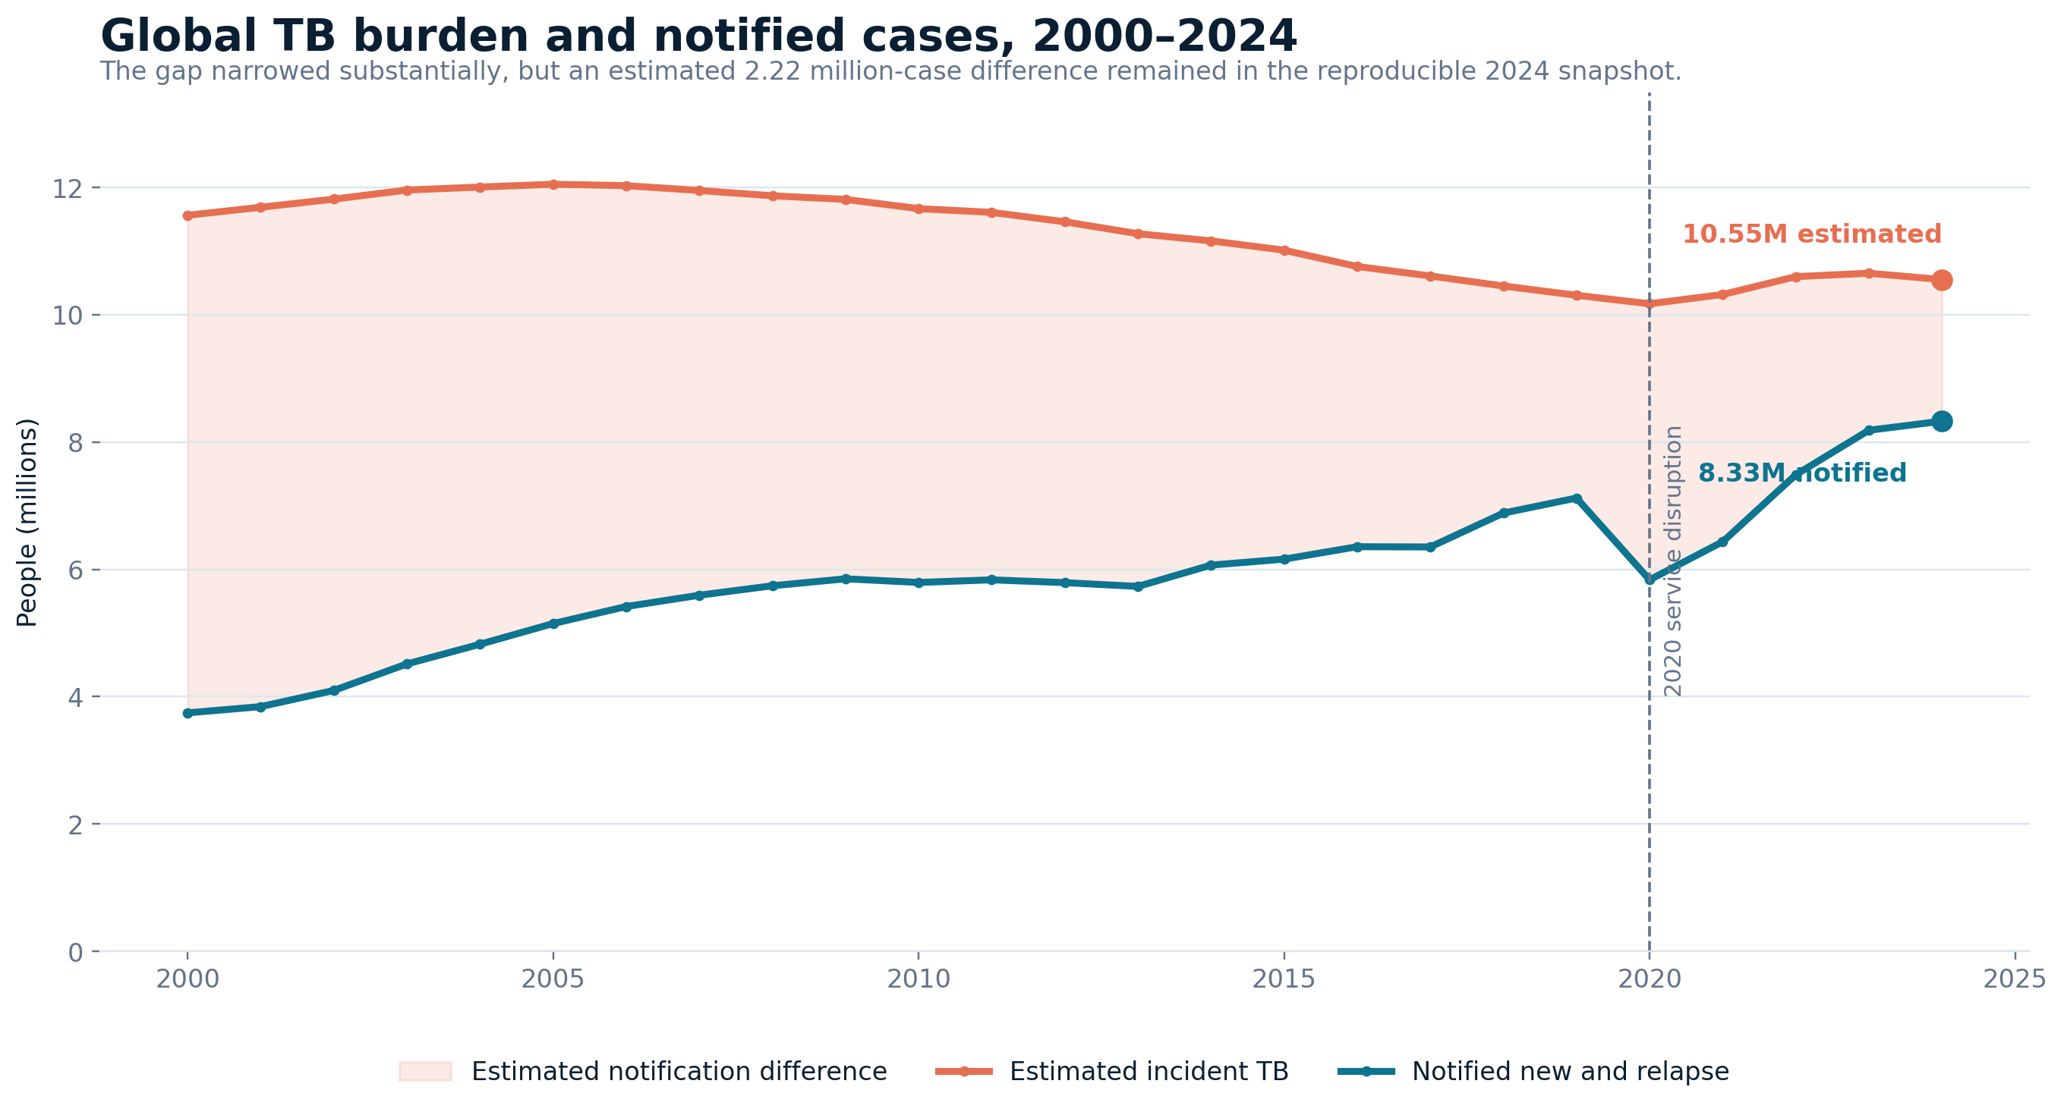
CORE RESULT
4/7
Global progress is real — but the gap remains
2024 SNAPSHOT
10.55M estimated 8.33M notified
REMAINING SIGNAL
2.22M notification difference
SYSTEM SHOCK
18.1% notification fall in 2020
The gap narrowed, but detection and linkage remain incomplete.
WHO-derived project snapshot; Global Tuberculosis Report 2025 context
MSBA382 · Healthcare Analytics
Notes:
The core time series shows substantial improvement. Notifications more than doubled since 2000, and calculated coverage rose from 32.4% to 78.9%. However, the 2024 snapshot still contains a 2.22 million difference between estimated burden and notified cases. The 2020 disruption is especially important: notifications fell by 18.1% from 2019 while estimated incidence moved much less. This shows that service access and reporting can deteriorate rapidly even when the underlying disease burden does not disappear.

Slide 5
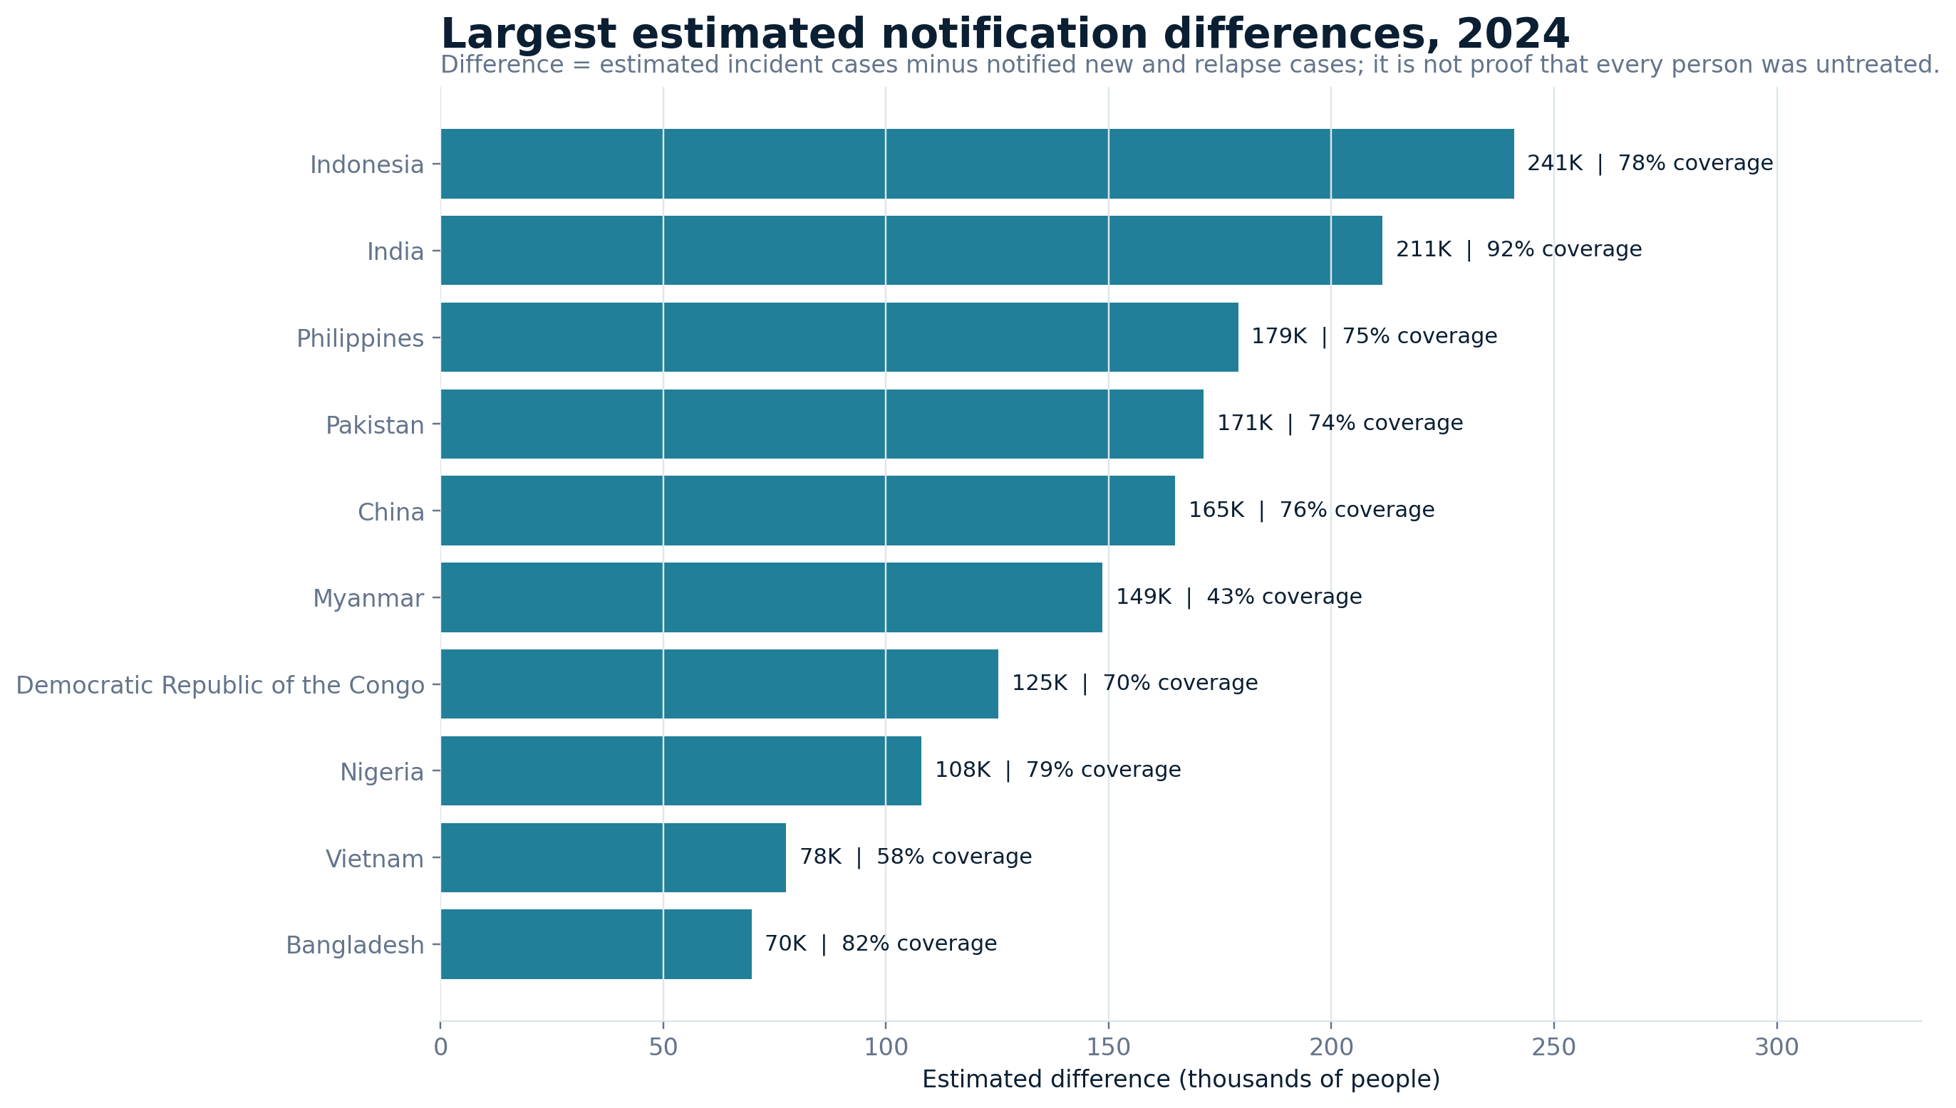
GEOGRAPHY AND GAPS
5/7
Priority depends on burden volume and service coverage
Largest absolute difference
Indonesia · 241K
Largest total burden
India · 2.71M 92% coverage
Low coverage warning
Myanmar · 43.5%
Regional perspective
732K regional gap
Use counts + rates + coverage together.
WHO-derived project snapshot; Global Tuberculosis Report 2025 context
MSBA382 · Healthcare Analytics
Notes:
Geography changes the interpretation. Indonesia had the largest absolute notification difference, about 241 thousand, while India had the largest total burden but calculated coverage above 92%. Myanmar illustrates a different risk: a smaller absolute burden, but coverage below 44%. At regional level, the Western Pacific had the largest absolute notification difference. The dashboard therefore avoids ranking countries on one indicator alone and encourages users to combine absolute volume, population rate and service coverage.

Slide 6
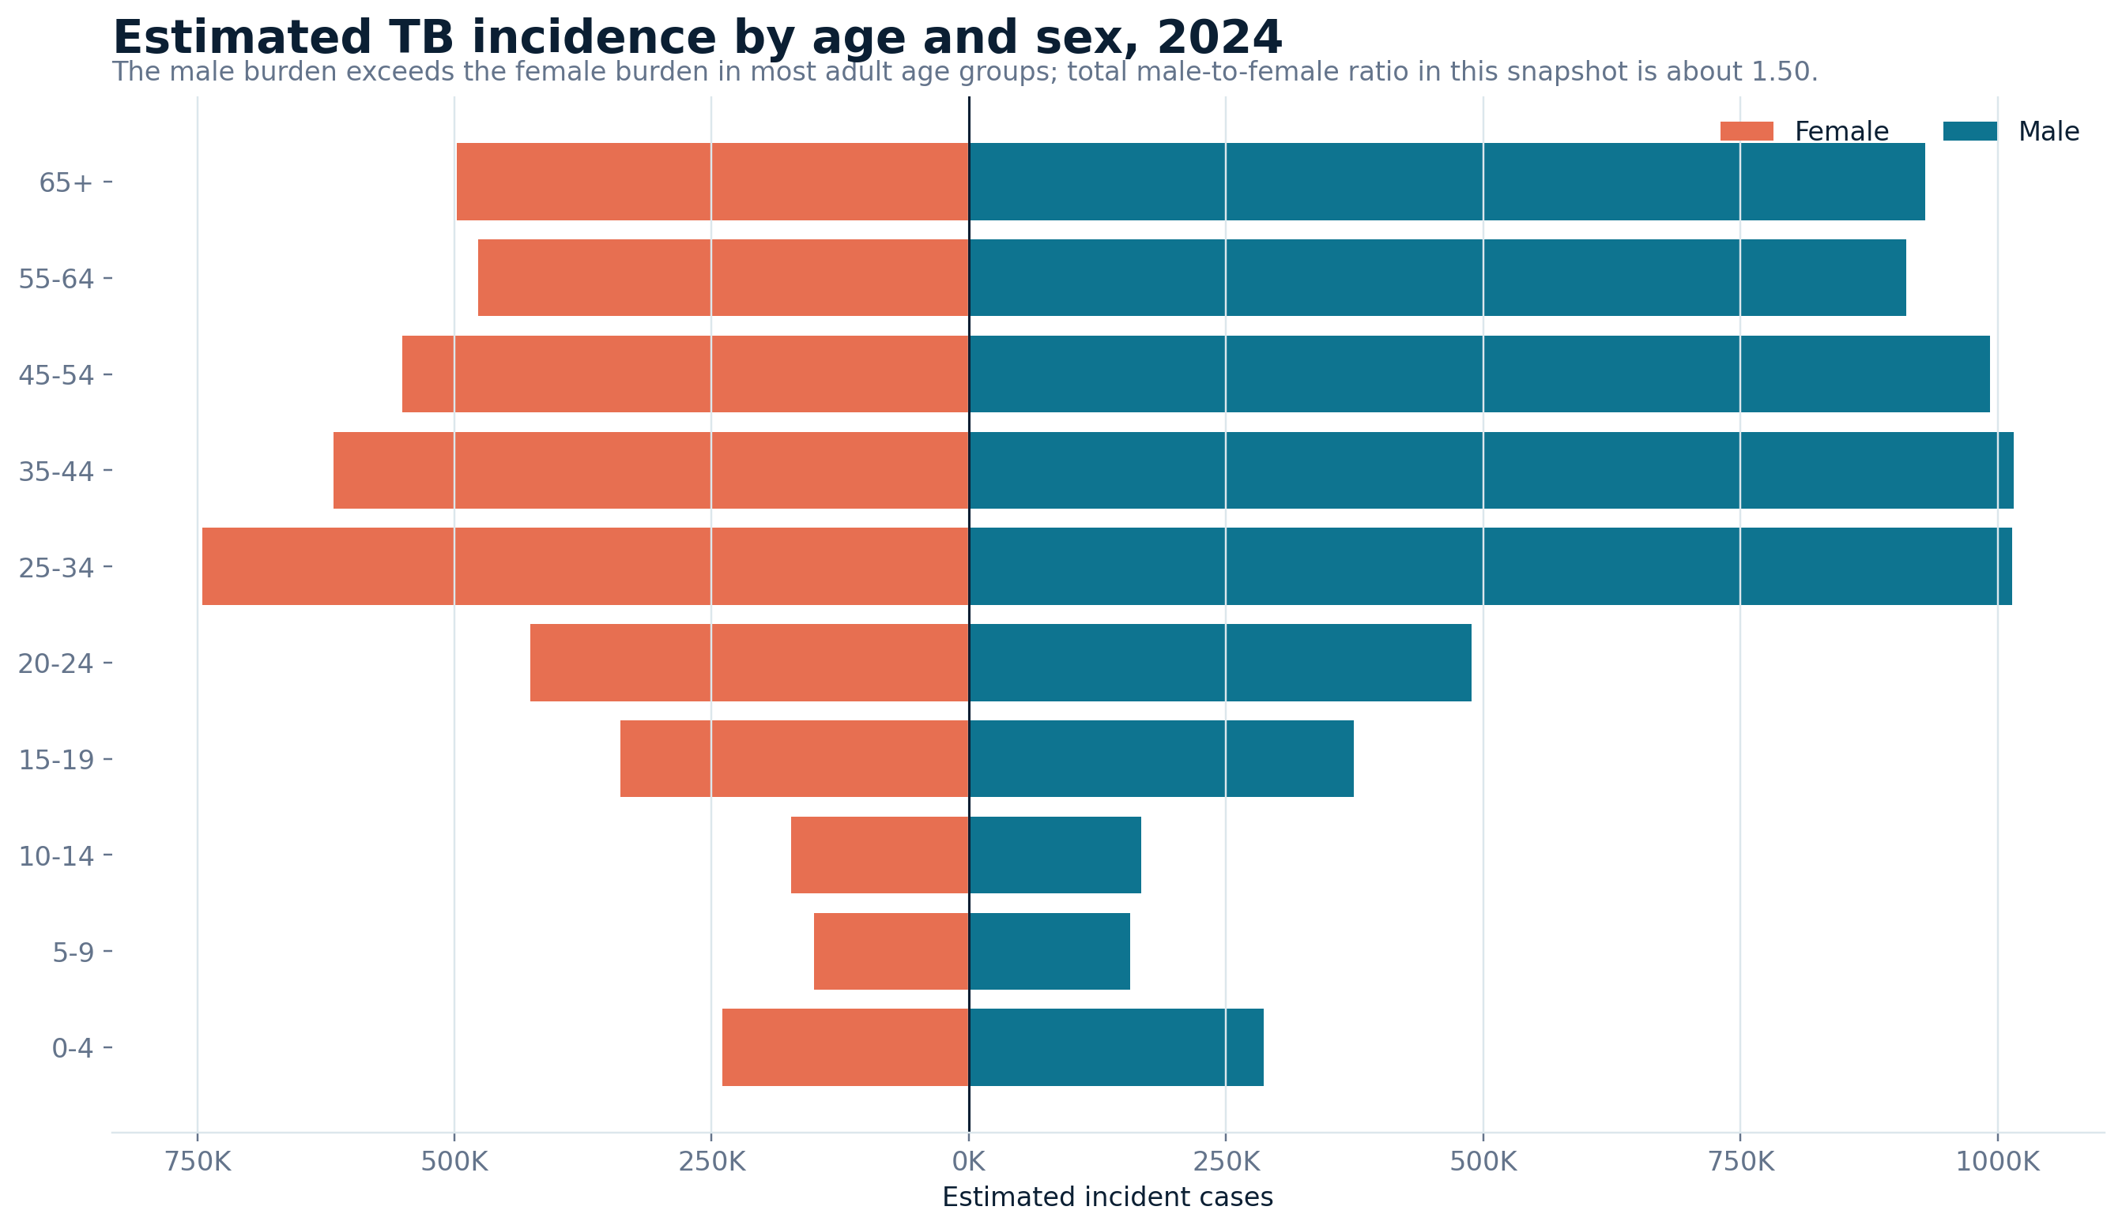
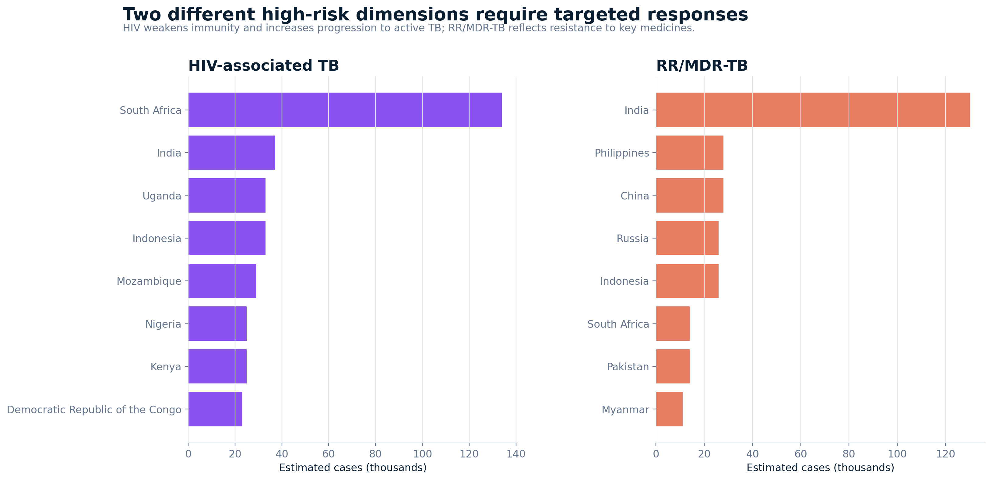
DEMOGRAPHICS AND SUBTYPES
6/7
Different populations and clinical dimensions need different responses
Male : female ≈ 1.50
South Africa · 134K TB–HIV
India · 130K RR/MDR-TB
Tailor outreach to adult men
Integrate TB and HIV pathways
Expand rapid resistance testing
WHO-derived project snapshot; Global Tuberculosis Report 2025 context
MSBA382 · Healthcare Analytics
Notes:
The age-sex analysis adds a population lens. Estimated male incidence was about one and a half times female incidence, with the largest adult burden in ages 25 to 54. The subtype analysis adds a clinical-programme lens. HIV-associated TB was concentrated in sub-Saharan Africa, especially South Africa, while drug-resistant TB followed a different pattern led by India and several European and Asian settings. These are not interchangeable problems: TB–HIV requires integrated testing and treatment pathways, while resistance requires rapid susceptibility testing and effective regimens.

Slide 7
FROM INSIGHT TO ACTION
Four recommendations for a stronger TB response
1
Prioritize high-volume detection gaps
Focus case finding, diagnostics and reporting audits where absolute differences are largest.
FIND
where burden and gaps are concentrated
2
Protect continuity during disruption
Maintain diagnostics, drug supply, follow-up and data reporting during emergencies.
↓
TARGET
3
Integrate TB–HIV and resistance pathways
Match the service model to co-epidemic and drug-resistance patterns.
the population and programme response
↓
4
Tailor outreach and govern the data
Use demographic targeting; investigate outliers and refresh with each WHO release.
ACT
with measurable, data-governed interventions
Published dashboard URL: [PASTE STREAMLIT URL HERE]
Thank you
Notes:
The dashboard leads to four actions: prioritize high-volume detection gaps; protect TB services during disruption; integrate TB–HIV and drug-resistance pathways according to the local pattern; and tailor outreach while governing the data carefully. The value of the project is the sequence: find where burden and coverage gaps are concentrated, target the population and programme response, and act with measurable interventions. The app, data, code, manual, report and presentation are ready for deployment; the final step is publishing through the student’s Streamlit account.

