Slide 1
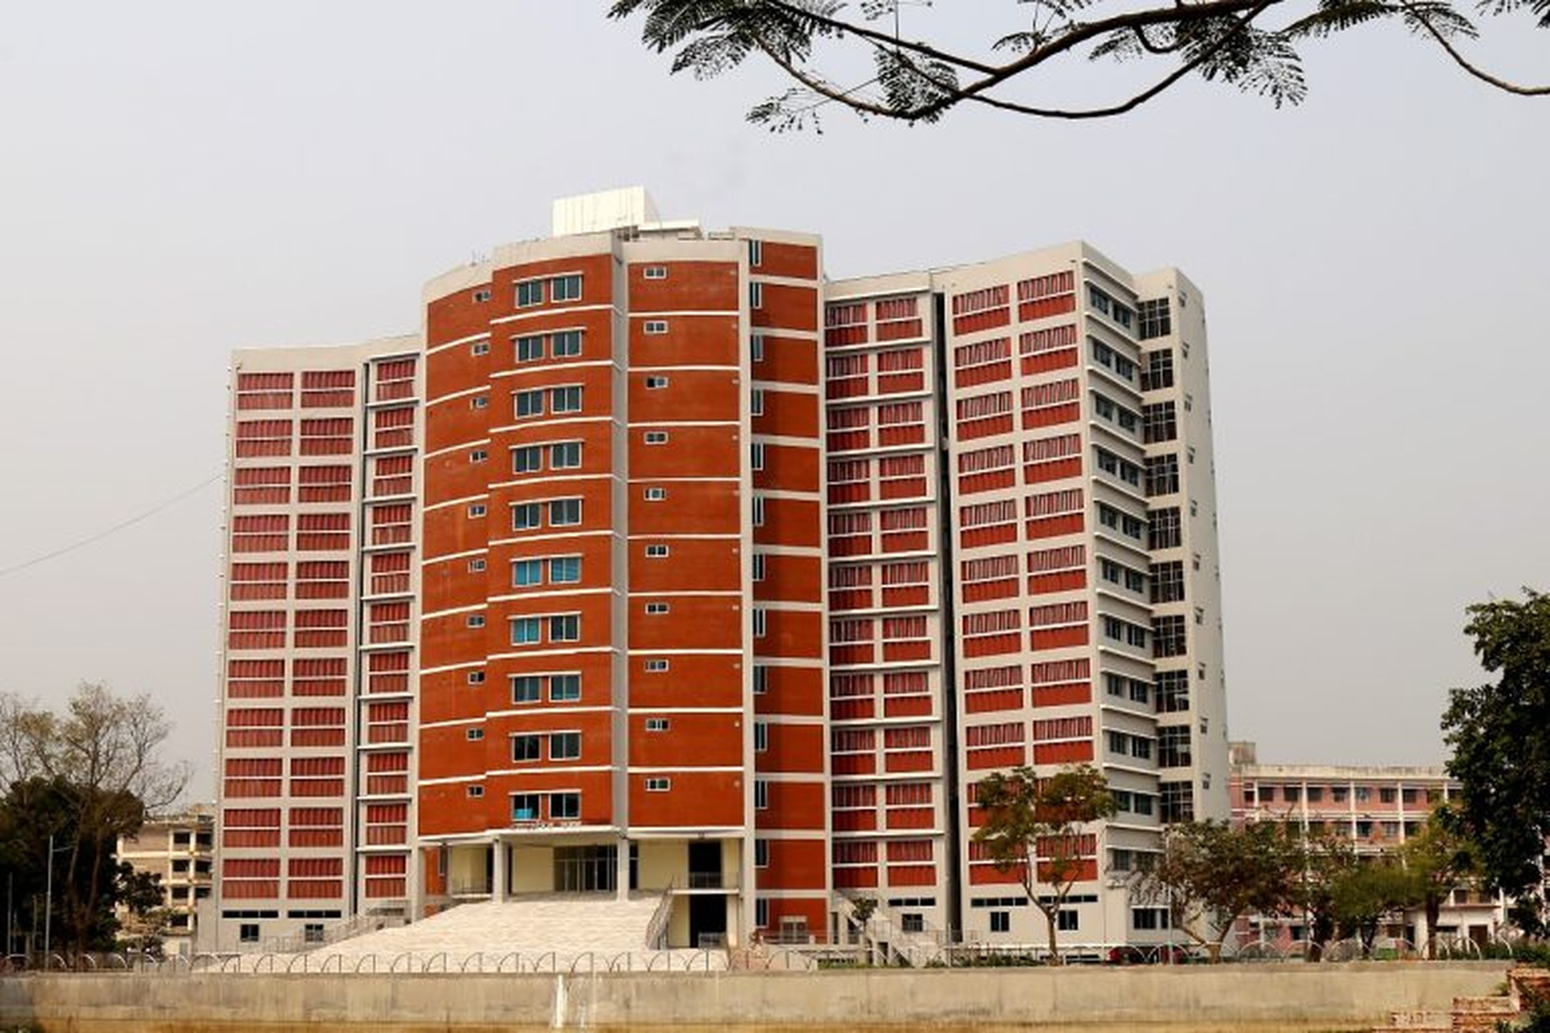


MAWLANA BHASHANI SCIENCE AND TECHNOLOGY UNIVERSITY
DEPARTMENT OF INFORMATION AND COMMUNICATION TECHNOLOGY
PRESENTATION ON
RIP: Routing Information Protocol
MD. AFIF ZAMAN
ID: IT-23059
Course Teacher: Dr. Nazrul Islam
Course: Data Communication
Course Code: ICT-3101
Topic: RIP

Slide 2


DATA COMMUNICATION • ICT-3101
Presentation roadmap
1
01 Foundations
Why routers need a dynamic routing protocol
2
02 RIP in action
Distance vectors, hop counts and route updates
3
03 Versions and resilience
RIPv1, RIPv2, RIPng and loop prevention
4
04 Evaluation
Advantages, limitations and protocol comparison
ROUTING INFORMATION PROTOCOL
02

Slide 3
DATA COMMUNICATION • ICT-3101
The routing problem
Many networks
Networks change
A shared solution
Routers must discover paths to destinations beyond directly connected links.
Links can fail, new networks appear and manual updates become difficult.
Dynamic routing lets routers exchange reachability information.
ROUTING INFORMATION PROTOCOL
03

Slide 4
DATA COMMUNICATION • ICT-3101
What is RIP?
1
Distance-vector routing protocol
Routers advertise destination networks and their distance in hops.
2
Bellman–Ford principle
Each router estimates the best route using information from neighbours.
3
Interior gateway protocol
Designed for routing within a single administrative domain.
ROUTING INFORMATION PROTOCOL
04

Slide 5
DATA COMMUNICATION • ICT-3101
RIP topology | Finding the shortest path
B
1 hop
1 hop
A → D
via B: 2 hops
via C: 2 hops
A
D
1 hop
1 hop
C
Illustrative topology: RIP compares hop count, not bandwidth or delay.
ROUTING INFORMATION PROTOCOL
05

Slide 6
DATA COMMUNICATION • ICT-3101
How RIP learns a route
1
Step 1 | Discover
Each router knows its directly connected networks.
2
Step 2 | Advertise
Neighbours exchange routing entries, typically every 30 seconds.
3
Step 3 | Update
A router adds one hop and selects a route with the lowest hop count.
4
Step 4 | Adapt
Changed or unreachable routes trigger routing-table updates.
ROUTING INFORMATION PROTOCOL
06

Slide 7
DATA COMMUNICATION • ICT-3101
A simple routing-table example
Destination
Next hop
Hop count
192.168.10.0/24
Direct
0
192.168.20.0/24
Router B
1
192.168.30.0/24
Router B
2
192.168.40.0/24
Router C
3
Illustrative entries. Connected networks are shown as 0 hops locally.
ROUTING INFORMATION PROTOCOL
07

Slide 8
DATA COMMUNICATION • ICT-3101
RIP essentials
Metric
Maximum reach
Updates
Transport
Hop count only; the route with the fewest hops is preferred.
15 hops is the maximum usable metric; 16 means unreachable.
Periodic routing advertisements, normally every 30 seconds.
RIPv1 and RIPv2 use UDP port 520.
ROUTING INFORMATION PROTOCOL
08

Slide 9
DATA COMMUNICATION • ICT-3101
When a link fails | Convergence
LINK FAILURE
A
B
D
1 Route becomes unavailable
2 Router advertises the change
3 Neighbours recalculate their tables
RIP convergence can be slow, especially in larger or unstable networks.
ROUTING INFORMATION PROTOCOL
09

Slide 10
DATA COMMUNICATION • ICT-3101
How RIP reduces routing loops
Split horizon
Route poisoning
Triggered updates
Do not advertise a route back through the interface from which it was learned.
Advertise a failed destination with metric 16 (unreachable).
Send an update promptly after a significant routing change.
ROUTING INFORMATION PROTOCOL
10

Slide 11
DATA COMMUNICATION • ICT-3101
RIP versions | At a glance
Feature
RIPv1
RIPv2
RIPng
Address family
IPv4
IPv4
IPv6
Classless / CIDR
No
Yes
Yes
Update delivery
Broadcast
Multicast
Multicast
Authentication
No
Supported
Uses IPv6 security mechanisms
UDP port
520
520
521
RIPng is the IPv6 adaptation of RIP; it is not simply RIPv2 with longer addresses.
ROUTING INFORMATION PROTOCOL
11

Slide 12
DATA COMMUNICATION • ICT-3101
Advantages and limitations
1
Why RIP is still useful
Easy to understand, simple to configure and appropriate for small networks or labs.
2
Where RIP struggles
15-hop limit, slow convergence and no bandwidth-aware path selection.
3
Practical takeaway
A straightforward teaching protocol, but often not the first choice for large modern networks.
ROUTING INFORMATION PROTOCOL
12

Slide 13
DATA COMMUNICATION • ICT-3101
RIP vs OSPF vs EIGRP
Aspect
RIP
OSPF
EIGRP
Approach
Distance vector
Link state
Advanced distance vector
Main metric
Hop count
Cost
Composite metric
Scalability
Small networks
Large networks
Medium to large
Convergence
Relatively slow
Generally fast
Generally fast
Complexity
Low
Higher
Moderate
Performance depends on topology, implementation and configuration.
ROUTING INFORMATION PROTOCOL
13

Slide 14
DATA COMMUNICATION • ICT-3101
Where RIP makes sense
Networking labs
Small legacy networks
Protocol fundamentals
Learn routing tables, advertisements, metrics and convergence.
Simple environments with limited size and modest routing requirements.
A clear introduction before studying OSPF, IS-IS or BGP.
ROUTING INFORMATION PROTOCOL
14

Slide 15
DATA COMMUNICATION • ICT-3101
Key takeaways
1
RIP exchanges distance vectors
Routers learn routes through advertisements from their neighbours.
2
Hop count drives decisions
15 hops is the maximum usable distance; 16 means unreachable.
3
Simplicity has trade-offs
RIP is accessible but less scalable and slower to converge than modern alternatives.
ROUTING INFORMATION PROTOCOL
15

Slide 16
DATA COMMUNICATION • ICT-3101
Selected references
[1] RFC 1058 — Routing Information Protocol (RIPv1), C. Hedrick, 1988.
[2] RFC 2453 — RIP Version 2, G. Malkin, 1998.
[3] RFC 2080 — RIPng for IPv6, G. Malkin and R. Minnear, 1997.
[4] RFC 4822 — RIPv2 Cryptographic Authentication, R. Atkinson and M. Fanto, 2007.
ROUTING INFORMATION PROTOCOL
16

Slide 17
DATA COMMUNICATION • ICT-3101
THANK YOU
ROUTING INFORMATION PROTOCOL
17

