Slide 1
Android Operating System
Presentation on
History, Features, Architecture & Impact
Presented by :
Presented to :
Course Title : OPERATING SYSTEM
Course Code : ICT 2201
MD. Afif Zaman
ID: IT-23059
Dr. Nazrul Islam
Associate Professor

Slide 2

What is Android?
Android logo
Open-source mobile operating system
Developed by Google
Based on Linux kernel
Used in smartphones, TVs, wearables

Slide 3
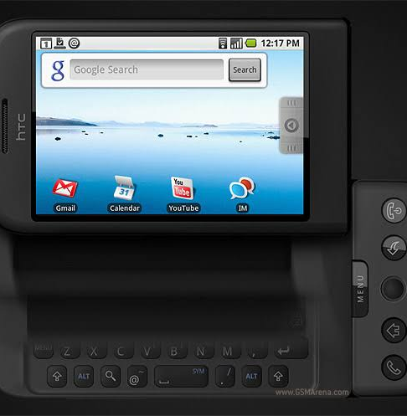
History
HTC Dream phone
Android Inc. founded in 2003
Acquired by Google in 2005
First Android phone in 2008
Rapid global growth

Slide 4
Key Features
Open-source & customisable
Multitasking
Large app ecosystem
Google services integration

Slide 5
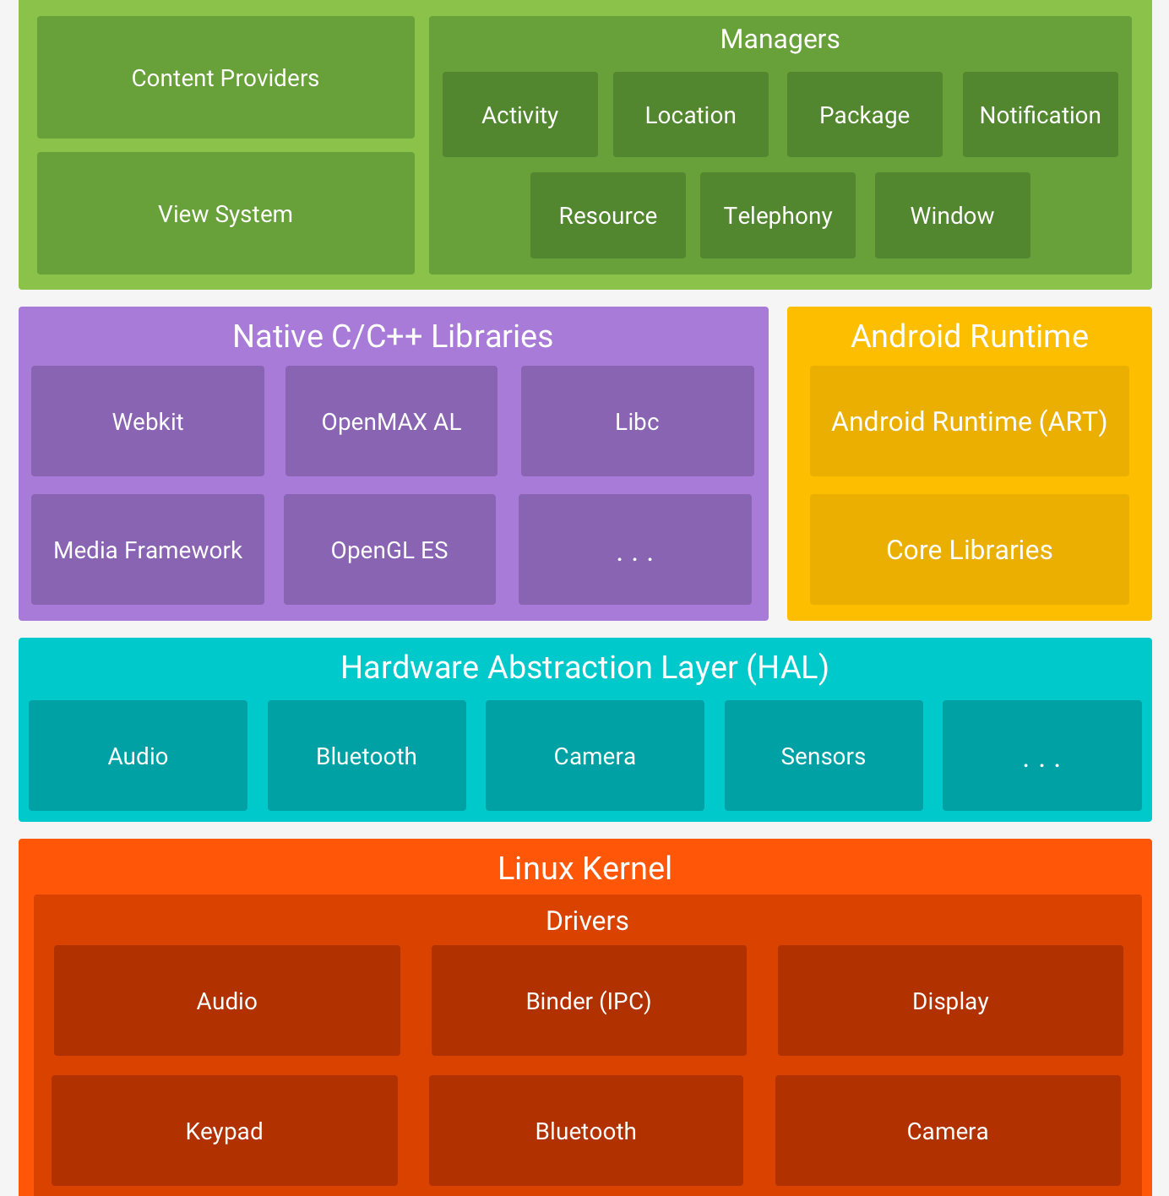
Architecture
Android architecture diagram
Applications
Application Framework
Android Runtime (ART)
Linux kernel

Slide 6
App components
Activities → UI screens
Services → Background tasks
Broadcast Receivers → System events
Content Providers → Data sharing

Slide 7
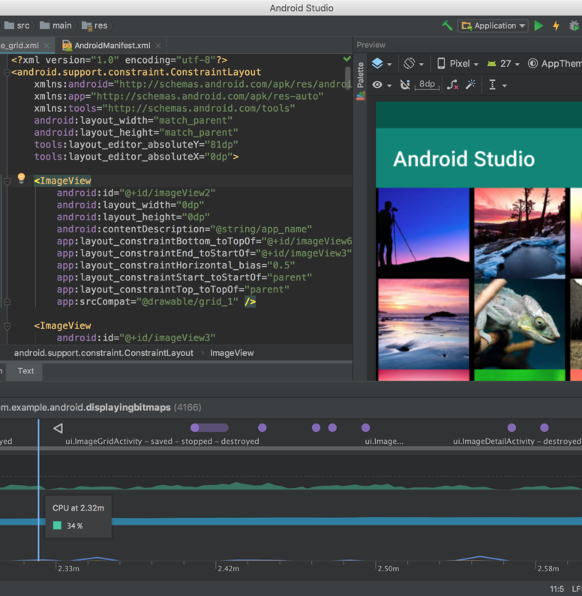
Development
Android Studio
Android Studio (IDE)
Languages: Java, Kotlin
Google Play Store for apps

Slide 8
Conclusion
Leading mobile OS
Flexible and powerful
Widely used worldwide
Continuously evolving

Slide 9
THANK YOU

