Slide 1

Bank Marketing Campaign
Afif Ariqulfikri

Slide 2
Why Banks Need Deposits
Source of Funds for Lending
Provides capital for loans
Liquidity Management
Ensures funds for withdrawals and obligations
Operational Efficiency
Low-cost funding source
Credit Creation
Expands money supply
Interest Rate Spread
Generates revenue from interest differential
Regulatory Compliance
Meets reserve requirements
Trust and Confidence
Indicates stability and attracts business
Fee Income
Generates additional revenue from fees

Slide 3
Business Problem
Profit Increase
Good Marketing Campaign
Accurate resource allocation

Slide 4
Solution
To predict which customers are likely to subscribe to a term deposit.
Enhance marketing effectiveness by targeting the right customers.

Slide 5
By accurately predicting this, a bank can better target its marketing efforts, improve customer conversion rates, and optimize resource allocation.
The main business problem addressed by the code is to predict which customers are likely to subscribe to a term deposit.

Slide 6
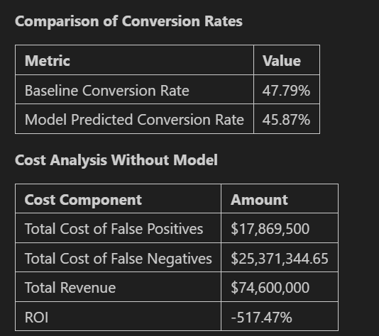
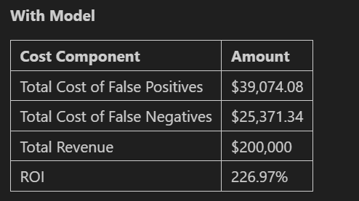
Analysis

Slide 7
Impact
Financial Impact:
The model generates substantial additional revenue, demonstrating a strong return on investment (assumed that revenue_per_correct_prediction = 200 ). This occurred because Cost of False Negatives (not predicting a subscriber) could be decreased.
False negative represents the lost revenue opportunity when a potential subscriber is not identified by the model.
Cost of False positive reflects the expense associated with targeting a customer who does not end up subscribing, such as marketing costs, which is shown that with the best model, it is lower than without implementing the best model.

Slide 8
Attachment #1
Term Deposit:
The types of financial products used by the public are more varied. One financial product that is well-known to the public is term deposits. The term deposit mechanism is that a customer deposits a sum of money at a bank or a financial institution, and the money can only be withdrawn after a certain period of time. As compensation, customers will be given a fixed interest according to the nominal amount of money deposited.

