Slide 1
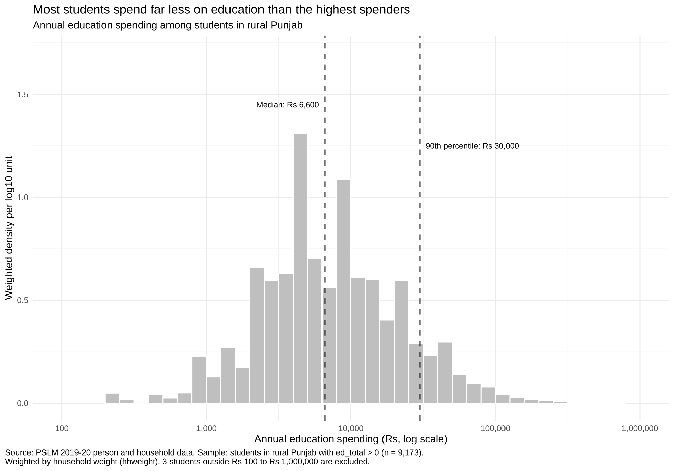
What rural Punjab families pay for a student’s education
VARIANT 0 · PUNJAB RURAL
PSLM 2019–20 · Afifa Farooq · FA24-BEDS-008
9,173
students with positive education spending
Rs 6,600
weighted median annual spending
15×
the 90th percentile (Rs 30,000) over the 10th (Rs 2,000)
Notes:
~1.5 minutes. I am Afifa Farooq, variant 0: rural Punjab, from PSLM 2019-20.
Of the students in my variant, 9,173 have positive education spending. Spending is very skewed, so I used a log scale: the weighted median is Rs 6,600, the 10th percentile Rs 2,000 and the 90th percentile Rs 30,000, a ratio of 15.00.
The unweighted median is Rs 7,000. The weighted one is lower because households that stand for more people spend a little less than the sample average suggests. 3 students fell outside Rs 100 to Rs 1,000,000 and were excluded.
Be ready to explain: the weighted quantile definition (sort by x, cumulative weight share, first x where it reaches p), and why the histogram axis is in log10 units but labelled in rupees.

Slide 2
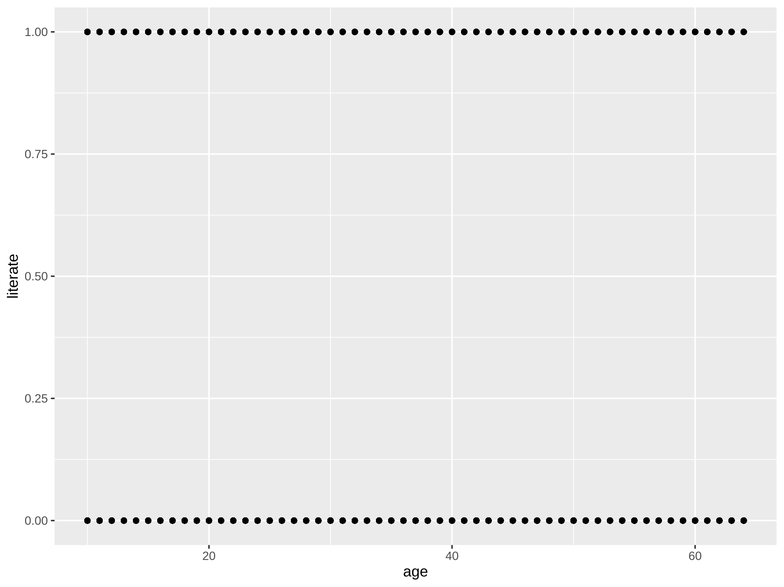
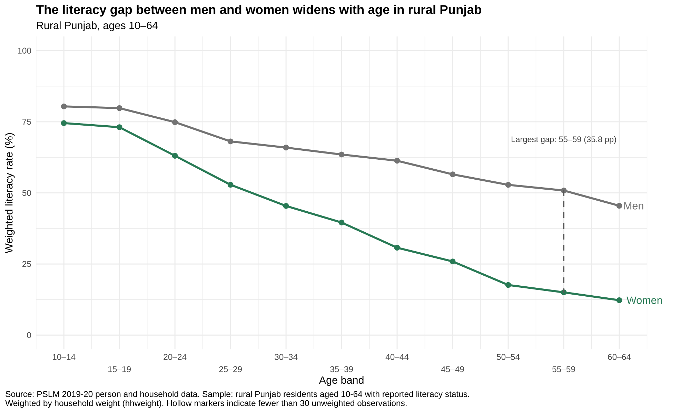
The makeover: from a cloud of dots to a clear comparison
BEFORE · R default, geom_point() only
AFTER · redesign (Question 3)
Lines + weighted means
one clear value per band
Direct labels
no legend to look back at
Gap annotated
35.8 pp at ages 55–59
Notes:
~1.5 minutes. Left: R's untouched default, literate (0 or 1) against age. 24,630 points sit on top of each other in two rows, so you cannot see how many people are literate at any age. That is overplotting.
Right: my redesign. I computed the weighted literacy rate for each five-year age band and each sex, plotted at the band midpoint, joined by lines, with the two series labelled directly instead of a legend.
The dashed line marks the band with the largest gap, ages 55-59: 35.8 percentage points. Hollow markers would flag bands with fewer than 30 observations; there are none, since the smallest cell has 412 persons.

Slide 3
The literacy gap grows from 6.7 to 35.8 points with age
35.8 pp
Ages 55–59
Men 50.8% literate vs women 15.0%
6.7 pp
Ages 15–19
Men 79.8% literate vs women 73.1%
What it cannot tell us: why the gap exists, or whether age itself lowers literacy. One survey mixes age with birth cohort.
Gaps computed from the weighted band table (README). Source: PSLM 2019–20, rural Punjab, ages 10–64, household weights.
Notes:
~1.5 minutes. This is my main finding. Among young people in rural Punjab, literacy is high and the gap is small: at 15-19 men are at 79.8% and women at 73.1%, a gap of 6.7 points.
The gap then grows band by band. At 55-59 men are at 50.8% and women at only 15.0%, the largest gap, 35.8 points. Every band has at least 412 persons, so no cell is thin.
Limits: one survey year cannot separate ageing from birth cohort, and it does not tell us why girls were less schooled.
Gaps are computed from the rounded band table, so they can differ by 0.1 from the unrounded values.

Slide 4
Why the redesign works, and what it hides
1
Conditional means by band
Overplotting. Thousands of 0/1 dots hide the pattern; one weighted mean per age band and sex shows it.
WHAT THE REDESIGN HIDES
The individual observations and their distribution, which the default scatterplot still shows.
2
Direct labels, no legend
Data–ink. Fewer elements to decode; no looking back and forth.
THE PYTHON CHECK
73.1%
73.1%
3
Common 0–100 scale, gap annotated
Perceptual ranking of channels. Position is read most accurately, and the annotation steers the eye.
R
Python
Women aged 15–19. Band tables agree to one decimal.
Notes:
~1.5 minutes. Three design choices, each tied to a principle from the course.
1) Conditional means: the default plots thousands of overlapping 0/1 points, so I replaced them with weighted literacy rates per age band and sex.
2) Direct labels instead of a legend: data-ink, nothing for the reader to look back at.
3) A common 0-100 scale with the largest gap annotated: position is the most accurately read channel, and the annotation points to the finding.
What it hides: the individual observations and their distribution.
Check: I reproduced the band table in Python, and women aged 15-19 come out at 73.1% in both R and Python.
Questions to prepare: how the age bands are built (R's cut with right = FALSE vs Python's age // 5 * 5), how the weighted mean is computed, and how to change a setting and rerun a script.

