Slide 1




COMPAS 2026
IEEE 3rd International Conference on Computing, Applications and Systems
Terahertz Communication for Future 6G Wireless Networks
Afifa Tahsin Haq
Mawlana Bhashani Science and Technology University, Bangladesh
Paper ID: IT22005
9–10 October 2026
MBSTU, Bangladesh

Slide 2
Presentation Outline
01
Introduction and research problem
02
Related work and research gap
03
Proposed solution and methodology
04
Experiments and results
05
Conclusion
Terahertz Communication for 6G
Paper ID: IT22005
02

Slide 3
Introduction and Research Problem
THz links promise very high data rates, but usable range and reliability are limited by propagation loss and blockage.
01
6G applications may need extreme throughput for immersive media, rapid data delivery and wireless backhaul.
02
Wide bandwidth alone is insufficient: absorption, beam alignment, hardware limits and mobility affect real links.
03
How can frequency selection, directional beamforming and propagation-aware design balance data rate, range and reliability?
Terahertz Communication for 6G
Paper ID: IT22005
03

Slide 4
Related Work and Research Gap
Study / approach | Key idea | Relevant limitation
Akyildiz et al. (2014) | THz as a high-capacity wireless frontier | Early vision; technology has evolved
Jornet & Akyildiz (2011) | THz channel modelling and absorption | Results depend on frequency and environment
Jiang et al. (2024) | Review of THz communications and sensing | Device, propagation and deployment challenges remain
Research gap
A practical design must jointly consider THz windows, path loss, blockage, beam alignment and achievable throughput—not bandwidth alone.
Terahertz Communication for 6G
Paper ID: IT22005
04

Slide 5
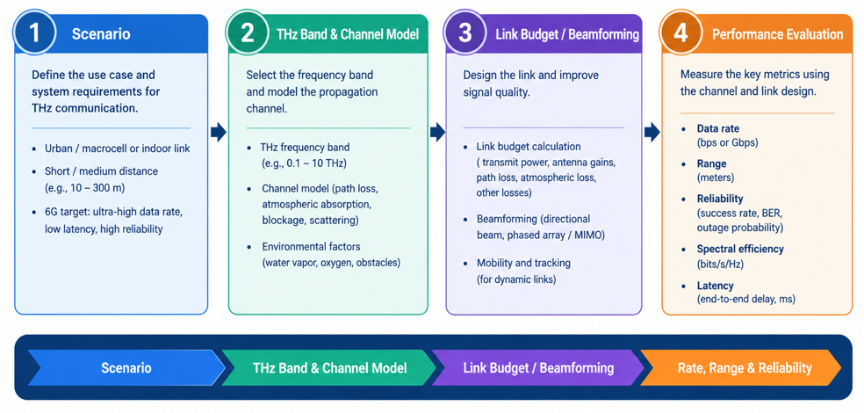
Methodology
Propagation-aware THz link assessment
01
1. Define scenario
Choose indoor hotspot or short-range backhaul; set frequency, distance and environment.
02
2. Model the channel
Estimate path loss and atmospheric absorption; include blockage, reflections and antenna gain.
03
3. Evaluate trade-offs
Compare rate, received power, coverage and robustness across frequency, distance and beamforming.
Terahertz Communication for 6G
Paper ID: IT22005
05

Slide 6
Experimental Setup
Data / study setting
Scenario-based study: define carrier frequency (e.g., 0.1–1 THz), distance, humidity, obstacles and antenna parameters. No measured dataset is assumed.
Baselines / comparisons
Compare a lower-frequency baseline, THz without beamforming, and THz with directional gain under matched assumptions.
Evaluation metrics
Path loss (dB), received power (dBm), achievable rate (Gb/s), coverage distance (m), and outage probability (%).
Implementation / protocol
Use a documented analytical or simulation model. Report bandwidth, antenna gains, frequency window and environment; validate against published measurements where possible.
Terahertz Communication for 6G
Paper ID: IT22005
06

Slide 7
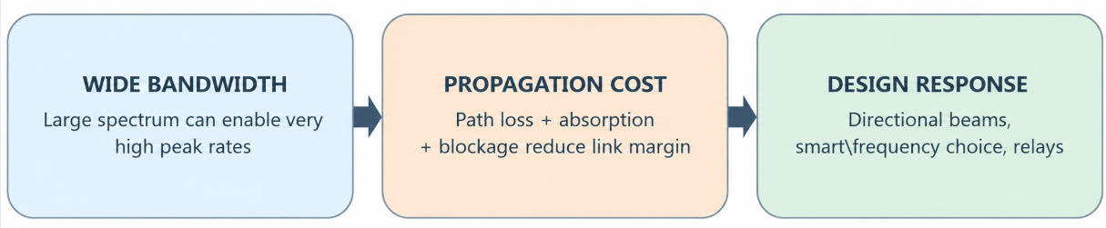
Results and Discussion
Main finding
Wide bandwidth and high-gain directional antennas can enable very high data rates.
But path loss, molecular absorption and blockage reduce range and reliability. THz is most promising for suitable short-range or line-of-sight links, alongside lower-frequency coverage.
Literature-derived conceptual summary;
Terahertz Communication for 6G
Paper ID: IT22005
07

Slide 8
Quantitative Comparison
Approach | Bandwidth potential | Coverage robustness | Maturity
Sub-6 GHz | Moderate | High / broad | Established
mmWave | High | Moderate; blockage-sensitive | Deployed in some networks
THz targeted links | Very high | Short-range; directional | Research / early demonstrations
Qualitative literature comparison: THz offers the greatest bandwidth potential, but needs tighter directionality and careful range / blockage management.
Terahertz Communication for 6G
Paper ID: IT22005
08

Slide 9
Conclusions and Future work
THz is a promising enabler for selected high-capacity 6G links, not a universal replacement for lower-frequency access.
01
Jointly assess spectrum, propagation, antennas and beam management for realistic high-speed links.
02
Performance is environment-sensitive; hardware, blockage, mobility and regulation remain constraints.
03
Next: simulate multiple THz windows and distances, then validate against published channel measurements.
Terahertz Communication for 6G
Paper ID: IT22005
09

Slide 10
Selected References
[1] I. F. Akyildiz, J. M. Jornet, and C. Han, “Terahertz band: Next frontier for wireless communications,” Physical Communication, vol. 12, pp. 16–32, 2014.
[2] J. M. Jornet and I. F. Akyildiz, “Channel modeling and capacity analysis for electromagnetic wireless nanonetworks in the terahertz band,” IEEE Transactions on Wireless Communications, vol. 10, no. 10, pp. 3211–3221, 2011.
[3] “Terahertz Channel Propagation Phenomena, Measurement Techniques and Modeling for 6G Wireless Communication Applications: A Survey,” IEEE Communications Surveys & Tutorials, vol. 24, no. 4, pp. 1957–1996, 2022. doi: 10.1109/COMST.2022.3205505.
[4] W. Jiang et al., “Terahertz Communications and Sensing for 6G and Beyond: A Comprehensive Review,” IEEE Communications Surveys & Tutorials, vol. 26, no. 4, pp. 2326–2381, 2024. doi: 10.1109/COMST.2024.3385908.
[5] ITU-R, “Framework and overall objectives of the future development of IMT for 2030 and beyond (IMT-2030),” Recommendation M.2160, 2023.
Terahertz Communication for 6G
Paper ID: IT22005
10

Slide 11
Thank you
Questions and Discussion
Afifa Tahsin Haq
Mawlana Bhashani Science and Technology University, Bangladesh
it22005@mbstu.ac.bd
Terahertz Communication for 6G
Paper ID: IT22005
11

