Slide 1
SecDevQA
A benchmark of real developer security queries and to evaluate how LLMs and coding agents answer them

Slide 2
Motivating Examples
Developers ask different types of security queries in software repositories. Some examples:
• Am I affected? triage a disclosed CVE/advisory against real usage (Pillow #6955)
• Is it even a real issue? false-positive / scanner-noise triage (cryptography #14207)
• Which fix, which version? point to a prior issue, PR, commit, or release (Kubernetes#137891).
• How do I do this securely? configuration & best practice from general knowledge (fastapi#5837)
• How do I remediate? fix a transitive dependency (axios#6969)

Slide 3
We Ask
Can LLMs/agents answer such questions that may require one or more internal (issue tracker, commits, code, etc.) or external (internet, advisory databases) artifacts?
Which kind of artifacts are essential to answer what kind of questions?

Slide 4
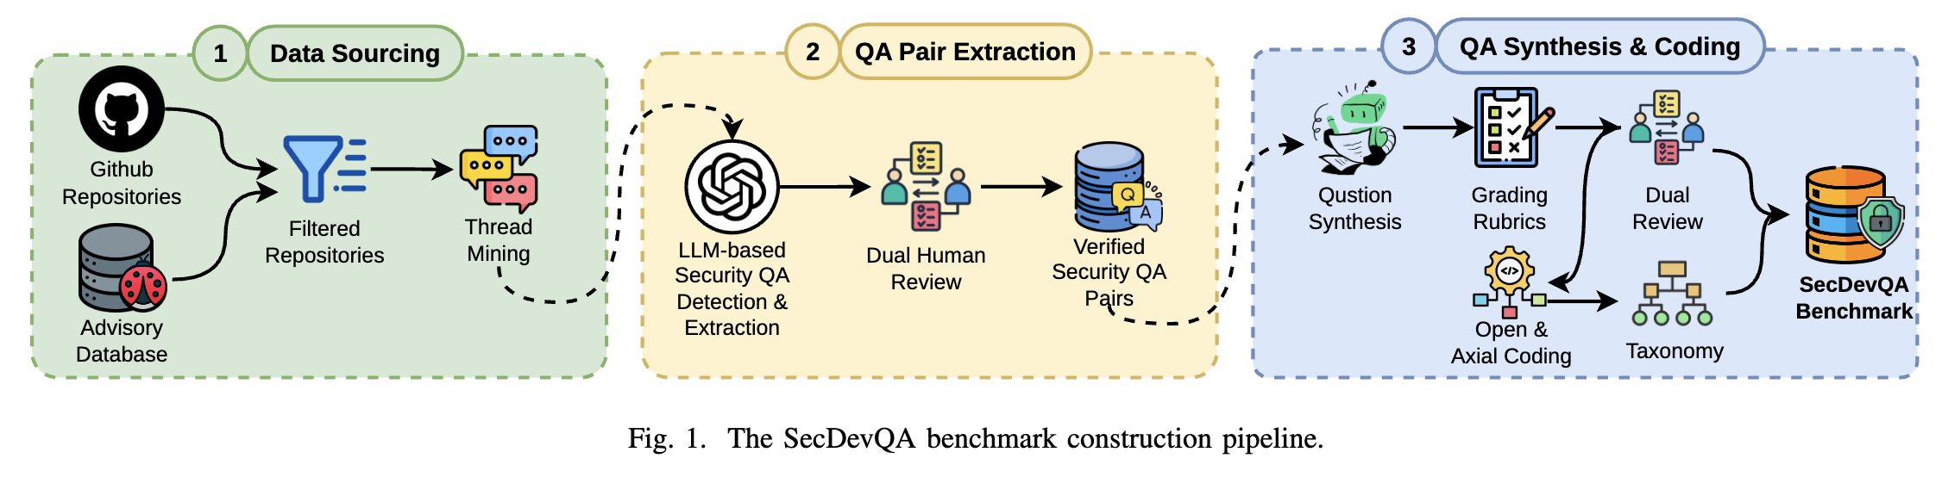
Approach
3 Steps
Data Collection
QA Pair Extraction
QA Synthesis

Slide 5
Data Sourcing
• Independent source. Repositories that appears in GitHub Advisory Database
• Repo Filtering.
≥10 fix-bearing advisories
≥1,000 stars
actively maintained
• Current corpus: 20 repos, 3 languages. HTTP clients, cryptography, image processing, web frameworks, auth, payments.
• Thread mining. Closed issues + discussion threads (2024-01 – 2026-05)

Slide 6
QA Pair Extraction
• Security Q&A is a sparse minority. Two-stage LLM pipeline as a prefilter, then human verification
• Stage 1 — detection. GPT-5.4-mini flags threads with a possible security query
• Stage 2 — extraction. Pulls query/answer comments, answerer role, artifact types drawn on, and verifiable facts (CVE/GHSA/version/PR/commit).
• Dual human verification. 2 persons verify whether the thread actually contains a security issue.

Slide 7
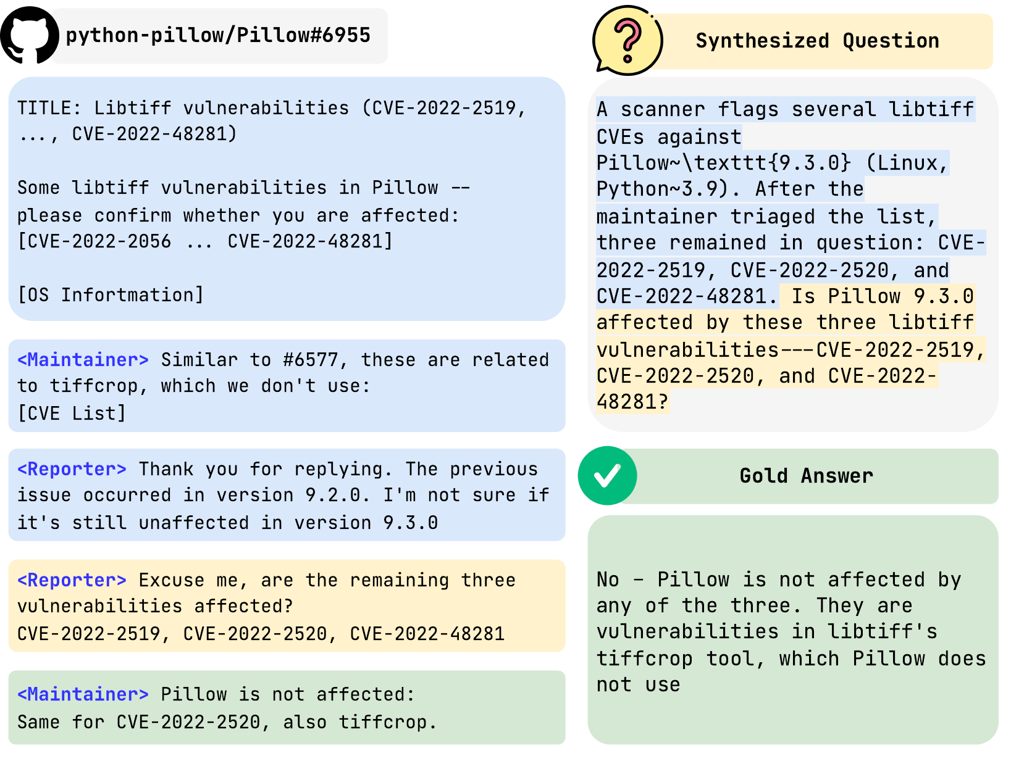
QA Synthesis
• Raw threads are hard to grade
They query may also contain a possible fix
The question can be somewhere in the thread while it also requires the context
• Synthesis (GPT-5.5 + human). Each pair → a self-contained, resolution-free (query, answer) item; reporter specifics kept verbatim.
• Knowledge Type. Contextual, Parametric
Pillow #6955: raw thread → synthesized question + gold answer

Slide 8
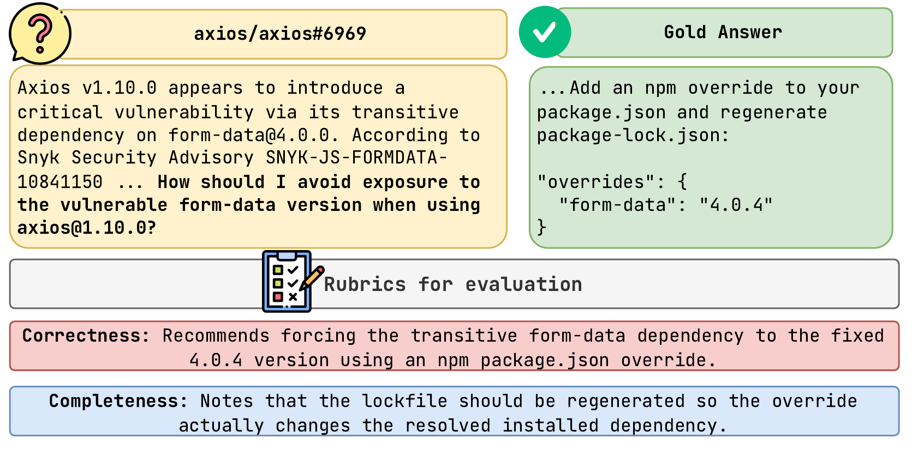
Grading Rubric
• One rubric per item, ≤5 criteria. Authored at construction from answer-side evidence; independently dual-verified.
• Two axes. Correctness (must be correct) + Completeness (coverage).
• Timing-aware. Name a fix that predates the query; for later fixes, credit same-direction remediation.
• Condition- & knowledge-type-aware. Hallucination is scored separately.
axios #6969: question + gold answer → Correctness / Completeness rubric

Slide 9
Evaluation
• Time-capped snapshot. Repo, issues/PRs, and advisories frozen at the moment the query was asked
• Three system classes.
Bare LLMs (no repo context) (Implemented)
Typed-tool reference agent (5 artifact groups / 11 tools) (Implemented)
Off-the-shelf agents (Claude Code, OpenCode) (Planned)
• Context conditions. No context · full snapshot · selective provision (leave-one-out & single-group).
• Accuracy. Accuracy by category × knowledge type; marginal value of each artifact type when granted or withheld.

Slide 10
Status & Next Steps
• Done – pipeline is complete. Mining + two-stage detection battle-tested across 20 repos;
• Done – evaluation harness built. Time-capped snapshot, typed-tool reference agent, and a web UI for launching/monitoring runs.
• In progress. Scaling the corpus (300+ pairs, ≥ 25 repos), QA synthesis + per-item rubrics at scale, and dual annotation with Cohen’s κ.
• Next. Finding multi turn queries from Github Issues.

