Slide 1

Project “Terra Trek”
Group name: ”Cyan”
Munim Ahemd (192-35-477) 35%
Tisha Khandokar (192-35-459) 35%
Afifa Hossain (192-35-453) 30%

Slide 2
Storyboard of ‘Terra Trek’

Slide 3
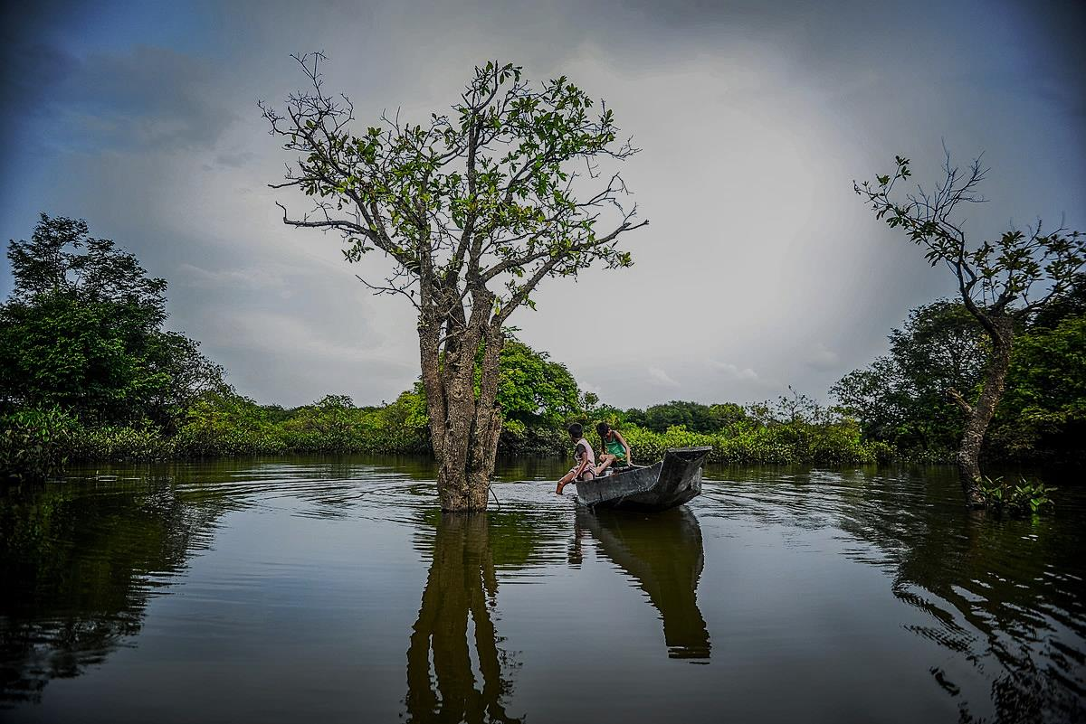
Agent
T
Tourist
A`

Slide 4
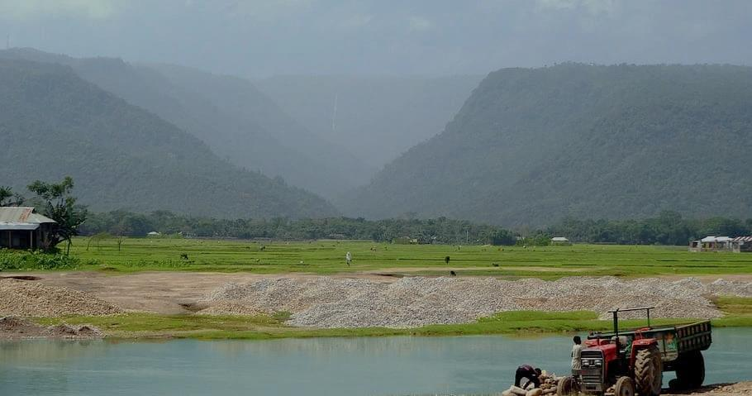
Agent
T
Tourist
A`

Slide 5
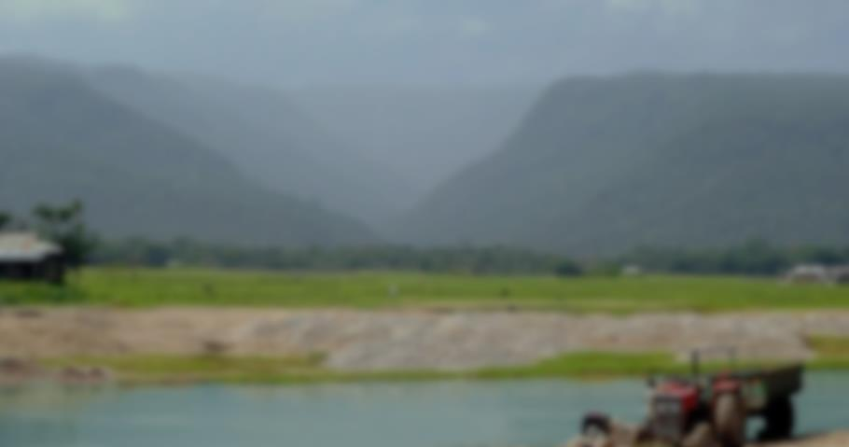
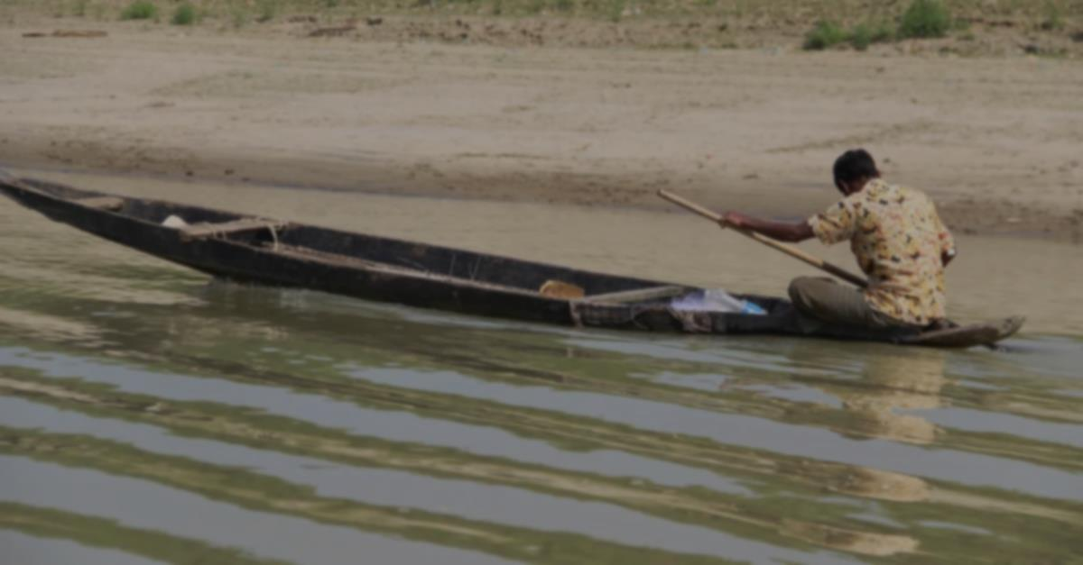
Agent
T
T
Tourist
A`
Username
Password
Log in
Name
Email
Password
NID/Birth Certificate/
Register

Slide 6
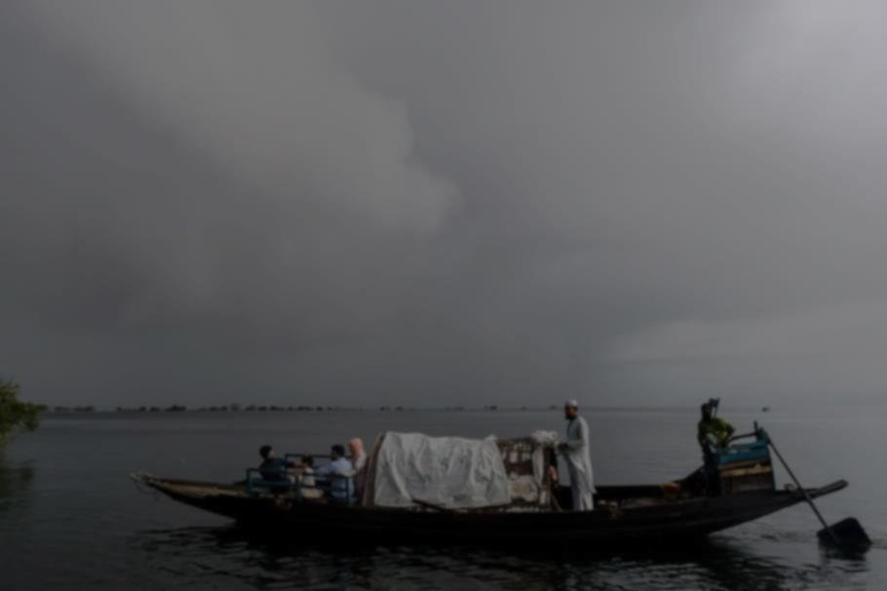
Agent
Agent
T
T
Tourist
A`
Username
Password
Log in
Name
Email
Password
NID/Birth Certificate/
Register

Slide 7





Ask
User
Home
About
Contact

Slide 8



Ask
User
My Trip
Bonus point
Name
Photo Album
Email
Favourite
Settings
Home
About
Contact

Slide 9
Ask
User
Home
About
Contact

Slide 10


Location
Package
Discussion
Home

Slide 11
Location
Booking
Package
Information&Security
Discussion
Home

Slide 12
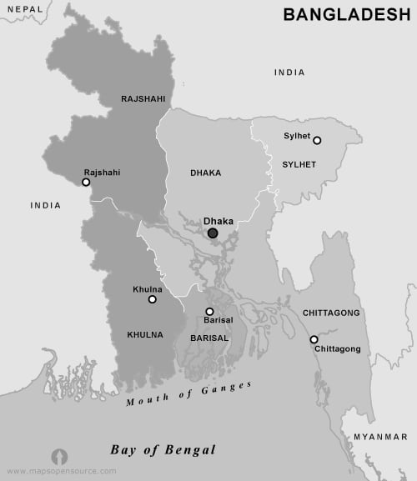





Slide 13

Sylhet
Area for trip: Srimongol.Shah Poran Majar,Ratargul,Bichanakandi,Lalakhal, Jaflong,Panthumai. Photo: //Photo.link Video: //Video.link
Home

Slide 14
Family Pack
Friends Pack
Create a Pack

Slide 15
Pack 1
Pack 2
Pack 3
Location: A,X,Y,Z(4)
Location: X,Y,Z(3)
Location: X,Y,Z(3)
Service: 1,2
Service: 1,2
Service: 2,3
Price:4,500/- (5% Discount)
Price:4 Price:4000/- (5% Discount)
Price:3,500/- (5% Discount)
+Add
Service: 1.Transport,Hotel,Food,Sightseeing,Photography,Guideline 2.Transport,Hotel,Food,Sightseeing,Photography 3.Transport,Hotel,Food,Sightseeing

Slide 16

pACK
Pack 1
+ Add Service
Location: A,X,Y,Z(4)
+Add Location
Service: 1,2
Service: 1.Transport,Hotel,Food,Sightseeing,Photography,Guideline 2.Transport,Hotel,Food,Sightseeing,Photography 3.Transport,Hotel,Food,Sightseeing
Home

Slide 17

Discussion
Ask
Open Text!
User
Chat
+
Call
Cell: 018……… 019………. Email: terratrek11@gmail.com

Slide 18

Booking
Division: Pack: Pack No: Price: Personal Details Name: Address: Mobile: Mail:

Slide 19

Members Information
Members List/Name: Amount: Date: Payment Method:
Payment System
Total Amount
Pay Now (70%)
Pay later(30%)
Bkash
Confirm

Slide 20
Members Information
Members List/Name: Amount: Date: Payment Method:
Payment System
Total Amount
Pay Now (70%)
Pay later(30%)
Bkash/Rocket
Card pay
Confirm

Slide 21
Information
Information about this trip: //Confirmation Info..
About all of your trip: //User all trip
Security
NID/Birth Certificate No: 1809-2304-xxxx-xxxx NID/Certificate File(png/jpg):
+File

Slide 22


About us
“Terra Trek“ Helps and procceses us to make a good trip.For those we connected An agent and Tourist each other. Our motto, ”Travelling is pleasant.”
Terra Trek
Address: 12/A,K block,Baridhara, Dhaka,Bangladesh. Email: terratrek11@gmail.com Facebook Page: //.terra.trek.11 Insta follow: Terra_Trek

Slide 23
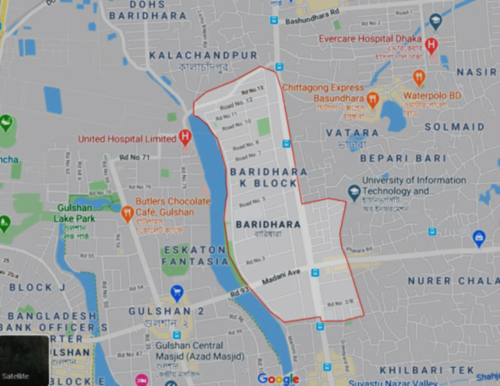
Contact us
Address of office: 12/A K block , Baridhara , Dhaka , Bangladesh. Email: terratrek11@gmail.com Cell: 019………….. 018…………..
Inbox us://Terra Trek Box

