Slide 1
MLOPs Diamond Dataset ML Pipeline Orchestration and Experiment Tracking.
Report by ~ Afif Jetham

Slide 2
MLflow and Prefect
Why MLflow?
Experiment Tracking.
Model Management.
Why Prefect?
Workflow Management.
Scheduling and Monitoring Tasks.
Get Observability for each task.

Slide 3
MLflow Steps:
Step 1 - Import MLFlow
import mlflow
Step 2 - Set the tracker and experiment
mlflow.set_tracking_uri(DATABASE_URI)
mlflow.set_experiment("EXPERIMENT_NAME")
Step 3 - Start a experiment run
with mlflow.start_run():
Step 4 - Logging the metadata
mlflow.set_tag(KEY, VALUE)
mlflow.log_param(KEY, VALUE)
mlflow.log_metric(KEY, VALUE)
Step 5 - Logging the model and other files (2 ways)
mlflow.<FRAMEWORK>.log_model(MODEL_OBJECT, artifact_path="PATH")
mlflow.log_artifact(LOCAL_PATH, artifact_path="PATH")

Slide 4
Prefect Steps:
Creating and activating a Virtual Environment
In order to install prefect, create a virtual environment:
$ python -m venv my_env
Enter the Virtual Environment using below mentioned command:
$ .\my_env\Scripts\activate
Installing Prefect 2.0
$ pip install prefect
OR if you have Prefect 1, upgrade to Prefect 2 using this command:
$ pip install -U prefect
OR to install a specific version:
$ pip install prefect==2.4
Check Prefect Version
$ prefect version
Running Prefect Dashboard
$ prefect orion start

Slide 5
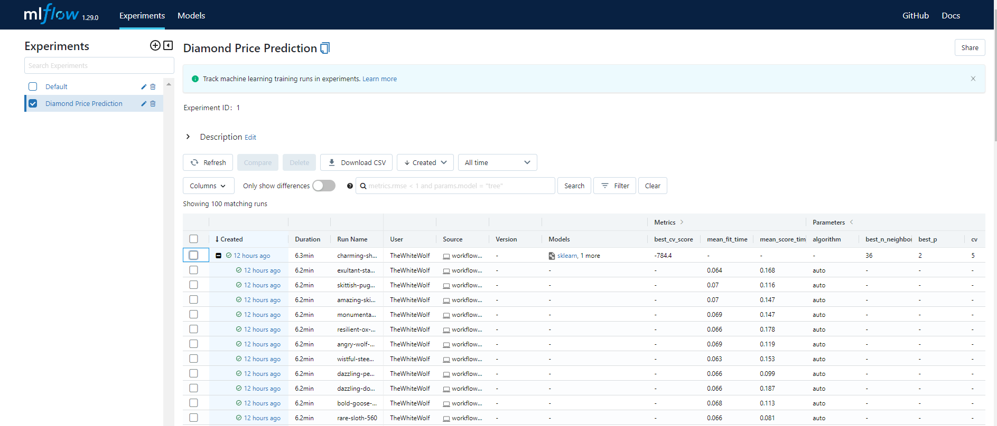
MLflow: Experiment Tracking

Slide 6
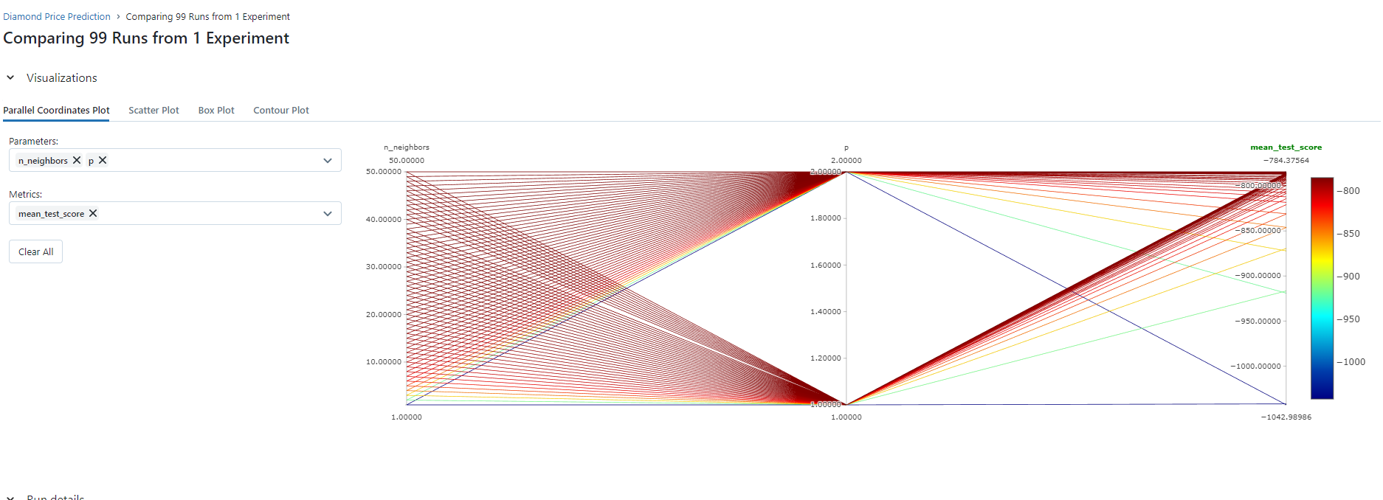
MLflow: Parallel Coordinates Plot

Slide 7
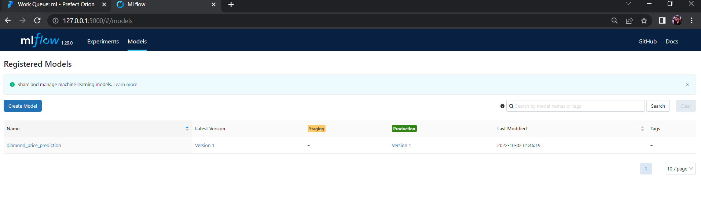
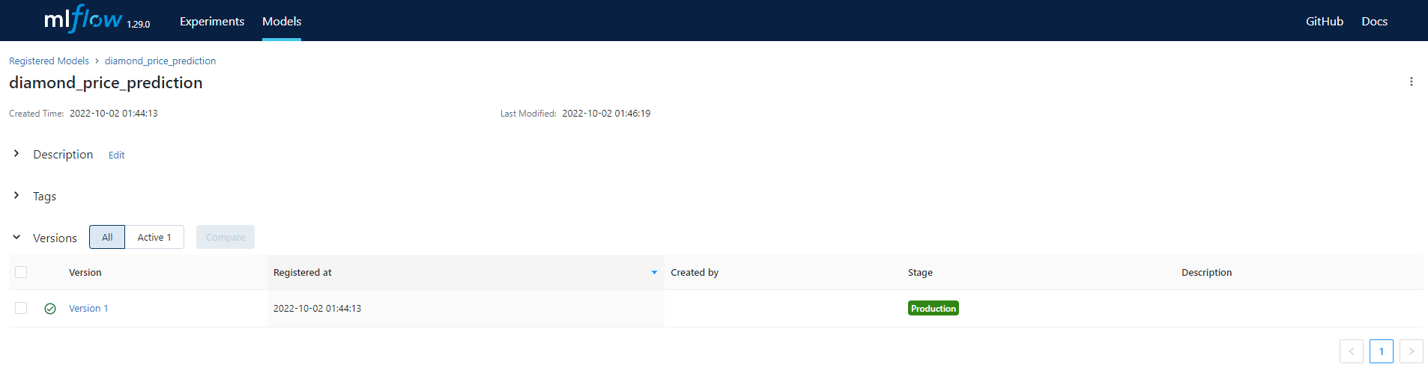
MLflow: Model Management

Slide 8
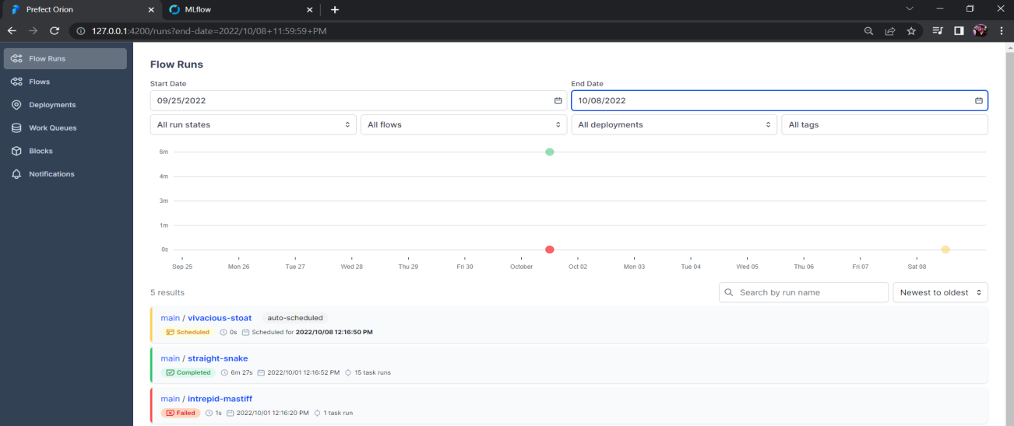
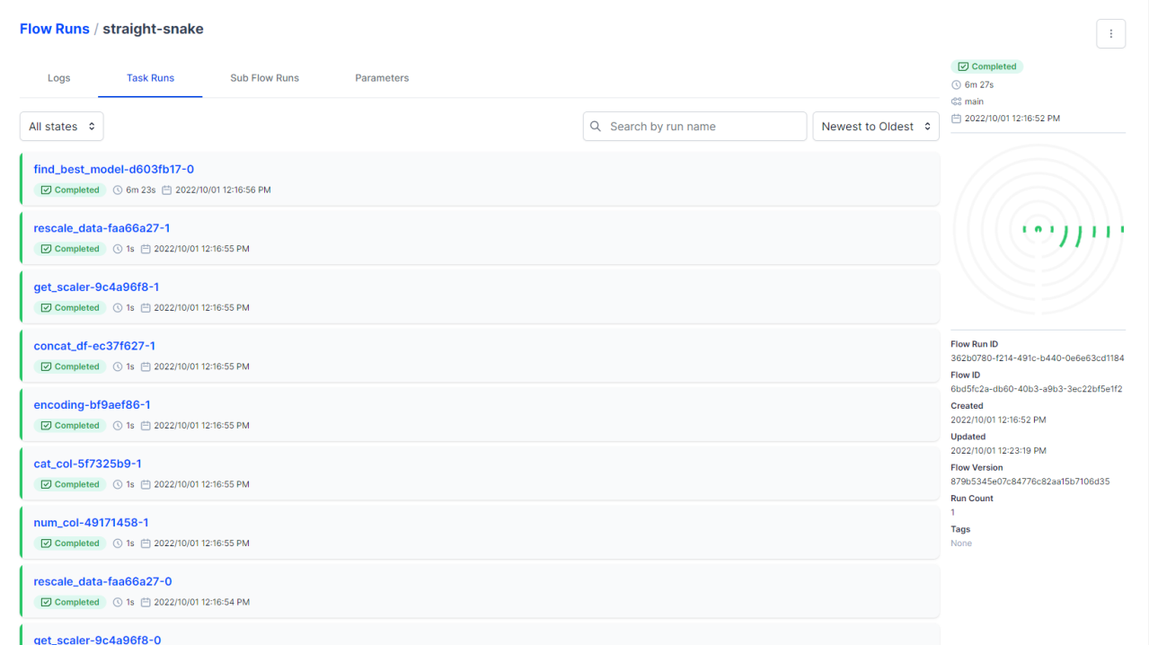
Prefect: Flow Runs

Slide 9
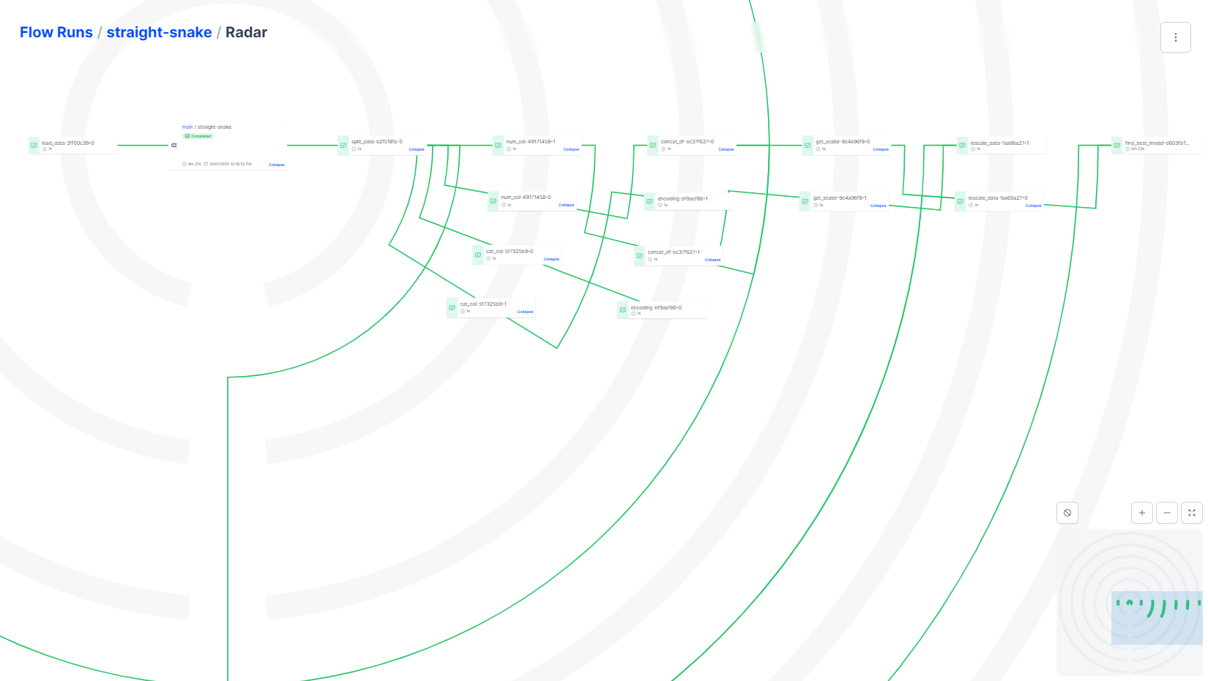
Prefect: Radar Plot (To View entire pipeline)

Slide 10
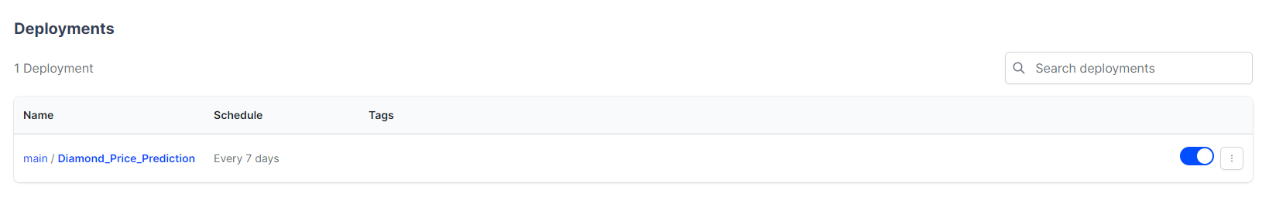
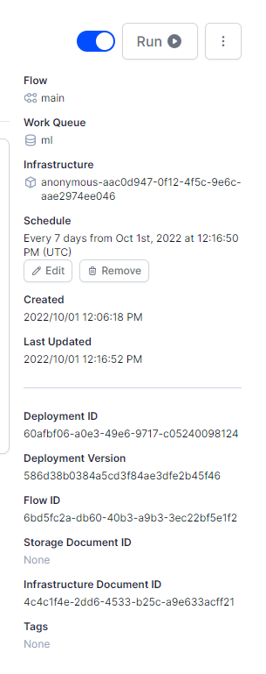
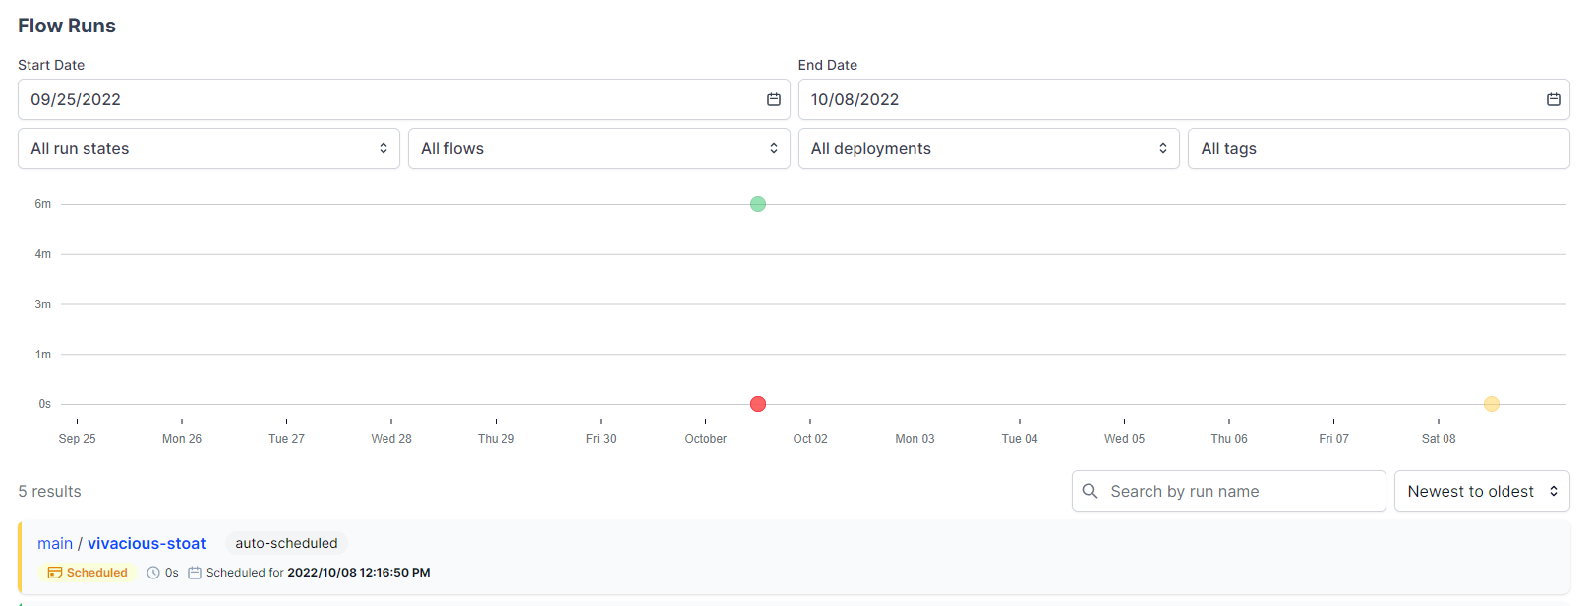
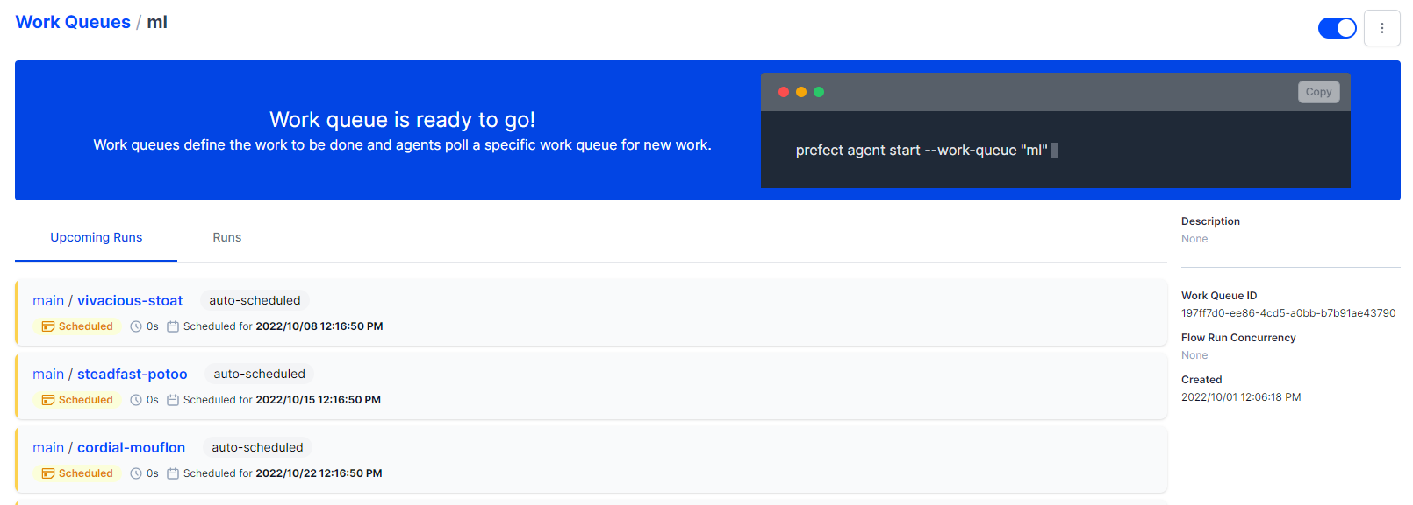
Prefect: Auto-Scheduling the Pipeline

Slide 11
THANKYOU

