Slide 1
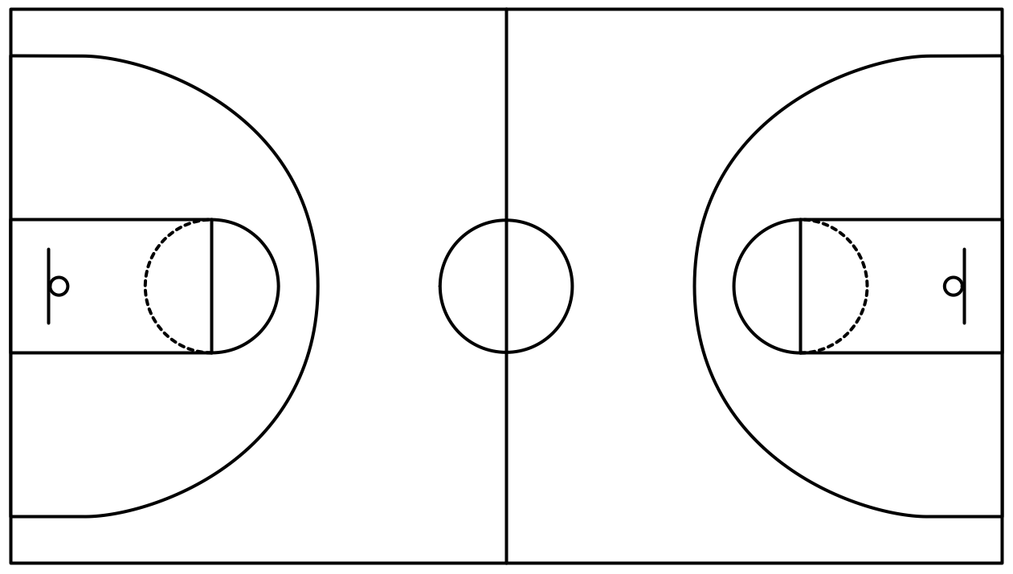
Improving NCAA Rankings
Brian Brungardt, Liam Crawley, Nathan Fraser, Christopher Hyland, Afif Mazhar, Taylor Neal, & Andy Wang

Slide 2
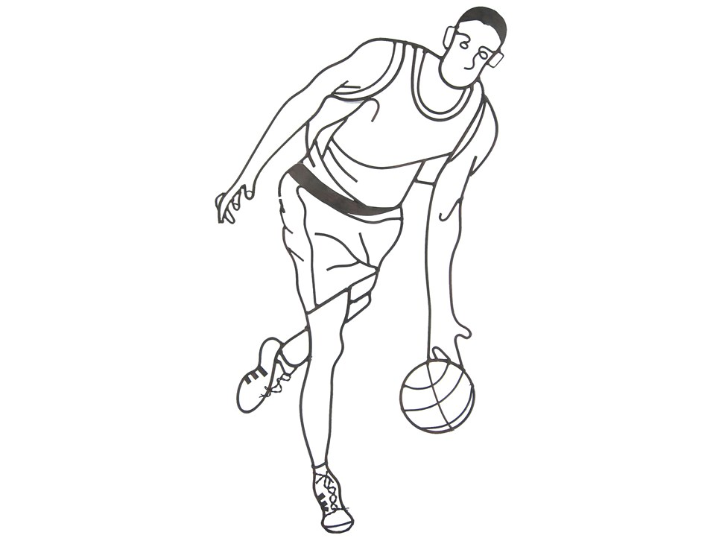
Strategy & Data
Strategy
Use OLS to combine rating systems
pts_team1 - pts_team2 = b0 + b1(SRS1) + b2(SRS2) + b3(RPI1) + b4(RPI2)
rank_team1 = b1(SRS1) + b3(RPI1)
Data
RPI
SRS
Game Data

Slide 3
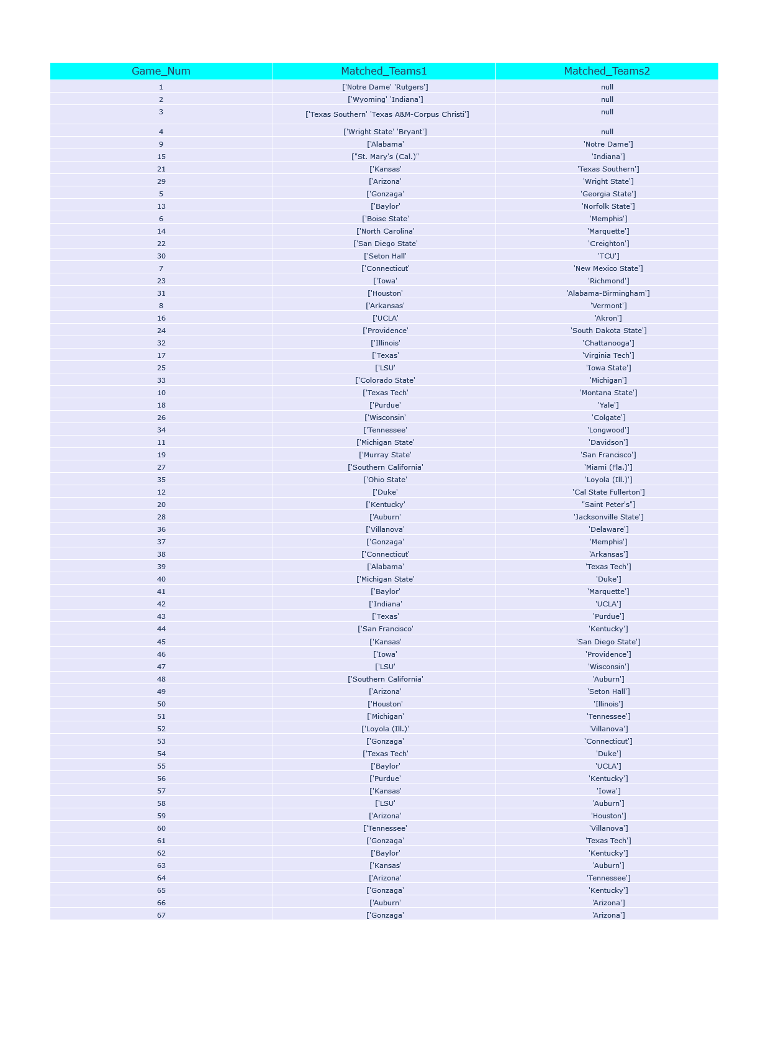
Visualizations
Predicted game matchups for every tournament game
Every game match is based on the result of previous games in the tournament

Slide 4
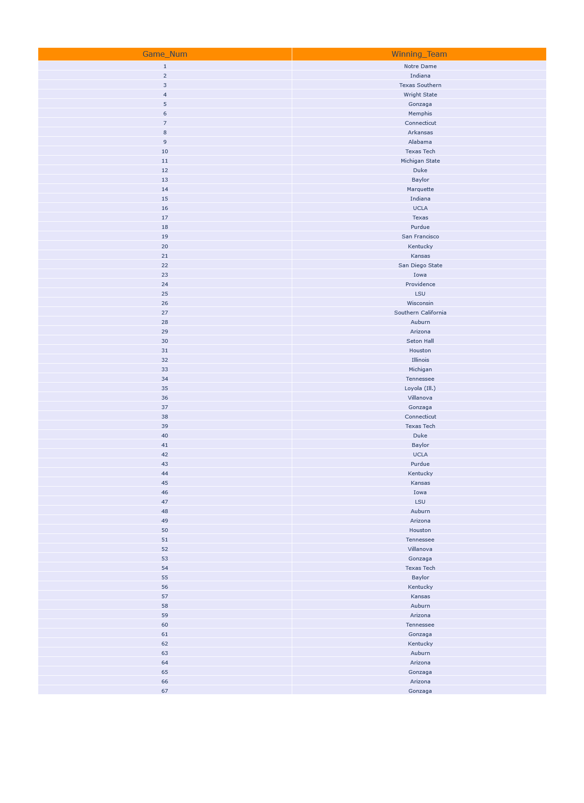
Visualizations
Gonzaga predicted to win game 67, making it the NCAA champion
Arizona predicted to come in second, losing to Gonzaga
Auburn predicted to come in third, losing to Arizona

Slide 5
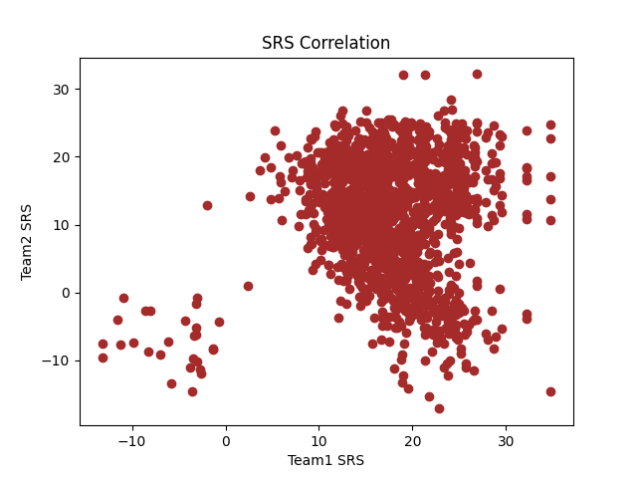
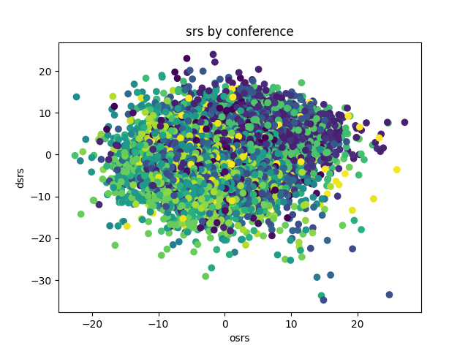
Miscellaneous Visualizations

Slide 6
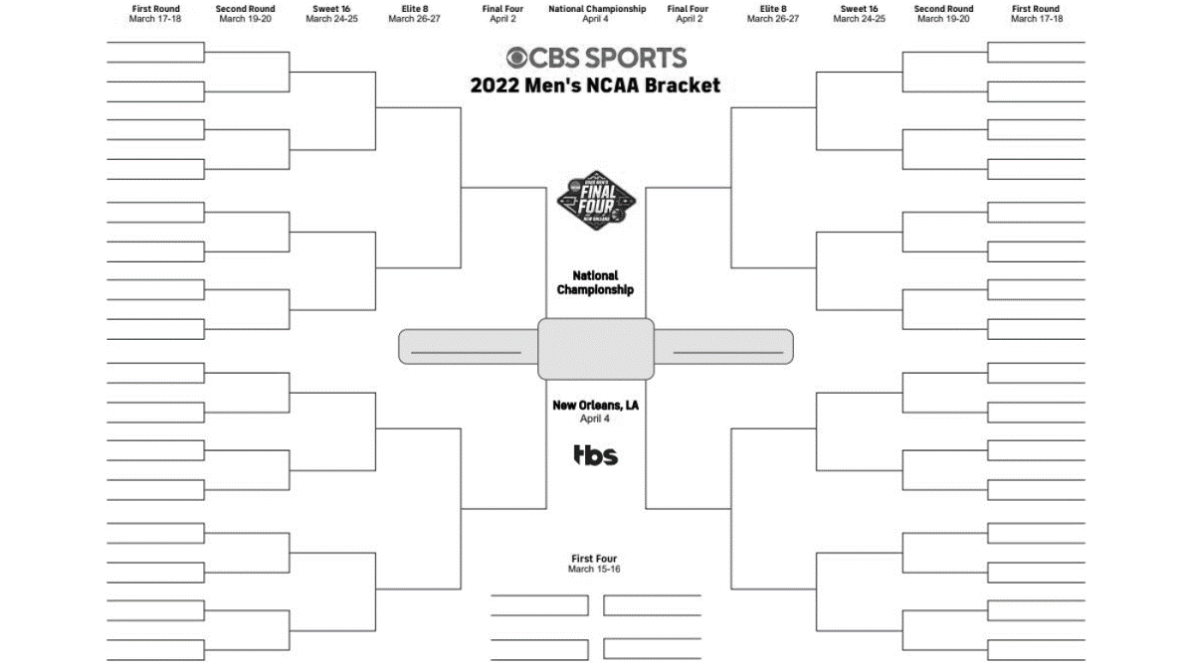
Conclusions and Rankings
How accurate is our model?
Current tournament outcomes place bracket in ~50th percentile range
Who will win March Madness?
Gonzaga is our predicted winner and is still currently in the tournament. Arizona is also still competing.

Slide 7
Questions?

