Slide 1
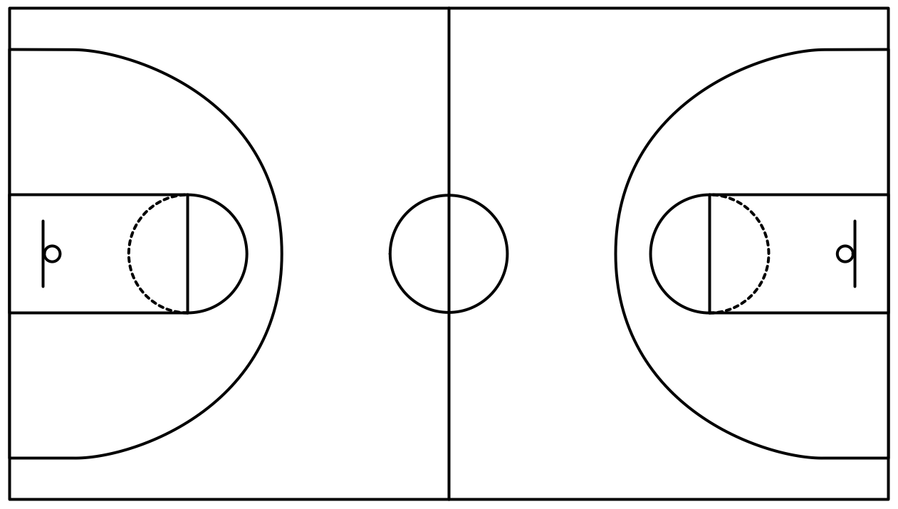
Lazy NCAA Brackets
Brian Brungardt, Liam Crawley, Nathan Fraser, Christopher Hyland, Afif Mazhar, Taylor Neal, & Andy Wang

Slide 2
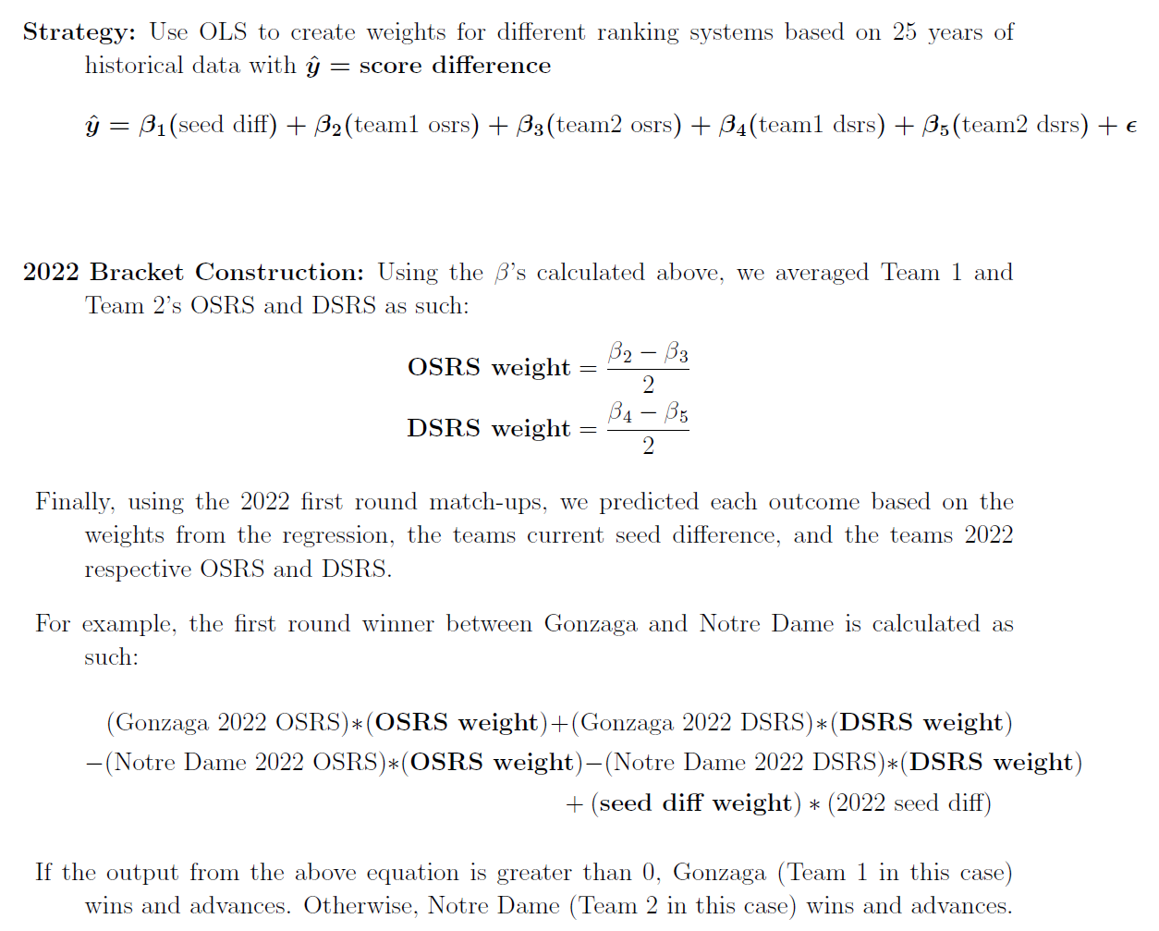
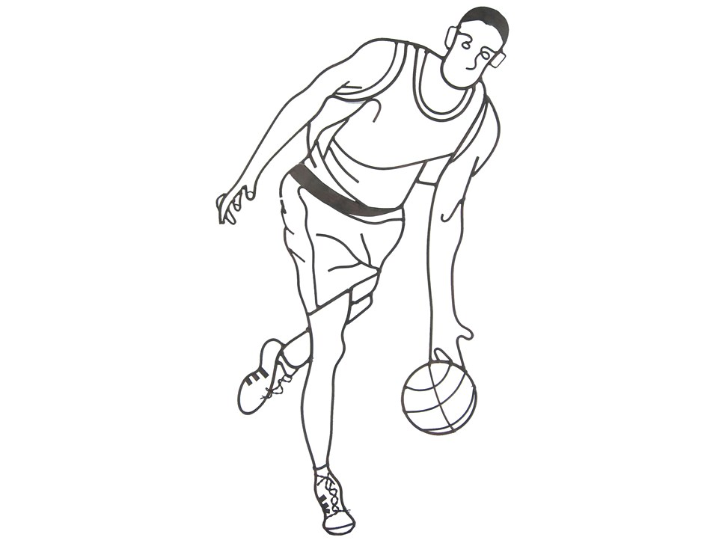
Strategy & Data Analysis

Slide 3
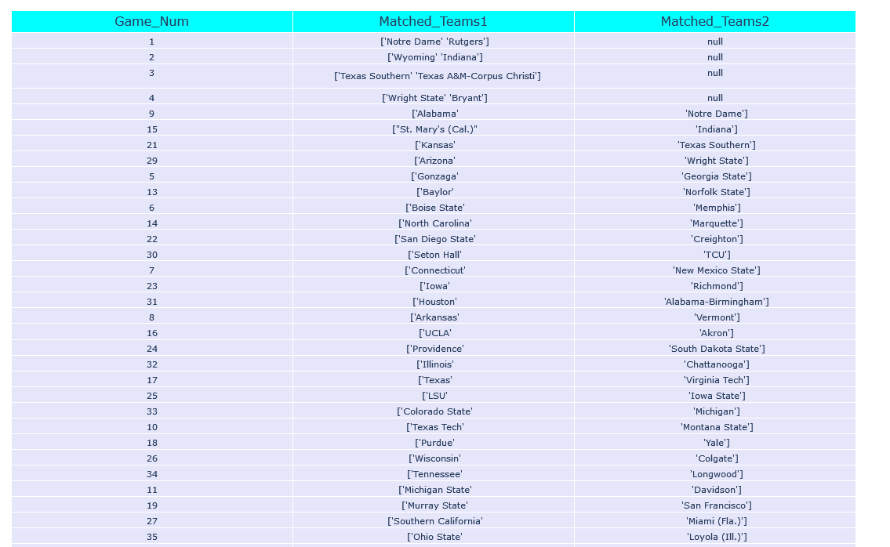
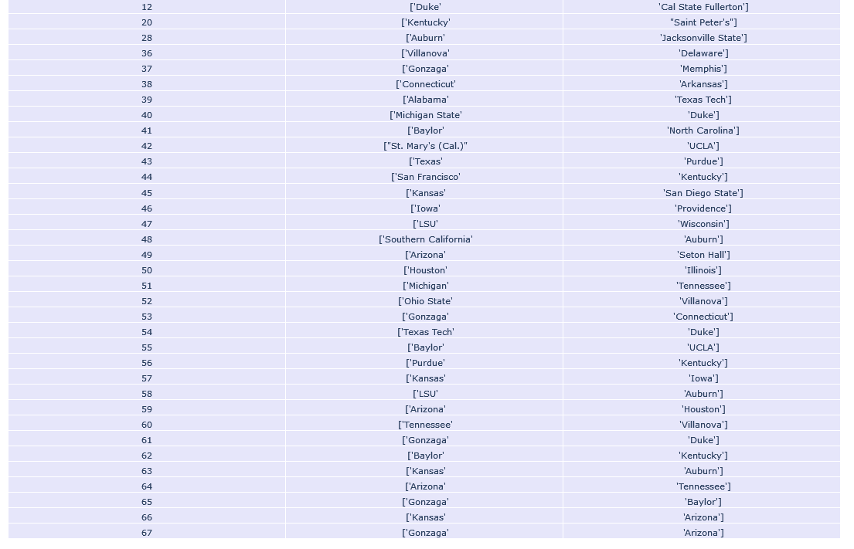
Visualizations
Predicted game matchups for every tournament game
Every game match is based on the result of previous games in the tournament

Slide 4
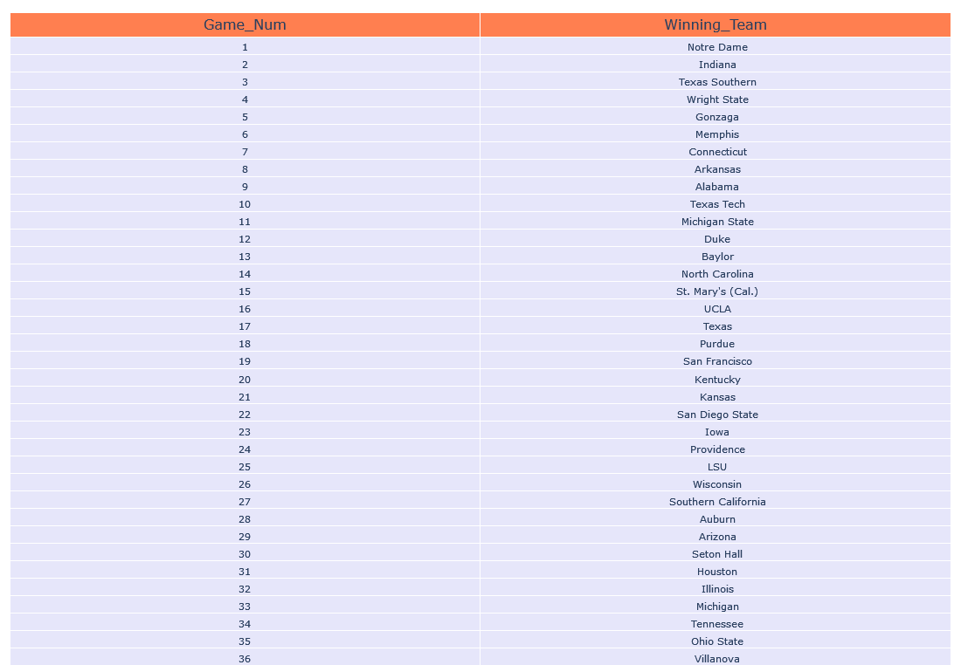
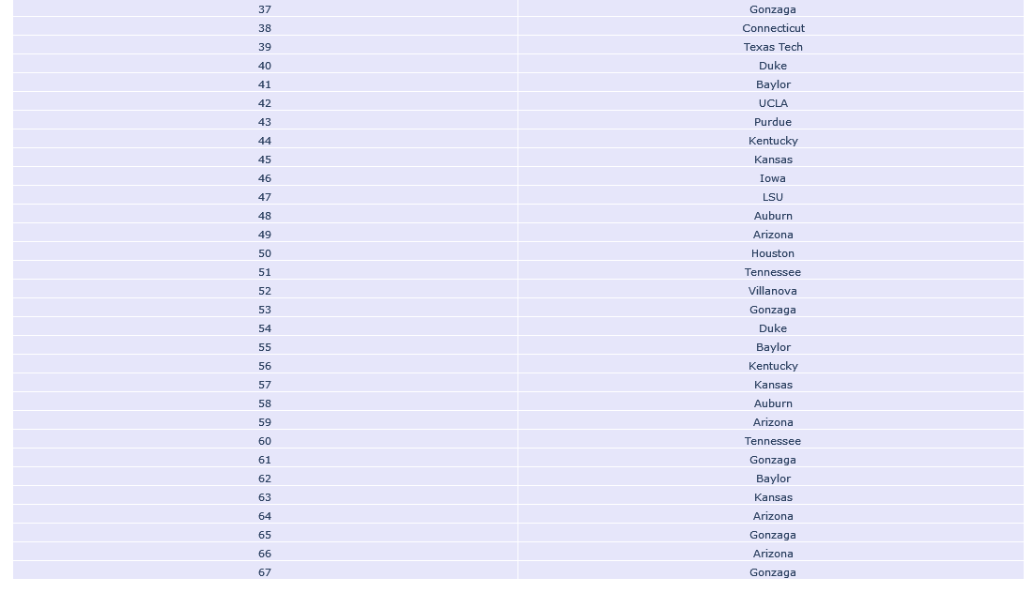
Visualizations
Gonzaga predicted to win game 67, making it the NCAA champion

Slide 5
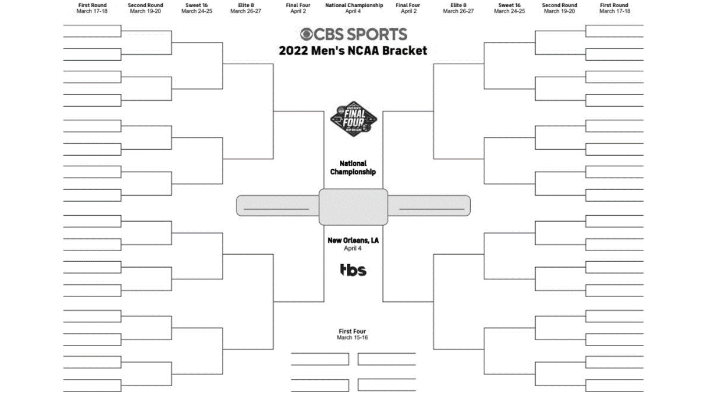
Conclusions and Rankings
How accurate is our model?
Current tournament outcomes place our bracket slightly above the 50th percentile range.
Who will win March Madness?
Gonzaga is our predicted winner and is still currently in the tournament. Arizona is also still competing.

Slide 6
Questions?

