Slide 1
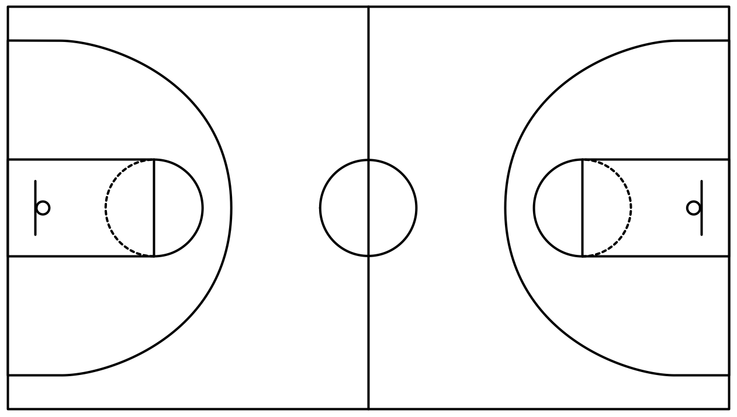
Improving NCAA Rankings
Brian Brungardt, Liam Crawley, Nathan Fraser, Christopher Hyland, Afif Mazhar, Taylor Neal, & Andy Wang

Slide 2

Strategy & Data
Strategy
Use OLS to combine rating systems
pts_team1 - pts_team2 = b0 + b1(OSRS1) + b2(OSRS2) + b3(DSRS1) + b4(DSRS2) + b5(seed_diff)
rank_team1 = b1(OSRS1) + b3(DSRS1) + b5(seed_diff)
Data
OSRS
DSRS
Game Data

Slide 3
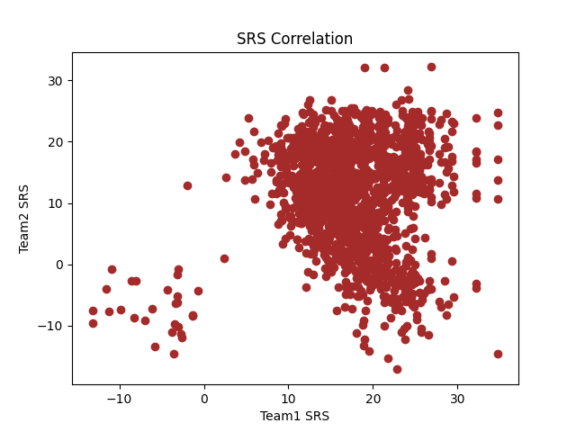
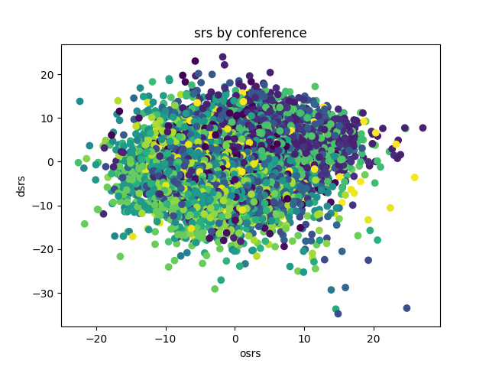
Visualizations

Slide 4
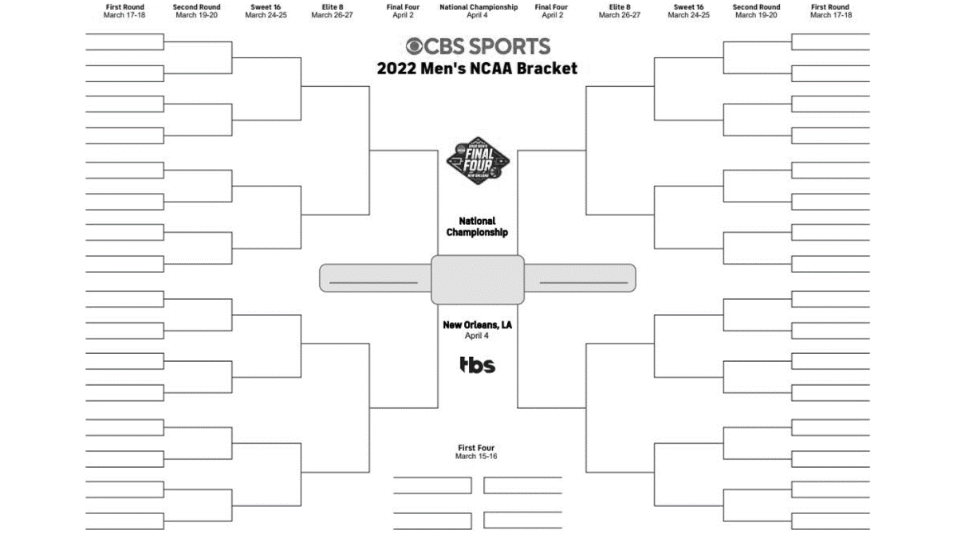
Conclusions and Rankings
How accurate is our model?
Limitations in data
Probabilities?
Who will win March Madness?
Gonzaga?

Slide 5
Questions?

