Slide 1
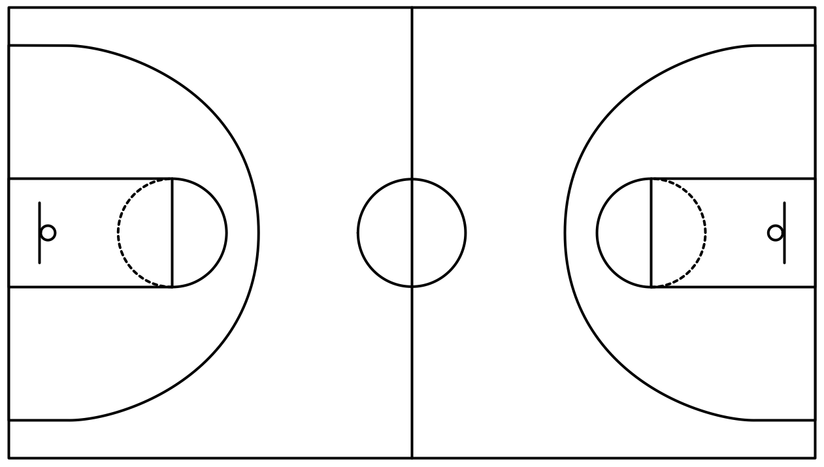
Improving NCAA Rankings
Brian Brungardt, Liam Crawley, Nathan Fraser, Christopher Hyland, Afif Mazhar, Taylor Neal, & Andy Wang

Slide 2
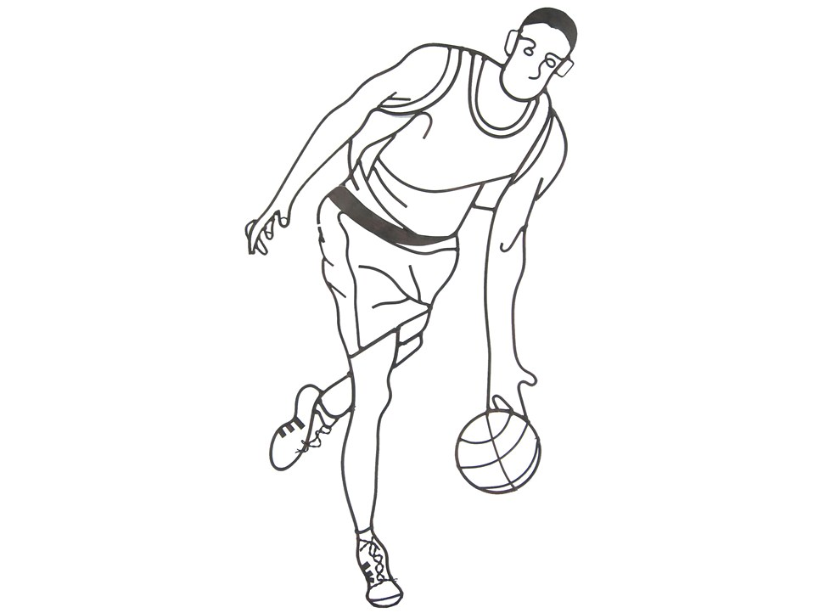
Strategy & Data
Strategy
Use OLS to create weights for different ranking systems based on 25 years of historical data
score_diff = b1(seed_diff) + b2(team1_osrs) + b3(team2_osrs) + b4(team1_dsrs) + b5(team2_dsrs) + e
2022 Ranking Method
Calculate the averages for OSRS, DSRS using beta coefficients
osrs_avg_weight = (b2 – b3)/2 = 1.05263
dsrs_avg_weigth = (b4 – b5)/2 = 1.15755
seed_diff = b1 = 0.39081
Multiply by teams 2022 ratings and sum
So, Gonzaga’s 2022 rating = (osrs_2022 * osrs_avg) + (dsrs_2022 * dsrs_avg) + (matchup_seed_diff_2022 * seed_diff_weight)

Slide 3
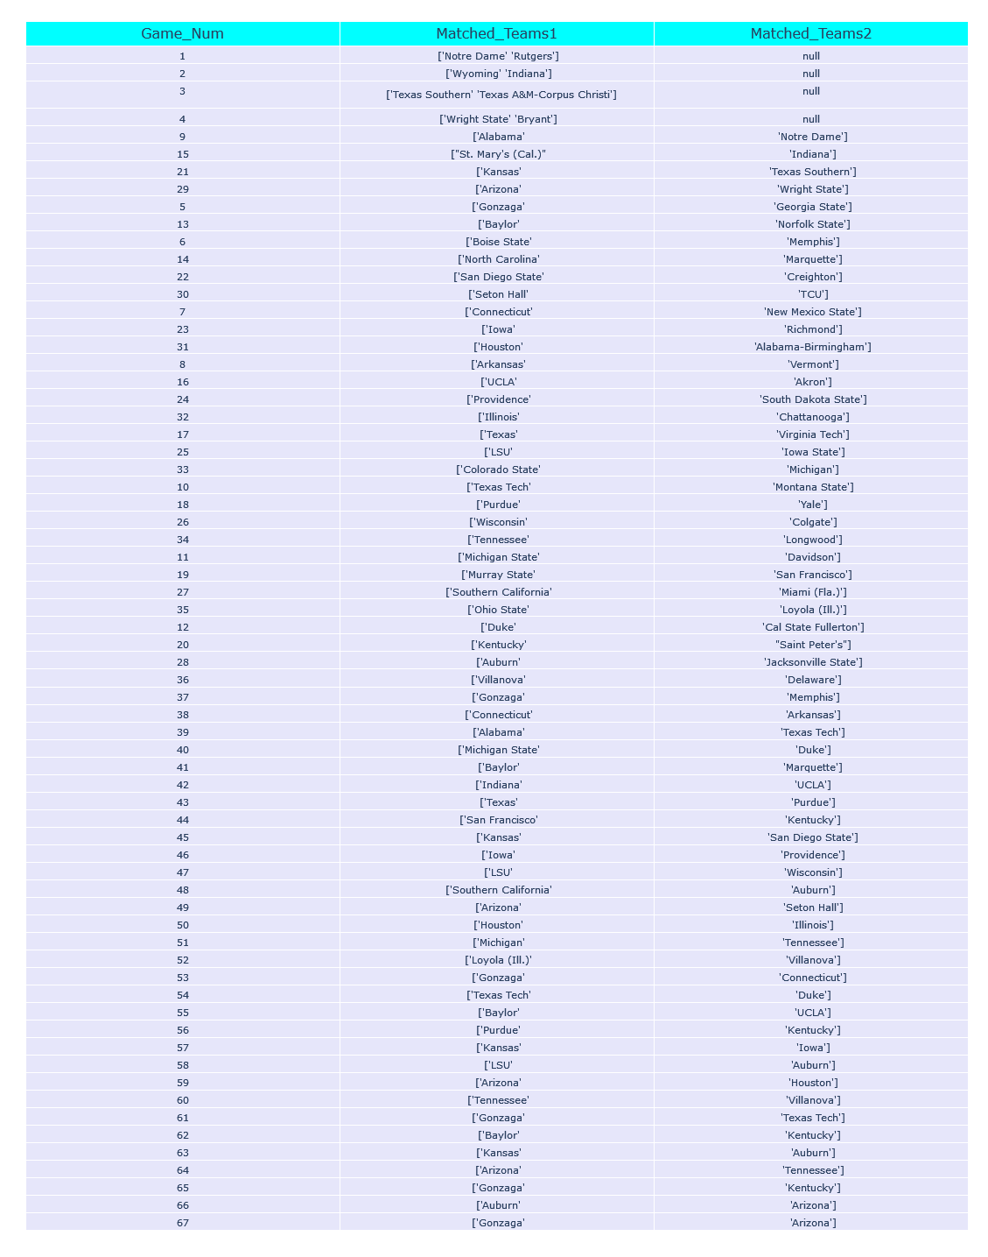
Visualizations
Predicted game matchups for every tournament game
Every game match is based on the result of previous games in the tournament

Slide 4
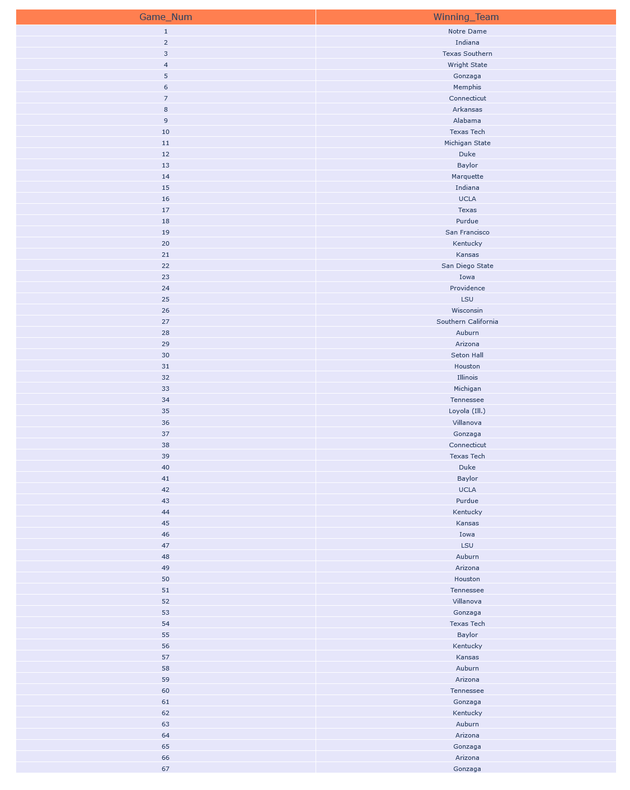
Visualizations
Gonzaga predicted to win game 67, making it the NCAA champion
Arizona predicted to come in second, losing to Gonzaga
Auburn predicted to come in third, losing to Arizona

Slide 5
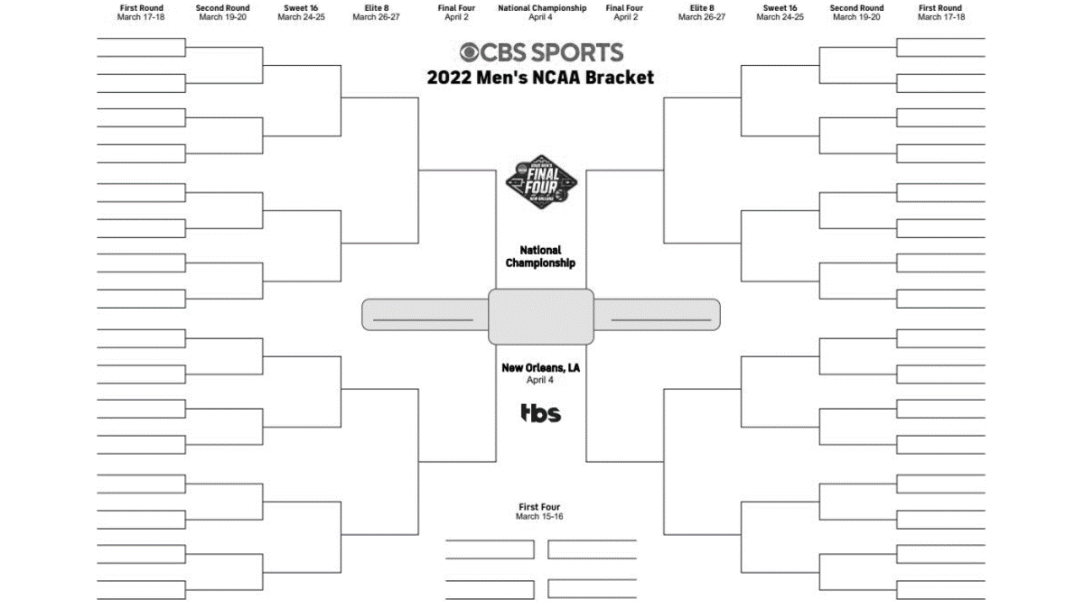
Conclusions and Rankings
How accurate is our model?
Current tournament outcomes place our bracket in ~50th percentile range.
Who will win March Madness?
Gonzaga is our predicted winner and is still currently in the tournament. Arizona is also still competing.

Slide 6
Questions?

