Slide 1
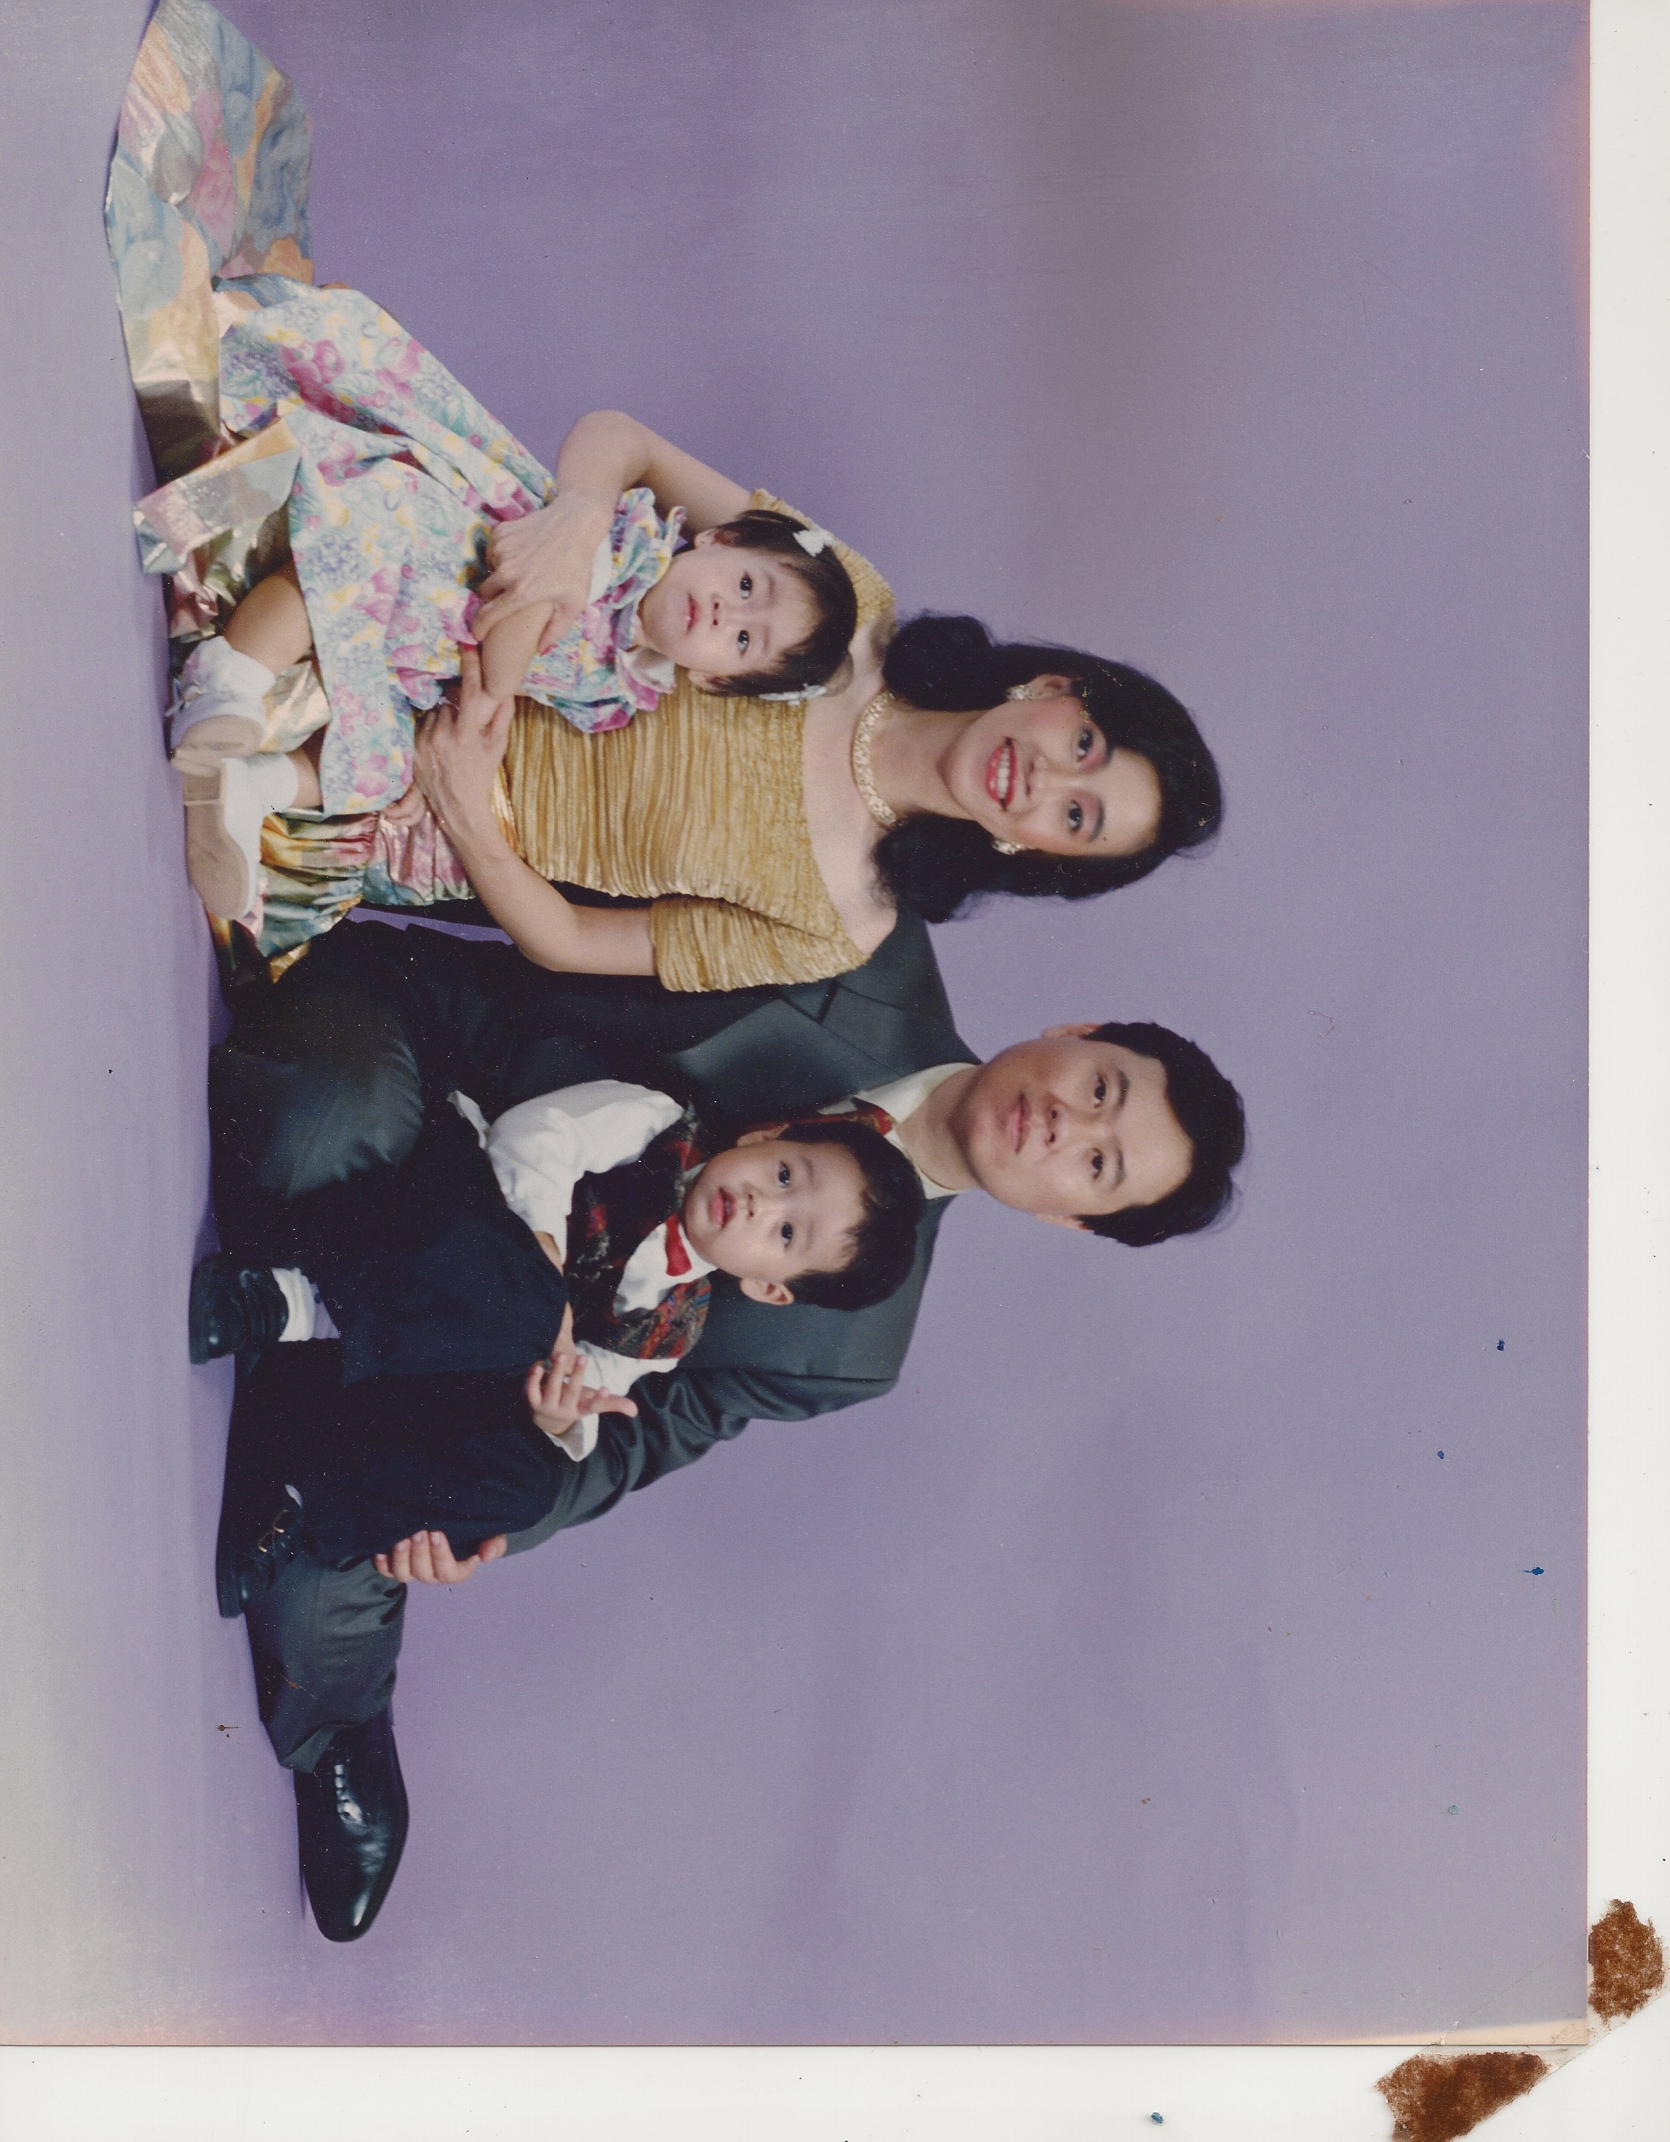
About us
Events
Sign in
Sign up
SMA St. Ursula Alumni Association
Home /
We are the alumni association of SMA St. Ursula. Dedicated to humanity and service to others (SERVIAM), we create our family as an extension of St. Ursula high school. We welcome home those of our own, and those who share our vision and passion. Questions? Contact us.
Sign in
RSVP
E-mail
Password
Sign in
Shop and Events slideshow
Sign up
… to start RSVP-ing in our events, shopping, and connecting.

Slide 2
About us
Events
Sign in
Sign up
SMA St. Ursula Alumni Association
Home /
We are the alumni association of SMA St. Ursula. Dedicated to humanity and service to others (SERVIAM), we create our family as an extension of St. Ursula high school. We welcome home those of our own, and those who share our vision and passion. Questions? Contact us.
RSVP
Shop and Events slideshow

Slide 3
About us
Events
Sign in
Sign up
SMA St. Ursula Alumni Association
Home / sign in
Enter your e-mail address:
Password:
Sign in

Slide 4
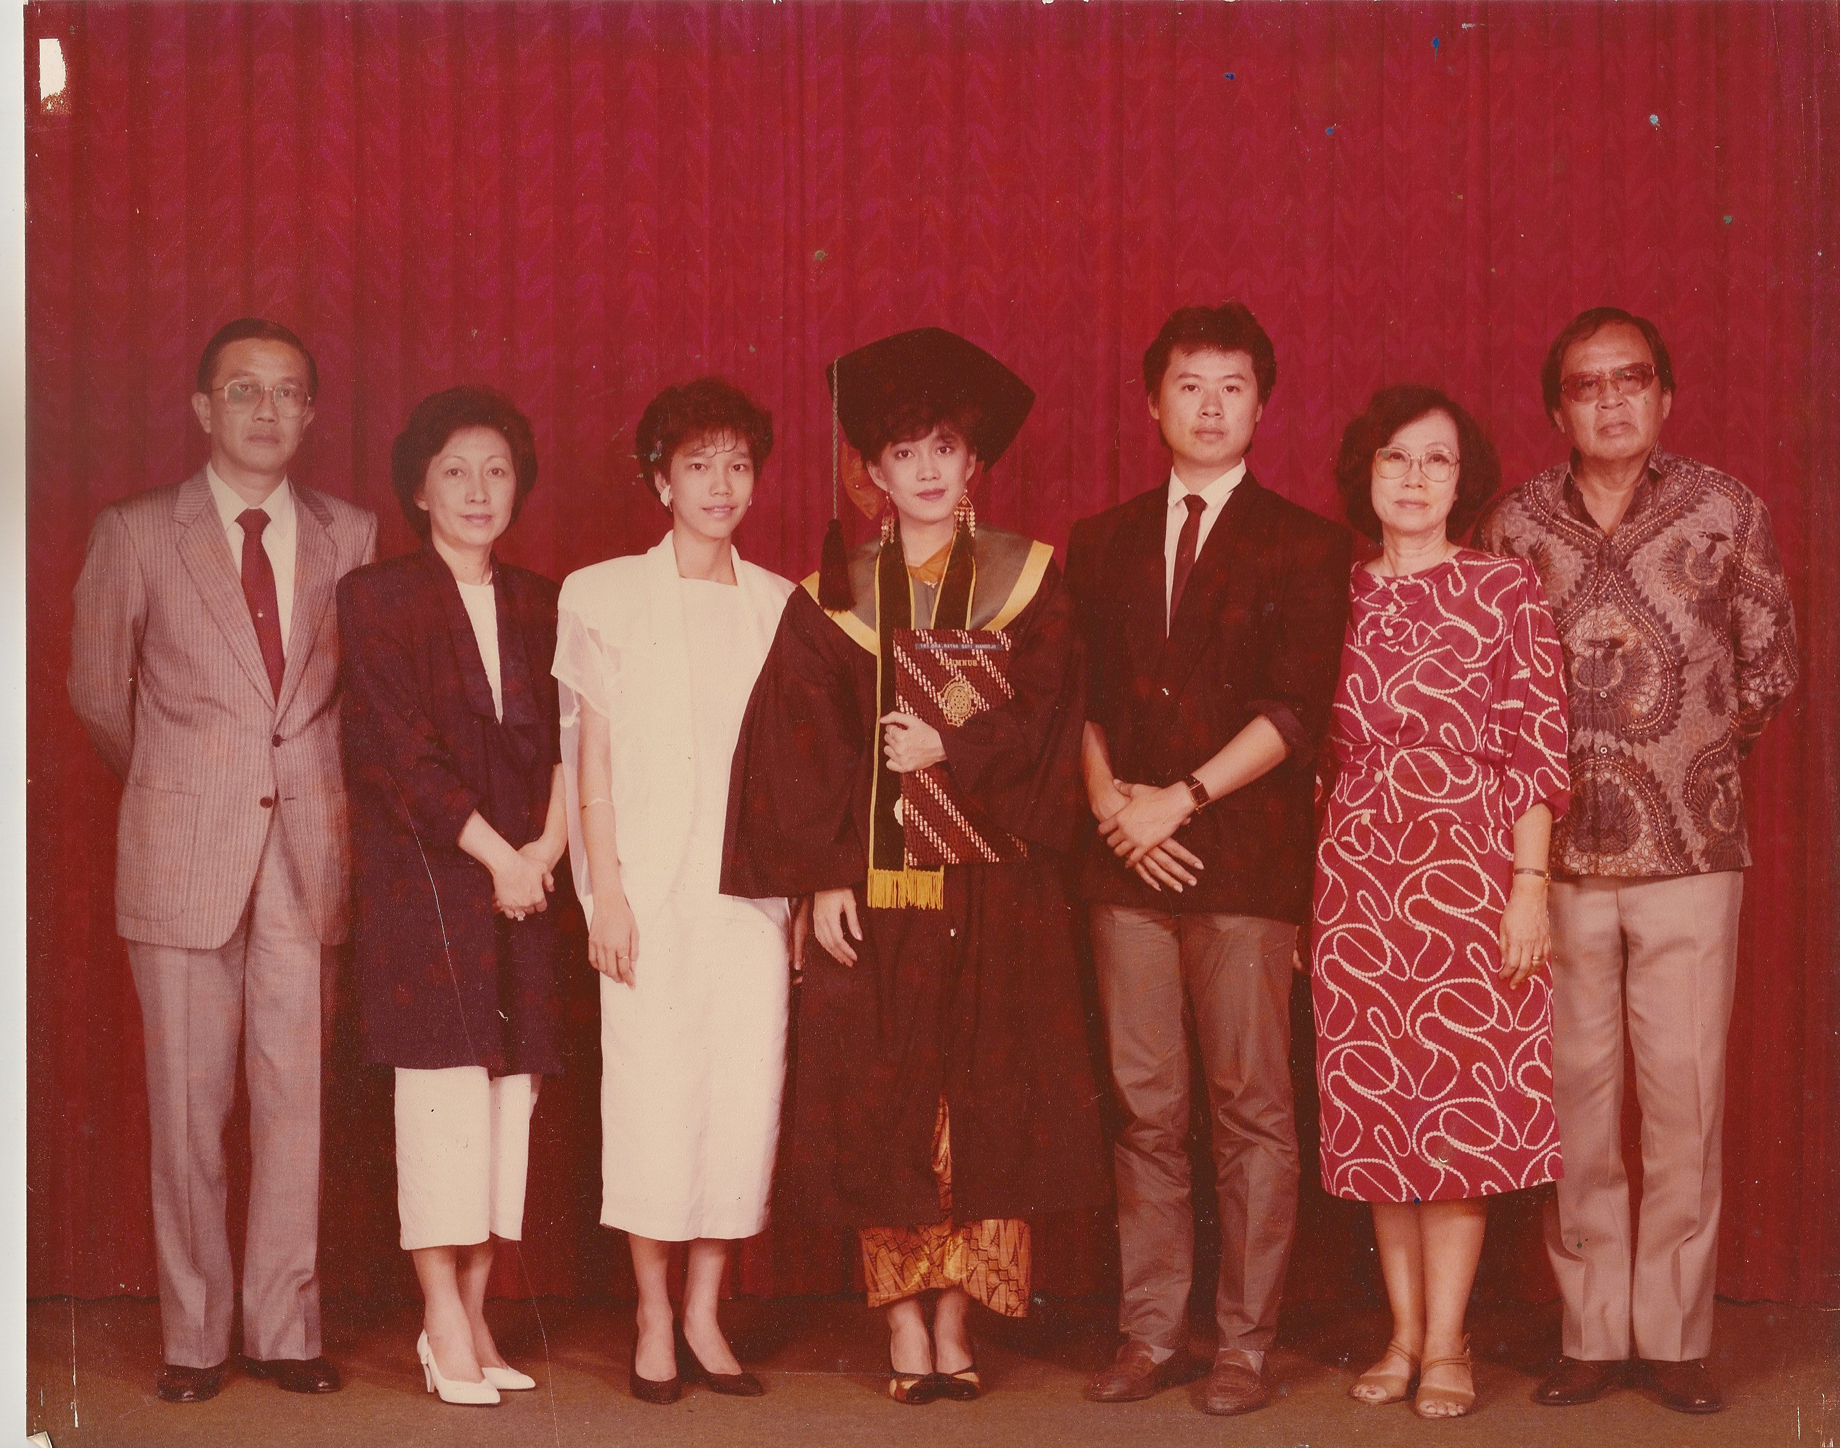
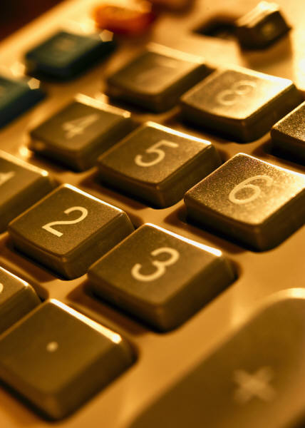
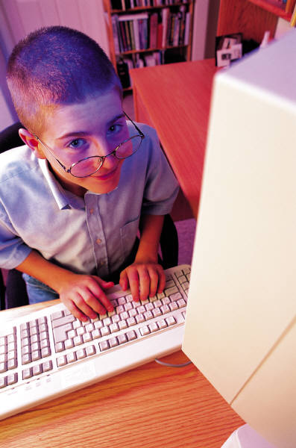
About us
About us
Events
Sign in
Sign up
SMA St. Ursula Alumni Association
Home / About us / History
History
Vision and Mission
Contact us
SMA St. Ursula
blablablablablabla
blablabla
blablabla
blablabla
blablabla
blablabla
blablabla
blablabla
blablabla
blablabla
blablabla
blablabla

Slide 5
About us
About us
Events
Sign in
Sign up
SMA St. Ursula Alumni Association
Home / About us / History
History
Vision and Mission
Contact us
SMA St. Ursula
Contact us
Naration explaining the picture when mouse passes through picture

Slide 6
About us
About us
Events
Sign in
Sign up
SMA St. Ursula Alumni Association
Home / About us / SMA St. Ursula
History
Vision and Mission
Contact us
SMA St. Ursula
Map of school
We are the alumni associatio of St. Ursula highschool.
SMA St. Ursula is an all-girls school located in central Jakarta. .....
http://www.sanctaursula-jkt.sch.id/home
Girls in
uniform
Serviam logo

Slide 7

About us
About us
Events
Sign in
Sign up
SMA St. Ursula Alumni Association
Home / About us / Vision and Mission
History
Vision and Mission
Contact us
SMA St. Ursula
Vision and mission of the alumni association

Slide 8
About us
Events
Sign in
Sign up
SMA St. Ursula Alumni Association
Home / About us / Contact us
About us
History
Vision and Mission
Contact us
SMA St. Ursula
E-mail
Subject
Say what you need to say…

Slide 9
Events
About us
Events
Sign in
Sign up
SMA St. Ursula Alumni Association
Home / Events
Click on the picture to view details
Sort by:
- categories
- Number of people attending
Events here will be arranged by preference.
- Upcoming events
Sign in
to view your personal calendar
E-mail
125
40
32
10
2
Password

Slide 10
Events
About us
Events
Sign in
Sign up
SMA St. Ursula Alumni Association
Home / Events/ A night of neglect
Contact info untuk beli tiket
POSTER
Name of event
Where
When
Description
Contact person:
Raissa Multaputri, 08888888888
Please contact Raissa to purchase tickets
Number of people attending so far: 125.
Levana Laksmicitra
Andri Putri
Lola Wijaya
Shika Paramastri
Quamilla Vertinanda
RSVP
3
Number of persons

Slide 11
Events
Home / Events/ A night of neglect
Name of event
Where
When
Description
Number of people attending so far: 125.
POSTER
You have successfully RSVP-ed to this event.
A reminder of the event will be sent to your e-mail a day before the event.
Levana Laksmicitra
Andri Putri
Lola Wijaya
Shika Paramastri
Quamilla Vertinanda
Dialogue box will appear for 2 seconds
RSVP
3
Number of persons

Slide 12
Events
About us
Events
Sign in
Sign up
SMA St. Ursula Alumni Association
Home / Events / Your events calendar
Your Events Calendar
Sunday
Monday
Tuesday
Wednesday
Thursday
Friday
Saturday
Garage sale
View all events
AIDS walk
View events RSVP-ed
fundraising
dinner
Acara SMA
Boxes in orange are events not hosted by alumni. Events in yellow are hosted by us.
concert

Slide 13
Events
About us
Events
Sign in
Sign up
SMA St. Ursula Alumni Association
Home / Events / Your events calendar
Sunday
Monday
Tuesday
Wednesday
Thursday
Friday
Saturday
Garage sale
View all events
View events RSVP-ed
AIDS walk
fundraising
dinner
Acara SMA
x
Boxes in orange are events not hosted by alumni. Events in yellow are hosted by us.
x
concert
RSVP

Slide 14
Events
About us
Events
Sign in
Sign up
SMA St. Ursula Alumni Association
Home / Events / Your events calendar
Your Events Calendar
Sunday
Monday
Tuesday
Wednesday
Thursday
Friday
Saturday
View all events
AIDS walk
View events RSVP-ed
fundraising
Boxes in orange are events not hosted by alumni. Events in yellow are hosted by us.
concert

Slide 15
Events
About us
Events
Sign in
Sign up
SMA St. Ursula Alumni Association
When mouse moved over, this appears
Home / Events / Your events calendar
Sunday
Monday
Tuesday
Wednesday
Thursday
Friday
Saturday
View all events
Place
x
Monday,
9 Aug 2008
View events RSVP-ed
fundraising
Boxes in orange are events not hosted by alumni. Events in yellow are hosted by us.
concert

Slide 16
About us
Events
Sign in
Sign up
SMA St. Ursula Alumni Association
Home / Sign up
Sign up
Welcome to our online community! Signing up is the first step to start connecting, attending and making events, and get better deals!
Please choose the last level of education achieved in St. Ursula
TK SD SMP SMA
2010
2009
2008
2007
2006
2005
2004
2003
2002
2001
2000
1999
1998
1997
1996
1995
1994
1993
1992
1991
1990
1889
1888
1887
1886
1885
1884
1883
1882
1881

Slide 17
About us
Events
Sign in
Sign up
SMA St. Ursula Alumni Association
Home / Sign up
Sign up
Welcome to our online community! Signing up is the first step to start connecting, attending and making events, and get better deals!
Click on your name. Click here if your name is not here.
2010
Levana Laksmicitra Sani
Raissa Multaputri
Kirana Perwitasari
Catherina Kartika Hapsari
Andri Putri
Shika Paramastri
Engeline Pratiwi
Lola
Rena Multaputri

Slide 18
About us
Shop
Events
Sign in
Forum
Sign up
home
Search the website
SMA St. Ursula Alumni Association
Home / Sign up
Sign up
Welcome to our online community! Signing up is the first step to start connecting, attending and making events, and get better deals!
2010
Welcome, Levana Laksmicitra Sani!
Please enter your birth date (DD/MM/YYYY) to verify.
/ /
submit

Slide 19
About us
Events
Sign in
Sign up
SMA St. Ursula Alumni Association
Home / Sign up
Sign up
Please wait while we verify your data.

Slide 20
About us
Events
Sign in
Sign up
SMA St. Ursula Alumni Association
Home / Sign up
Sign up
Welcome Levana Laksmicitra Sani! You are successfully registered as an alumni.
Please enter your e-mail and password that you want to use to sign in next time:
E-mail:
Password:
Edit your profile
Find a friend
Check out events
Go to homepage

Slide 21

About us
Events
Sign in
Sign up
SMA St. Ursula Alumni Association
Home / Edit your profile
Click to change profile
picture
Jenis Kelamin:
Tempat/Tanggal Lahir (dd-mm-yy):
Alamat Rumah:
Telfon Rumah:
HP:
Email:
Areas of interest: (You can choose more than one)
business
arts and design
sciences
political and social sciences
engineering
music
sports
literature
religious and philosophical studies
Education
Military studies
culinary
Next step

Slide 22
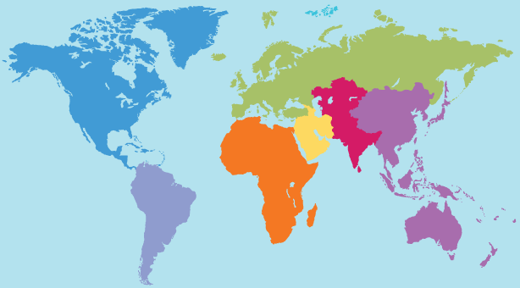
About us
Events
Sign in
Sign up
SMA St. Ursula Alumni Association
Work with google maps to locate our members
Home / Edit your profile
Search your location
Or select your location on the map
Previous step
Next step

Slide 23
About us
Events
Sign in
Sign up
SMA St. Ursula Alumni Association
High school
Bachelor degree (S1)
Sekolah kejuruan
D3
Masters degree (S2)
Doctorate degree (S3)
Home / Edit your profile
Highest degree of education: (Choose one)
(Select one)
College/ University attended for Bachelor degree:
Major (s):
Minor:
Graduation year:
If a person chooses Bachelor degree, the form will stop here, then continued to next step
College/ University attended for Masters degree:
Major (s):
Minor:
Graduation year:
College/ University attended for Doctorate degree:
Major (s):
Minor:
Graduation year:
Previous step
Next step

Slide 24
About us
Events
Sign in
Sign up
SMA St. Ursula Alumni Association
Home / Edit your profile
Work experience:
Company/ Association:
Year:
Position:Nama Kantor:
Alamat Kantor:
Nomor telfon Kantor:
Fax Kantor:
Work HP:
Work Email:
Current Work:
Company/ Association:
Year:
Position:Nama Kantor:
Alamat Kantor:
Nomor telfon Kantor:
Fax Kantor:
Work HP:
Work Email:
When a person clicks this, a copy of the field will be added below.
Add field
Previous step
Next step

Slide 25
Home / Edit your profile
Please choose the information that you want other people than your year to see.
E-mail address:
Password:
Re-enter password:
Work experience:
Company/ Association:
Year:
Position:Nama Kantor:
Alamat Kantor:
Nomor telfon Kantor:
Fax Kantor:
Work HP:
Work Email:
Jenis Kelamin
Tempat/Tanggal Lahir (dd-mm-yy):
Alamat Rumah:
Telfon Rumah:
HP:
Email:
Tick boxes
Areas of interest:
Business
sciences
Social studies
Arts
Current Work:
Company/ Association:
Year:
Position:Nama Kantor:
Alamat Kantor:
Nomor telfon Kantor:
Fax Kantor:
Work HP:
Work Email:
College/ University attended for Bachelor degree:
Major (s):
Minor:
Graduation year:
College/ University attended for Masters degree:
Major (s):
Minor:
Graduation year:
College/ University attended for Doctorate degree:
Major (s):
Minor:
Graduation year:
Previous step
Finish

Slide 26
About us
Events
Sign in
Sign up
SMA St. Ursula Alumni Association
Home / ... / Levana Laksmicitra Sani
Levana Laksmicitra Sani
Alumni of SMA St. Ursula, 2010
Pursuing a Bachelor degree in University of Southern California
Majoring in Chemical Biology
Areas of interest: medicines and fashion
Working experience: none
Send her an e-mail:
Your e-mail address
Levana is hosting “A Night of Neglect” this Saturday, 8 October 2011. Check it out
Subject
Content
(Request for letter of reference, reference to places, life advices, or just a friendly hi ☺)
Add as friend ☺

Slide 27
Home / Sign up
Levana Laksmicitra Sani
Alumni of SMA St. Ursula, 2010
Pursuing a Bachelor degree in University of Southern California
Majoring in Chemical Biology
Areas of interest: medicines and fashion
Working experience: none
Add a message here to Levana
Send her an e-mail:
Add as friend ☺
Your e-mail address
Levana is hosting “A Night of Neglect” this Saturday, 8 October 2011. Check it out
Subject
Content
Levana is selling clothes and other stuff. See her products
Levana made it to the Alumni news board in the article “Alumni went around the world in 80 days”
Add as friend ☺

Slide 28
Home / Sign up
Levana Laksmicitra Sani
Alumni of SMA St. Ursula, 2010
Pursuing a Bachelor degree in University of Southern California
Majoring in Chemical Biology
Areas of interest: medicines and fashion
Working experience: none
You have successfully added Levana as a friend.
Send her an e-mail:
Your e-mail address
Levana is hosting “A Night of Neglect” this Saturday, 8 October 2011. Check it out
Subject
Content
Levana is selling clothes and other stuff. See her products
Levana made it to the Alumni news board in the article “Alumni went around the world in 80 days”
Add as friend ☺

Slide 29
About us
Events
Sign in
Sign up
SMA St. Ursula Alumni Association
Home / Your Profile
Edit profile
Host an event
Find a friend
Levana Laksmicitra Sani
Alumni of SMA St. Ursula, 2010
Pursuing a Bachelor degree in University of Southern California
Majoring in Chemical Biology
Areas of interest: medicines and fashion
Working experience: none
Notifications: events, forums, shop (events dulu saja)
No upcoming events
Go to your calendar

Slide 30
About us
Events
Sign in
Sign up
SMA St. Ursula Alumni Association
Home / Your Profile
Host an event
Find a friend
Edit profile
Levana Laksmicitra Sani
Alumni of SMA St. Ursula, 2010
Pursuing a Bachelor degree in University of Southern California
Majoring in Chemical Biology
Areas of interest: medicines and fashion
Working experience: none
Upcoming events: AIDS walk, tomorrow, Senayan
x
x
x
Go to your calendar
Today’s date shown by different color

Slide 31
About us
Events
Sign in
Sign up
SMA St. Ursula Alumni Association
Home / Your Profile
Edit profile
Host an event
Find a friend
Sell something on the web
Post a forum box
Levana Laksmicitra Sani
Alumni of SMA St. Ursula, 2010
Pursuing a Bachelor degree in University of Southern California
Majoring in Chemical Biology
Areas of interest: medicines and fashion
Working experience: none
Upcoming events: AIDS walk, Thurs, Senayan
Your events are colored in pink. Check attendance
x
x
x
Go to your calendar

Slide 32
About us
Events
Sign in
Sign up
SMA St. Ursula Alumni Association
Home / Your Profile / Host an event
When
Where
Description
Click to change picture
Select a group to invite.
Choices:
Everybody
Areas of interest
Location
Same association/ school
Same year
Special invitations will be sent through e-mail
to all the members of the group, but the event will
still show on the homepage.
You can check attendance to your event in
your profile page.

Slide 33
Find a friend
About us
Shop
Events
Sign in
Forum
Sign up
home
Search the website
SMA St. Ursula Alumni Association
Home / Your Profile / Find a friend
Areas of interest (Choose one)
Name
Search
Year
Click on one of the blinking spots to select a location

Slide 34
Find a friend
About us
Events
Sign in
Sign up
SMA St. Ursula Alumni Association
Home / Your Profile / Find a friend / Search results
Your search for “Levana” , graduation year 2010, and has interest in medicine has matched two result(s).
Levana Laksmicitra Sani
Alumni of SMA St. Ursula, 2010
Pursuing a Bachelor degree in University of Southern California
Los Angeles, California, USA
Majoring in Chemical Biology
Areas of interest: medicines and fashion
Working experience: none
Levana Maria Angela
Alumni of SMA St. Ursula, 2011
Pursuing a Bachelor degree in Insitut Teknologi Bandung (ITB)
Bandung, Indonesia
Majoring in civil engineering
Areas of interest: fashion, engineering
Working experience: none

Slide 35
Notes
Kalau ada orang yang di tengah proses “edit profitle” ingin ke page lain, misalnya home, maka data yang sudah diinput akan otomatis tersimpan. Tapi kalau belum memasukkan e-mail dan password, maka harus melalui proses sign-up lagi.

