Slide 1

FYP Presentation

Slide 3
Automated Classification of Files based on SAAS Cloud
Group Members:
Muhammad Muneeb (46009)
Mehreen Sultana (46080)
Afif Sheikh (45994)
Supervisor:
(Dr) Ghulam M. Sheikh
Computer Science Department

Slide 4
Overview
Introduction
Background
Motivation
Problem Statement
Scope of the Project
Objectives
Literature Review
Methodology/Framework
Implementation
Tools and Languages
Developing Life Cycle
Conclusion
References
Notes:
These are the contents for today’s presentation.

Slide 5
Introduction
Software-as-a-service (SaaS) is one of three principal components of cloud computing.
In SaaS, a service provider hosts the application at its data center and a customer access it.
SaaS has not only its business model but also its unique development processes and computing infrastructure.
SaaS infrastructure, To manage the software data, conventional systems often use relational databases
The first wave of cloud computing relied on Infrastructure as a Service that replaced on-premise infrastructure with virtual machines running in cloud data centres.

Slide 6
Background
Everyday more and more data is generated, from the business, individuals or communities.
Data gets saved or uploaded to cloud, users move on and data is forgotten and lost.
Valuable data is saved in files and document, not protected and unrecoverable because no one knows where to find it. This software will help in categorizing and classifying the unstructured data.
With this software you can categorize and search your data to find the important information.
This software will use searching techniques to help finding the right files more easily and quickly.

Slide 7
Background
The ability to send files and get files with just a click of a button brings ultimate convenience and ease.
No doubt today most of the users are manually categorizing and ordering their files and data in their storage.
Apparently, there are many business organizations where most of the data is unstructured and its very difficult to search for valuable information in long gone data in the storage.
Previously there were no cloud storage and even today many users are using local storage to save their data, which is unprotected and unreachable in large datasets.
The automated classification will be based on file formats and titles, all the data will be categorized properly within the folders and directories.

Slide 8
Motivation
File System: A file system stores and organizes data and can be thought of as a type of index for all the data contained in a storage device. These devices can include hard drives, optical drives and flash drives.
How File System Works: File systems specify conventions for naming files, including the maximum number of characters in a name, which characters can be used and, in some systems, how long the file name suffix can be. In many file systems, file names are not case sensitive. Along with the file itself, file systems contain information such as the size of the file, as well as its attributes, location and hierarchy in the directory in the metadata. Metadata can also identify free blocks of available storage on the drive and how much space is available.

Slide 9
Problem Statement
Data Security concern: Multiple serious threats like virus attack and hacking of the client’s site are the biggest cloud computing data security issues.
Reliability on new technology: It is a fact of human nature that we trust on the things present in front of our eyes. Normally entrepreneurs feel hesitation in letting out the organizational information to any unknown service provider.
Cloud Infrastructure: It was problem to establish a cloud environment with large setup.
Cost concern: As Cloud services are paid to use for 1 year service.
Mapping Connection of Application: User require access to application which expose on some ip:port to be mapped for external user.

Slide 10
Scope of Project
Following are the scopes of this project:
Files organization is an issue in every small or large storage. Users must organize their files manually in their storage. For example, when you download a file in any extension or Exe File.
If a person downloads multiple extension files like Pdf, Word, Excel and Images after some time it goes bunch of files in your storage.
File will save with Title in automated created folder.
This project is developing an application based on cloud to self-organize the title based on their format.
Another side is that application can be down due to any failure in application or host to save application it will be manage by new technology with concern to cloud infrastructure.

Slide 11
Aims & Objectives
The aims and objectives of this proposed methodology are shown as following:
An application will have a User Interface so that users can upload their files and these files will be organized by using Machine Learning algorithms, on the cloud.
By using cloud services, the user can access their data from anywhere and can upload or download any file from anywhere.
Main objective of this project is to make easier for the user to classify and organize the files with titles so that any file cannot be misplaced.

Slide 12
Literature Review
Software-as-a-service (SaaS) is one of three principal components of cloud computing, with the other two being platform-as-a-service (PaaS) and infrastructure-as-a-service (IaaS).
SaaS runs on top of PaaS that in turn runs on top of IaaS. SaaS has not only its business model but also its unique development processes and computing infrastructure.
At the system level, unlike traditional software that runs on operation systems, SaaS is usually deployed on a PaaS system such as GAE1, EC22, orAzure3, or specialized SaaS infrastructure.
To manage the software data, conventional systems often use relational databases that support concurrent processing and give readers priority over writers. Data schemas are usually normalized.
For reliability, availability, and security, conventional systems use security kernels and redundancy and rollback mechanisms.

Slide 13
Literature Review Continue…
Cloud computing is computing in which big clusters of remote servers are networked to sanction centralized data storage and online access to computer services or resources.
The cloud setup is deployed in four different deployment models as follows:
Public Cloud: Services in public clouds are available to the all customer without pay.
Private cloud: Service in private clouds are available to only some customer which are sitting behind the firewall. These services are paid services.
Community cloud: A community cloud in computing is a collaborative effort in which infrastructure is shared between several organizations from a specific community with common concerns (security, compliance, jurisdiction, etc.), whether managed internally or by a third-party and hosted internally or externally.
Hybrid Cloud: Services in hybrid cloud are the combination of public and private in which some services are freely available, and some are paid.

Slide 14
Methodology/Framework
FLASK:
Flask is a web framework. This means flask provides you with tools, libraries and technologies that allow you to build a web application.
This web application can be some web pages, a blog, a wiki or go as big as a web-based calendar application or a commercial website.
Flask is part of the categories of the micro-framework.
Micro-framework are normally framework with little to no dependencies to external libraries.
This has pros and cons. Pros would be that the framework is light, there are little dependency to update and watch for security bugs, cons is that some time you will have to do more work by yourself or increase yourself the list of dependencies by adding plugins. In the case of Flask, its dependencies are:
Werkzeug a WSGI utility library
jinja2 which is its template engine
WSGI is basically a protocol defined so that Python application can communicate with a web-server and thus be used as web-application outside of CGI.

Slide 15
Methodology/Framework
Werkzeug :
Werkzeug is a comprehensive WSGI web application library.
It began as a simple collection of various utilities for WSGI applications and has become one of the most advanced WSGI utility libraries.
Flask wraps Werkzeug, using it to handle the details of WSGI while providing more structure and patterns for defining powerful applications.
Template Engine:
Using templates, you are able to set a basic layout for your pages and mention which element will change.
This way you can define your header once and keep it consistent over all the pages of your website, and if you need to change your header, you will only have to update it in one place.
Using a template engine will save you a lot of time when creating your application but also when updating and maintaining it.

Slide 16
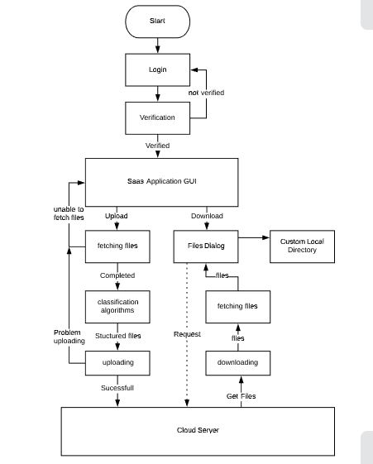
Methodology/Framework
Application Flow Chart

Slide 17
Implementation
A cloud-based application will be designed to provide great user experience and give user to access from anywhere. The development of the App required teamwork among pathologists and information technology professionals. The application will be developed over the course of four sprints. It was critical to allow web application to interface with the AI algorithm designed in python. Flask web framework was used to allow the application interface with the AI algorithm. The user credentials were encrypted using hash codes to eliminate the risk of electronic protected health information (ePHI) exposure. The intent was not to store any data on client site to mitigate privacy risk. The User data is stored encrypted in the database and the files are stored on the server memory. We will complete the development of the algorithm and the basic UI to test implementation of the algorithm. The application will be launched on a virtual cloud as soon as it is completed with all the user privileges and the final algorithm is completed. Currently algorithm is fully functional with classifying the files based on the file type and an additional feature is added which is user can also upload multiple files at one time.

Slide 18
Tools and Languages
Python 3.7.1
Flask 1.1.1
Werkzeug 0.15.5
Jinja2
Conda 4.5.12
SQLite DB
Sublime Text
PyCharm
Windows Command Prompt
FireFox Web Browser, Google Chrome
Laptops
Mobile Phones

Slide 19
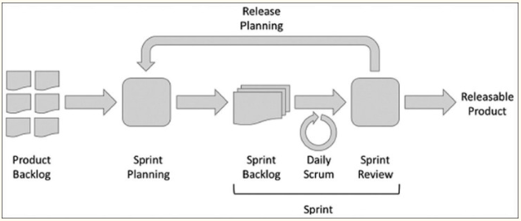
Developing Life Cycle
Sprint Planning: Sprint planning is an event in the Scrum framework where the team determines the product backlog items they will work on during that sprint and discusses their initial plan for completing those product backlog items.
Daily Scrum: In Scrum, on each day of a sprint, the team holds a daily scrum meeting called the daily scrum. Meetings are typically held in the same location and at the same time each day.

Slide 20
Conclusion
Main objective of this project is to make easier for the user to classify and organize the files with titles so that any file cannot be misplaced.
Application will be stimulated on local host and will give environment of real server with help Kubernetes ease to manage application with horizontal scalability, portability , load balancing , Intelligent Scheduling and health check.

Slide 21
References
Athens Cyber Park Paggaious & 1 Aggistis st. Athens, “Document Classification” (2018).
P. Mell and T. Grence, “The NIST definition of cloud computing”, Special Publication 800–145 (2011).
M. Rajendra Parsad, “International Journal of Cloud Computing and Services
Science (IJ-CLOSER)”, Vol.2, No.2, April 2013, pp. 134~140.
Steve Ranger, “Cloud Computing”, vol. 34, pp.8427-445, December 13, 2018.
Kgs Venkatesan, “Issue in Cloud Computing”, May 29, 2019.
Dennis Gannon, “Cloud Native Applications”, vol. 4, pp. 16-21, October 2017.
Abhay Goswami, “Why we need Docker?” Feb 21, 2019. Available online at: https://dev.to/abhay676/why-we-need-docker-4gdh.
Adari Girish Kumar, “The emergence of Containers: Diving into Docker”, May 1, 2017. Available online at: https://medium.com/@adari.girishkumar/the-emergence-of-containers-diving-into-docker-part-1.

Slide 22
References
Michelle Moore, “Guide to Container Security”, Oct 22, 2019. Available online at: https://www.tripwire.com/state-of-security/devops/guide-container-security/.
Yang X, Pan T, Shen J (2010) “On 3G mobile e-commerce platform based on cloud computing”, 3rd IEEE International Conference on Ubi-Media Computing.
Kohana M., Sakaji H., Kobayashi A., Okamoto S. (2019) “File Assignment Control for a Web System of Contents Categorization”, vol 11610, June 21, 2019.
Kester, Harold M., Hegli, Ronald B., Dimm, John Ross, Anderson, Mark Richard “System and method of monitoring and controlling application files”, Sept 14, 2010.
Bruhn, David M., Capitano, Douglas L., “Automated file acquisition, identification, extraction and transformation”, Oct 26, 2016.
Thomas Pisello, David Crossmier, Paul Ashton, “Network Management System having Virtual Catalog Overview of files distributive stored across Network Domain ”, Nov 11, 2016.

Slide 23
Question/Answer ?

