Slide 1
Matplotlib & Jupyter
9.27.24

Slide 2
Midterms
Required: Problem 1
You choose: Problems 2-4
Undergrads: choose 1 (or multiple and receive the highest grade)
Grads: choose 2 (or all three and receive the 2 highest grades)

Slide 3
Matplotlib
The most popular Python library for plotting data
Plots for line, surface, volumetric data etc.
https://matplotlib.org/stable/plot_types/index.html

Slide 4
Jupyter Notebook
“Computational Notebook” to organize code
Runs in-browser
Independently runnable code-blocks
Supports Markdown documentation
Inline figure/table creation

Slide 5
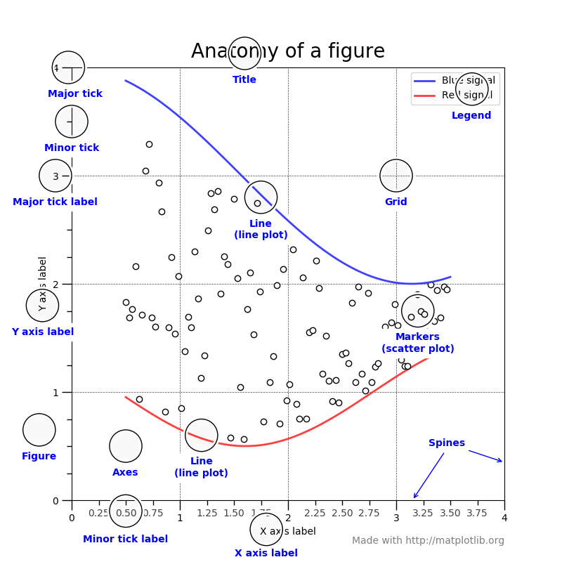
Plot Components

Slide 6
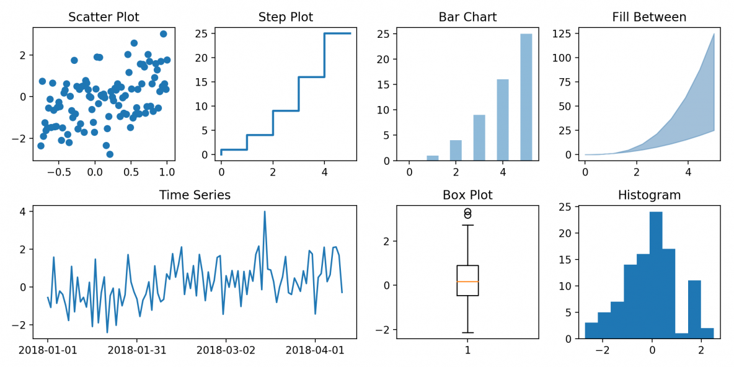
Chart Types

Slide 7
Onto Jupyter Demo….

