Slide 1
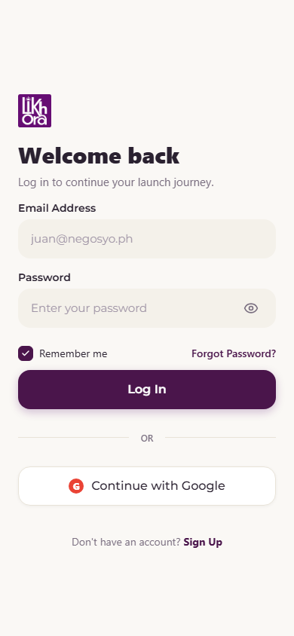
LIKHORA AI
A Business Launch Companion for Filipino Micro & Small Entrepreneurs
App Walkthrough · Module-by-Module Overview
Expo React Native · Supabase (Postgres + Edge Functions) · Firebase Auth · Claude (Anthropic) AI

Slide 2
SYSTEM OVERVIEW
How the App is Put Together
Client
Auth
Data
AI
Expo (React Native) app — file-based routing under src/app. Runs on iOS, Android, and Web from one codebase.
Firebase Authentication issues the session; AuthContext.tsx guards every protected route and tab.
Supabase Postgres holds profiles, roadmap tasks, products, notifications, templates & community posts, secured by row-level security.
Khora AI calls Anthropic Claude through a Supabase Edge Function — the API key never ships in the app bundle.
Data flow: Sign in → Firebase verifies → backend reads/writes Supabase → AI-powered screens call the khora-ai edge function → results render live in the app.
13 Core Modules
Auth
Onboarding
Dashboard
Roadmap
Khora AI
Suppliers
Community
Calculator
Templates
Notifications
Profile
Location (PSGC)
Password Reset
LIKHORA AI
02

Slide 3
MODULE 01 · ACCESS
Sign In & Authentication
Firebase Auth: Email/password and Google sign-in create the session; Supabase Auth issues the matching backend session.
Session guard: AuthContext.tsx watches auth state app-wide and redirects unauthenticated users straight to Login.
Password reset: In-app 6-digit code flow — code is generated, hashed, and verified server-side (no email link needed).
Persistence: "Remember me" keeps a returning user signed in across app restarts.
src/context/AuthContext.tsx · src/app/login.tsx
LIKHORA AI
03

Slide 4
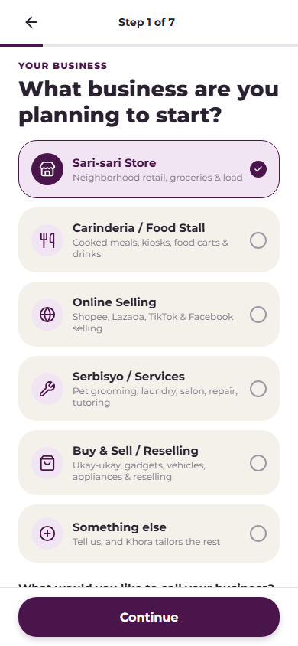
MODULE 02 · ONBOARDING
Business-Type-Aware Onboarding
5 built-in profiles: Sari-sari Store, Carinderia/Food Stall, Online Selling, Serbisyo/Services, Buy & Sell — each with its own risks, permits and roadmap.
"Something else": A custom trade (e.g. pet grooming, car wash) is sent to Khora AI, which generates the onboarding questions and roadmap on the fly.
7-step wizard: Business → Stage → Location → Market → Money → Legal → Risks, each step saved as the user progresses.
src/services/businessProfiles.ts · src/services/onboardingAdvisor.ts
LIKHORA AI
04

Slide 5
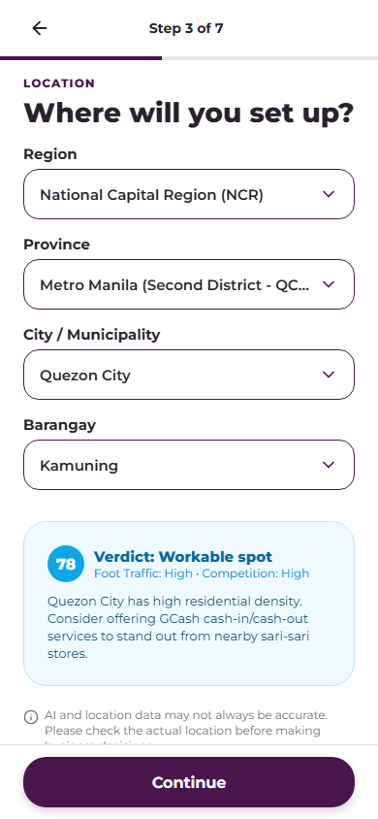
MODULE 02 · ONBOARDING
Philippine Geographic Selector
PSGC API: Live cascading dropdowns for Region → Province → City/Municipality → Barangay, covering 17 regions and 1,600+ municipalities.
Offline fallback: A bundled dataset keeps onboarding usable even if the PSGC API is unreachable.
Instant AI read: As soon as a city is picked, Khora AI returns a location verdict — foot traffic, competition, and a tailored tip — before the user even continues.
src/services/location.ts
LIKHORA AI
05

Slide 6
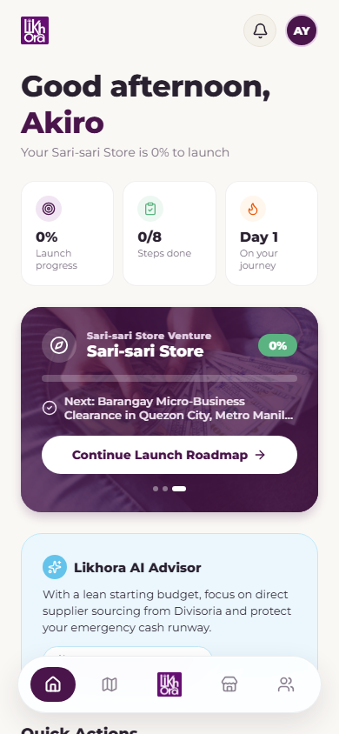
MODULE 03 · HOME
Dashboard
Launch progress: Live percentage complete, steps done, and "Day N" since account creation, computed from the roadmap in Supabase.
Continue Launch Roadmap: One tap resumes exactly where the founder left off — the next locked or in-progress step.
Likhora AI Advisor card: A short, personalized nudge (budget-aware, risk-aware) generated for the active business profile.
src/app/(tabs)/index.tsx
LIKHORA AI
06

Slide 7
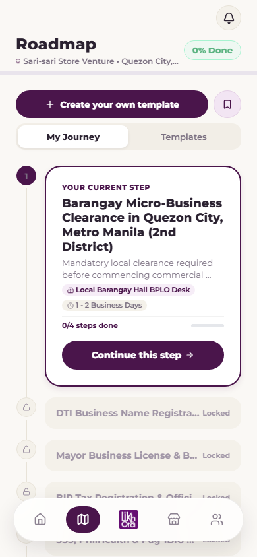
MODULE 04 · ROADMAP
Business Roadmap (Full CRUD)
Create: Add custom tasks — title, category (Finance / Legal / Marketing), description, and checklist sub-steps.
Read: Real-time rendering of the user's roadmap with automatic completion-percentage calculation.
Update: Toggle status (Pending → In Progress → Completed) and tick individual sub-steps.
Delete: Remove a task with a confirmation prompt; completing a task fires a milestone notification.
fetchUserRoadmapFromSupabase · createRoadmapTaskInSupabase · updateRoadmapTaskInSupabase
LIKHORA AI
07

Slide 8
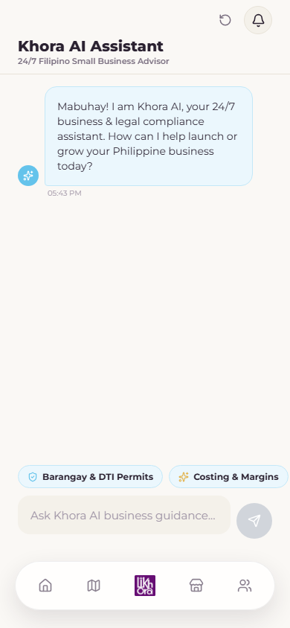
MODULE 05 · AI ADVISOR
Khora AI Assistant
24/7 chat advisor: Answers permit, legal-compliance, marketing and financial questions for Philippine MSMEs, in plain English/Taglish.
Quick-ask chips: One-tap prompts like "Barangay & DTI Permits" or "Costing & Margins" for common questions.
Server-side model: Claude runs behind a Supabase Edge Function — the Anthropic key, model choice and token ceiling are fixed server-side, never in the app bundle.
src/services/claude.ts · supabase/functions/khora-ai/
LIKHORA AI
08

Slide 9
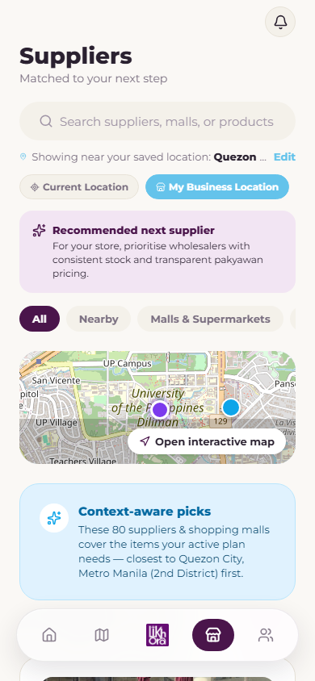
MODULE 06 · SOURCING
Wholesale Supplier & Market Finder
OpenStreetMap Overpass API: Locates verified markets, malls, supermarkets and wholesale vendors within a 15 km radius.
Haversine sorting: Distances are computed in real kilometers and results are sorted nearest-first.
AI-targeted categories: Khora AI decides which supplier categories this specific business needs, and the search phrases that find them.
Interactive map & filters: Category chips, search bar, Leaflet map with custom markers, and one-tap "Contact" via the tel: scheme.
src/services/supplierAdvisor.ts
LIKHORA AI
09

Slide 10
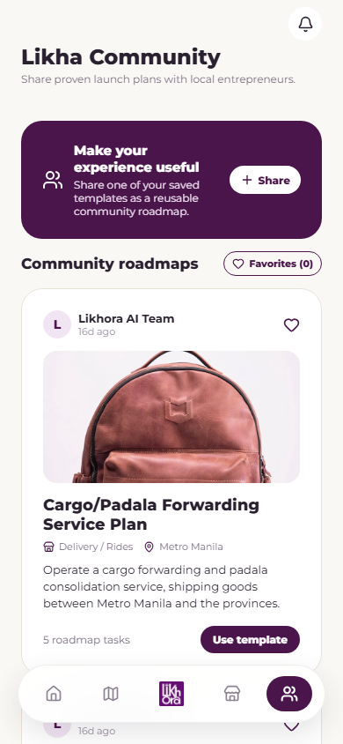
MODULE 07 · COMMUNITY
Likha Community Template Marketplace
Publish: Founders turn a completed roadmap into a public, reusable template for others to launch from.
Browse & import: Feed of founder-made and Likhora-AI-authored templates, each with roadmap task counts and business context.
Favorites: Bookmark templates to revisit later without losing the current active roadmap.
public.community_posts · public.community_template_favorites
LIKHORA AI
10

Slide 11
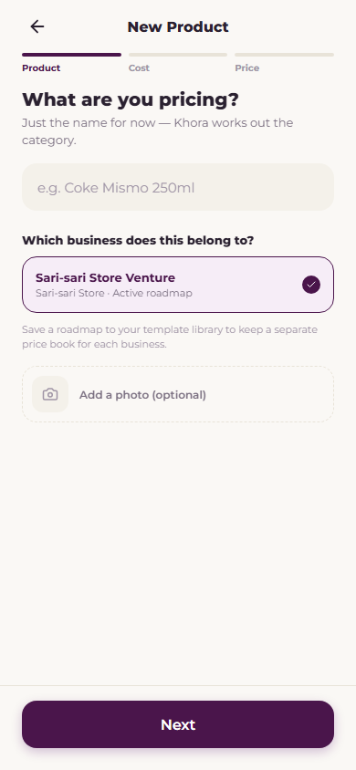
MODULE 08 · PRICING
Smart Calculator — AI Pricing & Break-Even
AI-decided pricing: The user enters only the product name, purchase unit and cost; Khora AI infers the category, markup, and selling price with a plain-English explanation.
Derived portioning: Bulk buys (kilos, packs, cases) are converted into a piece count automatically — never guessed.
Profit & ROI: Profit per piece, margin, effective markup, batch capital, and units-to-recover-capital, all computed live.
Price Book: Full CRUD on products with Supabase Storage photos, category filters and sorting.
src/services/pricingAdvisor.ts · src/services/calculator.ts
LIKHORA AI
11

Slide 12
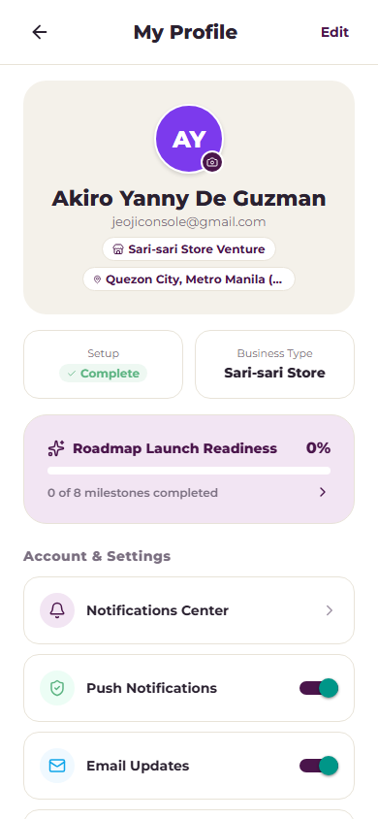
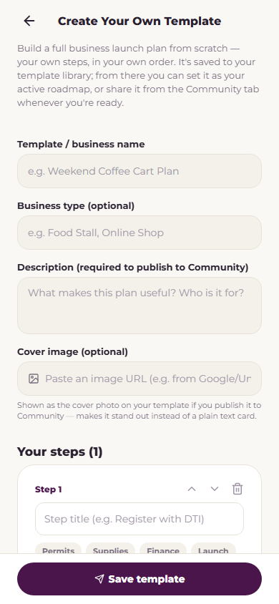
MODULE 09 & 10 · LIBRARY AND ACCOUNT
Template Library & Founder Profile
Create Your Own Template
8 pre-built startup roadmaps ship in-app, each with real Philippine agencies, legal bases, fees and required documents.
Custom builder lets a founder define their own steps, categories, and checklists, saved to My Templates and optionally published to Community.
LIKHORA AI
12

Slide 13
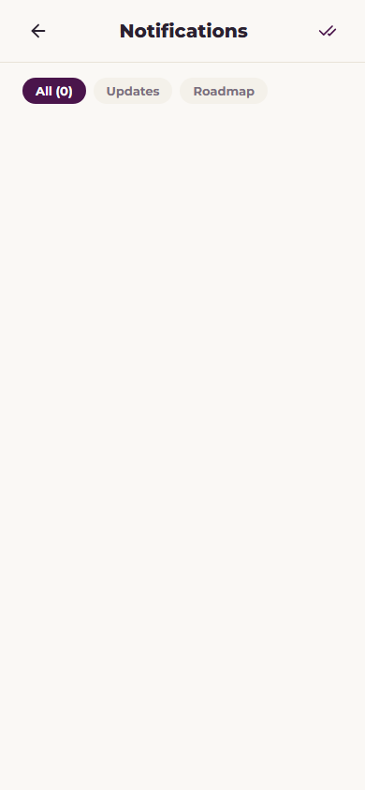
MODULE 11 & 12 · ACCOUNT AND ALERTS
Profile, Milestones & Notifications
Founder profile: Business title, industry, capital tier, location and launch date, stored in public.profiles.
Launch readiness: "X of 8 milestones completed" score surfaces directly on the profile screen.
Notification Center: Automated milestone alerts fire when a roadmap task is completed, with unread badges and mark-all-as-read.
Profile photos: Uploaded to Supabase Storage and shown on the dashboard and community posts.
NotificationContext.tsx · public.notifications
LIKHORA AI
13

Slide 14
Salamat!
Likhora AI — helping Filipino entrepreneurs go from idea to launch.

