Slide 1
Spectrometry_Gamma a new Module for the
EduGATE Project
Uwe Pietrzyk & Michaela Gaens
Institute of Neurosciences and Medicine (INM), Research Center Juelich, Germany
Department of Mathematics and Natural Sciences, University of Wuppertal, Germany
(Paper → „Zeitschrift für Medizinische Physik“ / Z. Med. Phys. 23 (2013) 65-70)

Slide 2
Long is the way of theory,
short and effective by examples –
(Lucius Annaeus Seneca (the Younger),
Epistulae morales)

Slide 3
Using GATE to Educate → EduGATE
Aim: Provide insights into Physics of Medical Imaging
Means: Provide a collection of very basic and simple GATE macros
Simple Detector setups, but variable Materials
Selection of Physical Processes
Easy switching between Sources of different Types
  Ion sources (General Particle Source)
  Gamma source
  Electron or Positron source
Provide a simple Analysis Module for ROOT
Coincidence Channel (→Coin_Chan)
Gamma Camera (→ Gamma_Camera)

Slide 4
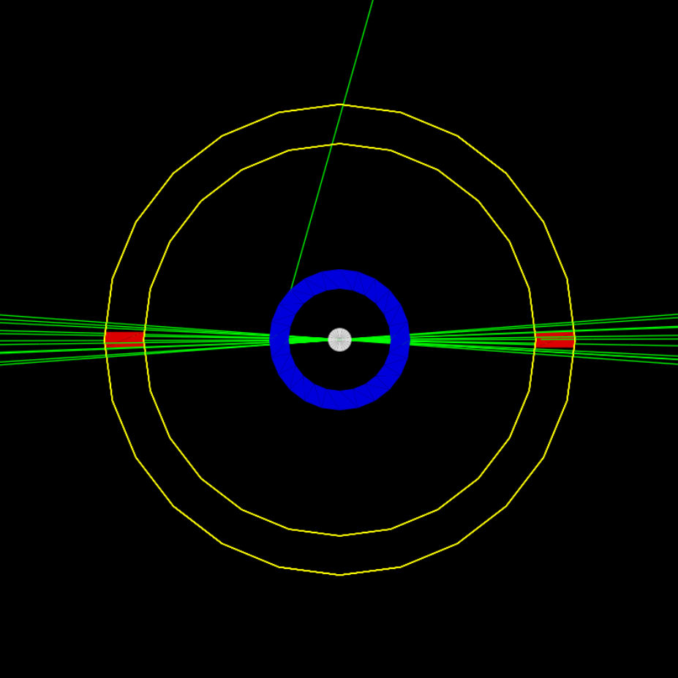
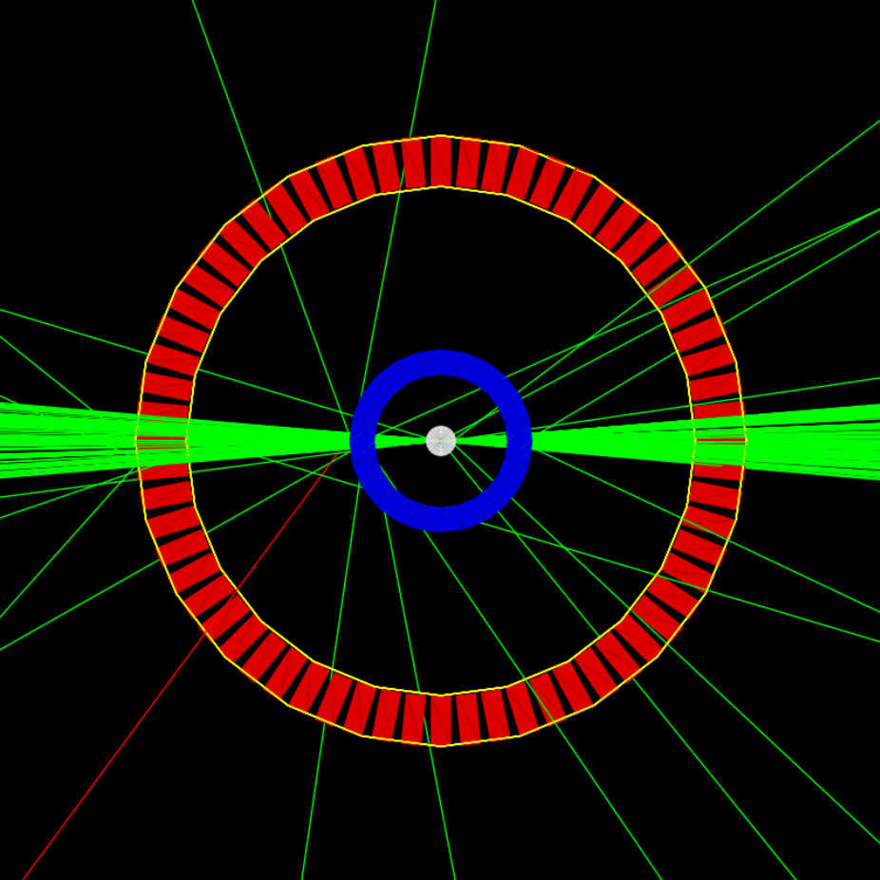
Basic Coincidence Channel
Full Detector Ring

Slide 5
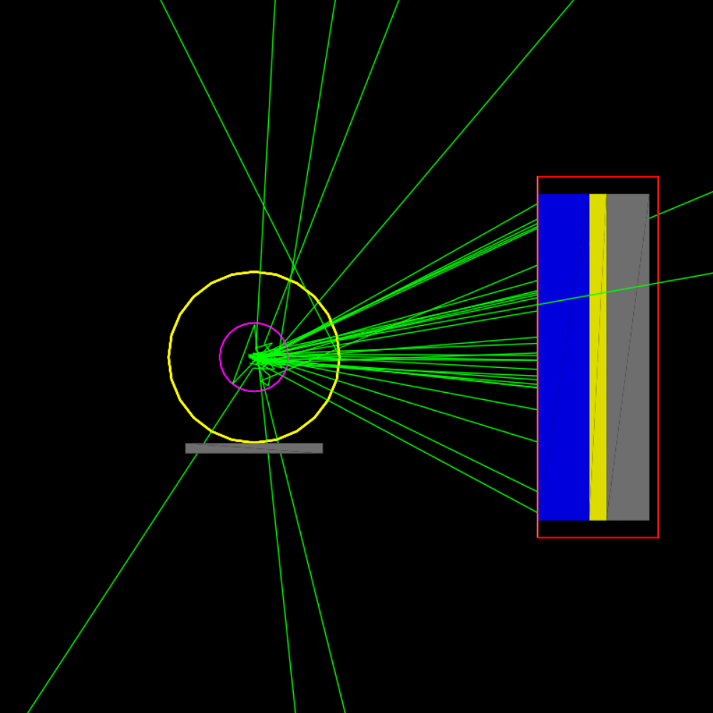
Planar Gamma
Camera System
Left : Magenta: cylindrical Phantom & Source, Yellow: hollow cylinder serving as
attenuating material of various types,
Right: Head – Blue: Collimator – Yellow: Crystal, Grey: Back-compartment

Slide 6
Using GATE to Educate → EduGATE
Aim: Provide insights into Physics of Medical Imaging
Means: Provide a collection of very basic and simple GATE macros
Simple Detector setups, but variable Materials
Selection of Physical Processes
Easy switching between Sources of different Types
  Ion sources (General Particle Source)
  Gamma source
  Electron or Positron source
Provide a simple Analysis Module for ROOT
Two New Examples:
1) Acquisition and
Reconstruction
SPECT_to_Reco
2) Isotope Spectrometer
→ Spectro
Coincidence Channel (→Coin_Chan)
Gamma Camera (→ Gamma_Camera)

Slide 7
SPECT-to-Reco
  SPECT – Rotating HEAD
  Store data as Projections
  Display with Fiji / ImageJ
  Reconstruct with FBP and Iterative Methods in IDL/GDL (or ROOT)
  Display with Fiji / ImageJ
  All Code and READMEs provided!!

Slide 8
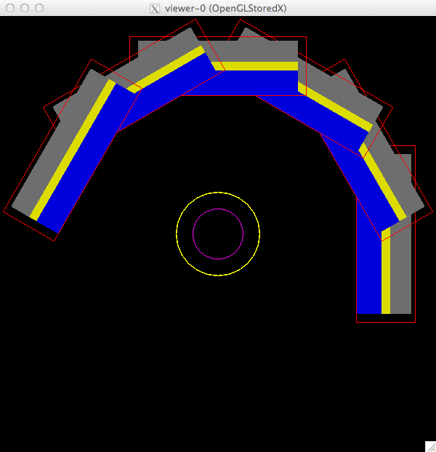
#
## File: Readme_Intro.txt
#
Description of EduGATE module: SPECT_to_Reco
--------------------------------------------
* Intro *
There are three main aspects, which are demonstrated to the interested user:
Running a "Gamma_Camera" in SPECT-mode, acquiring 60 projections covering 180°
The setup relates closely to the Gamma_Camera example of the
EduGATE-collection
2) produce basic output like energy spectra with "root“
3) Use the provided IDL/GDL modules to reconstruct images, either
with filtered backprojection or with an iterative approach
4) Use Fiji (or ImageJ) to inspect
a) the acquired projections
b) reconstructed images
……………………………………………………………
additional information or readme-files for parts 1 to 4
part1: start with config_starter.sh (needs probably to be adapted to the individual environment
part2: ROOT-analysis; this is automatically started, when GATE has completed
part3: Readme_reco_demo_idl_gdl
idl (Interactive Data Language) or gdl (GNUDataLanguage) can be used with the supplied "pro"-files.
part4: Readme_reco_demo_Fiji.txt

Slide 9
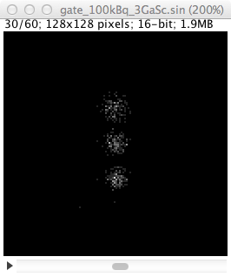
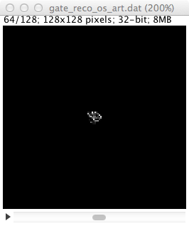
Display via Fiji:
Projections and Reconstruction

Slide 10
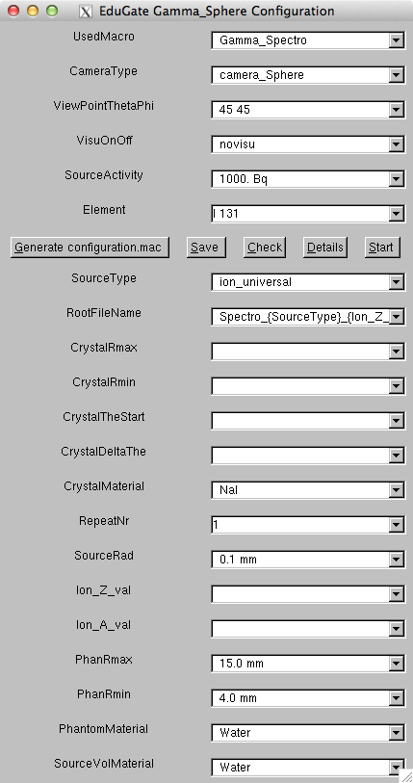
Isotope Selection
Data Taken from File →
GEANT4-DataBase:
RadioactiveDecay3.3
Isotope-Spectrometer:
→ Spectro

Slide 11
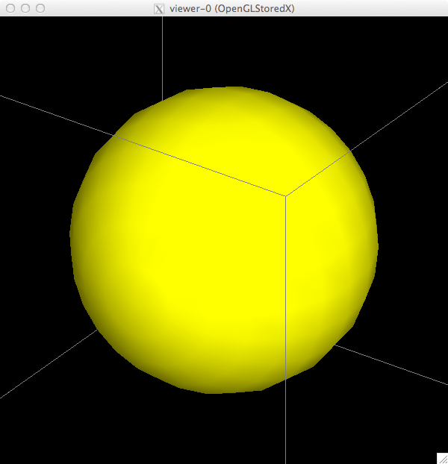
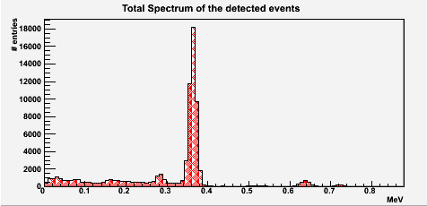
Sphere
Homogeneous or
N-Wedges
(N = 2, 4, .. 36, 360)

Slide 12
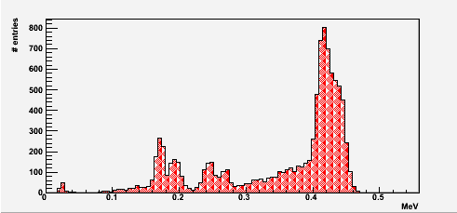
Sphere with ¹¹¹In

Slide 13
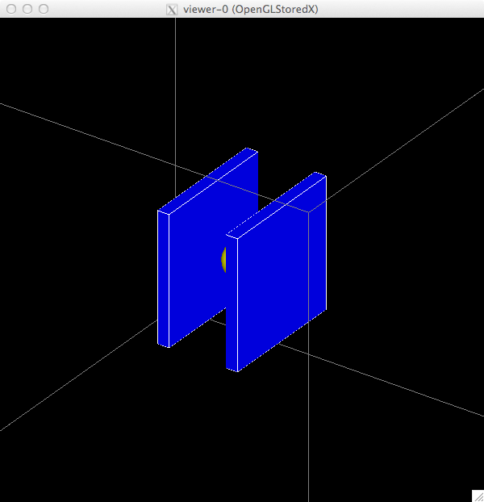
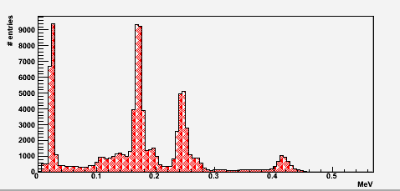
Two Heads with ¹¹¹In
Coincident Gammas
Resolved !!
Sphere with ¹¹¹In
Coincident Gammas
→ Summed Peak !!

