Slide 1
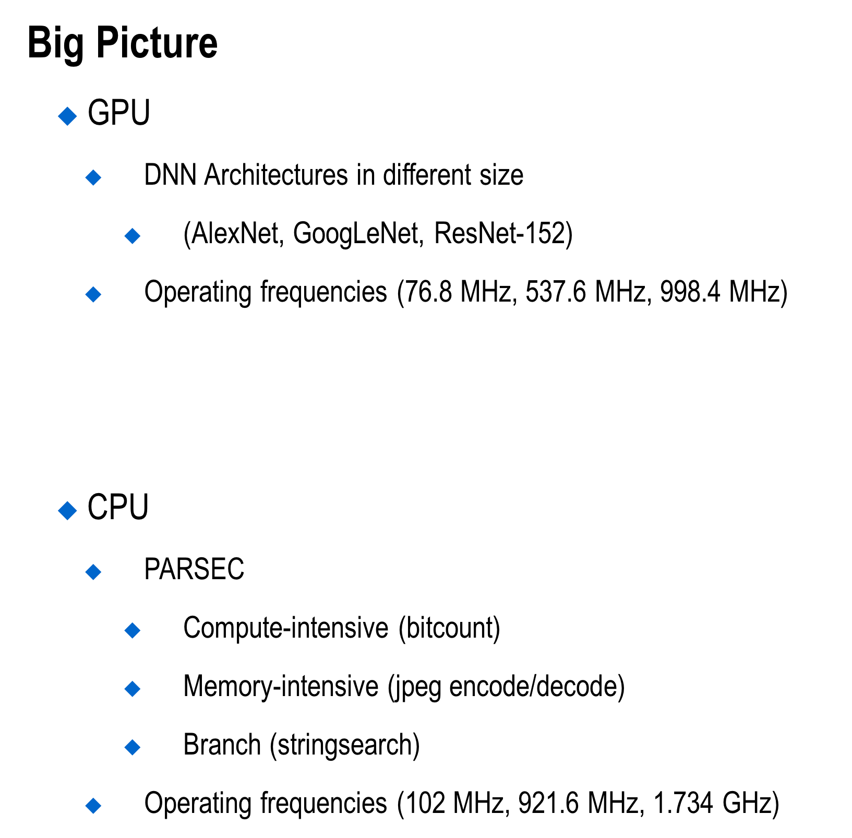
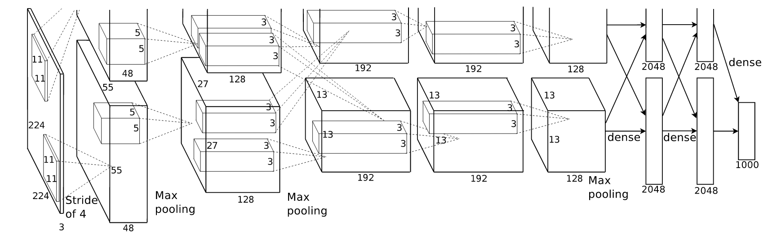
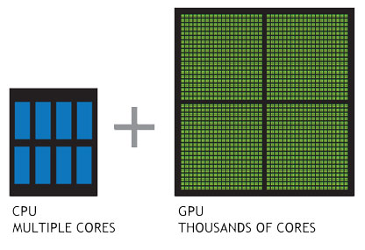
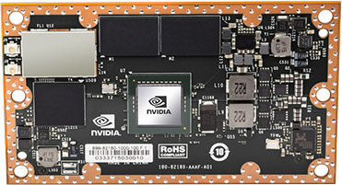
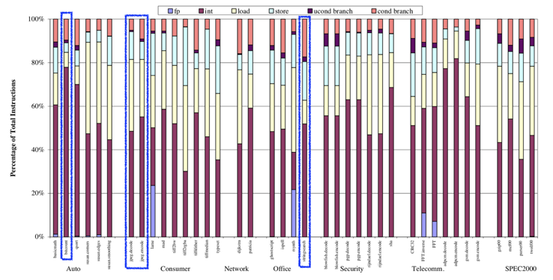
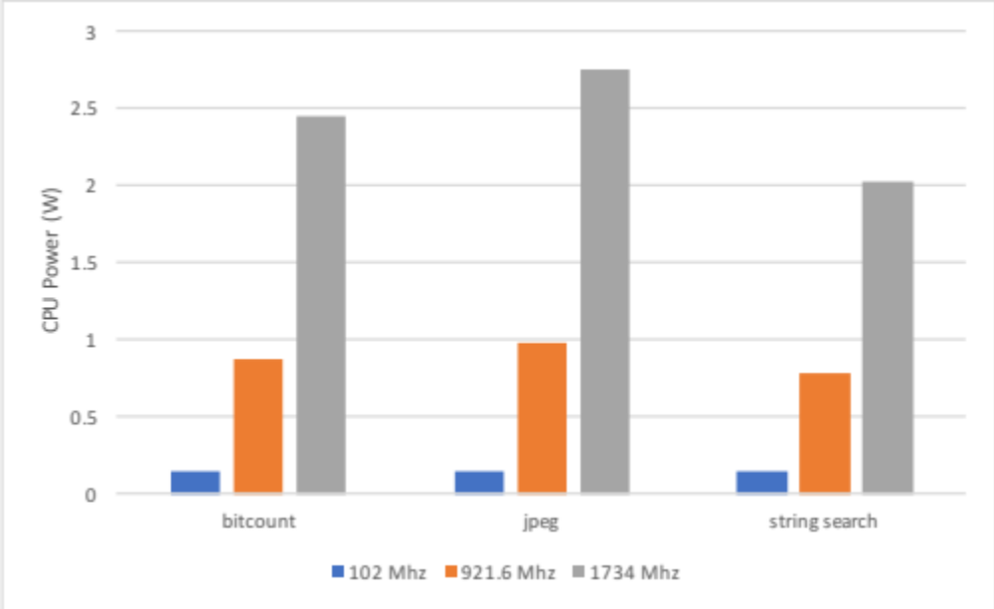
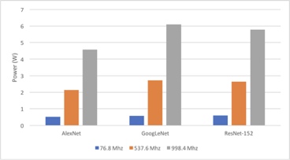
ECE 18-743 Poster Session
December 2017
Power/Performance Analysis and Optimization for Deep Learning on a CPU-GPU Platform Ahmet Fatih Inci, Ting-Wu (Rudy) Chin
1. Goals
2. System Overview
Objectives
  Understanding what is left to be done on CPU while performing inference on DNNs by using GPU
  Characterizing different DNN architectures on GPU and finding suitable benchmarks for CPU to utilize available resources under power/performance constraints
NVIDIA Jetson TX1
3. Baseline Results
4. Results
Details
  CPU
    XXXX
  GPU
Plots
Summary
  Our comprehensive analysis (81 results with different configurations) show us that
    XXXXX

