Slide 1

Logical Vulnerabilities in Windows
Michał Bazyli afine.com

Slide 2
Arbitrary File *.
File system bugs.

Slide 3
Techniques and Stuff
•Object manager symbolic links
•Directory Junctions
• Opportunistic Locks
• Combinations
• Exploitation
• Demo

Slide 4
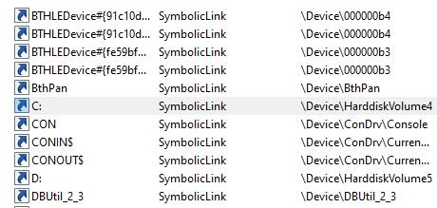
Object manager symbolic links

Slide 5
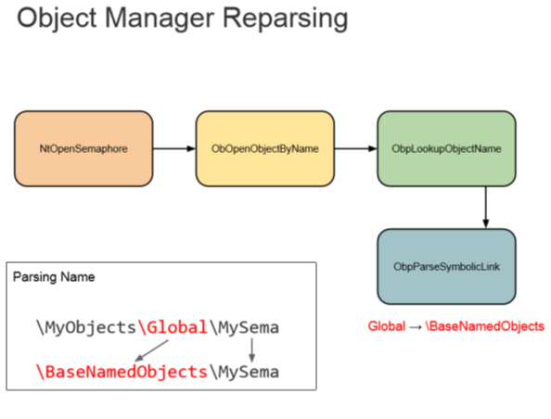
https://infocon.org/cons/SyScan/SyScan%202015%20Singapore/SyScan%202015%20Singapore%20presentations/SyScan15%20James%20Forshaw%20-%20A%20Link%20to%20the%20Past.pdf

Slide 6
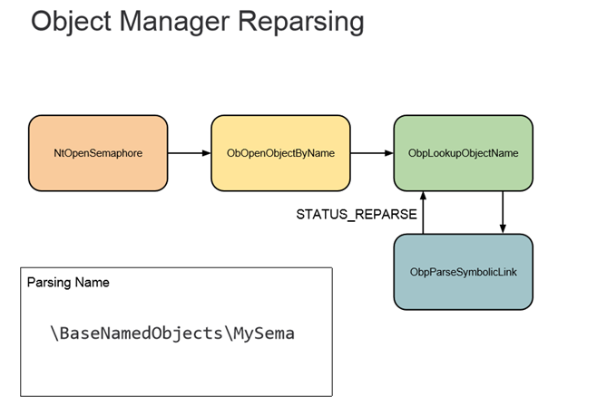
https://infocon.org/cons/SyScan/SyScan%202015%20Singapore/SyScan%202015%20Singapore%20presentations/SyScan15%20James%20Forshaw%20-%20A%20Link%20to%20the%20Past.pdf

Slide 7
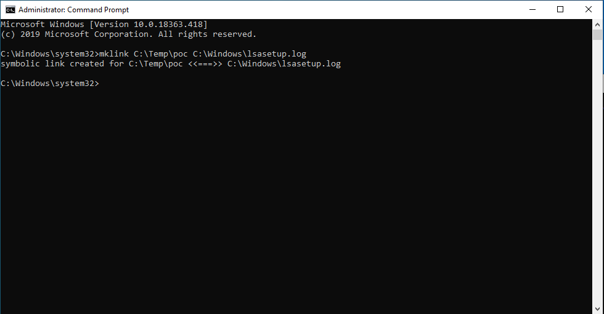

Slide 8
Directory Junctions

Slide 9
https://infocon.org/cons/SyScan/SyScan%202015%20Singapore/SyScan%202015%20Singapore%20presentations/SyScan15%20James%20Forshaw%20-%20A%20Link%20to%20the%20Past.pdf

Slide 10
https://infocon.org/cons/SyScan/SyScan%202015%20Singapore/SyScan%202015%20Singapore%20presentations/SyScan15%20James%20Forshaw%20-%20A%20Link%20to%20the%20Past.pdf

Slide 11
https://infocon.org/cons/SyScan/SyScan%202015%20Singapore/SyScan%202015%20Singapore%20presentations/SyScan15%20James%20Forshaw%20-%20A%20Link%20to%20the%20Past.pdf

Slide 12
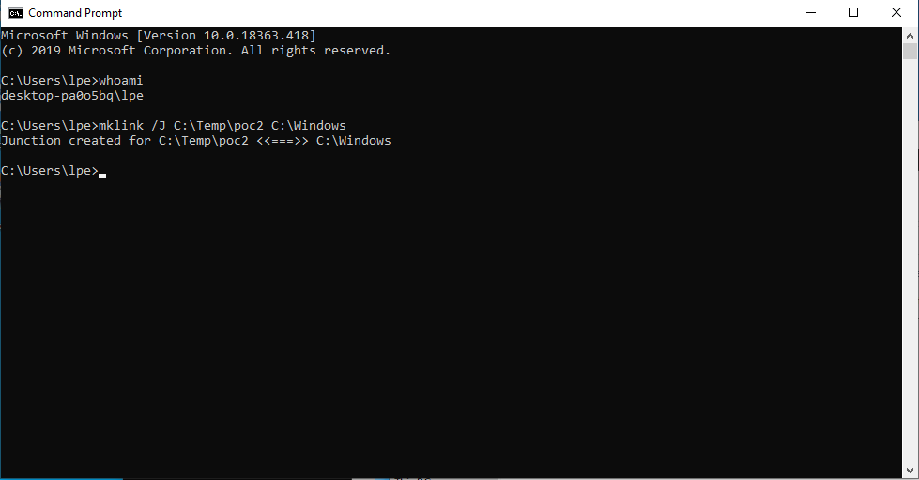

Slide 13
Symbolic links without permissions

Slide 14
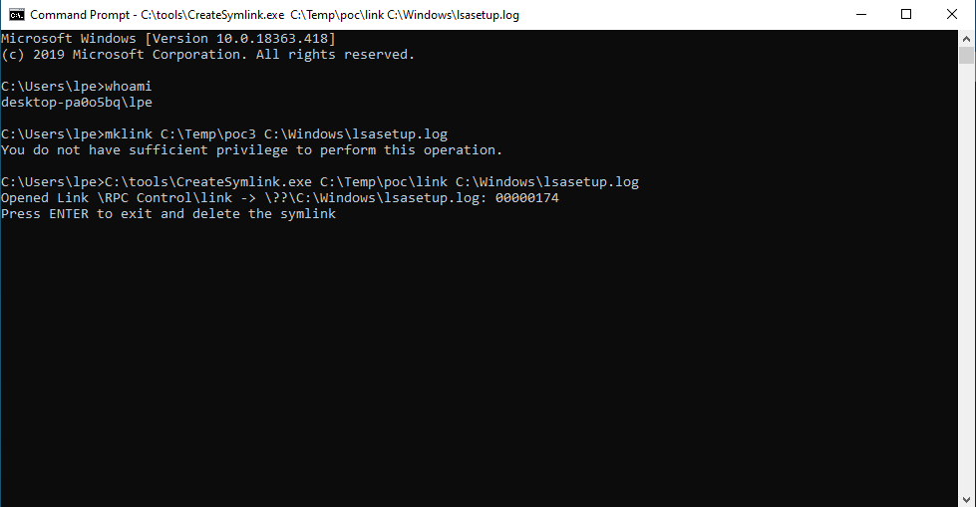

Slide 15
https://infocon.org/cons/SyScan/SyScan%202015%20Singapore/SyScan%202015%20Singapore%20presentations/SyScan15%20James%20Forshaw%20-%20A%20Link%20to%20the%20Past.pdf

Slide 16
https://infocon.org/cons/SyScan/SyScan%202015%20Singapore/SyScan%202015%20Singapore%20presentations/SyScan15%20James%20Forshaw%20-%20A%20Link%20to%20the%20Past.pdf

Slide 18
OpLock

Slide 19
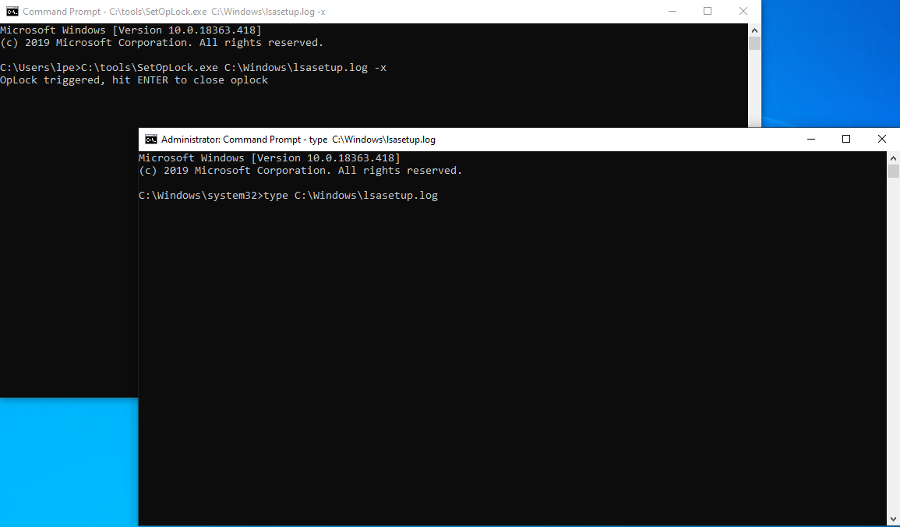

Slide 20
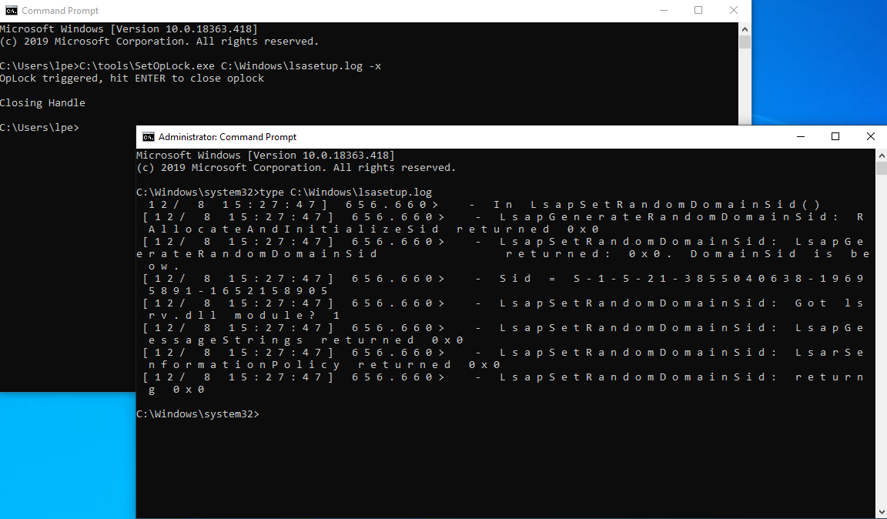

Slide 21
Exploitation

Slide 22
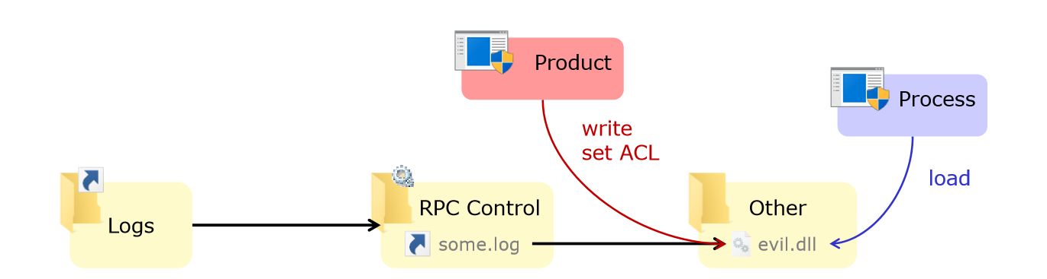
Arbitrary file write
C:\ProgramData\Product\Logs\some.log resolves to C:\Other\evil.dll
https://troopers.de/downloads/troopers19/TROOPERS19_AD_Abusing_privileged_file_operations.pdf

Slide 23
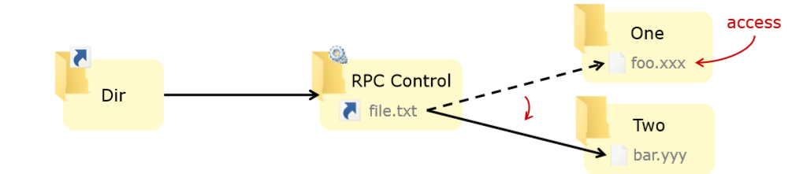
Winning the TOCTOU race
• C:\Dir\file.txt resolves to C:\One\foo.xxx then to C:\Two\bar.yyy
https://troopers.de/downloads/troopers19/TROOPERS19_AD_Abusing_privileged_file_operations.pdf

Slide 24
Tools

Slide 25
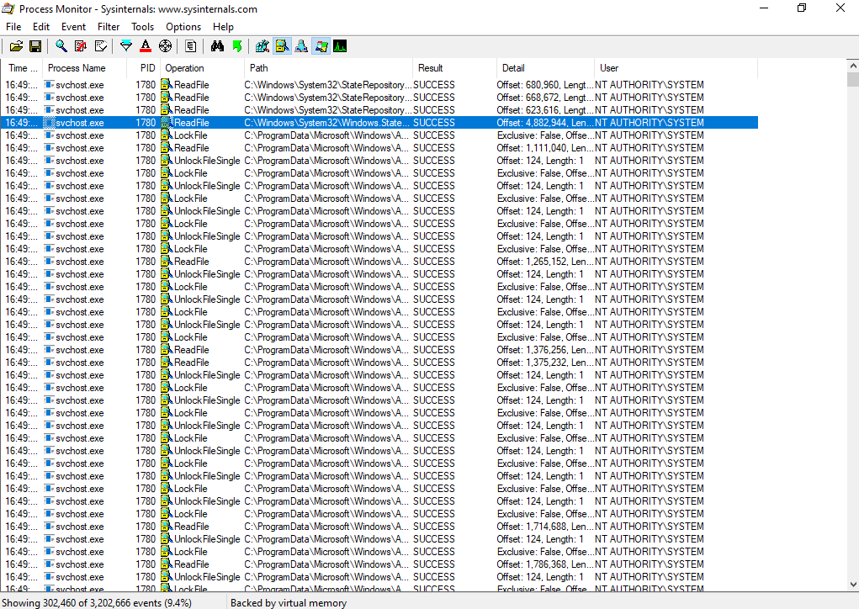

Slide 26
!!Demo!!

Slide 27
References
https://googleprojectzero.blogspot.com/2015/08/windows-10hh-symbolic-link-mitigations.html
https://googleprojectzero.blogspot.com/2015/12/between-rock-and-hard-link.html
https://troopers.de/downloads/troopers19/TROOPERS19_AD_Abusing_privileged_file_operations.pdf
https://infocon.org/cons/SyScan/SyScan%202015%20Singapore/SyScan%202015%20Singapore%20presentations/SyScan15%20James%20Forshaw%20-%20A%20Link%20to%20the%20Past.pdf

