Slide 1

Data Visualization 14 August 2024 Introduction to R

Slide 2
Objective
Understand why we need data visualization
Principles of data visualization
Identify types of data visualization/figures
Acquire skills to perform data visualization

Slide 3

Materials
https://github.com/afiqamsyar90/data_visualisation

Slide 4
Necessary
R software
R Studio / POSIT Cloud
Data sets
Good to go.
p/s don’t worry about the scripts/codes…

Slide 5
Workflow
Theory
Understand about visualization
Demo
Get your hand dirty

Slide 6
What is Data Visualization
Graphical representation of information and data.
Provide an accessible way to see and understand trends, outliers, and patterns in data
Analyze massive amounts of information and make data-driven decisions.
Notes:
Data visualization is • … the graphical representation of information and data. • This is done using visual elements like charts, graphs, and maps •
Data visualization tools provide an accessible way to see and understand trends, outliers, and patterns in data.
• Objective: data visualization tools and technologies are used to analyze massive amounts of information and make data-driven decisions.

Slide 7
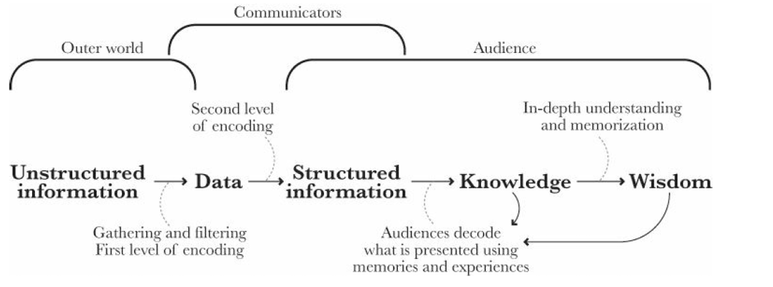
How to visualize?
Source: Alberto Cairo. The Functional Art

Slide 8
Good and Clear Graphics
Data
Substance rather than about methodology, graphic design, the technology of graphic production or something else
No distortion to what the data has to say
Presence of many numbers in a small space
Coherence for large data sets
Encourage the eye to compare different pieces of data
Reveal the data at several levels of detail, from a broad overview to the fine structure
Serve a reasonably clear purpose: description, exploration, tabulation or decoration
Be closely integrated with the statistical and verbal descriptions of a data set.

Slide 9
Graphics packages in R
graphics : a base R package
ggplot2 : a user-contributed package by Hadley Wickham
lattice : a user-contributed package
survminer::ggsurvlot
sjPlot

Slide 10
Answer the questions..
Which variable or variables do I want to plot?
What is (or are) the type of that variable?
Are they factor (categorical) variables ?
Are they numerical variables?
Am I going to plot
a single variable?
two variables together?
three variables together?

Slide 11
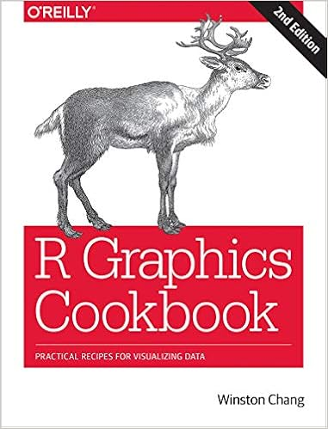


Slide 12
Demonstration

