Slide 1
Kivy環境によるロコモ年齢測定システムのモバイルアプリ開発
宮崎大学情報システム工学部
片山徹郎研究室
67200577 アフィク

Slide 2
目次
背景と目的
全体構造
準備
アプリ
まとめ
今後の課題

Slide 3
背景
ロコモとはロコモティブシンドロームの略称であり、運動器症候群のことである。人間は加齢と共に移動機能を低下するが，その低下のペースは平均より顕著に早い場合，ロコモ発症の可能性があり，移動機能に障害が生じ，介護や支援が必要となることがある．2007年日本整形外科学会がロコモの概念を提唱し、人間の基礎移動機能（立ち上がる機能や歩く機能）の低下の早期予防を促している。
＃pendekkan sikit intro

Slide 4
背景
ロコモ早期対応の意義
ロコモの検証方法
健康寿命の延伸
質の高い老後生活
医療・介護負担の軽減
立ち上がりテスト
２ステップテスト
ロコモ25（アンケート）

Slide 5
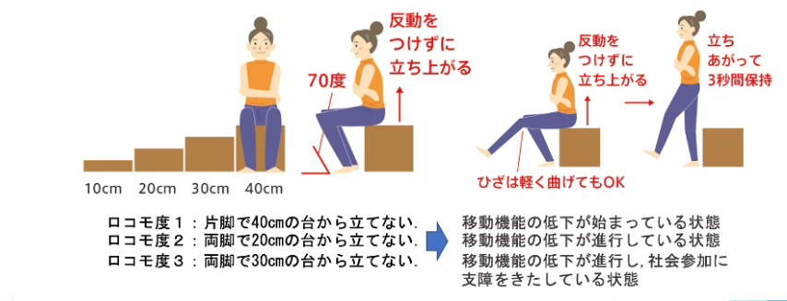
背景
立ち上がりテスト

Slide 6
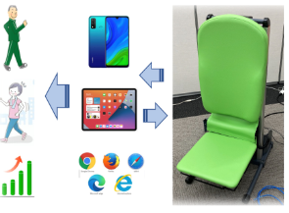
既存システムの構造構造
Must be moved by hand
Result also must be calculated by hand

Slide 7
目的、手法、結果
アプリによるシステムの単純化と自動化だれでも使えるようにする
Kivyアプリを利用してモバイルアプリ開発を行った

Slide 8
言語と環境
Python
将来データをAIに活用するため
Kivy
スマートフォンアプリ開発環境
Buildozer
Kivyで開発されたアプリをAPK（アンドロイド・パッケージ）化にする

Slide 9
アプリの流れ

Slide 10
アプリの流れ

Slide 11
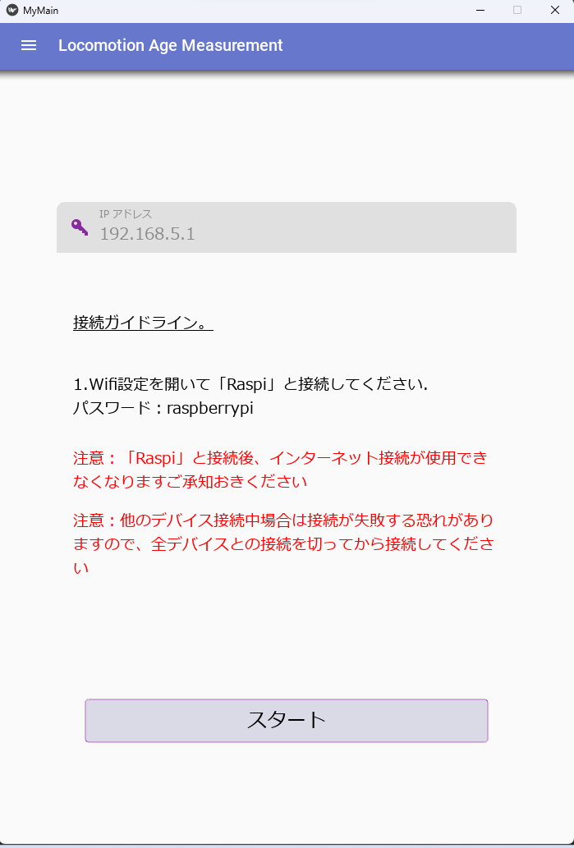
アドレス画面(Address Window）
Connection window where you put the IP address of the server into the text field and will connect
Inserted with it the guidelines in case the user fails to connect to the server successfully

Slide 12
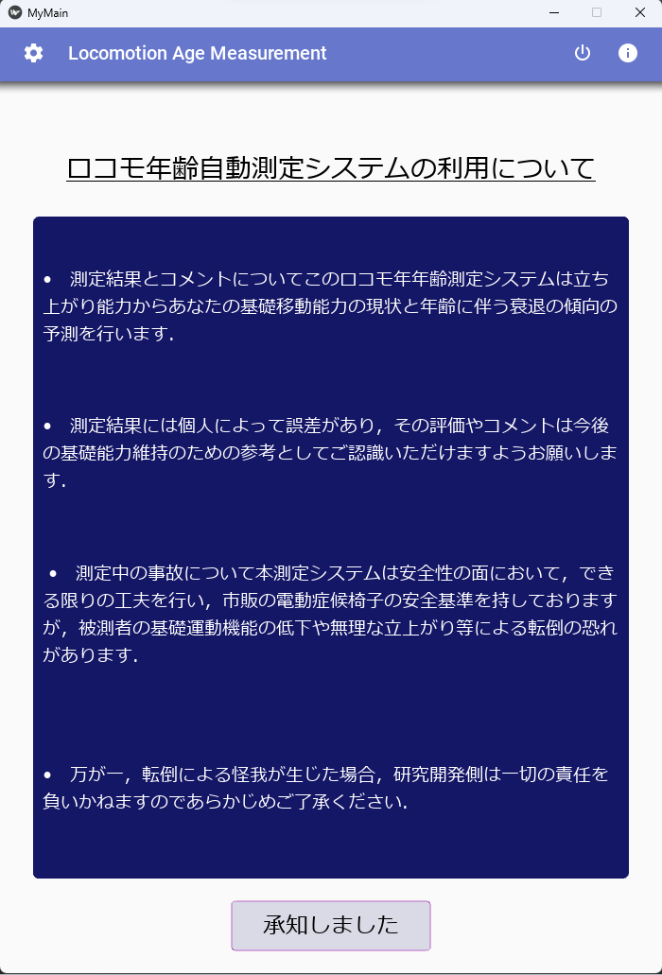
タイトル画面(Title Window）
Explaining about the whole system that the application will provide service
You can access multiple screens from here
Explanation screen
Maintenance screen a
And the shutdown button(shutdown button and application will end)
A popup window will appear in case the user accidentally press the shutdown button to prevent accidental shutdown

Slide 13
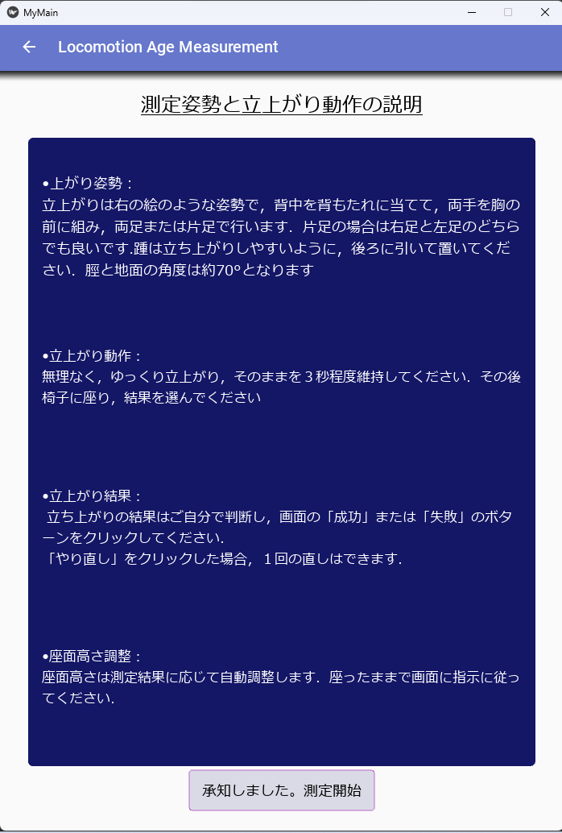
説明画面(Explanation Window）
This screen will explain the flow of the test and what is expected from the user

Slide 14
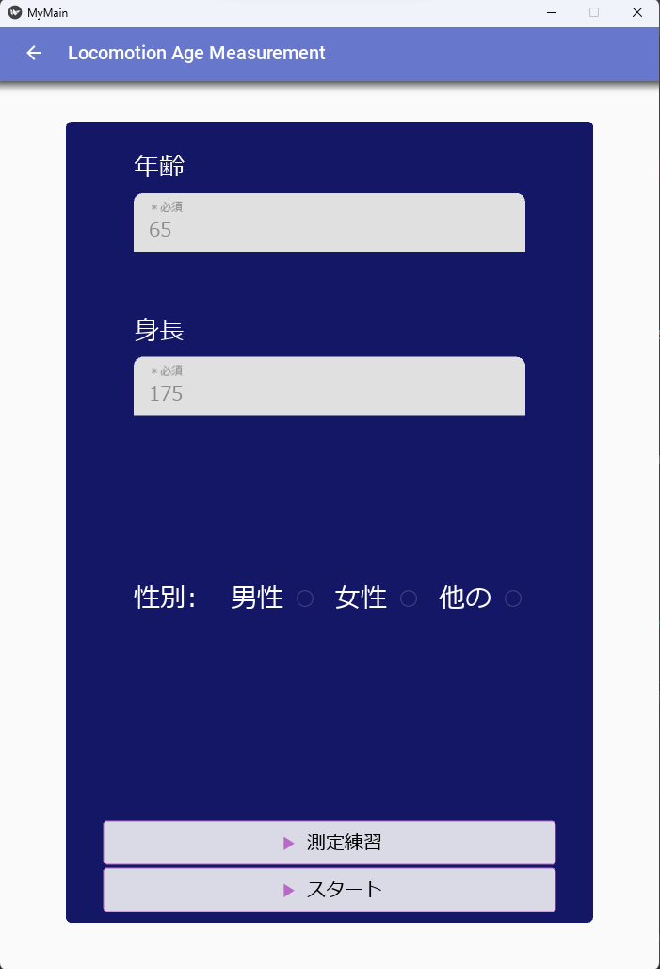
入力画面(Input Window）
User will input their height and age so that system can provide appropriate measurements that will cater to the user based on the metrics inputted
For the gender button it is still yet to be implemented, because the calculations involved does not require the metrics, “gender”
User can either take the test straight away of practice first until they are confident before taking the test
The textfield will be highlighted in the case of inappropriate values are inputted and and error message will appear.
For the time being the range for age is (15-95)
For height it is 90cm-200cm

Slide 15
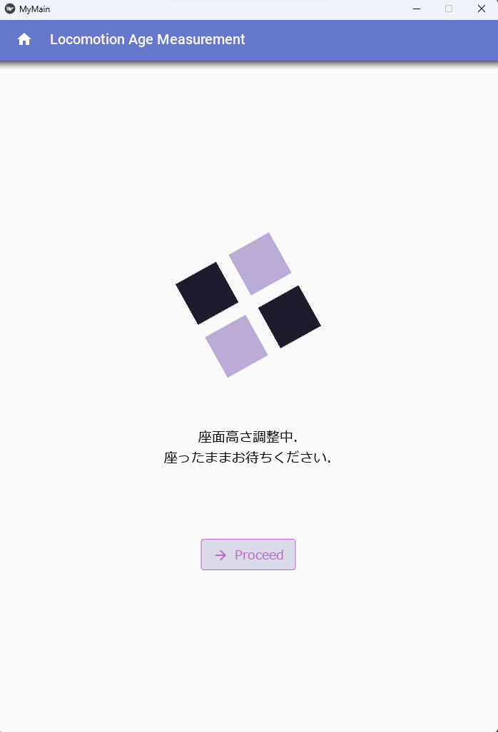
ローディング画面(Loading Window）
Basically, the loading window while waiting for the chair to move to the calculated height
User cannot move to another screen while the chair is moving
In the case of error while the chair is moving, A popup window will appear and bring the user back to the input screen
A thread process is used to separate between the GUI and the daemon process as not to interrupt one another

Slide 16
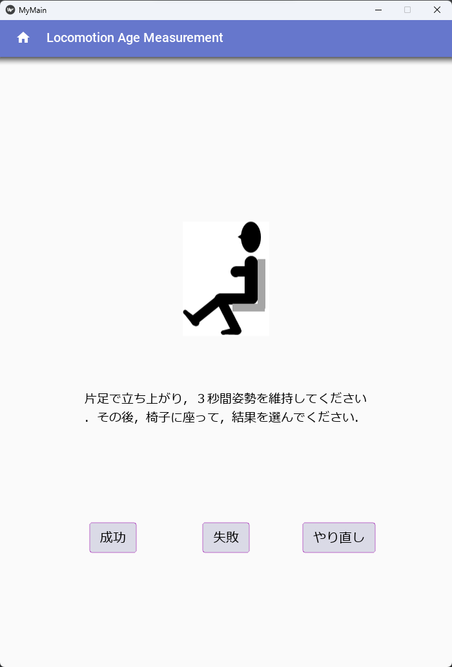
テスト画面(Test Window）
This window will guide the user on what to do during the test , a clear picture and instruction is provided.
User must choose between either they fail or pass the current test so that they can proceed to the next stage of the test
The retry button will change the text and guide the user in case they want to retry the current stage of the test
Number of retries will not affect the results for test as of now

Slide 17
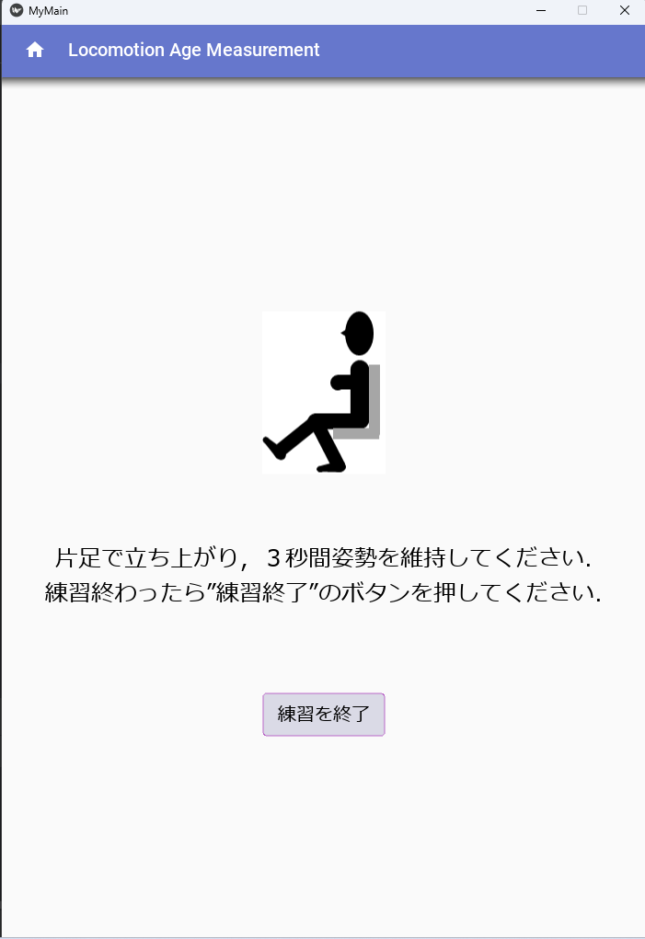
練習画面(Practice Window）
This window will guide the user on what to do during the test , a clear picture and instruction is provided.
User must choose between either they fail or pass the current test so that they can proceed to the next stage of the test
The retry button will change the text and guide the user in case they want to retry the current stage of the test
Number of retries will not affect the results for test as of now

Slide 18
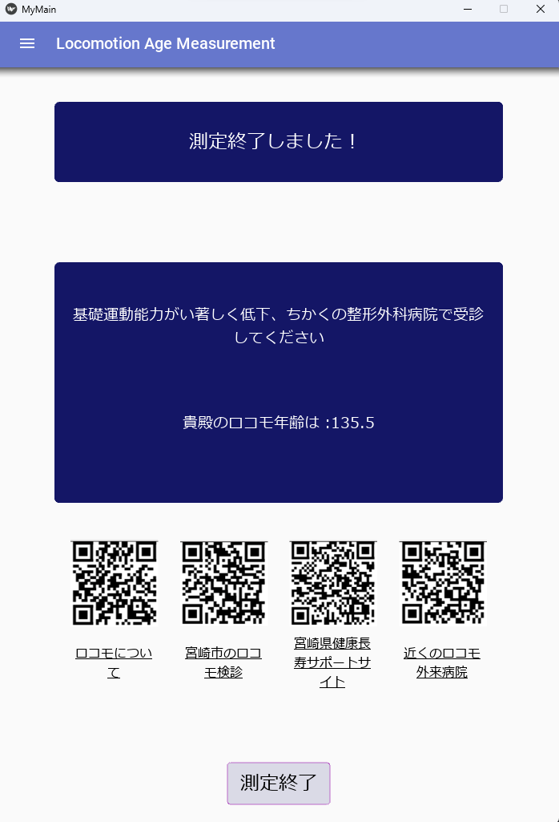
結果画面(Result Window）
The result window ill show the advice and your current locomotion age in the case of a bad locomotion age e.g real age : 50 , locomotion age : 80 the application will advice you to go to take a test at the nearest medical facilities,
The four QR code at the bottom will show you the nearest locomotion checkup place and websites on further detailed explanation of the lomotion syndrome
The end button will bring the user back to the main screen

Slide 19
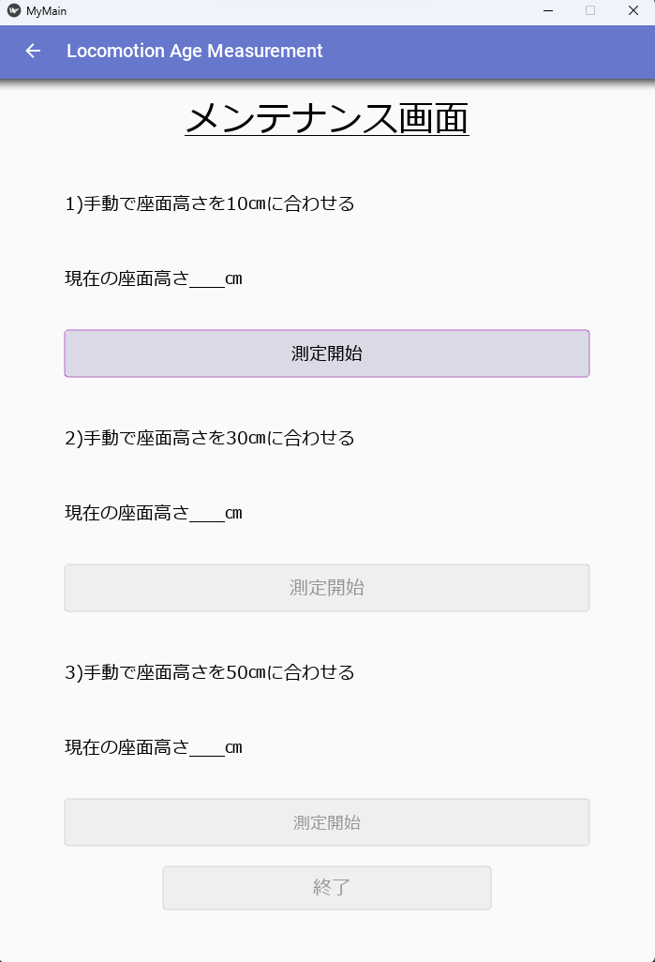
メンテナンス画面(Maintenance Window）
Maintenance window is for adjusting the reading of the sensor .
Because of the sensor is not quite accurate because of the noise especially at further distance, (40cm>) a correction is done.
This screen will ask the person in charge to move the chair three times and each time the current reading of the chair will be recorded (10cm,30cm,50cm)
The calculated correction values will be sent to the chair and stored inside the server. The values stored will be used every time the chair is using the sensor for testing of practice purposes

Slide 20
グラフ画面(Graph Window）
未実装
This is for users that will come to take the test again after undergoing treatments to track their progress
It is still yet to be built because it will require a database to store the user personal data and a consent form will be required in order to do so

Slide 21
フィードバック画面(Feedback Window）
This will be the feedback screen so that user can provide information or bugs that appeared while using the mobile application
All feedbacks will be anonymous
This function is yet to be built because while connected to the chair, connections to the internet will be lost and need to figure out ways to store the feedback response on the internet so that Developers can access it anywhere to make improvements on the mobile application
未実装

Slide 22
工夫点
Use Blue trust Peace and Order
Use Fonts that is easily readable by the user
Use leave comments in each lines of code so that easier for the next person that will oversee the applications for maintenance purposes
Split the GUI Thread and Process Thread so that the UI does not hang while waiting data from the user
Add Feedback Mechanism so that User can Provide useful input on improvisation of the app

Slide 23
データ送信の仕組み
クライアント
サーバー
クライアント
サーバー
座席の高さ、height
“GET_HEIGHT”
“+OK”
“現在の高さ、height”
座席の高さ、height
“+OK”
“GET_HEIGHT”
座席の高さ、height
“現在の高さ、height”
“+OK”
テスト
メンテナンス

Slide 24
まとめ
目的
測定の簡単化と自動化
分かりやすい測定結果の表示
より合理的な立ち上がりテストの実現
手段
システムを自動化するためのKivy環境でできたスマホアプリを開発する
結論
スマホアプリにより、より分かりやすいと使いやすいシステムを提供できた

Slide 25
今後の課題
アクセシビリティのガイドラインの通りに体が不自由な人にも使いやすいようにする
データの保存機能を追加する
サーバ側のプログラムを改善する（自動てき接続切断）
自動再起動
接続ガイドラインを追加する
説明画面に画像を追加する
スレッドをもっとよく利用する.
デバッグ

