Slide 1
Ultimate tic tac toe AI
Elliott Tai, Asa Fischer, Riley Marek

Slide 2
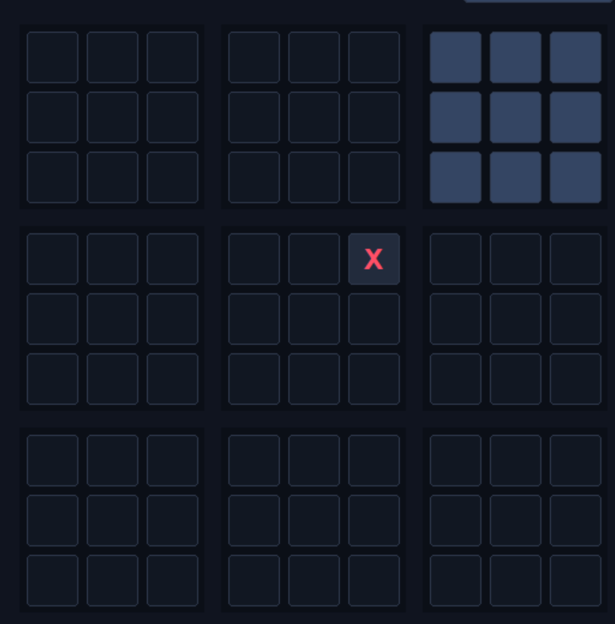
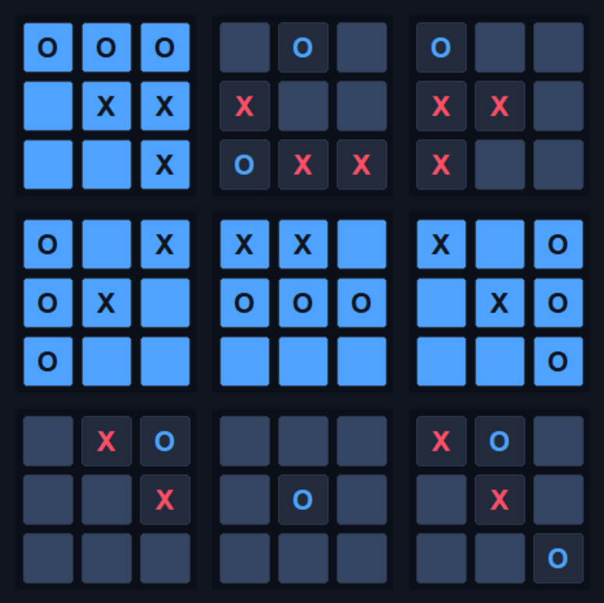
The Game

Slide 3
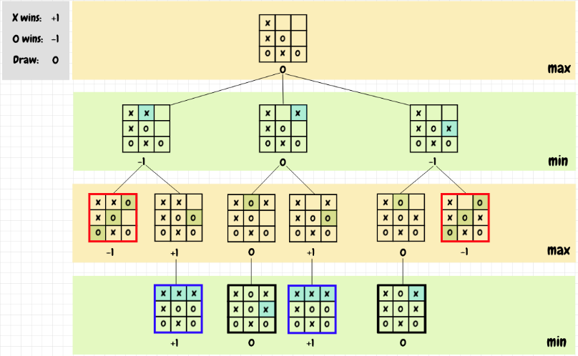
Our solution
Minimax tree
Limited depth
Heuristic
Alpha-beta
https://nestedsoftware.com/2019/06/15/tic-tac-toe-with-the-minimax-algorithm-5988.123625.html

Slide 4
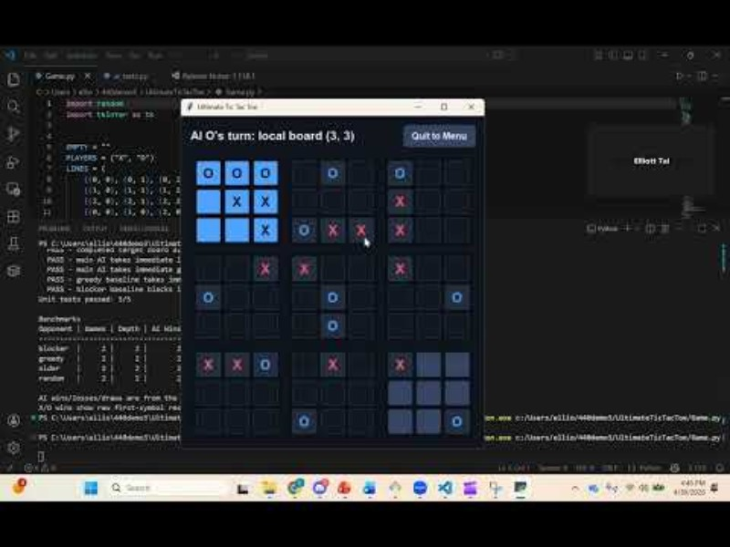
Game demo

Slide 5
Testing Strategy
We have automated unit tests to ensure that game logic correctly handles edge-cases in the rules
Unit testing ensures that Main Agent behaves correctly for edge cases (taking local and global boards)
We have 4 benchmark models:
Random Agent
Greedy-Local Agent: unit tested (takes immediate local win)
Blocker Agent: unit tested (blocks immediate win)
Lightweight or Older Agent
We test our Main (min-max) Agent against 100 games of each, testing depths 2, 3, 4, and 5 (Moves ahead)

Slide 6


Unit Testing
All unit Tests passed

Slide 7
Testing Results

Slide 8
Testing Results
Opponent | Games | Depth | AI Wins | AI losses | Draws | Ave Move Time(s)
Blocker | 100 | 2 | 96 | 0 | 4 | 0.0217
Greedy | 100 | 2 | 100 | 0 | 0 | 0.0258
Heuristic | 100 | 2 | 84 | 0 | 16 | 0.0197
Random | 100 | 2 | 98 | 0 | 2 | 0.0063
Opponent | Games | Depth | AI Wins | AI losses | Draws | Ave Move Time(s)
Blocker | 100 | 3 | 92 | 2 | 6 | 0.1198
Greedy | 100 | 3 | 98 | 2 | 0 | 0.1164
Heuristic | 100 | 3 | 92 | 4 | 4 | 0.1036
Random | 100 | 3 | 98 | 0 | 2 | 0.0378

Slide 9
Testing Results Pt2
Opponent | Games | Depth | AI Wins | AI losses | Draws | Ave Move Time(s)
Blocker | 100 | 4 | 100 | 0 | 0 | 0.5307
Greedy | 100 | 4 | 98 | 0 | 2 | 0.5656
Heuristic | 100 | 4 | 90 | 0 | 10 | 0.4329
Random | 100 | 4 | 98 | 0 | 2 | 0.1569
Opponent | Games | Depth | AI Wins | AI losses | Draws | Ave Move Time(s)
Blocker | 100 | 5 | 100 | 0 | 0 | 1.7948
Greedy | 100 | 5 | 96 | 0 | 4 | 1.806
Heuristic | 100 | 5 | 94 | 0 | 6 | 1.869
Random | 100 | 5 | 100 | 0 | 0 | 0.6327

