Slide 1
Recirculation

Slide 2
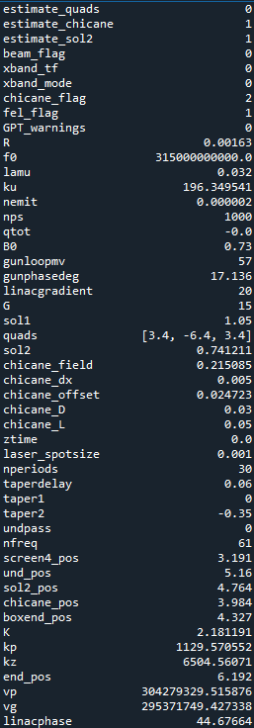
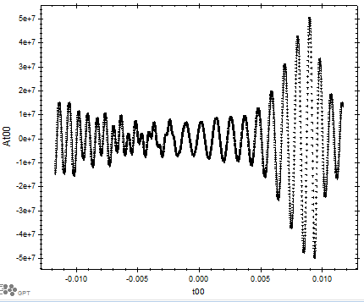
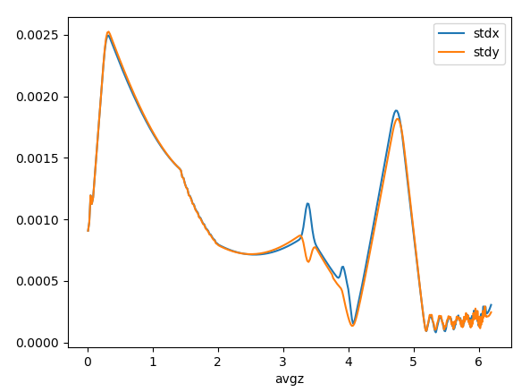
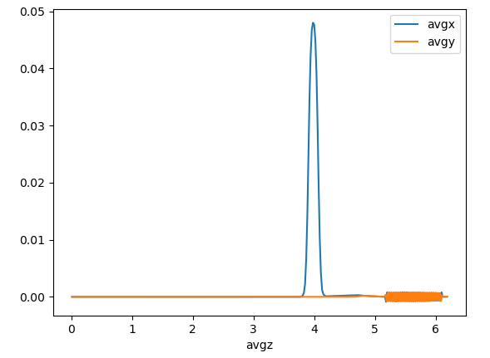
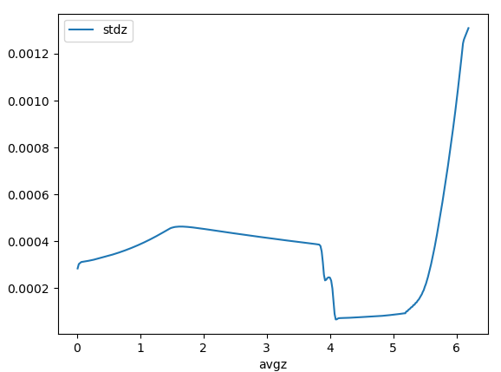
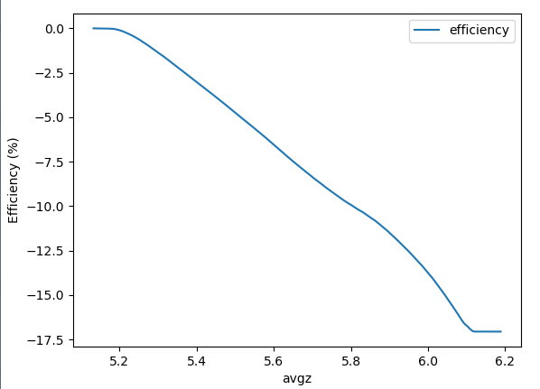
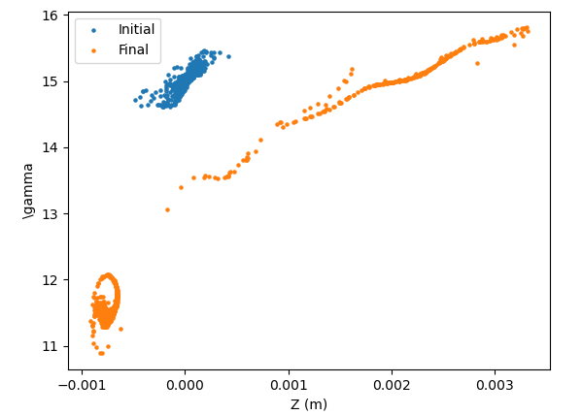
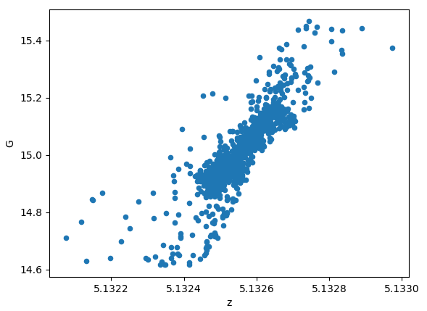
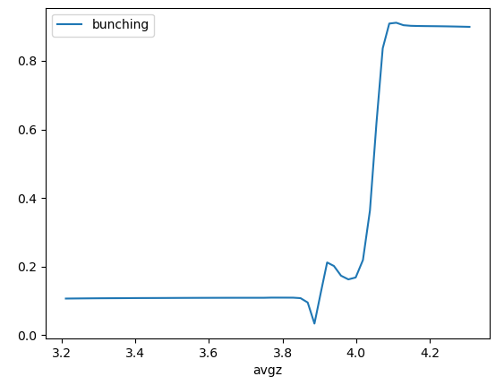
Beam Transport to Undulator
For Andrew: Check why chicane estimate needs fudge factor
Bunching factor approaching 90%, don’t see happening in actuality, but how to simulate less optimal conditions?
Efficiency already 17%
Gamma=15 when resonance is G=14.4 (want slight energy detuning?)

Slide 3
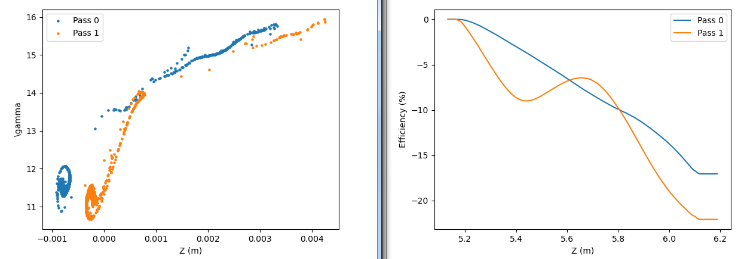
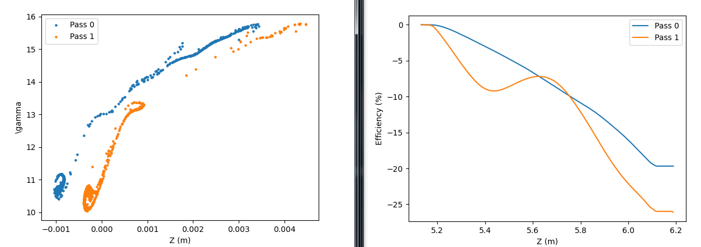
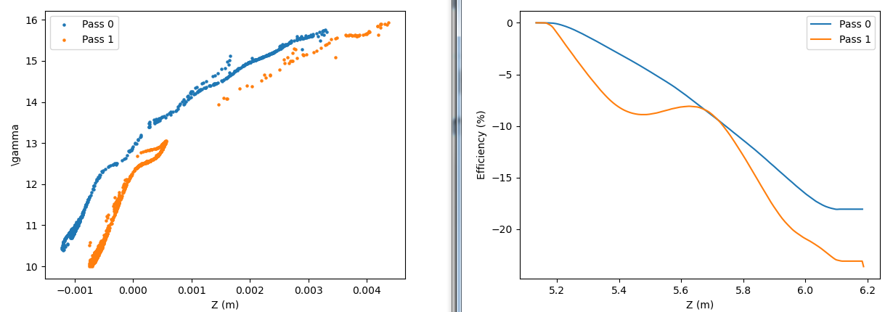
Recirculation (quadratic taper)
Increasing taper2 as -.35, -.45, -.55
Never benefit much from recirculation because I’m not using linear taper

Slide 4
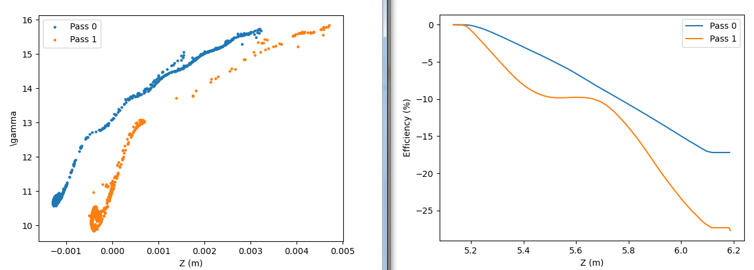
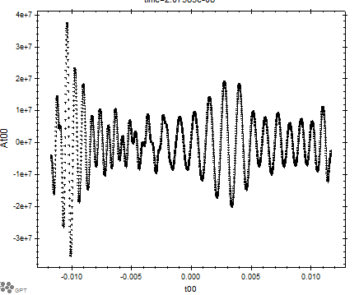
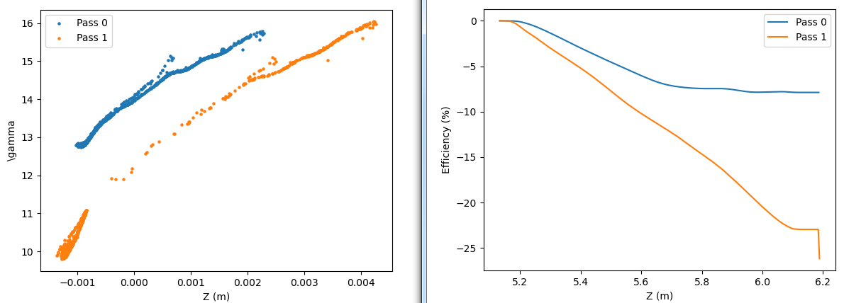
Recirculation (linear taper)
Keep taper2 as -0.35.
Increase linear taper as 0, -0.1, -0.2
Window isn’t large enough to keep dispersion from causing non-physical errors
At00 figure shows pulse after first pass

Slide 5
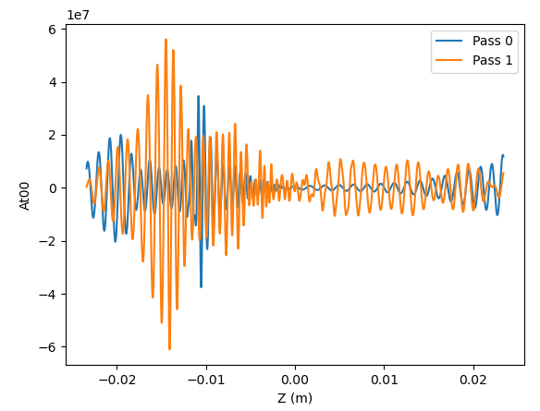
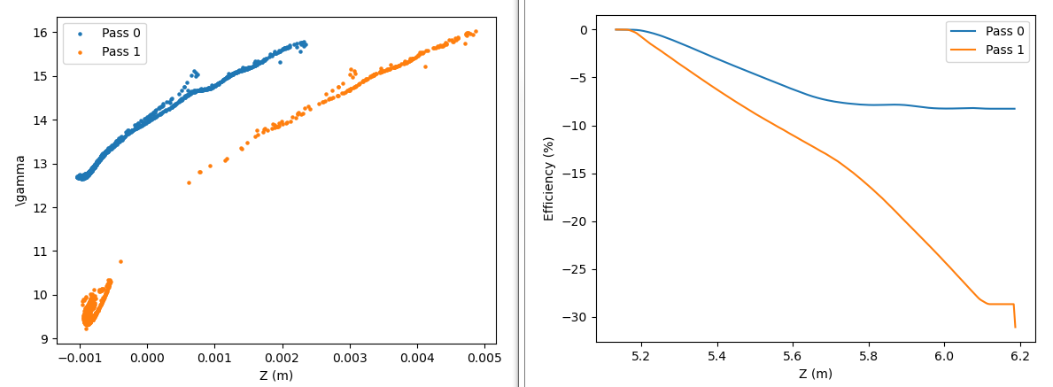
Doubled number of modes
Taper1 = -.2, Taper2 = -0.35

Slide 6
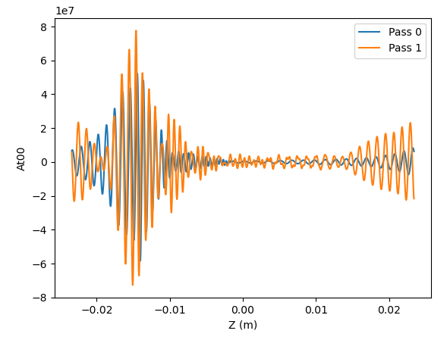
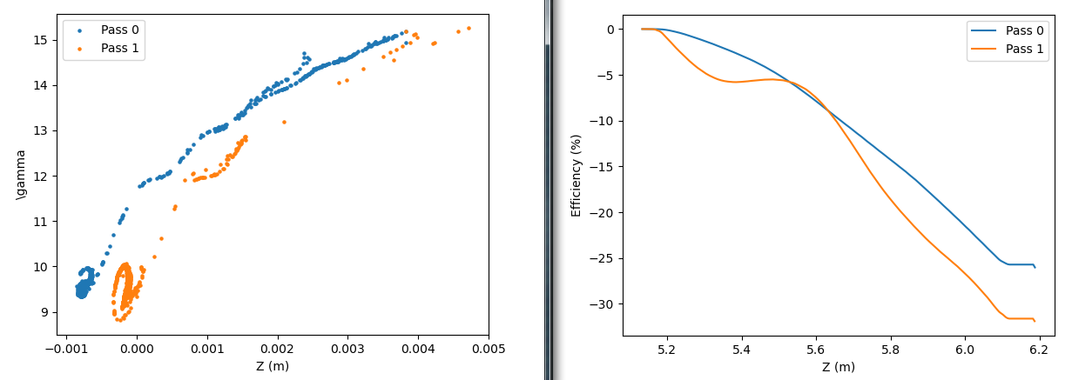
Run at G=14.5
Taper1= -.2, taper2 = -.35
Taper1 = -.2, taper2 = -.45

Slide 7
Concepts
Tapering will have/not have linear component depending on if an initial field is present.
First pass will not resonant all the way through. Important to have that be near to resonant energy so we don’t create two pulses at slightly detuned frequencies?

