Slide 1
Custom features
df["logSalePrice"]=np.log1p(df["SalePrice"]) df["logGrLivArea"]=np.log1p(df["GrLivArea"]) df['sqrGarageCars'] = df.GarageCars * df.GarageCars df['Bath'] = df.FullBath + 0.5*df.HalfBath df['FlrSF'] = df['1stFlrSF']+df['2ndFlrSF'] df['RemodAge'] = df.YearRemodAdd - df.YearBuilt df['RecentRemod'] = np.where(df.YearRemodAdd>1980, 1, 0) df['BedroomRatio'] = df.BedroomAbvGr / (df.BedroomAbvGr + df.TotRmsAbvGrd) df['hasFireplace'] = np.where(df.Fireplaces>0, 1, 0) df["enc_FireplaceQu"] = df["FireplaceQu"].map({'Null': 0.0, 'Po': -2.0, 'Fa': -1.0, 'TA': 0.0, 'Gd': 1.0, 'Ex': 2.0}).astype("float") df["logMasVnrArea"]=np.log1p(df["MasVnrArea"]) df["enc_ExterQual"] = df["ExterQual"].map({'Fa': -1.0, 'TA': 0.0, 'Gd': 1.0, 'Ex': 2.0}).astype("float") df['Porch'] = df.OpenPorchSF + df.WoodDeckSF df['Porch'] = 5 df['Porch'] = df.OpenPorchSF + df.WoodDeckSF df['trunLotArea'] = np.where(df.LotArea<30000, df.LotArea, 30000) df['trunLotArea'] = np.where(df.trunLotArea<20000, df.trunLotArea, 20000) df['trunLotFrontage'] = np.where(df.LotFrontage<150, df.LotFrontage, 150) df['trunBsmtSF'] = np.where(df.TotalBsmtSF<2500, df.TotalBsmtSF, 2500) df["enc_BsmtQual"] = df["BsmtQual"].map({'Null': 0.0, 'Fa': 0.0, 'TA': 1.0, 'Gd': 2.0, 'Ex': 3.0}).astype("float") df["enc_CentralAir"] = df["CentralAir"].map({'N': 0.0, 'Y': 1.0}).astype("float") df['hasCircuitBreaker'] = np.where(df.Electrical=='SBrkr', 1, 0) df['isPConc'] = np.where(df.Foundation=='isPConc', 1, 0) df['isPConc'] = np.where(df.Foundation=='PConc', 1, 0) df["enc_GarageFinish"] = df["GarageFinish"].map({'Null': 0.0, 'Unf': 1.0, 'RFn': 2.0, 'Fin': 3.0}).astype("float") df['isGarageAttached'] = np.where((df.GarageType=='Attchd') | (df.GarageType=='BuiltIn'), 1, 0) df["enc_HeatingQC"] = df["HeatingQC"].map({'Po': -2.0, 'Fa': -1.0, 'TA': 0.0, 'Gd': 1.0, 'Ex': 2.0}).astype("float") df["enc_KitchenQual"] = df["KitchenQual"].map({'Fa': -1.0, 'TA': 0.0, 'Gd': 1.0, 'Ex': 2.0}).astype("float") df['isLotRegular'] = np.where(df.LotShape=='Reg', 1, 0) df['isLowDensity'] = np.where((df.MSZoning=='RL')|(df.MSZoning=='FV'), 1, 0) df["enc_MasVnrType"] = df["MasVnrType"].map({'None': 0.0, 'BrkCmn': 0.0, 'BrkFace': 1.0, 'Stone': 2.0, 'Null': 0.0}).astype("float") df["enc_PavedDrive"] = df["PavedDrive"].map({'N': 0.0, 'P': 1.0, 'Y': 2.0}).astype("float") df['isNewHome'] = np.where(df.SaleCondition=='Partial', 1, 0) df['isNewHome'] = np.where(df.SaleType=='New', 1, 0)

Slide 2
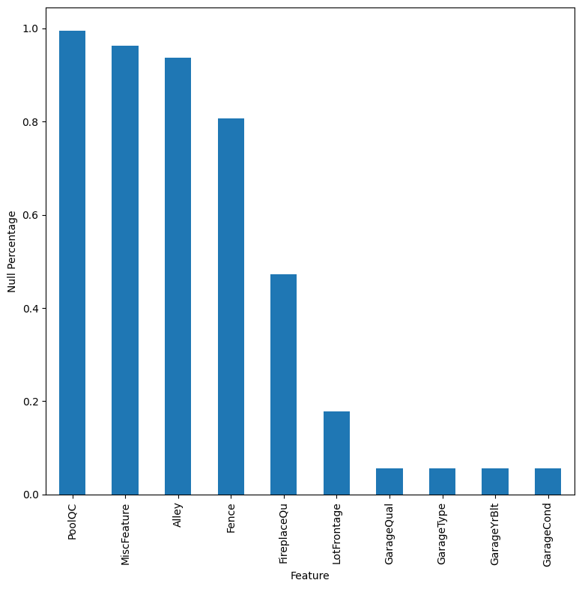
Null Values
After looking at PoolQC, MiscFeature, and Alley, I believe they can be dropped no problem. Fence is nan if they don't have a fence, that could be one-hot encoded. Same with fireplaces.

Slide 3
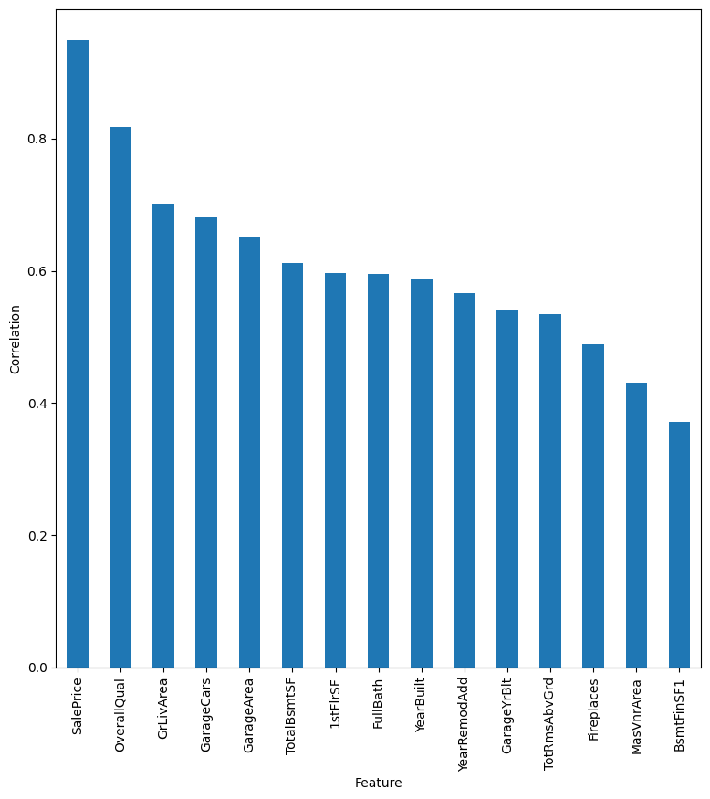
Largest Correlations
Many of these make sense. Overall Quality (overall condition?), living area, garage size, squarefootage, bath, yearbuilt, etc. Let's work our way down the list.

Slide 4
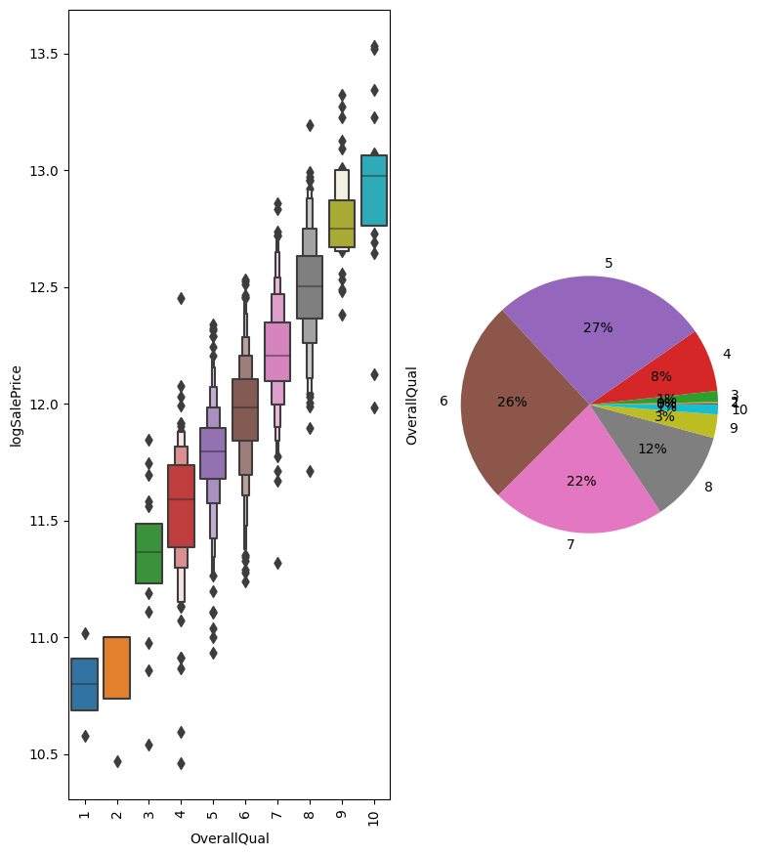
OveralQual
Very strong relationship. Definitely include.

Slide 5
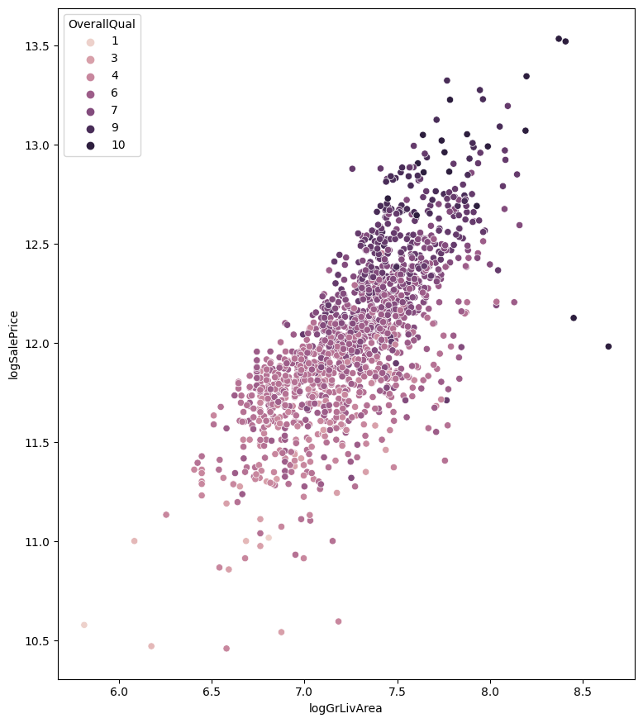
logGrLivArea
There was a tail on the living area distribution. There is a slightly larger correlation with the log transform. Clearly a general trend.

Slide 6
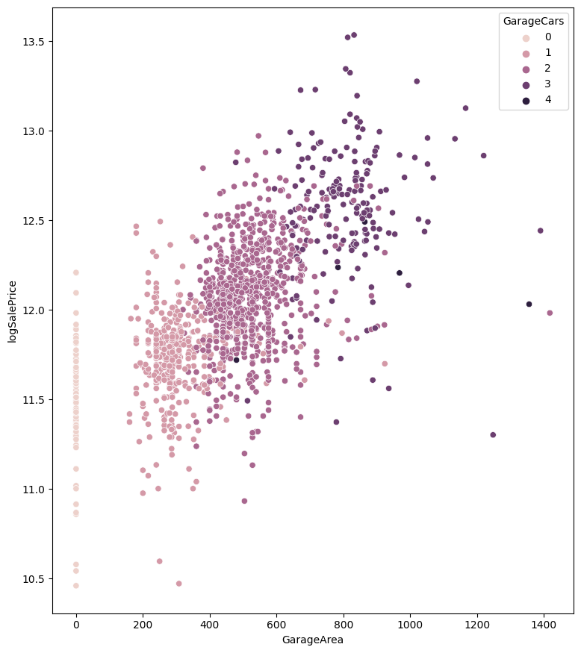
Garage Size
There is a clear relationship between garage cars and garage area. Can include both, or just one?

Slide 7
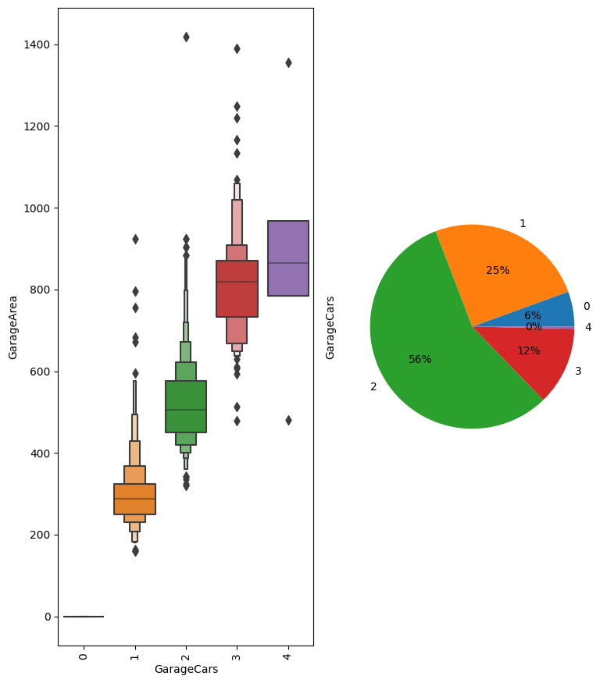
Garage Area vs Cars
Pretty linear relationship.

Slide 8
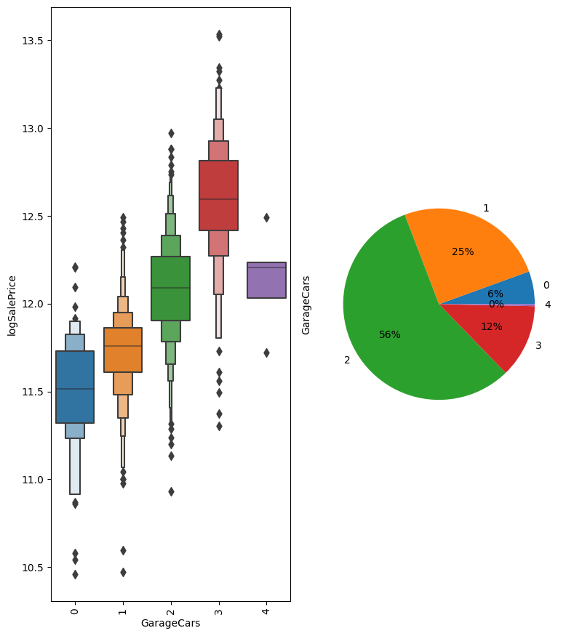
Garage Cars
Could we argue for a quadratic dependence here? Maybe include a garagecarsqr term?

Slide 9
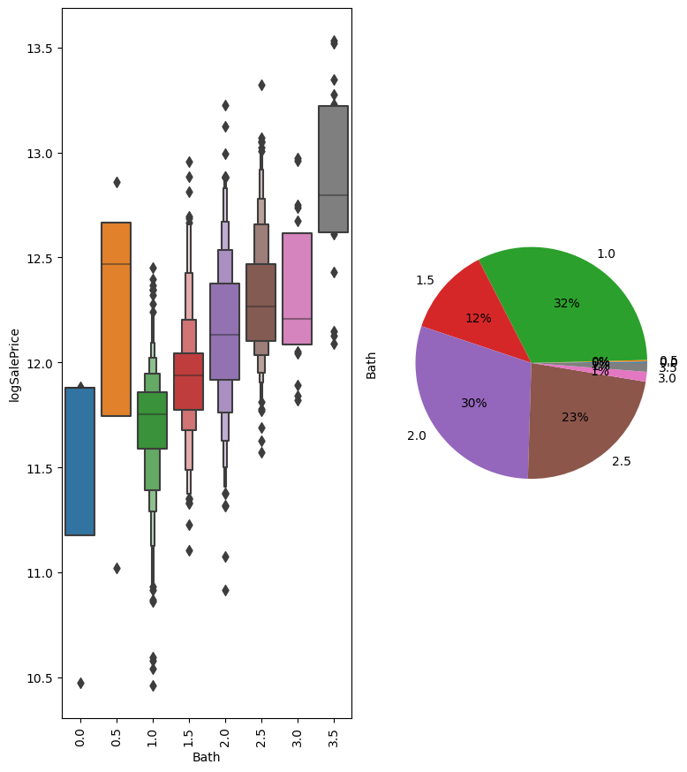
Bath
I decided to group Full and Half Bath into a single category. Has a stronger correlation than either. Maybe include FullBath in model as well.

Slide 10
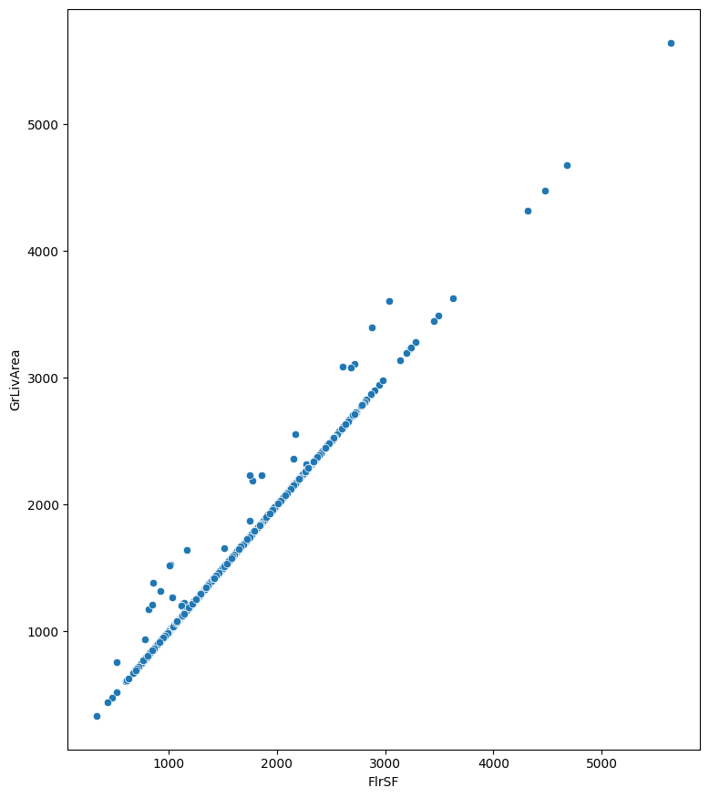
Square Footages
We have already included total living square footage. There is very little difference between the sum of the first and second floor SF (FlrSF) and Living Area. Also the number of floors is included in other features, so maybe drop 1stFlrSF and 2ndFlrSF.

Slide 11
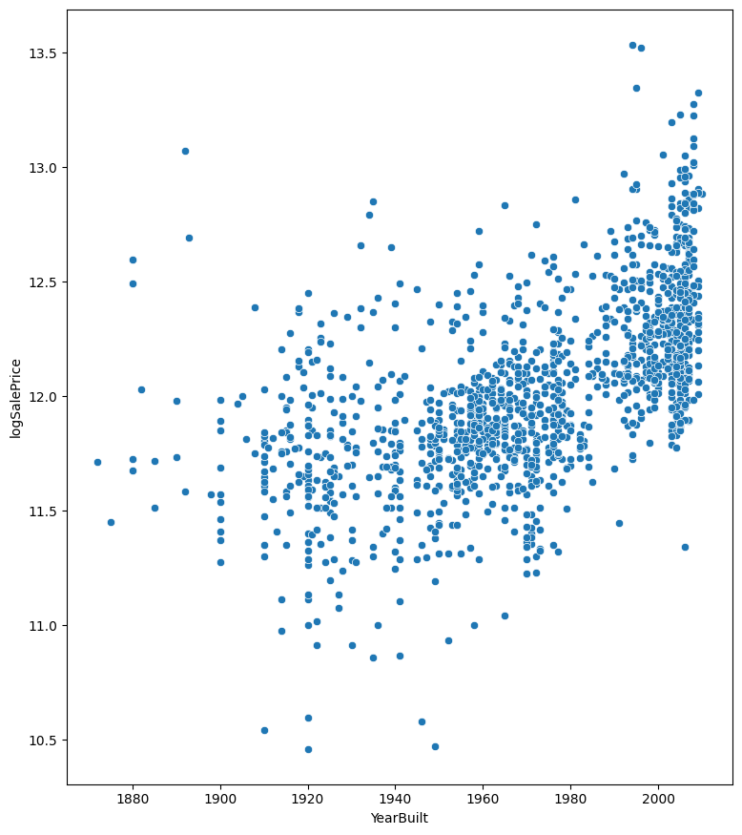
Year Built and Remodeling
The relationship between house age and sale price seems nonlinear. It was flatter before 1960 but has been increasing since. YearRemodAdd has less correlation, but it caps the minimum age at 1950, which seems to make the data more linear overall.

Slide 12
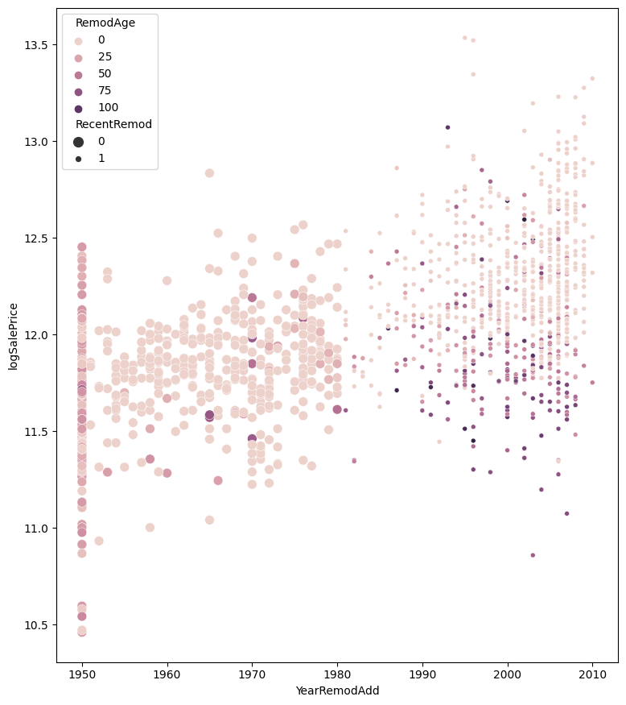
Effect of Age when remodeled
I color by the age of the house when remodeled. We see that it really only makes a significant difference after 1980. I add a feature for recentRemodel.

Slide 13
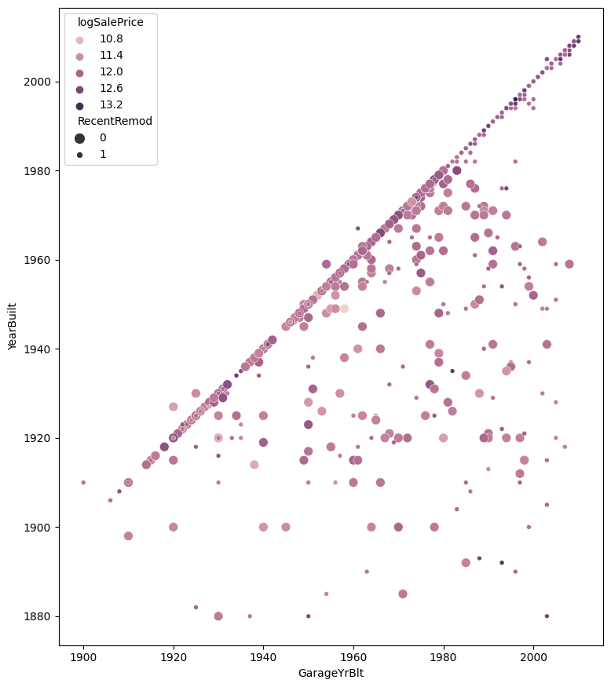
GarageYrBuilt
I don't see how to incorportate GarageYrBlt. For the most part, it is the same as YearBuilt. For garages built more recently, it doesn't track with remodel, so it must be treated as a separate entity. But I don't see much correlation to model..

Slide 14
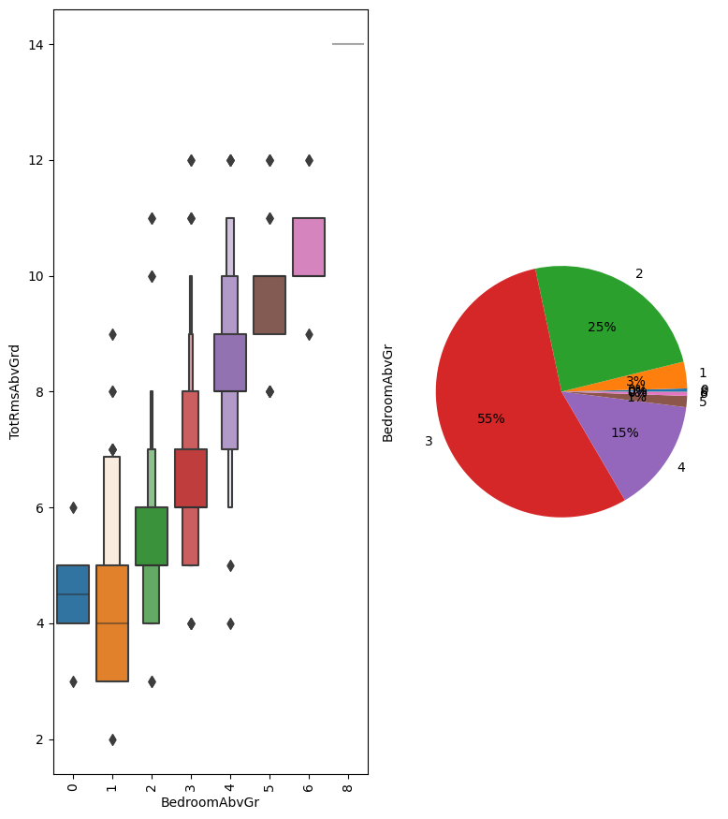
Bedrooms vs Total Rooms
Not shocking that total rooms increases with bedrooms. I tried to create an extra feature from these (ration of bedroom to total house), but it didn't appear fruitful.

Slide 15
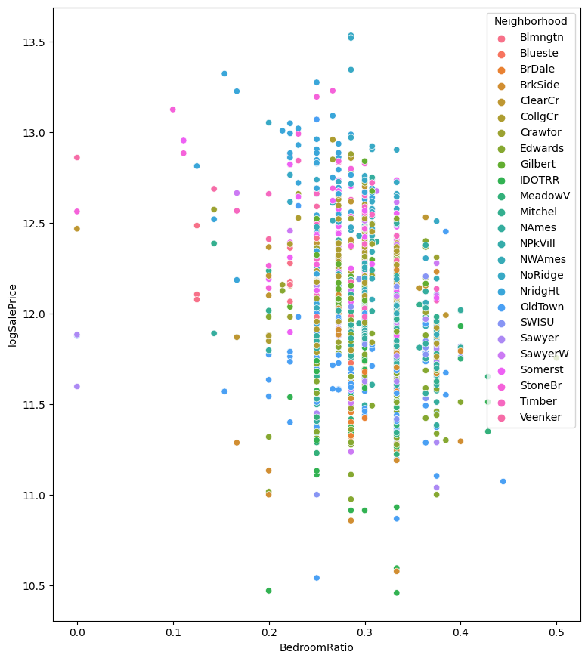
BedroomRatio
However, clear correlations could depend on some other variable like location or neighborhood.

Slide 16
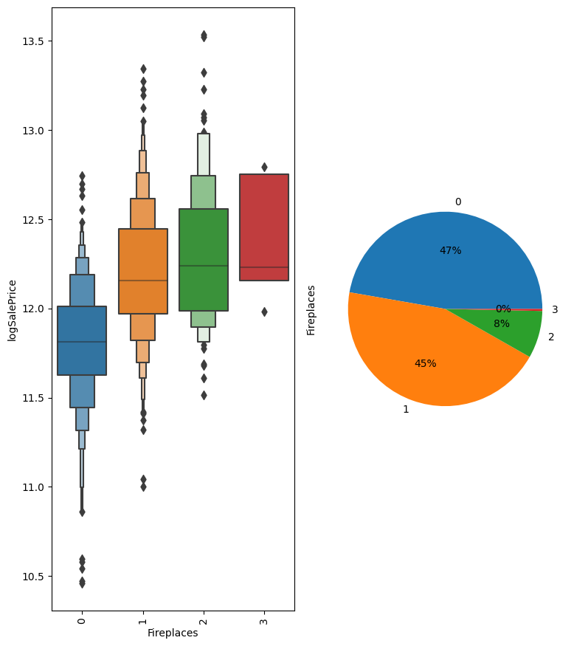
Fireplaces
There is very little different between having 1 or 2 fireplaces on total price, so I create a feature for hasFireplace.

Slide 17
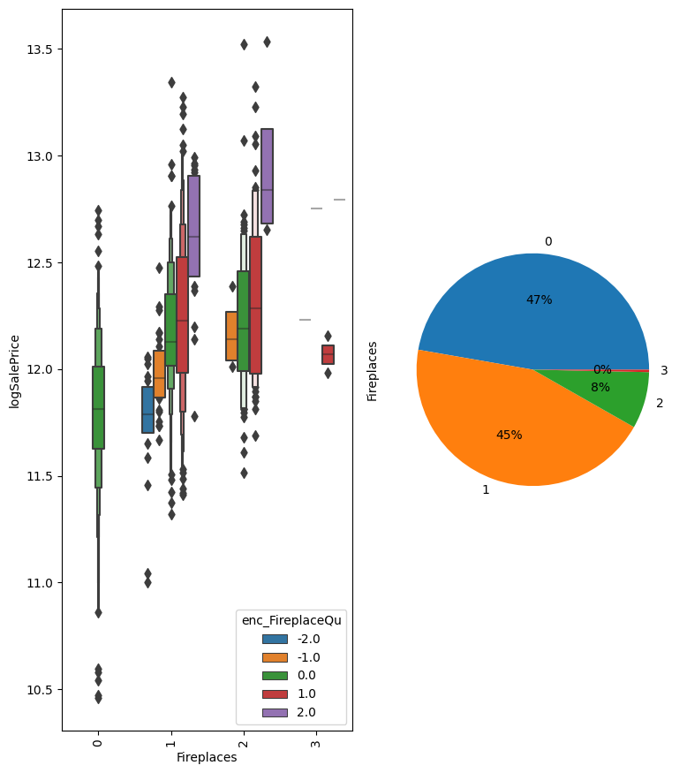
Fireplace Quality
Even though there were a lot of Nulls in Fireplace quality, that was just when no fireplace existed. Here we see that there is an ordering based on the fireplace quality. We make an encoding of Fireplace Quality.

Slide 18
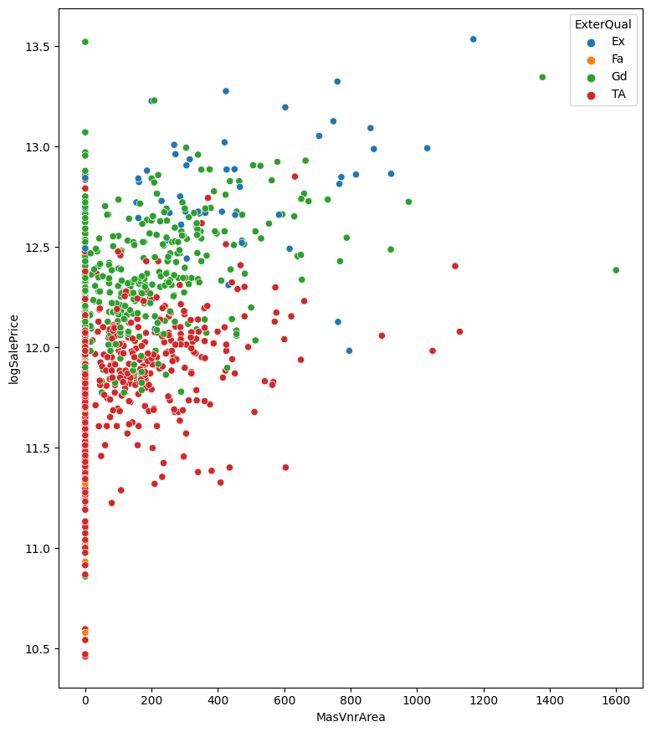
MasVnrArea
There was a correlation between MasVnrArea and Saleprice, but that appears to be mostly to the exterQual category. I don't see much of a dependence for each color.

Slide 19
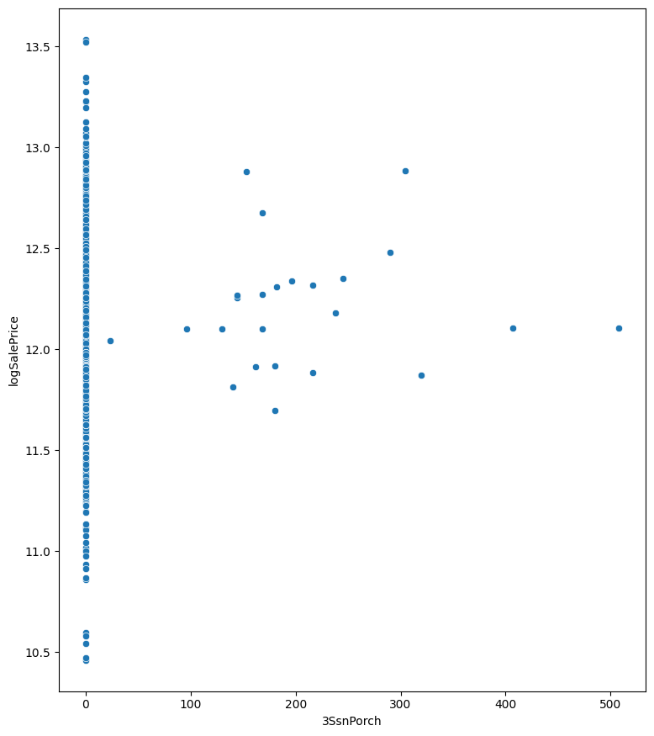
3SsnPorch
Doesn't do much for price

Slide 20
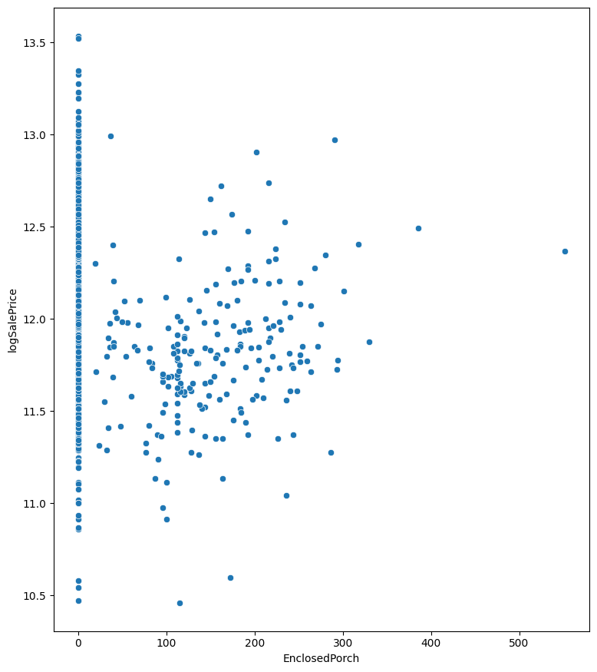
Enclosed Porch
If anything, this HURTS price.

Slide 21
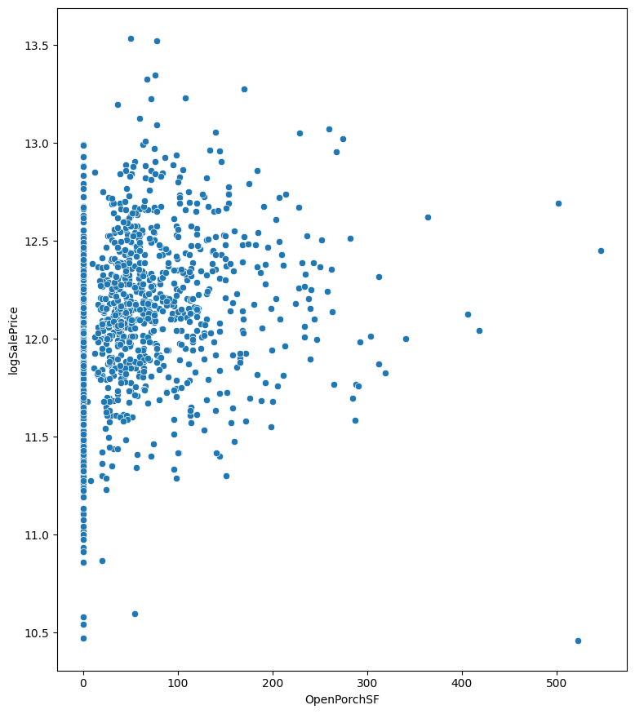
OpenPorchSF
Some positive correlation.

Slide 22
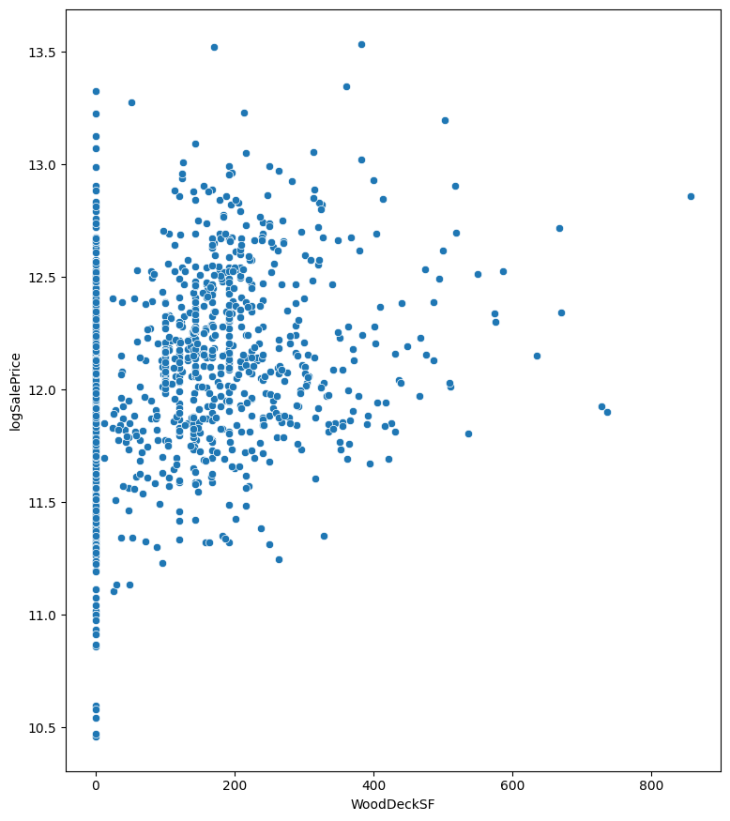
WoodDeckSF
Positive Correlation

Slide 23
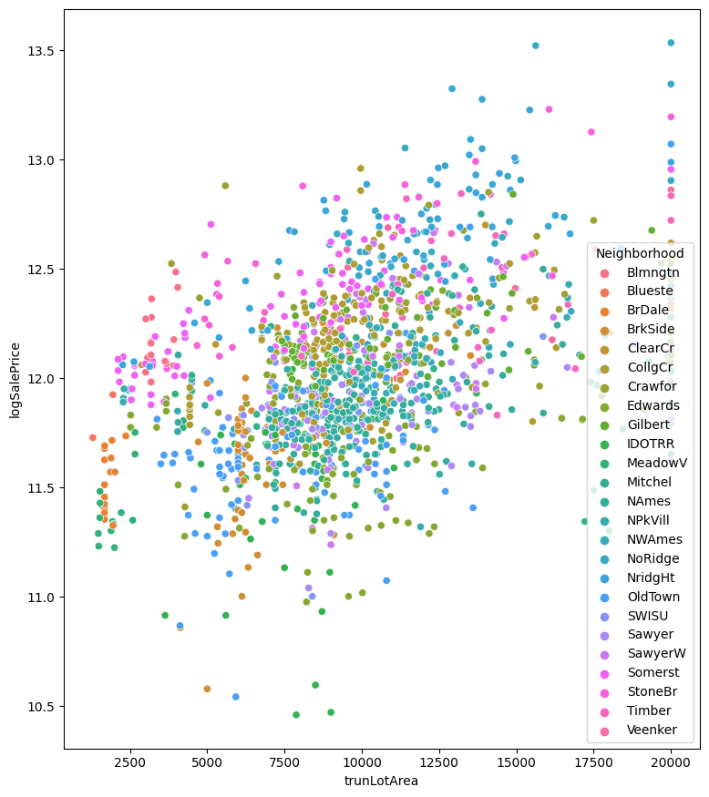
LotArea
I think there are strong correlations with LotArea after correcting for neighborhood. It will be important to characterize neighborhoods correctly.

Slide 24
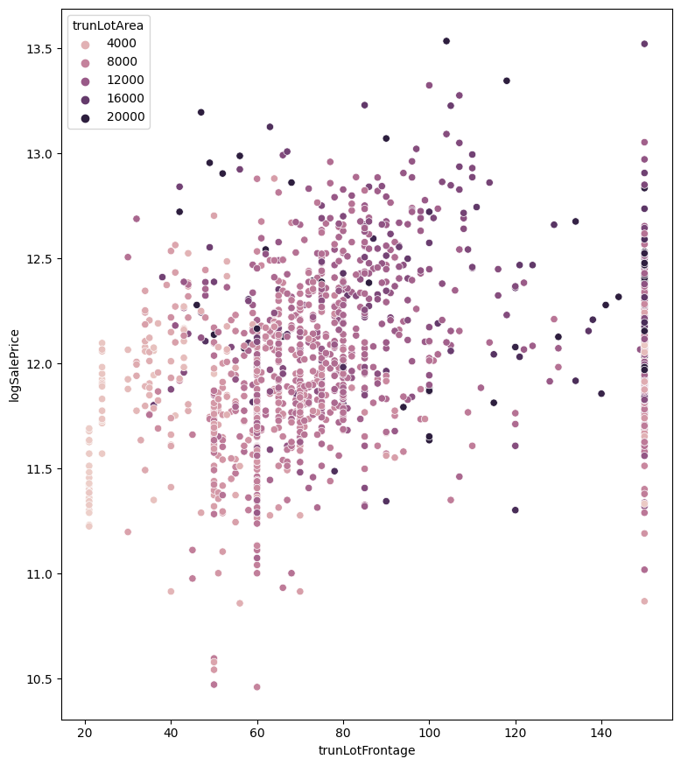
LotFrontage
I don't have much to say about LotFrontage.

Slide 25
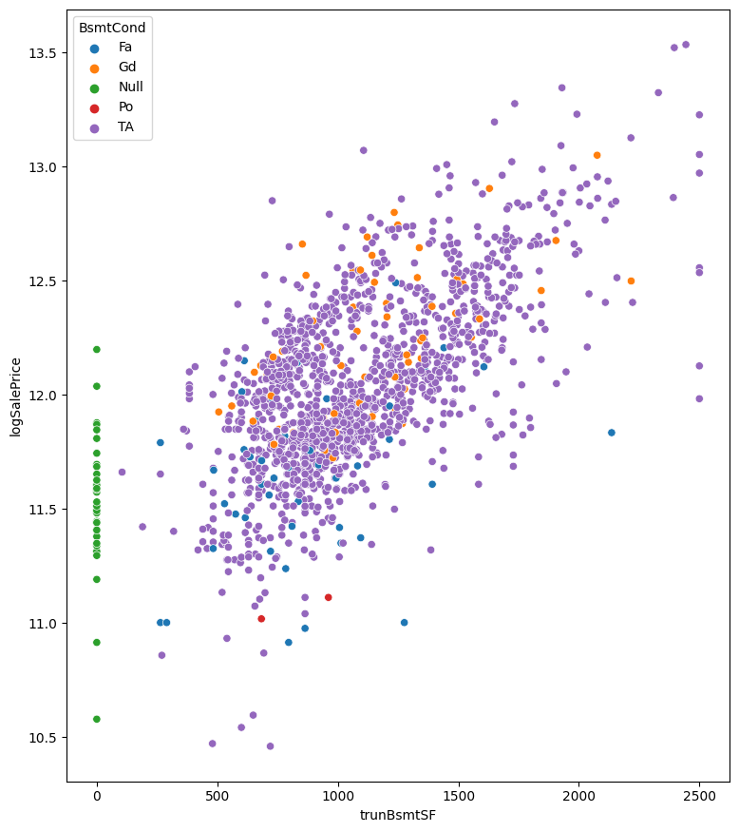
BsmtSF
Surprisingly strong correlation between BsmtSF and price.

Slide 26
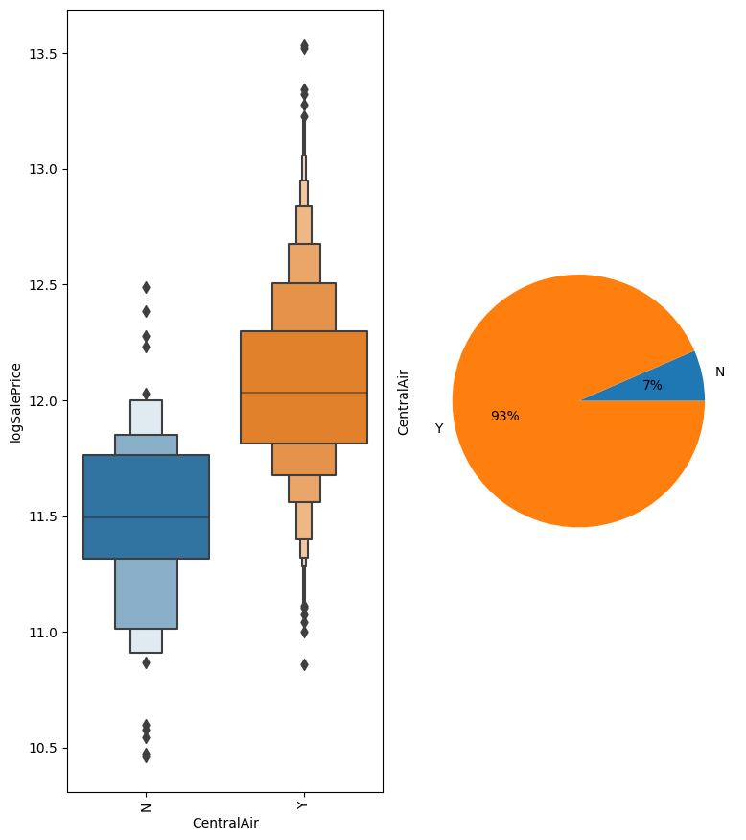
Central Air
Definition of a one-hot variable.

Slide 27
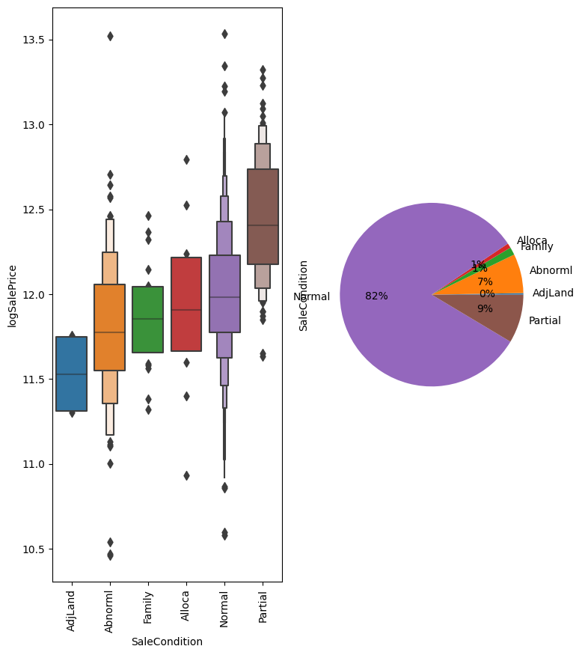
New Home
Partial means new home. Make one-hot variable.

