Slide 1
Custom features
df['encodedSex'] = np.where(df.Sex=='female', 1, 0) df['Status'] = np.where(df.Survived==1, 'Survived','Died') df['isKid'] = np.where(df.Age<14, 1, 0) df['Family'] = df.Parch+df.SibSp df['isLargeFamily'] = np.where(df.Family>=4, 1, 0)

Slide 2
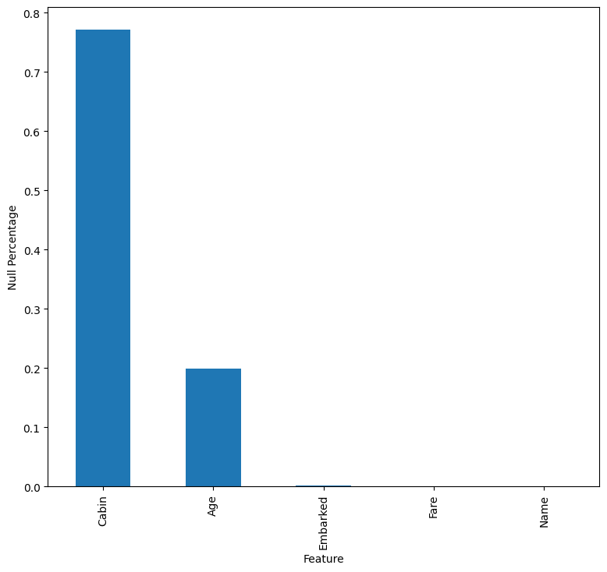
Null Values
Lots of null values from cabin. I suspect this will be dropped. Age should be very important. We need to be careful to impute the missing values accurately.

Slide 3
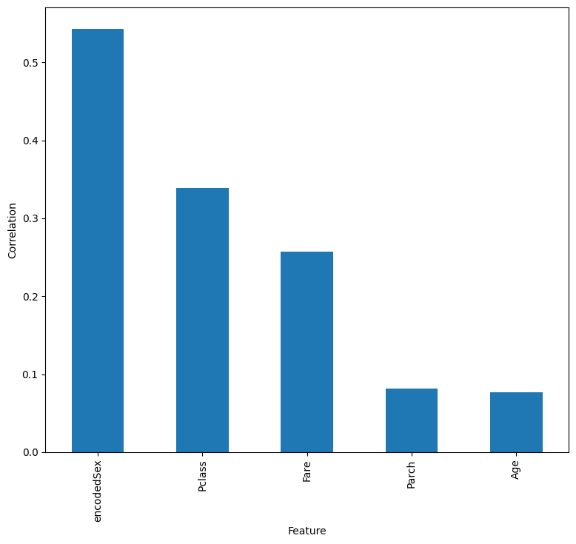
Largest Correlations
Unexpectedly, we see large correlations gender and wealth (expect Pclass and Fare to have significant correlations). There is a much smaller dependence on age than I would expect. Maybe there are nonlinear relationships we need to "suss" out

Slide 4
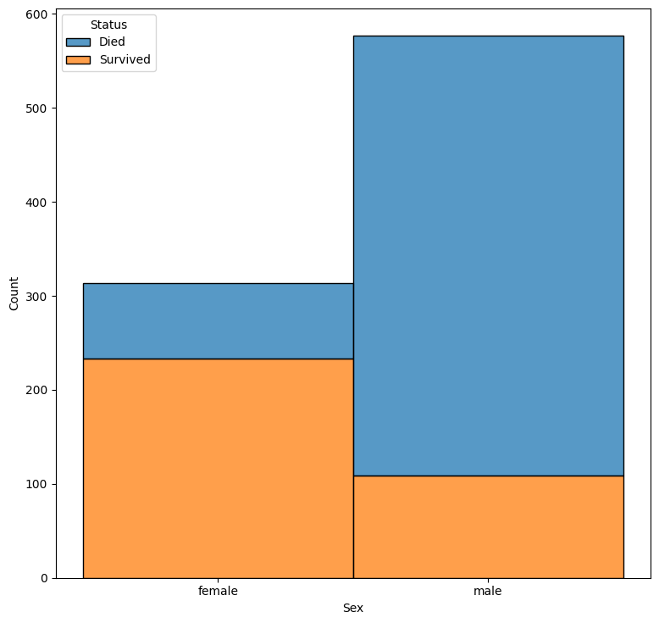
Gender
Roughly a third of the passengers were female, and they have a very good survival rate.

Slide 5
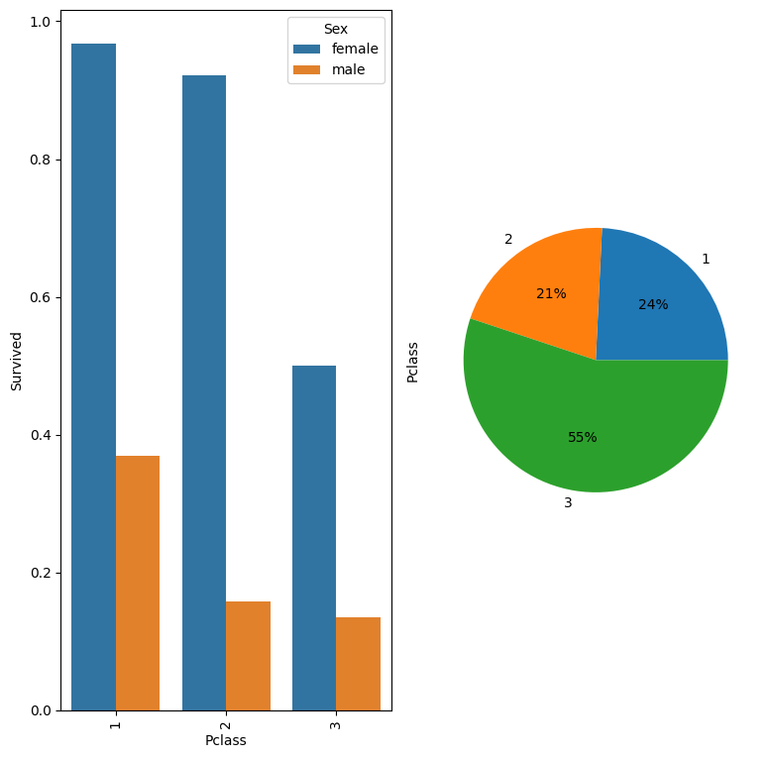
Pclass and Gender
Notice that the effect of Pclass is not linear (as would be modeled if I use numeric ordering). For females, the first and second classes both have very high survival rates while for males, it is only the first class that survive. This suggests I should make Pclass a categorical variable for me models?

Slide 6
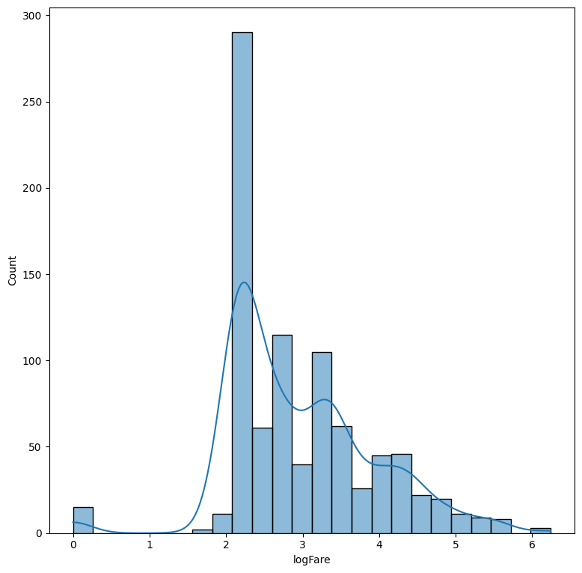
Fare
Very long tail, so I'm using log distribution.

Slide 7
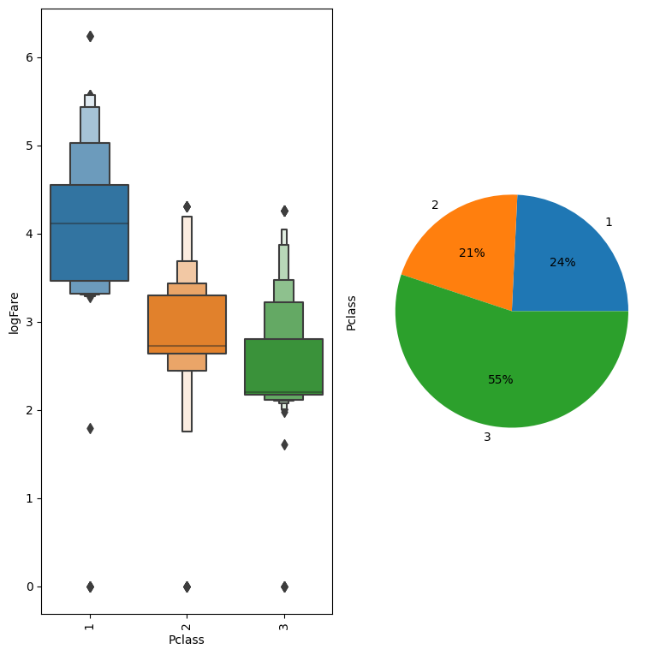
Fare vs Pclass
Clear relationship between Fare and Pclass. There might be some information for higher fares vs lower fares in a given class.

Slide 8
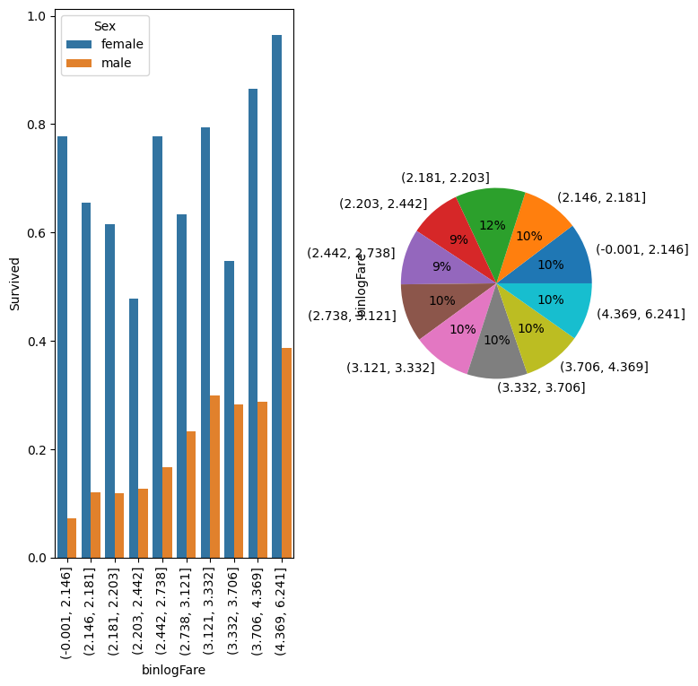
Survival by Fare and Gender
A clear increase in survival for men vs binlogFare. Again, not clear for women.

Slide 9
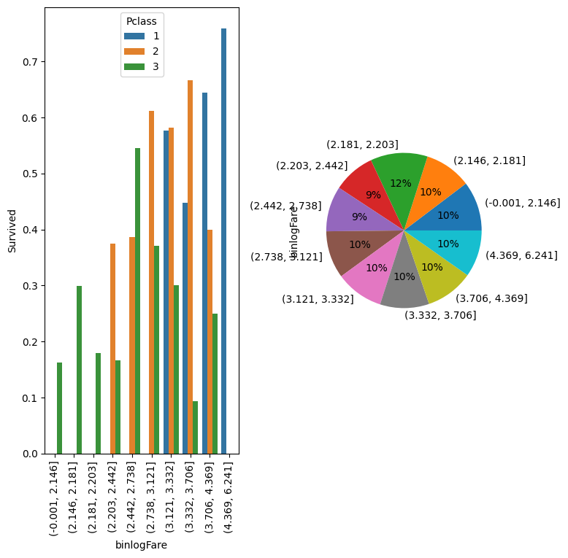
Survival vs Fare and Pclass
Here we see that for a given Pclass, there isn't a clear correlation between fare and survival within a given class.

Slide 10
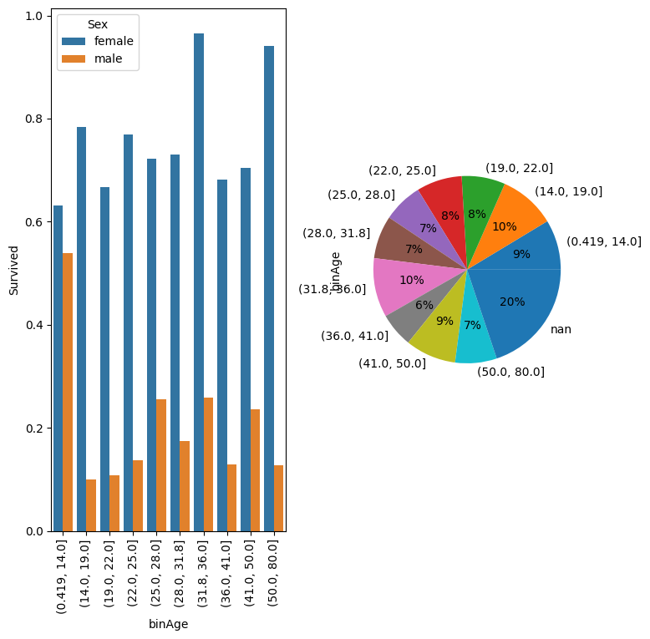
Survival vs Age
Here we see interesting trends in survival vs. Age. Of course it is important to try to separate out the dominating effects of gender and Pclass. The figure appears to show that age has little effect for women and little effect for men except kids under the age of 14. There, we finally see men with a better than 50/50 chance of survival.

Slide 11
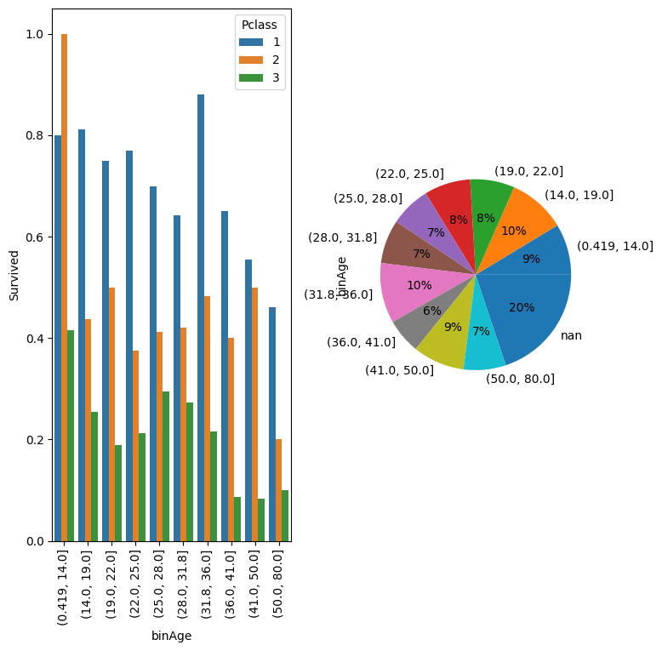
Survival vs Age
If we apply hue by Pclass, we see that there is actually quite the decrease in survival with age. We still add a feature to tell if someone is a kid.

Slide 12
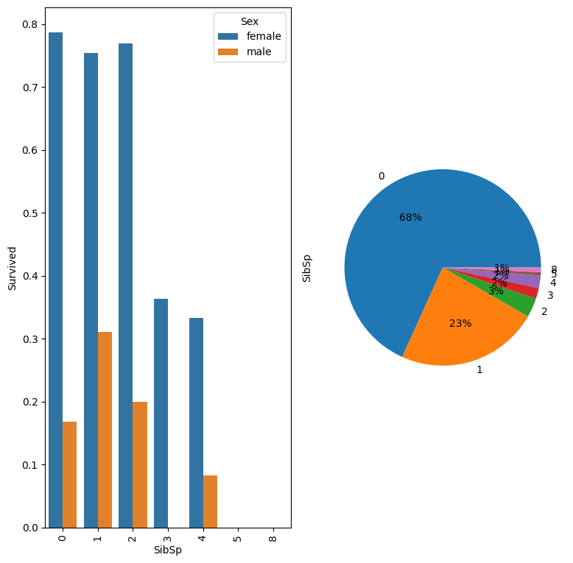
SibSp
Do not see much information from SibSp. Most of the data points are in SibSp=[0, 1]

Slide 13
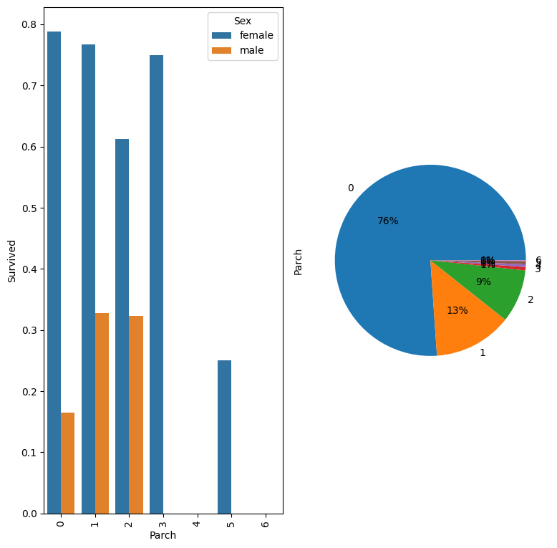
Parch
Very similar looking to SibSp. Not much to infer?

Slide 14
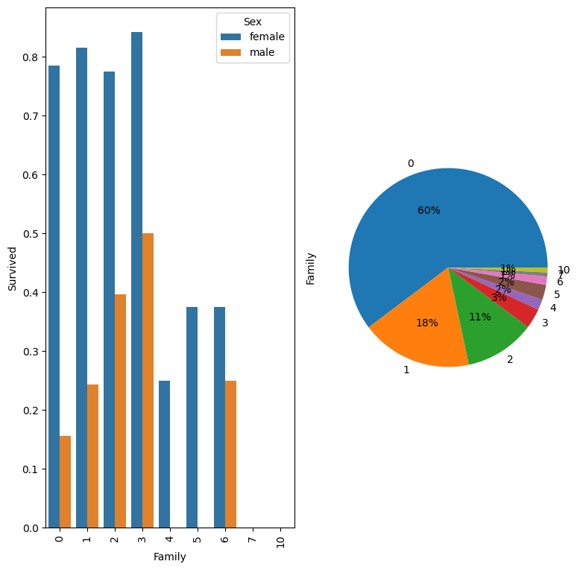
Total Family Size
When you look at total family size, there is a discontinuity at Family=4. We could including LargeFamily as a Feature.

