Slide 1
Summary of GRIT Runs

Slide 2
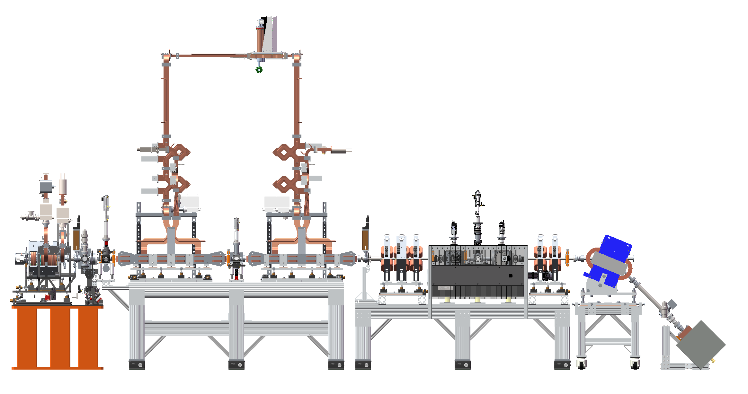
Solidwork Files
Assembly 9978 is IP region.
Assembly file above that is for entire beamline.

Slide 3
Beamline To do
Camera field of view
Logistics for installation
Popins
Enough air hoses
Cameras
Lenses
Power cables
Ethernet
Cameras slide for Marcos

Slide 4
Friday, 8/9/24
Changed gun temps back to nominal values
Chiller1: 30 C
Chiller2: 27.5 C
Chiller3: 26.5 C
Checked alignment on IP and Cam5
Gun and Quad scan

Slide 5
Gunphase scan
Scaled pixel sum (subtract minimum)
Redo with laser off.
We were operating at 268 degrees.
Ask Maksim about how charge scan was measured.

Slide 6
Quad Scans
Created simple matrix model in Python.
Checked against elegant simulation
Given quad currents and spotsizes, optimize beam matrix to minimize error between simulation and data
Estimates emittance
Gives input twiss parameters for elegant simulation

Slide 7
Cameras
See GRIT Operations/Calibrations/Cameras
 | Cam1 | Cam2 | Cam3 | IP | Cam5 | Beam Dump | Extra | Extra
Screen | 1” yag | 1” yag | ½” OTR | ½” OTR | ½ OTR | 1” yag
Visible Aperture | 18mm | 18mm | 9mm | 9mm | 9mm | 18mm
Flip LR? | True | True | False | False | True | True
Flip TB? | False | False | True | False | False | False

