Slide 1
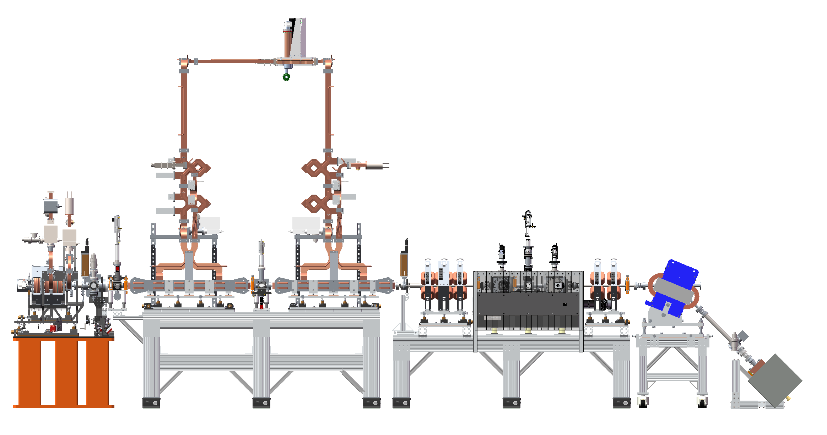
Solidwork Files
Assembly 9978 is IP region.
Assembly file above that is for entire beamline.

Slide 2
Run Plans
Target smaller spotsize on IP
Tune with photohybrid correctors
Quadscans on screen5
Take data showing linac tuning with beam on beamdump
Propagate beam through pinhole
Charge confirmation, transmission to IP.
Jitter measurements of beam

Slide 3
To do list
Hall probe interlock
Rearrange power supplies.
Dipole power supply
Alignment laser

Slide 4
Installation
Popins
Air connections, PLC controls/cables
Cameras
Lenses
Power cables
Ethernet
Steering magnets
Power supplies

Slide 5
Friday, 8/9/24
Changed gun temps back to nominal values
Chiller1: 30 C
Chiller2: 27.5 C
Chiller3: 26.5 C
Alignment between IP and Cam5
Very different. Beam found on dump with nearly 0 A on steering 4.
Can we move laser/pinhole to match ebeam axis?
Gun and Quad scan

Slide 6
Gunphase scan
Charge and pixel sum
Why the “shift”. Revisit when second ICT on beamline.
We were operating at 268 degrees.
Towards the compression point.

Slide 7
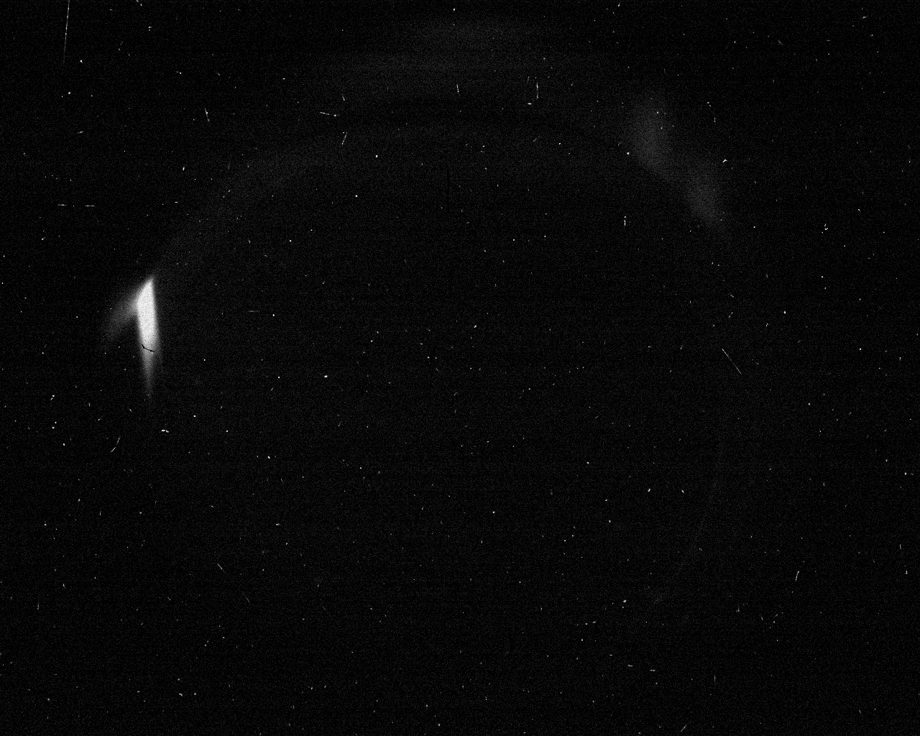
Tuesday, 8/13/24
Found beam on beam dump
146 Amps corresponds to 93 MeV
Limited in steering. Revisit after installation

