Slide 1
Once upon an ai
Or getting to know your new robot overlords
With Alex Fitts
Source: www.neuralnetworksanddeeplearning.com

Slide 2
What are neural networks used for?

Slide 3
What are neural networks used for?
Visual Pattern Recognition
‘seeing things’, picture tagging, scanning checks, etc

Slide 4
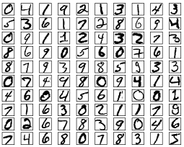
What are neural networks used for?
Visual Pattern Recognition
‘seeing things’, picture tagging, scanning checks, etc

Slide 5
What are neural networks used for?
Visual Pattern Recognition
‘seeing things’, picture tagging, scanning checks, etc
Natural Language Processing
google translate, spam filters, etc.

Slide 6
What are neural networks used for?
Visual Pattern Recognition
‘seeing things’, picture tagging, scanning checks, etc
Natural Language Processing
google translate, spam filters, etc.
Astronomy specific problems

Slide 7
What are neural networks used for?
Visual Pattern Recognition
‘seeing things’, picture tagging, scanning checks, etc
Natural Language Processing
google translate, spam filters, etc.
Astronomy specific problems
Filling DMO simulations with galaxies (Kamdar et al 2015 (a,b))

Slide 8
What are neural networks used for?
Visual Pattern Recognition
‘seeing things’, picture tagging, scanning checks, etc
Natural Language Processing
google translate, spam filters, etc.
Astronomy specific problems
Filling DMO simulations with galaxies (Kamdar et al 2015 (a,b))
Identifying galaxy morphologies from a picture (Huertas-Company et al. 2015)

Slide 9
What are neural networks used for?
Visual Pattern Recognition
‘seeing things’, picture tagging, scanning checks, etc
Natural Language Processing
google translate, spam filters, etc.
Astronomy specific problems
Filling DMO simulations with galaxies (Kamdar et al 2015 (a,b))
Identifying galaxy morphologies from a picture (Huertas-Company et al. 2015)
Most tasks can be broken down into two categories:

Slide 10
What are neural networks used for?
Visual Pattern Recognition
‘seeing things’, picture tagging, scanning checks, etc
Natural Language Processing
google translate, spam filters, etc.
Astronomy specific problems
Filling DMO simulations with galaxies (Kamdar et al 2015 (a,b))
Identifying galaxy morphologies from a picture (Huertas-Company et al. 2015)
Most tasks can be broken down into two categories:
Supervised Learning

Slide 11
What are neural networks used for?
Visual Pattern Recognition
‘seeing things’, picture tagging, scanning checks, etc
Natural Language Processing
google translate, spam filters, etc.
Astronomy specific problems
Filling DMO simulations with galaxies (Kamdar et al 2015 (a,b))
Identifying galaxy morphologies from a picture (Huertas-Company et al. 2015)
Most tasks can be broken down into two categories:
Supervised Learning
Unsupervised Learning

Slide 12
What are neural networks used for?
Visual Pattern Recognition
‘seeing things’, picture tagging, scanning checks, etc
Natural Language Processing
google translate, spam filters, etc.
Astronomy specific problems
Filling DMO simulations with galaxies (Kamdar et al 2015 (a,b))
Identifying galaxy morphologies from a picture (Huertas-Company et al. 2015)
Most tasks can be broken down into two categories:
Supervised Learning
Unsupervised Learning

Slide 13
What is a neural network?

Slide 14
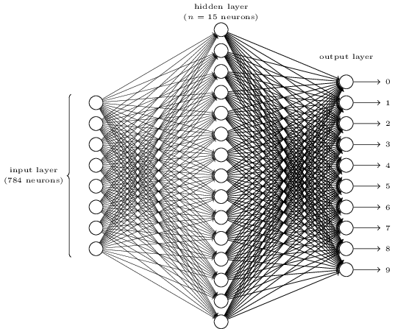
What is a neural network?

Slide 15
What is a neuron?

Slide 16
What is a neuron?
Perceptron

Slide 17
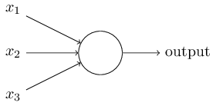
What is a neuron?
Perceptron

Slide 18
What is a neuron?
Perceptron

Slide 19
What is a neuron?
Perceptron

Slide 20
What is a neuron?
Perceptron

Slide 21
What is a neuron?
Perceptron

Slide 22
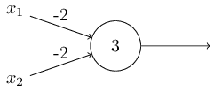
What is a neuron?
Perceptron

Slide 23
What is a neuron?
Perceptron

Slide 24
What is a neuron?
Perceptron
Notes:
Now that we have an idea of how this little machine works, lets stop and think what each respective part means. All the weights are doing are determining how important each respective input is, while the threshold or bias can be thought of as a measure of how easy it is to get the perceptron to output a 1. Ok, now that we understand what a neuron is, let’s put a few together and make a network.

Slide 25
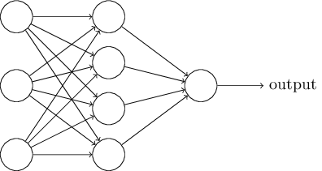
Architecture of Neural Netowrks

Slide 26

Architecture of Neural Netowrks

Slide 27

Architecture of Neural Netowrks

Slide 28

Architecture of Neural Netowrks

Slide 29


Architecture of Neural Netowrks

Slide 30
Architecture of Neural Netowrks
Need certain features to be able to learn
At extreme values, needs to give 0 or 1

Slide 31
Architecture of Neural Netowrks
Need certain features to be able to learn
At extreme values, needs to give 0 or 1 ✔

Slide 32
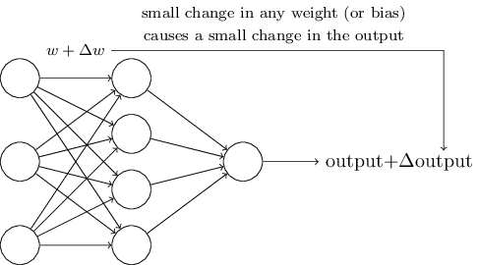
Architecture of Neural Netowrks

Slide 33
Architecture of Neural Netowrks
Need certain features to be able to learn
At extreme values, needs to give 0 or 1 ✔
Small changes in weights leads to small changes in output ✗

Slide 34
‘Better’ Neuron
Sigmoid

Slide 35
‘Better’ Neuron
Sigmoid

Slide 36
‘Better’ Neuron
Sigmoid

Slide 37
‘Better’ Neuron
Sigmoid

Slide 38
Architecture of Neural Netowrks
Need certain features to be able to learn
At extreme values, needs to give 0 or 1 ✔
Small changes in weights leads to small changes in output ✔

Slide 39
Cost Function

Slide 40
Cost Function

Slide 41
Cost Function
Quadratic Cost Function

Slide 42
Cost Function
Quadratic Cost Function

Slide 43
Cost Function
Quadratic Cost Function
New Goal: Minimize the cost function!

Slide 44
Cost Function
Quadratic Cost Function
New Goal: Minimize the cost function!
But how? Need a learning algorithm!

Slide 45
Gradient Descent

Slide 46
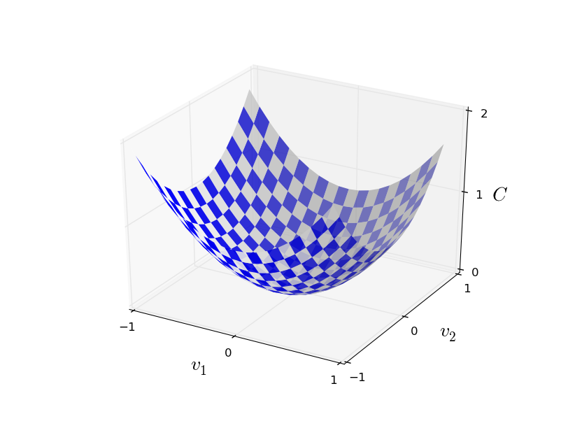
Gradient Descent

Slide 47
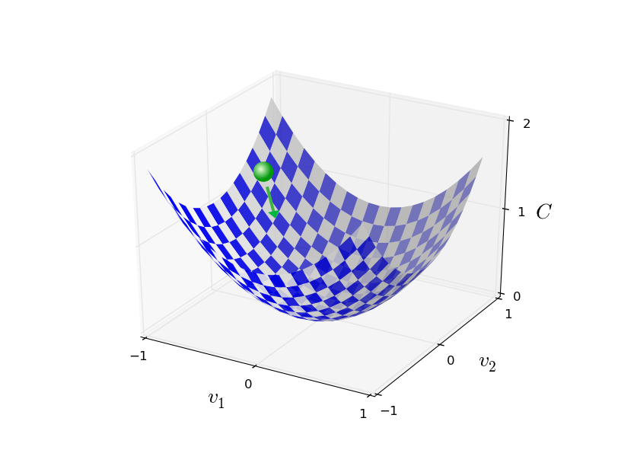
Gradient Descent

Slide 48
Gradient Descent

Slide 49
Gradient Descent

Slide 50
Gradient Descent

Slide 51
Gradient Descent

Slide 52
Gradient Descent

Slide 53
Gradient Descent

Slide 54
Gradient Descent

Slide 55
Stochastic Gradient Descent

Slide 56
Stochastic Gradient Descent

Slide 57
Stochastic Gradient Descent

Slide 58
Stochastic Gradient Descent

Slide 59
Stochastic Gradient Descent

Slide 60
Interchangeable Parts
Activation functions
How the weights + input determine the output
Perceptron, Sigmoid (logistic) function…
Cost/Loss/Objective functions
A way to measure how well we’re fitting the desired behavior
Quadratic cost (Mean squared error)…
Learning Algorithm
How our network minimizes the cost function
Gradient Descent, Stochastic Gradient Descent (SGD)…
Hyper-parameters
Various parameters that are tuned by us
Learning rate, mini-batch size, epochs of training, layers in neural network, etc...

Slide 61
The hard part has already been done!
TensorFlow, pyTorch, Theano, etc…

Slide 62

01000111 01101111 01101111 01100100 00100000 01101010 01101111 01110010 01100010 00100001

