Slide 1
Simulating the universe with hpc
Alex Fitts
IHPcss 6/26/16 – 7/02/16

Slide 2
collaborators
Advisor: Mike Boylan-Kolchin (UT Austin)
James Bullock (UCI)
Oliver Elbert
FIRE team
Phil Hopkins (Caltech)
Dusan Keres (UC San Diego)
Andrew Wetzel (Caltech)
Eliot Quataert (UC Berkley)
Claude-Andre Faucher-Giguere (UC Berkley)
Jose Onorbe (Max Planck)

Slide 3
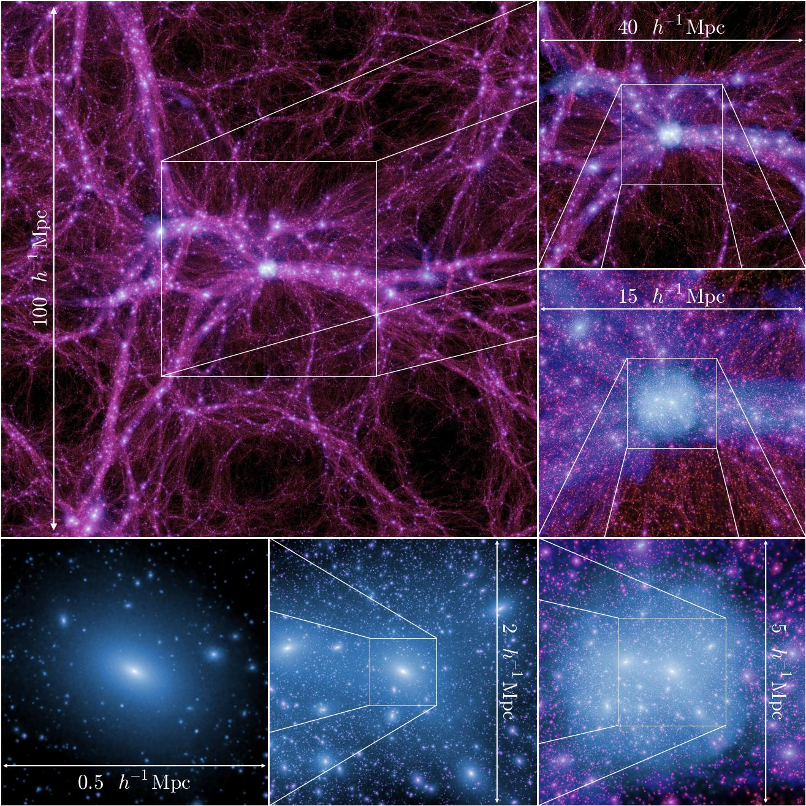
Boylan-Kolchin et al. 2009
Notes:
----- Meeting Notes (4/25/16 01:06) -----
In the standard cold dark matter (CDM) paradigm, the formation of galaxies is driven by the large-scale stucture of the universe and the formation of dark matter halos. Galaxies form by the c ooling and condensation of gas in the centers of the potential wells of extended virialized dark matter halos. in this picture, glaxy properties, such as luminosity or stellar mass, are expected to be tightly couple to th depth of the halo potential and thus to the mass.

Slide 4
Motivations
Dark matter makes up over 85% of all matter in the universe.
Our current theory is called Λ-Cold Dark Matter (ΛCDM).
Simulations only including ΛCDM (no stars, gas or planets, etc) do an excellent job reproducing the large scale structure and clustering of the universe.
All dark matter halos appear to individually follow an ‘NFW’ spatial distribution.
However there are certain ‘small scale issues’ that plague simulations.
Limit to our understanding of galaxy formation.
Question the nature of dark matter.
Notes:
have been excellent at matching observations of large scale structure, but remain imperfect at the low mass end.
Standard galaxy formation models have typically struggled to reproduce properties of dwarf galaxies.

Slide 5
Small scale issues
Missing Satellites
Core/cusp
Too-Big-to-Fail (TBTF)

Slide 6
Small scale issues
Missing Satellites
Results from dark matter only simulations predict a plethora of small structure that we just don’t observe.
Core/cusp
Too-Big-to-Fail (TBTF)

Slide 7
Small scale issues
Missing Satellites
Core/cusp
See lower density of matter in the center of certain (M_{vir}~10¹⁰ M) observed dwarf galaxies when compared with simulation.
Too-Big-to-Fail (TBTF)
Notes:
----- Meeting Notes (4/25/16 00:43) -----
Rotation curves of LSB and late-type, gas-rich dwarf galax- ies indicate the presence of constant-density or mildy cuspy (α ∼ −0.2) dark matter cores, contradicting the predictions of cosmological simulations. The most recent simulations still indicate resolved mass density slopes that are too steep to be easily reconciled with the observations (typically α ∼ −0.8 at a radius ∼ 0.1 kpc). Claims of shallow slopes at even smaller radii depend on the validity of the analytical description cho- sen for the mass-density profile.

Slide 8
Small scale issues
Missing Satellites
Core/cusp
Too-Big-to-Fail (TBTF)
The largest satellite dwarf galaxies in simulations are incompatible with the largest observed satellites.

Slide 9
Solutions
New theory of dark matter?
Warm Dark Matter
Self-interacting Dark Matter
Or maybe all the missing gas, stars, etc. are the answer!

Slide 10
Violent star formation
Star formation is bursty and violent.
In extreme cases, it can blow out all the gas in a galaxy and stop star formation. This seemingly ‘turns out the lights’ in the galaxy (i.e making them unobservable). If this occurred for enough satellite galaxies this could answer where all the missing satellites went!
This ‘feedback’ blows out mass in the very centers of the galaxy (i.e It can turn a cusp into a core!)
If the centers of the largest satellite galaxies in simulations had less mass in the center the could be compatible with observation! (i.e. solve the TBTF problem)

Slide 11
My simulations
GIZMO MFM code
FIRE feedback suite
10 isolated dwarfs at M_{vir}~10¹⁰ M+ 1 ultra-faint
Range of assembly histories
ε_{gas}~ 1.4 pc ε_{dm}~25 pc
M_{gas}~ 500 M, M_{dm}~ 2500 M
35³ Mpc³ box
Effective resolution of 2 x 8192³ particles
Notes:
----- Meeting Notes (4/24/16 22:44) -----
Explain isolation criteria.
Explain zoom in techinique.
----- Meeting Notes (4/25/16 10:19) -----
halos at z=0 have on the order of 1e6 dm particles and 1e4 star particles
----- Meeting Notes (5/25/16 14:10) -----
cluster star formation
resolve cluster function? if not hardwire it in!

Slide 12
Fitts et al (in prep) (2016? fingers crossed!!)
Do we find any trends in the global properties of halos at a fixed halo mass? Are they related to forming a core?
Better understand the slope in M* at a fixed M_{halo.}
Trend or stochastic?
Observables to better characterize the cores of halos.

Slide 13
Radial density profile and M*
Increasing stellar mass ➔➔➔➔➔➔
Notes:
Put stellar masses above each panel.

Slide 14
Core/cusp

Slide 16
M_{vir} vs time

Slide 17
Vmax vs time

Slide 18
More questions
Is this only an effect of stellar mass? Does it tell us anything else about the galaxy?
Are these cores constant or are they merely a temporary phenomena?

Slide 19
For larger galaxies, there appears to be a strong correlation between total mass and stellar mass.
Its not clear for smaller galaxies how stellar mass relates to the total mass of the galaxy. (I.e dwarfs at a specific mass can have a range of stellar masses.)
To better understand what dictates core formation I have run a suite of dwarfs at a specific total mass.

Slide 20
Too good to be true?
Why is this effect only observed in larger dwarfs?
I.e. Is the solution really that particular?
Larger galaxies follow a strict M_{DM}-M_{star} relation. Dwarfs don’t appear to follow this trend, or there at least appears to be a different slope for dwarfs.
Dwarfs are dominated by dark matter. Hence when we observe the movement (orbits) of stars and gas we can get a measure of the underlying mass of the dark matter.
Why isn’t this observed in all larger dwarfs?
Is this only an environmental effect or can these occur in isolation?

