Slide 1
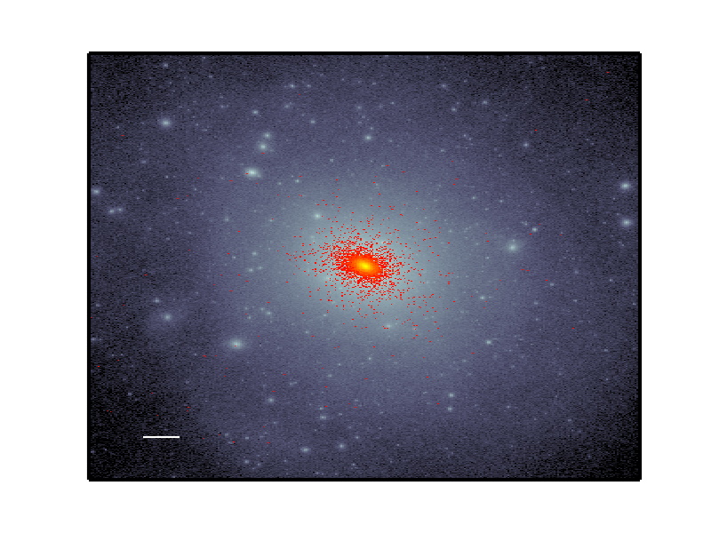
Fire in the field simulating the threshold of galaxy formation
Alex Fitts - Ut austin
Mike Boylan–Kolchin – UT Austin
James Bullock – UCI
Oliver Elbert – Uci
Jose oñorbe – Max Planck
Phil hopkins – caltech
and the fire team
Ut austin theory seminar 11/07/2016

Slide 2
motivation
Dwarf galaxies challenge ΛCDM theory
Notes:
Dwarf galaxies remain a thorn in our side when it comes to understanding dark matter and galaxy formation. And I’m going to cover (review) a few of the current issues to demonstrate this.

Slide 3
motivation
Dwarf galaxies challenge ΛCDM theory
Interesting scale at M_{vir}~10¹⁰ M, M★~10⁶ M
Notes:
To set the stage, we’re going to focus on a specific scale throughout my talk today.
ΛCDM simulations have had plenty of successes over the years, but they have also highlighted the limits of our understanding of dark matter and galaxy formation.
One particular scale where this is apparent is right around a halo mass of 10^10. This is the dwarf galaxy realm, specifically on the larger/classical end of things.
We see this limitations in our understanding in the form of two problems →

Slide 4
motivation
Dwarf galaxies challenge ΛCDM theory
Interesting scale at M_{vir}~10¹⁰ M, M★~10⁶ M
Core/cusp (Moore 1994, Flores-Primack 1994)
See cores in satellite galaxies, cusps in DMO simulations
Too Big to Fail (Boylan-Kolchin et al. 2011)
Most massive subhaloes don’t match brightest satellites
Notes:
Core/Cusp:
Rotation curves don’t match. Central density is much more peaked in DMO simulations than what we get from observational constraints.
Too Big to Fail:
Most massive subhaloes in MW-like dark matter halos are inconsistent with the dynamics of the brightest MW dwarf satellites. This is assuming both follow an NFW ‘cuspy’ profile. Assuming that a galaxy may have a different ‘cored’ profile, it is thought one may alleviate the tensions between simulation and observation.
Too big to Fail in M31 (Tollerud et al. 2014)
Too big to Fail in Field (Papastergis et al. 2014)

Slide 5
motivation
Dwarf galaxies challenge ΛCDM theory
Interesting scale at M_{vir}~10¹⁰ M, M★~10⁶ M
Core/cusp (Moore 1994, Flores-Primack 1994)
See cores in satellite galaxies, cusps in DMO simulations
Too Big to Fail (Boylan-Kolchin et al. 2011)
Most massive subhaloes don’t match brightest satellites
Crucial point for stellar feedback (Governato et al 2012, Di Cintio et al. 2014)
Notes:
Scale of faintest isolated dwarfs

Slide 6
motivation
Dwarf galaxies challenge ΛCDM theory
Interesting scale at M_{vir}~10¹⁰ M, M★~10⁶ M
Core/cusp (Moore 1994, Flores-Primack 1994)
See cores in satellite galaxies, cusps in DMO simulations
Too Big to Fail (Boylan-Kolchin et al. 2011)
Most massive subhaloes don’t match brightest satellites
Crucial point for stellar feedback (Governato et al 2012, Di Cintio et al. 2014)
Sensitive to reionization
Notes:
Scale of faintest isolated dwarfs

Slide 7
motivation
Dwarf galaxies challenge ΛCDM theory
Interesting scale at M_{vir}~10¹⁰ M, M★~10⁶ M
Core/cusp (Moore 1994, Flores-Primack 1994)
See cores in satellite galaxies, cusps in DMO simulations
Too Big to Fail (Boylan-Kolchin et al. 2011)
Most massive subhaloes don’t match brightest satellites
Crucial point for stellar feedback (Governato et al 2012, Di Cintio et al. 2014)
Sensitive to reionization
Scale of faintest observed isolated dwarfs
Notes:
Scale of faintest isolated dwarfs

Slide 8
Simulation details
15 isolated dark matter halos at M_{vir}~10¹⁰ M
Notes:
In an attempt to understand the relationship between halo assembly, galaxy formation and feedback’s effects on the central density structure in dwarf galaxies we have run…
Explain isolation criteria.
Explain zoom in technique.
Halos at z=0 have on the order of 1e6 dm particles and 1e4 star particles
Effective resolution of 2 x 8192³ particles

Slide 9
Simulation details
15 isolated dark matter halos at M_{vir}~10¹⁰ M
12 of 15 selected from 35³ Mpc³ boxes
ε_{gas}~ 1.4 pc, ε_{dm}~25 pc
M_{gas}~ 500 M, M_{dm}~ 2500 M
Notes:
In an attempt to understand the relationship between halo assembly, galaxy formation and feedback’s effects on the central density structure in dwarf galaxies we have run…
Explain isolation criteria.
Explain zoom in technique.
Halos at z=0 have on the order of 1e6 dm particles and 1e4 star particles
Effective resolution of 2 x 8192³ particles

Slide 10
Simulation details
15 isolated dark matter halos at M_{vir}~10¹⁰ M
12 of 15 selected from 35³ Mpc³ boxes
ε_{gas}~ 1.4 pc, ε_{dm}~25 pc
M_{gas}~ 500 M, M_{dm}~ 2500 M
GIZMO code + MFM hydro (Hopkins 2015)
Notes:
Explain isolation criteria.
Explain zoom in technique.
Halos at z=0 have on the order of 1e6 dm particles and 1e4 star particles
Effective resolution of 2 x 8192³ particles

Slide 11
Simulation details
15 isolated dark matter halos at M_{vir}~10¹⁰ M
12 of 15 selected from 35³ Mpc³ boxes
ε_{gas}~ 1.4 pc, ε_{dm}~25 pc
M_{gas}~ 500 M, M_{dm}~ 2500 M
GIZMO code + MFM hydro (Hopkins 2015)
FIRE-2 feedback (Hopkins et al. in prep)
Notes:
Explain isolation criteria.
Explain zoom in technique.
Halos at z=0 have on the order of 1e6 dm particles and 1e4 star particles
Effective resolution of 2 x 8192³ particles

Slide 12
Simulation details
15 isolated dark matter halos at M_{vir}~10¹⁰ M
12 of 15 selected from 35³ Mpc³ boxes
ε_{gas}~ 1.4 pc, ε_{dm}~25 pc
M_{gas}~ 500 M, M_{dm}~ 2500 M
GIZMO code + MFM hydro (Hopkins 2015)
FIRE-2 feedback (Hopkins et al. in prep)
Stellar Feedback – Rad. Pressure, SNe + stellar mass loss, photo-ion. + photo-heat.
Notes:
Explain isolation criteria.
Explain zoom in technique.
Halos at z=0 have on the order of 1e6 dm particles and 1e4 star particles
Effective resolution of 2 x 8192³ particles

Slide 13
Simulation details
15 isolated dark matter halos at M_{vir}~10¹⁰ M
12 of 15 selected from 35³ Mpc³ boxes
ε_{gas}~ 1.4 pc, ε_{dm}~25 pc
M_{gas}~ 500 M, M_{dm}~ 2500 M
GIZMO code + MFM hydro (Hopkins 2015)
FIRE-2 feedback (Hopkins et al. in prep)
Stellar Feedback – Rad. Pressure, SNe + stellar mass loss, photo-ion. + photo-heat.
Stellar Formation – self-gravitating, self-shielding, molecular, Jeans-unstable
Notes:
Explain isolation criteria.
Explain zoom in technique.
Halos at z=0 have on the order of 1e6 dm particles and 1e4 star particles
Effective resolution of 2 x 8192³ particles

Slide 14
Simulation details
15 isolated dark matter halos at M_{vir}~10¹⁰ M
12 of 15 selected from 35³ Mpc³ boxes
ε_{gas}~ 1.4 pc, ε_{dm}~25 pc
M_{gas}~ 500 M, M_{dm}~ 2500 M
GIZMO code + MFM hydro (Hopkins 2015)
FIRE-2 feedback (Hopkins et al. in prep)
Stellar Feedback – Rad. Pressure, SNe + stellar mass loss, photo-ion. + photo-heat.
Stellar Formation – self-gravitating, self-shielding, molecular, Jeans-unstable
Gas Cooling – follows an ionized+atomic+molecular cooling curve from 10 to 10¹⁰K
Notes:
Explain isolation criteria.
Explain zoom in technique.
Halos at z=0 have on the order of 1e6 dm particles and 1e4 star particles
Effective resolution of 2 x 8192³ particles

Slide 15
Simulation details
15 isolated dark matter halos at M_{vir}~10¹⁰ M
12 of 15 selected from 35³ Mpc³ boxes
ε_{gas}~ 1.4 pc, ε_{dm}~25 pc
M_{gas}~ 500 M, M_{dm}~ 2500 M
GIZMO code + MFM hydro (Hopkins 2015)
FIRE-2 feedback (Hopkins et al. in prep)
Stellar Feedback – Rad. Pressure, SNe + stellar mass loss, photo-ion. + photo-heat.
Stellar Formation – self-gravitating, self-shielding, molecular, Jeans-unstable
Gas Cooling – follows an ionized+atomic+molecular cooling curve from 10 to 10¹⁰K
Reionization – redshift-dependent, spatially uniform UV background
Notes:
Explain isolation criteria.
Explain zoom in technique.
Halos at z=0 have on the order of 1e6 dm particles and 1e4 star particles
Effective resolution of 2 x 8192³ particles

Slide 16
Kirby et al. 2013, 2014

Slide 17
Mass assembly Histories
Notes:
Lets first look at the global properties of my halos…
Black dashed line is the mean mass assembly history for all the halos at this mass range in the Millennium II simulations.
Assembly history spread not m vir spread

Slide 18
Mass assembly Histories
Simulations
Mean Assembly History
(Fakhouri 2010)
Notes:
Black dashed line is the mean mass assembly history for all the halos at this mass range in the Millennium II simulations.
Assembly history spread not m vir spread

Slide 19
A glance at M★
Notes:
Look at the spread of Mstar with such a narrow range of Mvir.

Slide 20
A glance at M★
Note narrow range of halo masses
Notes:
Look at the spread of Mstar with such a narrow range of Mvir.

Slide 21
Mass assembly histories

Slide 22
Mass assembly histories
m10a
No stars

Slide 23
V_{max} through time

Slide 24
V_{max} through time
Increasing
Stellar Mass

Slide 25
V_{max} through time
Reionization heating
Notes:
Facher-Giguere et al. 2009 for line

Slide 26
Skillman et al. 2014
Notes:
Self – quenching halos!
These halos have no cold gas at z = 0, indicating this self-quenching is likely to be long-lived. At slightly higher masses, quenched field galaxies are either extremely rare or exceedingly hard to detect at cosmological distances (Geha et al. 2012). The self-quenched galaxies in our sample raise the intriguing possibility of a larger population of self-quenched halos at low stellar masses

Slide 27
Star formation rate
Notes:
The star formation rate correlates with stellar mass implying that galaxies with larger stellar masses have likely experienced larger feedback-driven outflows that are likely to affect the central potential.

Slide 28
Radial density profiles
r_{1/2}

Slide 29
Radial density profiles
All galaxies have same halo mass of ~10¹⁰ M
No cores for halos with M★< ~2×10⁶ M (Governato et al. 2012, Di Cintio et al. 2014, Dutton et al. 2016)

Slide 30
Radial density profiles
Increasing M★
Decreasing Central Density

Slide 31
Radial density profiles
Increasing M★
Notes:
Draw arrow as build increasing stellar mass, decreasing central density another arrow showing this sets in at half light radius

Slide 32
Radial density profiles
Increasing M★
Notes:
Draw arrow as build increasing stellar mass, decreasing central density another arrow showing this sets in at half light radius

Slide 33
Central density reduction vs stellar mass

Slide 34
Radial density profiles

Slide 35
Stellar mass vs dmo central density

Slide 41
Conclusions
15 high-resolution gizmo + FIRE simulations of isolated dwarf halos, all with M_{vir}(z=0) ~ 10¹⁰ M
Good agreement between simulations and observed isolated dwarfs for M★(z=0), SFH, R_{1/2}, M_{dyn}/M★ and σ★.

Slide 42
Conclusions
15 high-resolution gizmo + FIRE simulations of isolated dwarf halos, all with M_{vir}(z=0) ~ 10¹⁰ M
Good agreement between simulations and observed isolated dwarfs for M★(z=0), SFH, R_{1/2}, M_{dyn}/M★ and σ★.
Strong correlation between early dark matter mass assembly and present-day stellar mass
higher concentration, higher V_{max} halos build up more stellar mass earlier
Strong correlation between the central density in the dark-matter-only version of each halo and the present-day stellar mass.
Central density in DMO simulations may serve as a "second parameter" in setting stellar masses at fixed dark matter halo mass.
Notes:
denser halos (in the DMO run) form more stars

Slide 43
Conclusions
M★(z=0) correlates well with density reduction
No modification from dark-matter-only simulations below M★~10⁶ M, density reduction and dark matter cores at higher stellar masses
Future work: dwarfs in WDM (including hydro; currently running with Brandon Bozek), SIDM (including hydro; Robles et al. in prep), reionization’s role, self-quenching galaxies, etc.

Slide 44
Thank you
-Learn to find the main points
-Don’t oversell fire
-NO one has focused on this mass scale. People have simulated a huge range of mass scale
- Don’t show M_star vs M_halo, Its not your battle
Don’t say my sims so much.
Don’t oversell that you found a starless halo, its interesting (in how its related to reionization) but its been done
Need to learn to deflect questions that are pit falls
Reionization prevents new accretion of gas NOT evaporation of hot gas
From observed SHFS these are isolated fields not satellites
Higher stellar mass is not necessarily burstier.
Self quench may not mean anything to people. Give one sentence description
Give context of conclusions
Adding fitts et al to all plots is great for advertising.

Slide 45
extras

Slide 47
convergence

Slide 48
convergence

