Slide 1

Predicting IT Hardware Service Times and Technician Performance Using Machine Learning
Md. Afjal Hossan Shajal
ID: 232217
Session: Summer 2023

Slide 2
Presentation Outline
Introduction
Objectives
Literature Review
Data Collection
Methodology
Results
Interface
Future Work
Conclusion

Slide 3
Introduction
In the digital world, without IT servicing management, especially hardware maintenance, we cannot think of modern civilisation. Because most of the people are directly or indirectly connected to IT hardware (ITH).
In developing countries, manual IT support processes cause delays, inefficiency, and poor user experience due to unclear technician assignment and problem resolution timelines.
This research shows a way to improve IT support by using machine learning. It will make support faster, smarter, and more helpful in reaching the company’s goals.

Slide 4
Objectives
The main objective of this research is to create a system using ML algorithms and an IT hardware servicing dataset to make the IT servicing process faster and easier.
The prepared dataset will then be used to train and test ML algorithms (RFC, XGBoost, LightGBM, RF Regressor, and GB Regressor). The training will have two targets (Classification and Regression).
Finally, the results from both targets will be used together to create a UI that will make the hardware support system modern, accurate, simple, and faster, and it will show us the results of the training.

Slide 5
Literature Review
No | Paper | Method | Accuracy/MSE
1 | A Deep Learning Based IT Service Desk Ticket Classifier Using CNN | SVM, LR, KNN | 91.2% (SVM)
2 | Random Forest-Based Machine Failure Prediction: A Performance Comparison | NB, SVM, LR, RF | 99.5% (RF)
3 | Performance Evaluation of ML Techniques on Resolution Time Prediction in Helpdesk Support System | RF, SVM, DT, LR, XGBoost. | 95% (LR), 6.29(XGBoost)
4 | Food Delivery Time Prediction in Indian Cities Using ML Models | LR, RF, DT, XGBoost, LightGBM | 20.59(LightGBM)
5 | A ML-based help desk system for IT service management | SVM | 81.4% (SVM)
Table 1: Literature Review.

Slide 6
Data Collection
The dataset employed in this research was sourced from our office.
It represents an initial collection featuring multiple variables, from which 8 key attributes were selected to predict IT hardware service times and technician performance using ML algorithms.
11

Slide 7
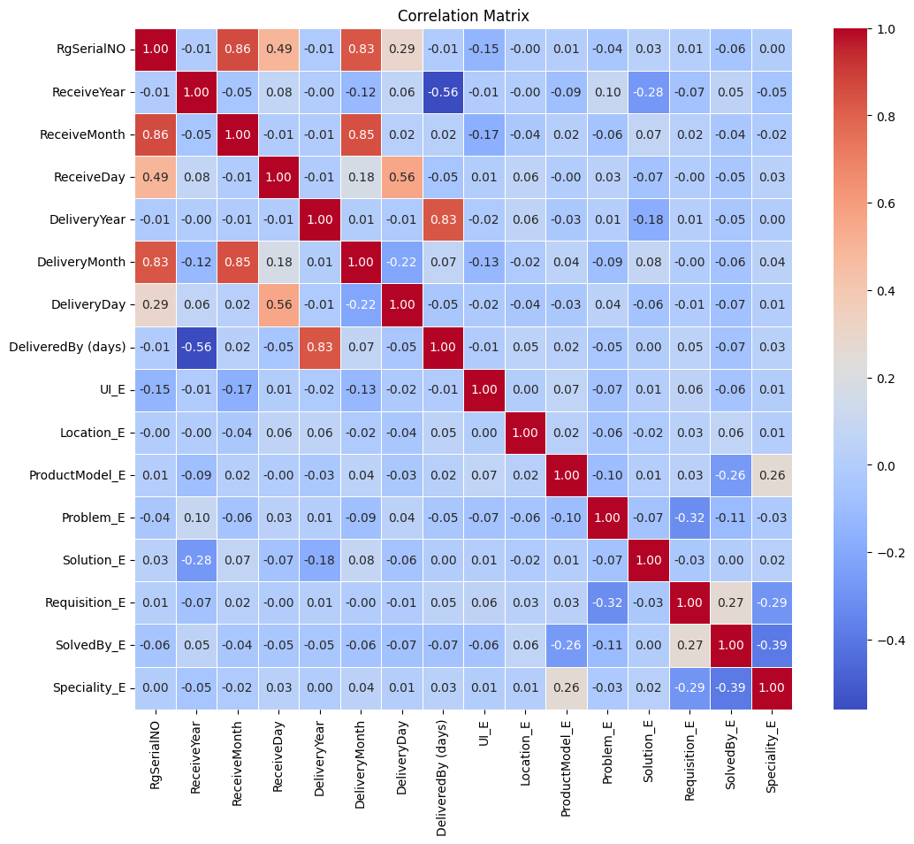
Correlation Plot

Slide 8
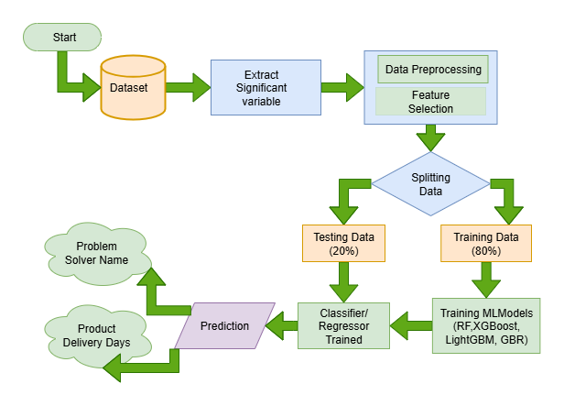
Proposed Model Workflow

Slide 9
Machine Learning Models
Random Forest (RF)
Extreme Gradient Boosting (XGBoost)
Light Gradient Boosting Machine (LightGBM)
Gradient Boosting Regressor (GBR)

Slide 10
Performance Measure Unit
Accuracy: (TP + TN) / (TP + TN + FP + FN) — overall correctness of the model
Precision: TP / (TP + FP) — proportion of true positives among predicted positives
Recall: TP / (TP + FN) — proportion of true positives among actual positives
F1-Score: 2 * (Precision * Recall) / (Precision + Recall) — harmonic mean of precision and recall
Definitions: TP = True Positive, FP = False Positive, TN = True Negative, FN = False Negative

Slide 11
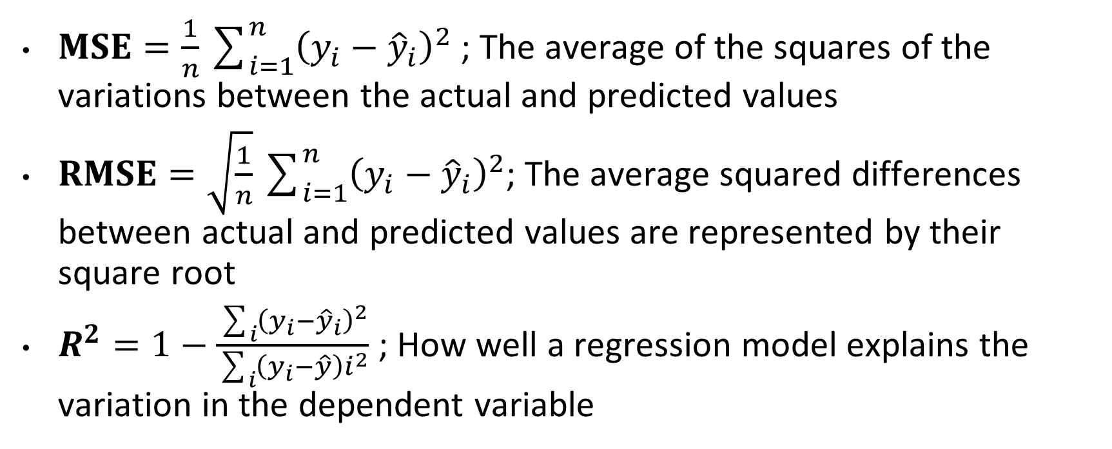
Performance Measure Unit
$MSE=\frac{1}{n}\sum_{i=1}^{n}{{\left(y_{i}−{\hat{y}}_{i}\right)}^{2}}$ ; The average of the squares of the variations between the actual and predicted values
$RMSE=\sqrt{\frac{1}{n}}\sum_{i=1}^{n}{{\left(y_{i}−{\hat{y}}_{i}\right)}^{2}}$; The average squared differences between actual and predicted values are represented by their square root
$R^{2}=1−\frac{\sum_{i}{{\left(y_{i}−{\hat{y}}_{i}\right)}^{2}}}{\sum_{i}{\left(y_{i}−\hat{y}\right)i^{2}}}$ ; How well a regression model explains the variation in the dependent variable

Slide 12
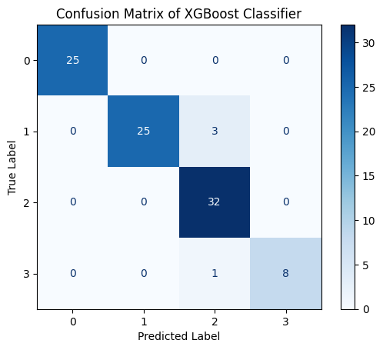


Confusion Matrix For Three Algorithm

Slide 13
Results for Classification
Models | Precission | Recall | F1-Score | Accuracy
RF | 0.96 | 0.96 | 0.96 | 96%
XGBoost | 0.96 | 0.96 | 0.96 | 96%
LightGBM | 0.96 | 0.96 | 0.96 | 96%
Table 4: Model Testing Results.
Institute of Information Technology, Jahangirnagar University

Slide 14

Results for Regression
Models | MSE | RMSE | R^2
RF | 13.09 | 3.62 | 0.57
GBR | 17.28 | 4.16 | 0.43

Slide 15
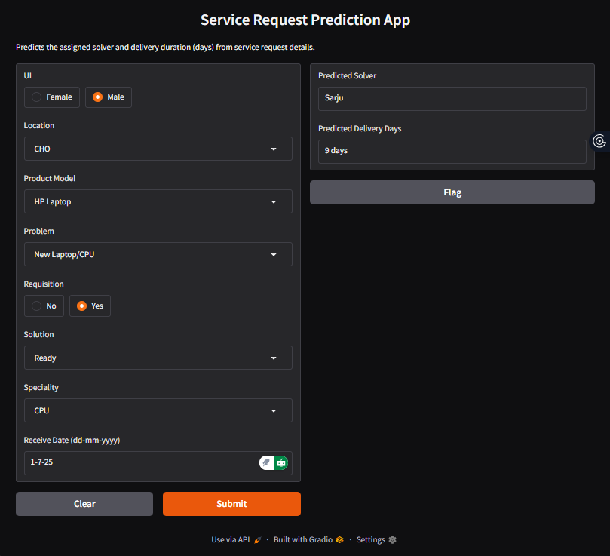
Interface of the Project

Slide 16
Conclusion
In modern offices in Bangladesh and other countries, IT hardware such as laptops, CPUs, monitors, UPS, and printers is used every day.
This study used machine learning to predict IT hardware service times and technician performance.
Three ML algorithms were tested for accuracy, and two ML algorithms were tested for regression.
The design performed well with over 96% accuracy on the IT problem solver name and an average error of 3.62 days for the time forecast of resolution.
The UI has successfully displayed the results.

Slide 17
Future Work
Future upgrades will include real-time data and datasets from many corporate offices to improve the IT support system’s efficiency and acceptance in Bangladesh and other countries.
Add more advanced models, such as deep learning.
An attempt will be made to update the user interface for IT servicing management of any small or large corporate offices.
Expand research and aim to publish.

Slide 18
Thank You

