Slide 1







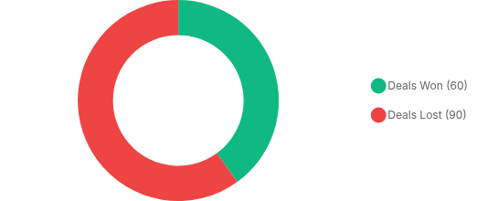
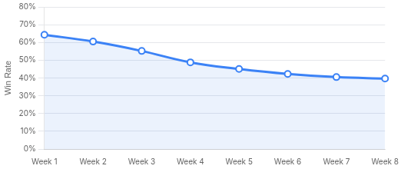
Executive Summary
Bob's Builders Sales Performance Analysis (Aug 6 - Sep 28, 2025)
150
5
40.0%
3.34
54.9m
Sales Conversations
Sales Representatives
Overall Win Rate
Avg Skill Score (/5)
Avg Call Duration
Critical Finding: Significant Performance Decline
analysis.py#L94-L111
Win rate dropped from 64.29% in the first week to 39.64% in the final week. Concurrently, average skill scores declined by 15% (4.10 to 3.50), indicating a shift in sales behavior away from proven techniques.
Outcome Distribution (n=150)
Win Rate Trend (Aug 6 - Sep 28)
Data Source: analysis.py#L33-L111
Temporal Analysis: analysis.py#L94-L111
Slide 1 of 6

Slide 2

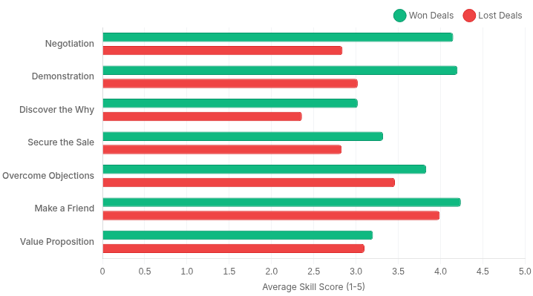


Skill Scores Strongly Predict Outcomes
Consistently Higher Performance Across All 7 Skills in Won Deals
Average Skill Score Comparison: Won vs Lost
Top Predictive Skills
Negotiation and Demonstration skills show the largest gap between success and failure, indicating these are decisive factors.
Negotiation Gap
+46%
Demonstration Gap
+39%
Discover "Why" Gap
+28%
Consistent Correlation
Every single evaluated skill shows a higher average score for won deals, validating the grading rubric's effectiveness in identifying success drivers.
Even "Value Proposition", with the smallest gap (+3%), still favors successful outcomes.
Source: Siro DS Takehome Analysis • 2025-11-20
Slide 2 of 6
Code Reference:
analysis.py#L120-L133
(Calculation) •
analysis.py#L280-L295
(Visualization)

Slide 3
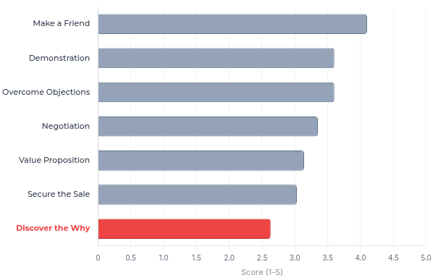


"Discover the Why" is the Weakest Skill
Foundational Gap: High Variability and Missed Opportunities for Connection
Average Skill Scores Across All Categories (1-5 Scale)
AVERAGE SCORE
LOW SCORE (1/5) FREQ.
2.63
/ 5.0
23.2%
(33 calls)
WON DEAL AVG
LOST DEAL AVG
3.02
2.36
LLM Identified Gaps
Weak Probing: Reps miss direct questions about customer motivation (e.g., "What is driving your decision today?").
Missing Summaries: Frequent failure to recap customer needs before pitching solutions.
⚠ Critical Finding
Premature Incentives: Discussing price/discounts before understanding the core "why" behind the purchase.
Lowest average score (2.63) with high Standard Deviation (1.21), indicating inconsistent execution.
Recommended Interventions
Standardize discovery phase to uncover emotional drivers:
Mandatory Needs Recap
"Why Now" Scripting
Motivation Checklist
Source: Siro DS Takehome Analysis
Code:
analysis.py#L134-L167
(Stats),
llm_analysis.py#L108-L149
(LLM)
Slide 3 of 6

Slide 4

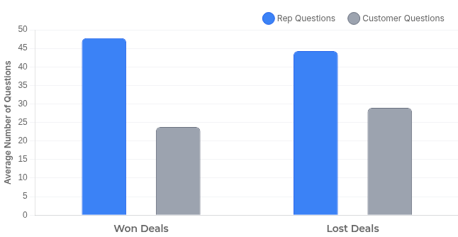

Question Strategy Differs Between Won and Lost Deals
Successful Reps Ask More Questions and Control the Conversation Flow
Question Volume & Ratio by Outcome
The "Golden Ratio"
Successful deals maintain a 2:1 ratio of rep-to-customer questions, indicating proactive discovery and leadership.
2.0
1.5
WON DEAL RATIO
LOST DEAL RATIO
Strategic Implications
Better Discovery
+3.5 Qs
More rep questions
Less Confusion
-5.2 Qs
Key Observation: In won deals, reps ask 3.5 more questions while customers ask 5.2 fewer questions compared to lost deals.
Fewer customer questions
High customer question volume in lost deals suggests unresolved doubts, lack of clarity, or the rep losing control of the agenda.
Source: Siro DS Takehome Analysis • 2025-11-20
|
Code:
analysis.py#L168-L206
analysis.py#L300-L315
Slide 4 of 6

Slide 5

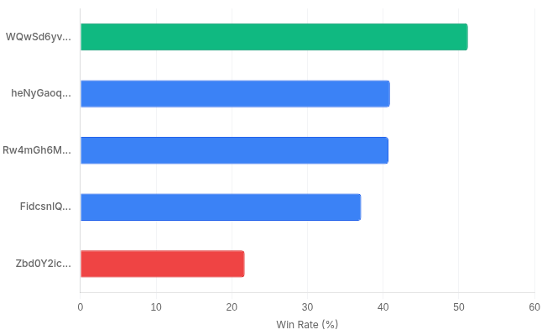


Significant Performance Variation Across Reps
Win Rates Vary Dramatically (2.4x Difference) Despite Similar Skill Scores
Win Rate by Sales Representative
Performance Gap
There is a 2.4x difference between the highest (51.2%) and lowest (21.7%) win rates.
Top performer handles 29% of all recordings.
Representative Performance Metrics
USER ID
RECORDINGS
WIN RATE
AVG SKILL
WQwSd6yv...
43
51.2%
3.24
heNyGaoq...
22
40.9%
3.20
Rw4mGh6M...
27
40.7%
3.20
FidcsnIQ...
35
37.1%
3.11
Zbd0Y2ic...
23
21.7%
3.00
Recommended Action
Implement peer coaching program where top performers mentor those with lower conversion rates.
Source: Siro DS Takehome Analysis • 2025-11-20
Code:
analysis.py#L207-L246
(Stats),
analysis.py#L320-L335
(Viz)
Slide 5 of 6

Slide 6

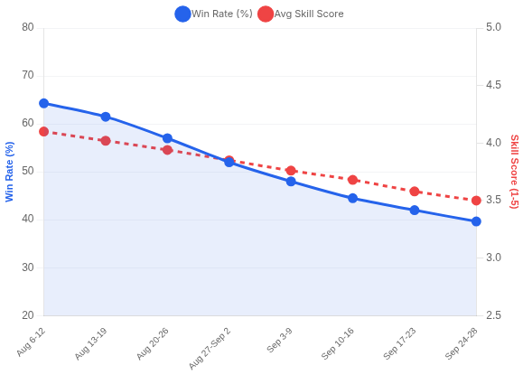




Performance Decline Over Time - LLM Deep Dive
Win Rate Dropped 24.6 Points; Skill Scores Declined 15% (Aug 6 - Sep 28)
Win Rate & Skill Score Trends (Weekly Analysis)
1. Shift to Transactional Approach
Early period (Aug 6-15) prioritized authentic connections and systematic discovery. Late period (Sep 15-28) shifted to transactional interactions, reducing trust.
2. Less Name Usage & Personalization
Consistent use of customer names and personalized questions dropped significantly in later weeks, leading to lower customer engagement.
3. Failure to Secure Explicit Agreement
Reps failed to confirm resolution of objections or gain progressive agreement on price/timing, causing ambiguity at the close.
4. Missing Clear Closing Questions
Unlike the early period, later calls lacked clear closing questions and follow-up confirmations, resulting in missed commitments.
Immediate Interventions
Training: Focus on authentic connections & securing explicit agreement.
Protocol: Mandate name usage and personalized discovery questions.
Win Rate: 64.29% → 39.64%
Skill Score: 4.10 → 3.50
Structure: Reinforce "permission to question" & emotional driver discovery.
Process: Implement clear closing checklists with confirmation steps.
Source: Siro DS Takehome • LLM Analysis of Recommendations & Impacts
Temporal Analysis: analysis.py#L94-L111
LLM Root Causes: llm_analysis.py#L150-L194

