Slide 1
Cover pls

Slide 2
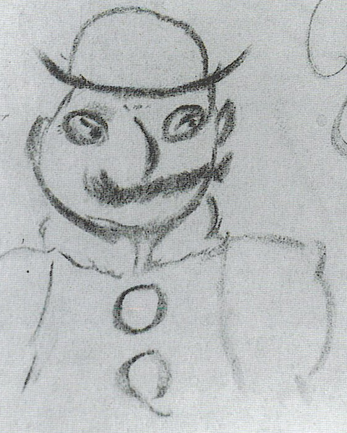
James Joyce - Ulysses
Publish 1922 in Paris
A school essay escalated
Based on Homers Odyssey
Illustrates the ordinary day of Leopold Bloom with parallels to the chapters and events of Odyssey
Includes themes of irish identity and nationalism, religion, fate vs. free will, love and sex, alienation and belonging

Slide 3
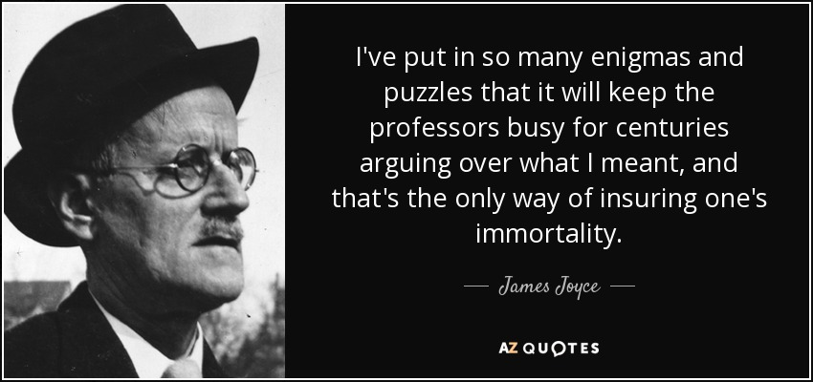

Slide 4
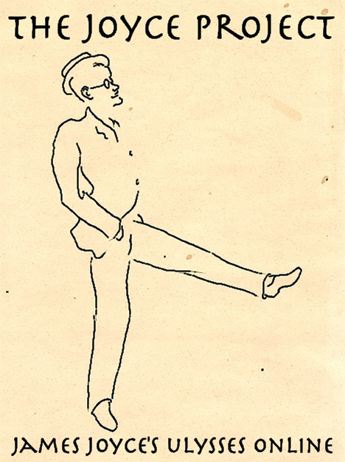
The Joyce Project
Website with annotated Ulysses chapters
Links to further information and resources
NAME
WEBSITE
Folie ändern

Slide 5
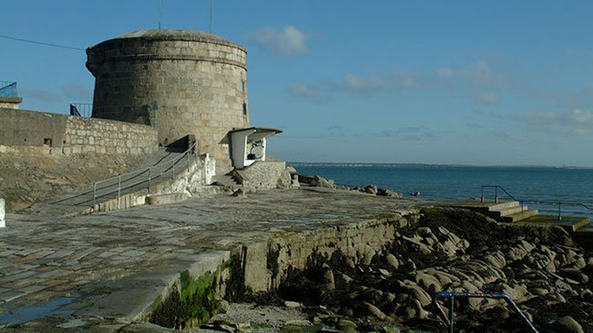
Dublin Deep Map based on Ulysses
Deep Map
Focus on of irish identity and nationalism
Points of interest through time
1883: historical relevance
1907: setting of Ulysses
Today: Joyce imprint on Dublin
How did Ulysses influenced places in Dublin?
Bild drehen

Slide 6
Tech Stack
Python
BeautifulSoup
spacy
Leaflet
Leaflet.ImageOverlay.Rotated from Iván Sánchez Ortega
Schickes Bild

Slide 7
Live Demo

Slide 8
Next steps
Implementing the second overlay
Formatting the results of the web scraping for spacy
Analyzing and filtering the data
Structuring data for popups

Slide 9
Thank you for your attention! Finishing Quote???

