Slide 1
Assignment7 Comparison of Regression method
12146304
Sung-je Kim

Slide 2
Objective
We have two data files for Rossman Sales prediction: “store.csv” and “train.csv”
Will be preprocessed
Was preprocessed
ID | Continuous | Categorical | Datetime
Store | Customers, CompetitionDistance | DayofWeek, Open, StateHoliday, SchoolHoliday, StoreType, Assortment, Promo, Promo2, PromoInterval | Date CompetitionOpenSince [Month/Year], Promo2Since[Year/Week]
How to use Customers
How to use CompetitionDistance -> Preprocessed in class
How to use PromoInterval
How to use CompetitionOpenSince[Month/ Year] -> Preprocessed in class
How to use Promo2Since[Year/ Week]
Explanatory Variable Preprocessing

Slide 3
Preprocessing
Continuous
Customers, CompetitionDistance
How to use “Customers” I just used Customers data without any processing.
Categorical
DayofWeek, Open, StateHoliday, SchoolHoliday, StoreType, Assortment, Promo, Promo2, PromoInterval
How to use “PromoInterval” “PromoInterval” is consisted of [nan, 'Jan,Apr,Jul,Oct', 'Feb,May,Aug,Nov', 'Mar,Jun,Sept,Dec’] I made dummy for this categorical variable
Datetime
Date CompetitionOpenSince [Month/Year], Promo2Since[Year/Week]
How to use “Promo2Since[Year/ Week]” We could handle CompetitionOpenSince[Month/Year] using datetime. However, Week could not be converted to Month directly using datetime. Therefore, I used some trick for converting like above code. And then, I did same way like CompetitionOpenSince.

Slide 4
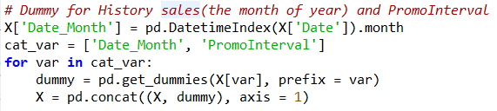
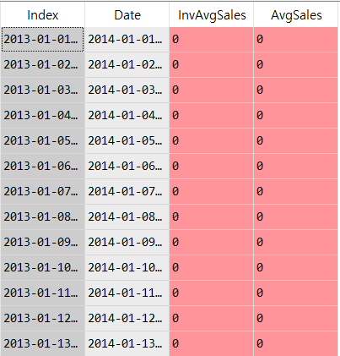
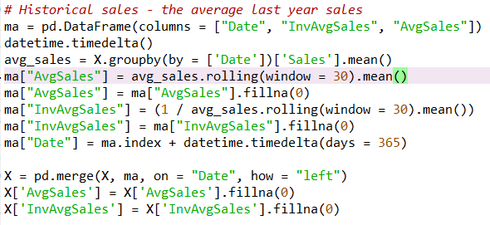
Preprocessing (Cont.)
Historical Sales 1) To create the month of year – Dummy 2) To create the average last year sales – rolling window calculation

Slide 5
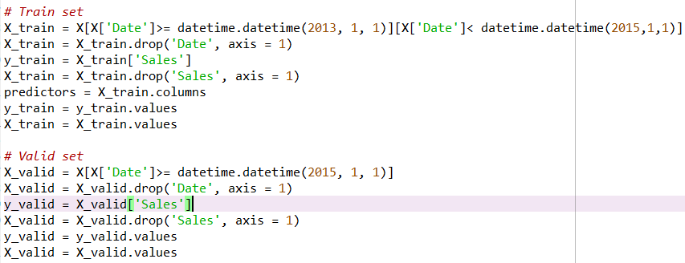
Training Set & Split Data
I dropped useless column for analysis because they were already used for preprocessing.
I assorted Data to separate Train set and Valid set using datetime .

Slide 6
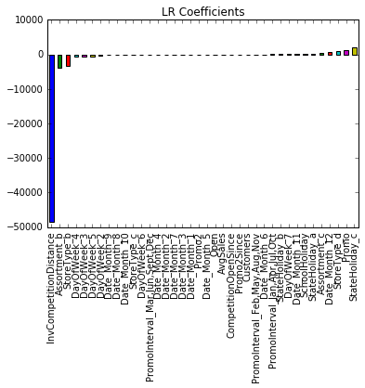
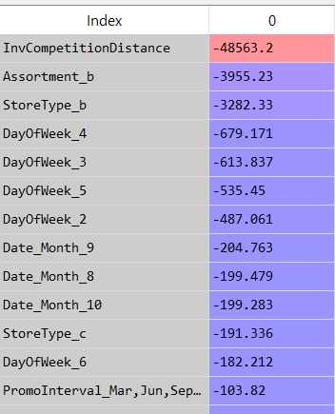
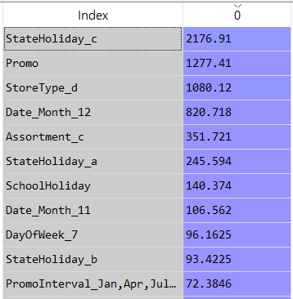
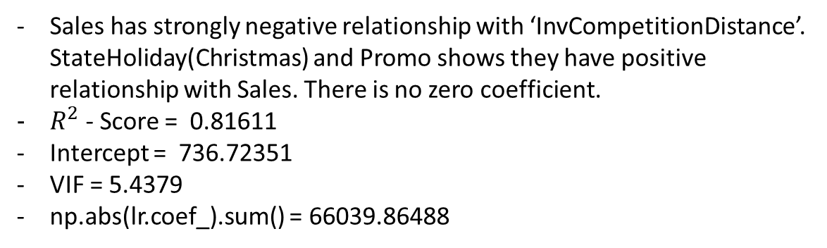
Regression Comparision - Linear
Linear Regression
Sales has strongly negative relationship with ‘InvCompetitionDistance’. StateHoliday(Christmas) and Promo shows they have positive relationship with Sales. There is no zero coefficient.
$R^{2}$- Score = 0.81611
Intercept = 736.72351
VIF = 5.4379
np.abs(lr.coef_).sum() = 66039.86488
< Coefficients >

Slide 7

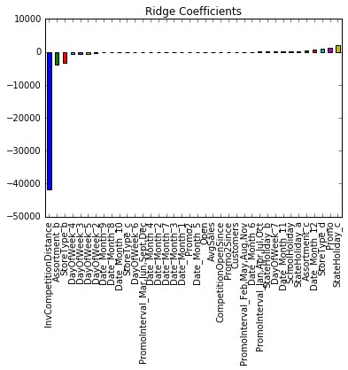
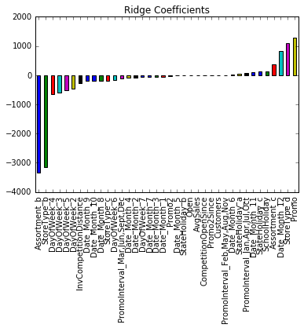
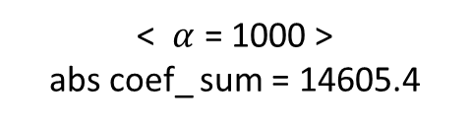
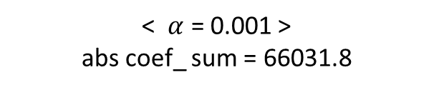
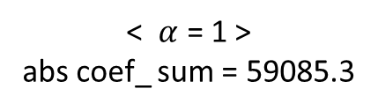


Regression Comparision - Ridge
Ridge Regression
$∥coef∥$ increase
$∥coef∥$ decrease → close to 0
< $α$ = 0.001 > abs coef_ sum = 66031.8
< $α$ = 1 > abs coef_ sum = 59085.3
< $α$ = 1000 >
abs coef_ sum = 14605.4

Slide 8
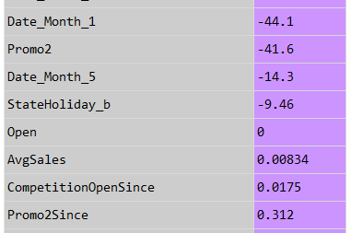
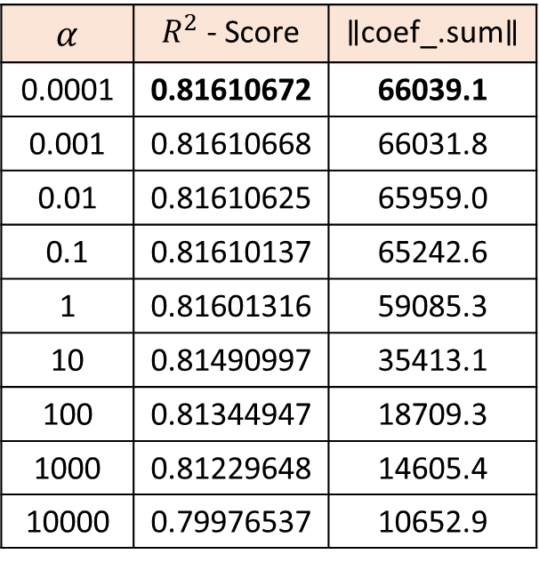
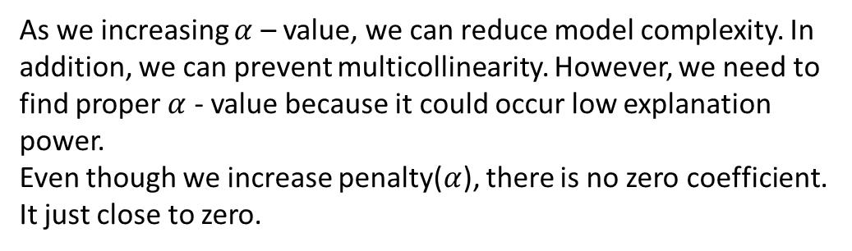
Regression Comparision – Ridge (Cont.)
Ridge Regression (Cont.)
$α$ | $R^{2}$- Score | $∥$coef_.sum$∥$
0.0001 | 0.81610672 | 66039.1
0.001 | 0.81610668 | 66031.8
0.01 | 0.81610625 | 65959.0
0.1 | 0.81610137 | 65242.6
1 | 0.81601316 | 59085.3
10 | 0.81490997 | 35413.1
100 | 0.81344947 | 18709.3
1000 | 0.81229648 | 14605.4
10000 | 0.79976537 | 10652.9
As we increasing $α$ – value, we can reduce model complexity. In addition, we can prevent multicollinearity. However, we need to find proper $α$ - value because it could occur low explanation power. Even though we increase penalty($α$), there is no zero coefficient. It just close to zero.
(Open → All values are same)

Slide 9
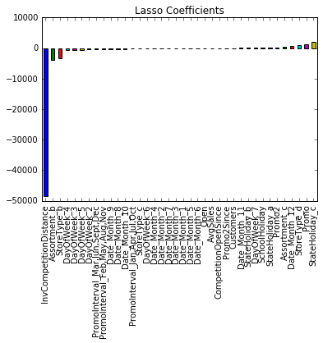
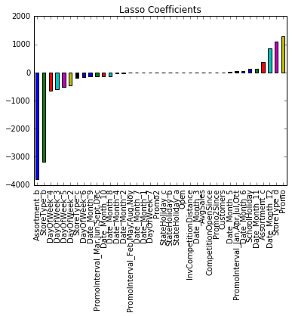
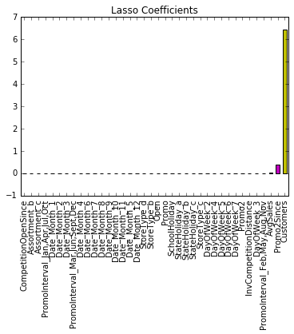
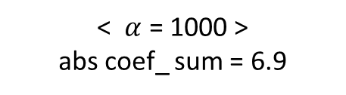
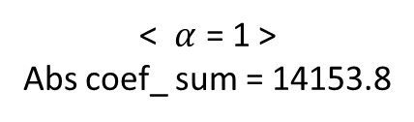
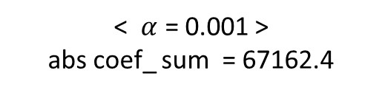
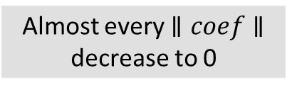

Regression Comparision - Lasso
Lasso Regression
$∥coef∥$ decrease to 0
Almost every $∥coef∥$ decrease to 0
< $α$ = 0.001 >
abs coef_ sum = 67162.4
< $α$ = 1 >
Abs coef_ sum = 14153.8
< $α$ = 1000 >
abs coef_ sum = 6.9

Slide 10
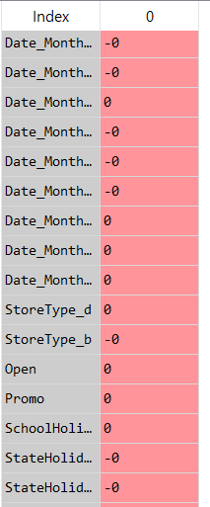
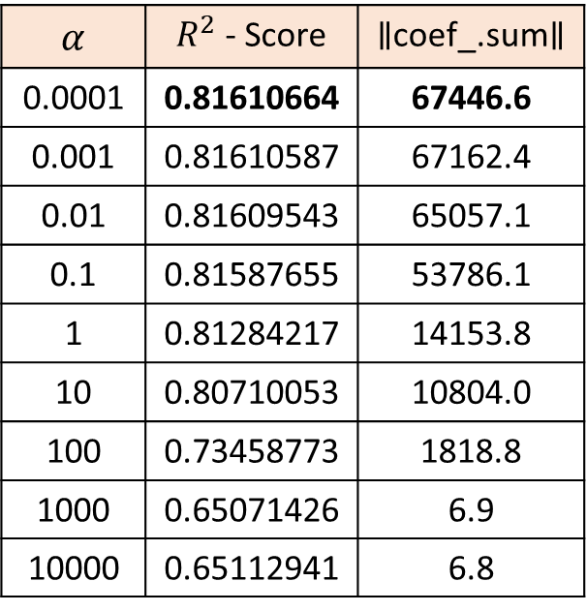
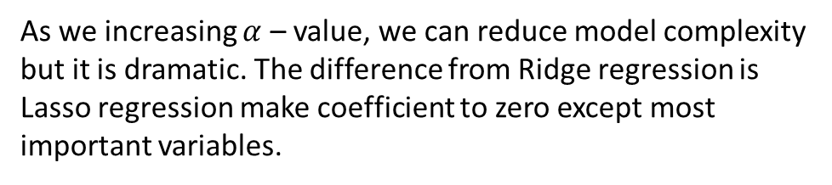
Regression Comparision – Lasso (Cont.)
Lasso Regression (Cont.)
$α$ | $R^{2}$- Score | $∥$coef_.sum$∥$
0.0001 | 0.81610664 | 67446.6
0.001 | 0.81610587 | 67162.4
0.01 | 0.81609543 | 65057.1
0.1 | 0.81587655 | 53786.1
1 | 0.81284217 | 14153.8
10 | 0.80710053 | 10804.0
100 | 0.73458773 | 1818.8
1000 | 0.65071426 | 6.9
10000 | 0.65112941 | 6.8
As we increasing $α$ – value, we can reduce model complexity but it is dramatic. The difference from Ridge regression is Lasso regression make coefficient to zero except most important variables.

Slide 11
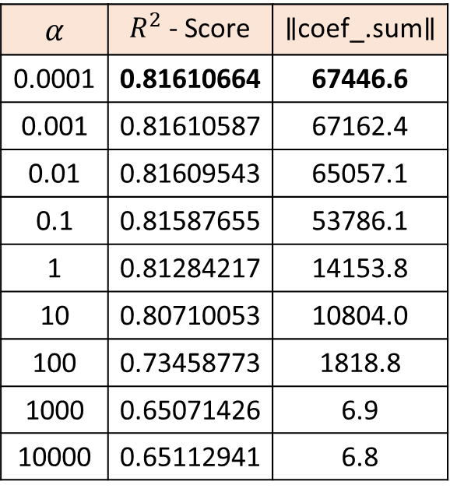
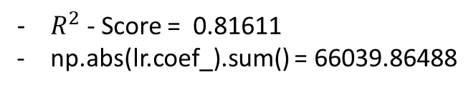
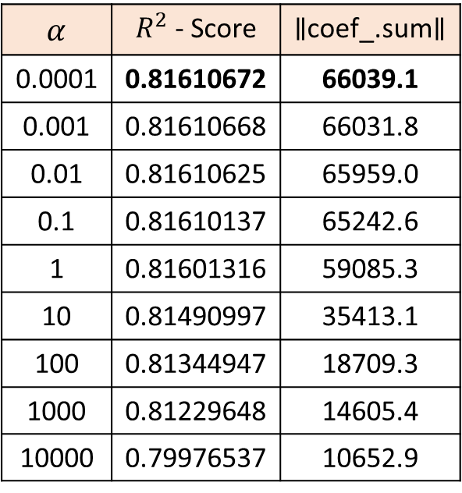
Regression Comparision – Result
Comparison at a look
$α$ | $R^{2}$- Score | $∥$coef_.sum$∥$
0.0001 | 0.81610672 | 66039.1
0.001 | 0.81610668 | 66031.8
0.01 | 0.81610625 | 65959.0
0.1 | 0.81610137 | 65242.6
1 | 0.81601316 | 59085.3
10 | 0.81490997 | 35413.1
100 | 0.81344947 | 18709.3
1000 | 0.81229648 | 14605.4
10000 | 0.79976537 | 10652.9
$α$ | $R^{2}$- Score | $∥$coef_.sum$∥$
0.0001 | 0.81610664 | 67446.6
0.001 | 0.81610587 | 67162.4
0.01 | 0.81609543 | 65057.1
0.1 | 0.81587655 | 53786.1
1 | 0.81284217 | 14153.8
10 | 0.80710053 | 10804.0
100 | 0.73458773 | 1818.8
1000 | 0.65071426 | 6.9
10000 | 0.65112941 | 6.8
$R^{2}$- Score = 0.81611
np.abs(lr.coef_).sum() = 66039.86488
< Linear Regression >
< Ridge Regression >
< Lasso Regression >

