Slide 1
[ Business Analytics ] Assignment 1 – Prediction on House Sales Prices
12146304
Sung-je Kim

Slide 2

Contents
Scatter Matrix
KDE of Each Data and $R^{2}$ - ‘yr_built’ - ‘yr_renovated’
Result

Slide 3
Overview
In class, we just used followed 8 variables for expecting [‘price’]:
In this assignment, I am going to add and use two more variables for analyzing: [‘yr_built’], [‘yr_renovated’]

Slide 4
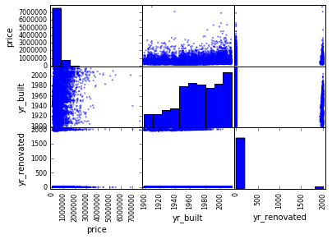
Scatter Matrix
Firstly, I wanted to have a glance the relationship between price and columns.
I used scatter_matrix function for glancing
We can know that distribution of ‘yr_built’ is almost even.
We can know that distribution of ‘yr_renovated’ looks like 0 or something. 0 means there is no renovation.

Slide 5
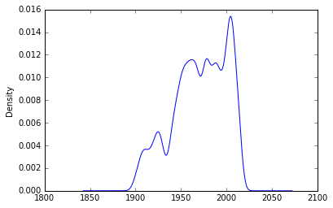
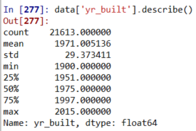

[‘yr_built’]
Based on describe(), I divided this data set to 4 parts. They will be explained how much they are old.
Data are divided to:
1900 – 1951: Very Old (score:1)
1951 – 1975: Old (score:2)
1975 – 1997: Middle (score:3)
1997 – 2015: New (score:4)
This is kde of ‘yr_built’. We can know many houses are built recently. However, ‘yr_built’ data are needed to process properly.
As you can see, correlation is very low between ‘price’ and ‘yr_built’.

Slide 6
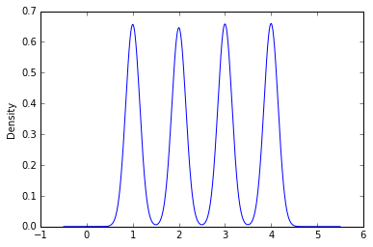



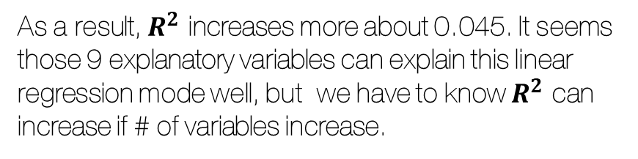
[‘yr_built’] (cont’)
Correlation increases slightly. Even though it increases, we cannot consider as good explanatory variable because correlation it self is very low.
As a result, $R^{2}$ increases more about 0.045. It seems those 9 explanatory variables can explain this linear regression mode well, but we have to know $R^{2}$ can increase if # of variables increase.
This is kde of ‘new_yr_built’. Their density are almost same.

Slide 7
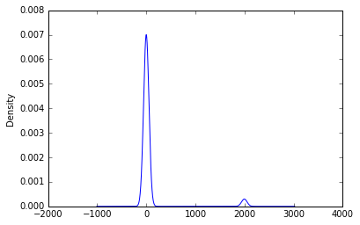




[‘yr_renovated’]
Above table is correlation between ‘price’ and ‘yr_renovated’.
Above table is correlation between ‘price’ and ‘new_yr_renovated’.
Actually, both of them have low correlation with price and even the correlation of new_yr_renovated fell.
According to KDE of ‘yr_renovated’, a lot of house are not renovated. Therefore, I just process it to whether renovated(1) or not(0).
$R^{2}$ increases.. very slightly.

Slide 8

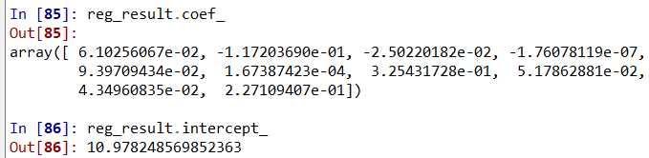

Result – Final $R^{2}$
The result of final $R^{2}$ is about 0.644 based on 10 explanatory variables. (['new_yr_renovated’, 'new_yr_built’, 'bedrooms', 'sqft_lot', 'bathrooms', 'sqft_living','waterfront', 'view', 'condition', 'grade’])
This coef_ and intercept_ are from between 10 variables and ‘log_price’. The reason why some negative coefficients appear, I think that variables are not linear correlation with dependent variable.

Slide 9
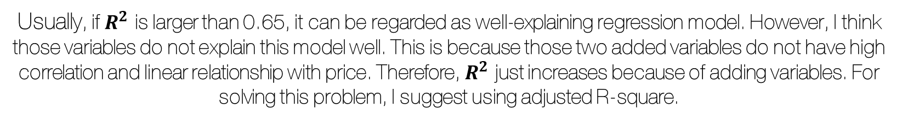
Result – Conclusion
Usually, if $R^{2}$ is larger than 0.65, it can be regarded as well-explaining regression model. However, I think those variables do not explain this model well. This is because those two added variables do not have high correlation and linear relationship with price. Therefore, $R^{2}$ just increases because of adding variables. For solving this problem, I suggest using adjusted R-square.

