Slide 1
[ Business Analytics ] Assignment 2 – Ideas to utilize zip code, lat, and long
12146304
Sung-je Kim

Slide 2
Contents
Description of data set
Without other resources
With other resources

Slide 3
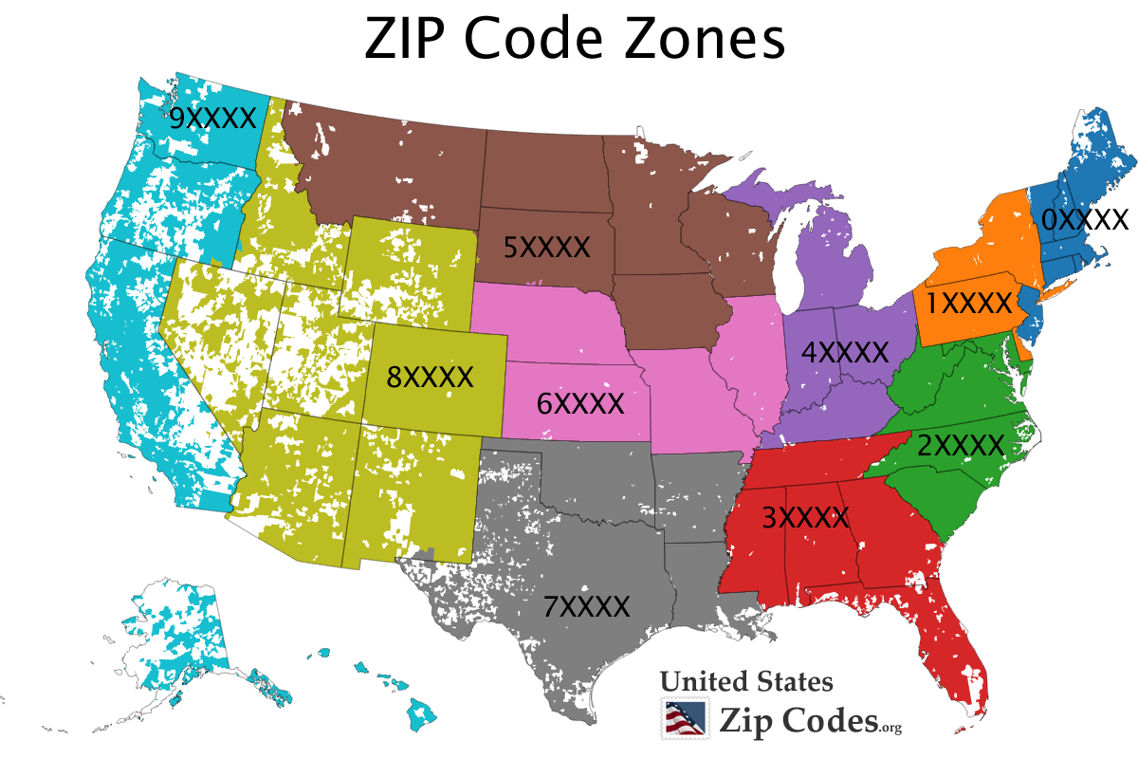
Description of data set
zip code: ZIP Codes are a system of postal codes used by the United States Postal service (USPS) since 1963. The term ZIP is an acronym for Zone Improvement Plan. (Wikipedia)
lat: Latitude (horizontal)
long: Longitude (vertical)

Slide 4
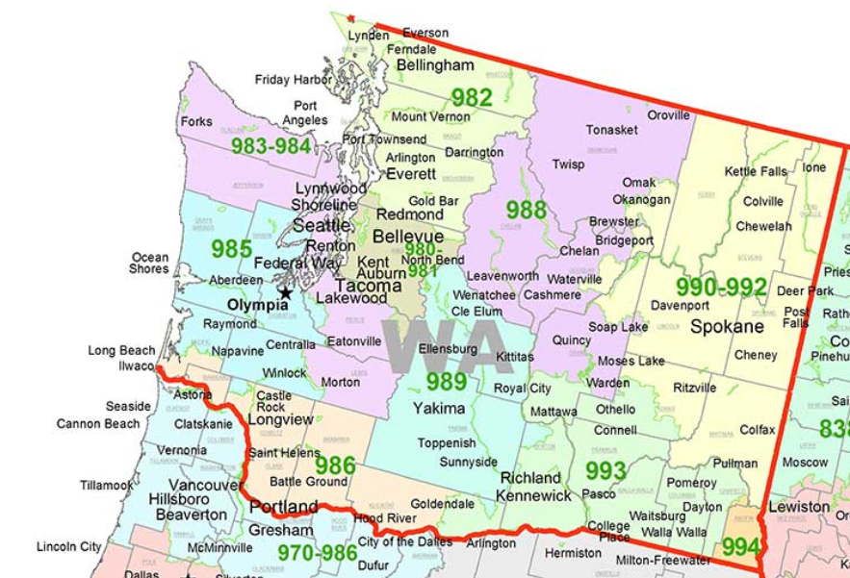
Without other resources
Those three variables describes location in US. Therefore, we can mark each house as a dot in the US map. We can know the distribution of house using those three variables.

Slide 5
With other resources
With [‘price’],[‘condition’]: We can know distribution of whether it is a rich village or not. For example, 90210 is zip code of Beverly hills.
With [‘yr_built’]: As using zip code and yr_built column, we can know average construction year each zip code.
With specific location of market, school and so on: We can calculate distance between house and market(like any other helpful place) and know where is better house.

Slide 6
With other resources (cont’)
With crime data: We can know where is a safe area relatively using crime data of specific zip code. Of course it will be connected high house price.

