Slide 1
Assignment3 US vote Analysis
12146304
Sung-je Kim

Slide 2
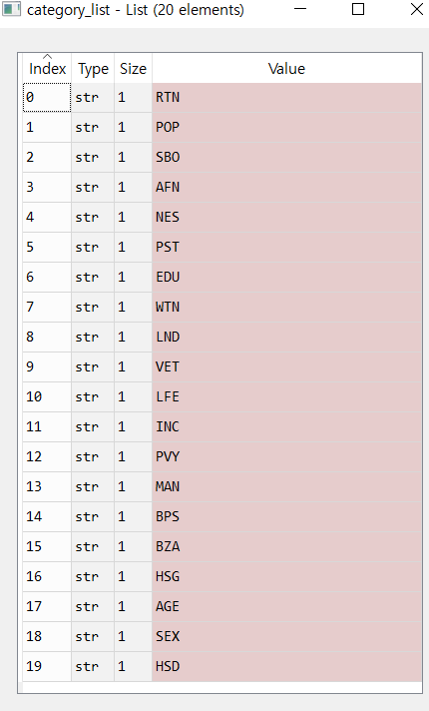
Relationship with [“RHI”]
There are 20 of county_facts keyword. I wanted to know the number of unique county_facts keyword. This is because I am going to look relationship between [“RHI“] which is fixed variable and one of other variables.

Slide 3
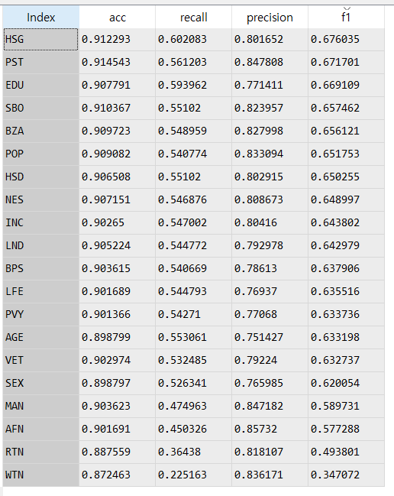
Relationship with [“RHI”] (cont’)
I am going to use those two values(“HSG” , “PST”). This is because two values have high f1 score when they are with [“RHI”]. (Also, they have higher accuracy than the others.) We can regard f1 score as indicator of model performance.
Therefore, I just thought they can be good variables.
column_name | description
PST045214 | Population, 2014 estimate
PST040210 | Population, 2010 (April 1) estimates base
PST120214 | Population, percent change - April 1, 2010 to July 1, 2014
HSG010214 | Housing units, 2014
HSG445213 | Homeownership rate, 2009-2013
HSG096213 | Housing units in multi-unit structures, percent, 2009-2013
HSG495213 | Median value of owner-occupied housing units, 2009-2013
[“PST”] is about population.
[“HSG”] is about housing information.

Slide 4
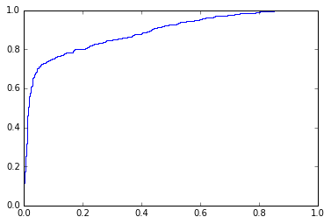
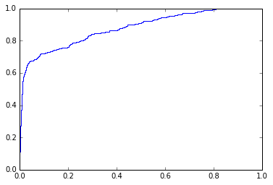
Result
1. [“RHI”] Only (format = %.5g)
Accuracy | Recall | Precision | F – Score | roc_auc_score
0.90394 | 0.54683 | 0.78418 | 0.64171 | 0.88923
<roc-curve>
2. [“RHI”] & [“PST”] (format = %.5g)
Accuracy | Recall | Precision | F – Score | roc_auc_score
0.91454 | 0.56120 | 0.84781 | 0.67170 | 0.87869
<roc-curve>

Slide 5
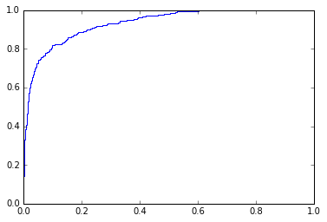
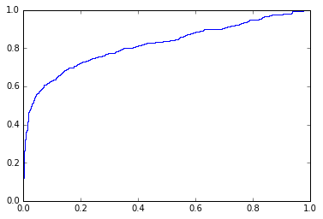
Result (cont’)
3. [“RHI”] & [“HSG”] (format = %.5g)
Accuracy | Recall | Precision | F – Score | roc_auc_score
0.91229 | 0.60208 | 0.80165 | 0.67604 | 0.93335
<roc-curve>
4. [“HSG”] & [“PST”] (format = %.5g)
Accuracy | Recall | Precision | F – Score | roc_auc_score
0.89142 | 0.40785 | 0.82665 | 0.52842 | 0.82073
<roc-curve>

Slide 6
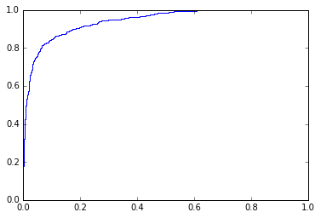
Result (cont’)
5. [“RHI”] & [“HSG”] & [“PST”] (format = %.5g)
Accuracy | Recall | Precision | F – Score | roc_auc_score
0.91904 | 0.63907 | 0.81974 | 0.70792 | 0.94339
<roc-curve>

Slide 7
Integrated Result
Variable(s) | Accuracy | Recall | Precision | F – Score | roc_auc_score
[“RHI”] | 0.90394 | 0.54683 | 0.78418 | 0.64171 | 0.88923
[“RHI”][“PST”] | 0.91454 | 0.56120 | 0.84781 | 0.67170 | 0.87869
[“RHI”][“HSG”] | 0.91229 | 0.60208 | 0.80165 | 0.67604 | 0.93335
[“HSG”][“PST”] | 0.89142 | 0.40785 | 0.82665 | 0.52842 | 0.82073
[“RHI”][“HSG”][“PST”] | 0.91904 | 0.63907 | 0.81974 | 0.70792 | 0.94339
When I used three variables, this model shows the highest performance among combination of variables.
(format = %.5g)
[“RHI”]_roc_curve
vs.
[“RHI”][“HSG”][“PST”]_roc_curve

