Slide 1
Assignment4 Sampling
12146304
Sung-je Kim

Slide 2
Selected Variables
I used [“RHI”] as input variable for comparing each sampling method.
RHI225214 | Black or African American alone, percent, 2014
RHI325214 | American Indian and Alaska Native alone, percent, 2014
RHI425214 | Asian alone, percent, 2014
RHI525214 | Native Hawaiian and Other Pacific Islander alone, percent, 2014
RHI625214 | Two or More Races, percent, 2014
RHI725214 | Hispanic or Latino, percent, 2014
RHI825214 | White alone, not Hispanic or Latino, percent, 2014
Description of “RHI”

Slide 3
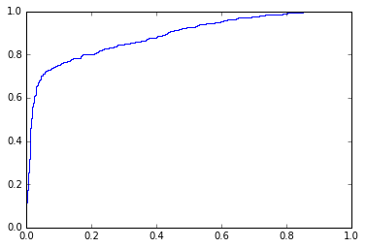

Original
Original | Accuracy | Recall | Precision | F1 | roc_auc_curve
Logistic | 0.9039 | 0.5468 | 0.7841 | 0.6417 | 0.8892
SVM | 0.9046 | 0.5305 | 0.8028 | 0.6348 | 0.8889

Slide 4
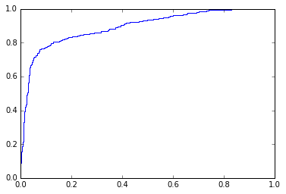

Over Sampling
OverSampling | Accuracy | Recall | Precision | F1 | roc_auc_curve
Logistic | 0.8130 | 0.8091 | 0.8197 | 0.8130 | 0.8960
SVM | 0.8183 | 0.8095 | 0.8281 | 0.8174 | 0.8969

Slide 5
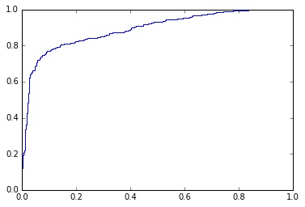

Under Sampling
UnderSamping | Accuracy | Recall | Precision | F1 | roc_auc_curve
Logistic | 0.8216 | 0.7930 | 0.8407 | 0.8157 | 0.8925
SVM | 0.8278 | 0.7909 | 0.8537 | 0.8207 | 0.8939

Slide 6
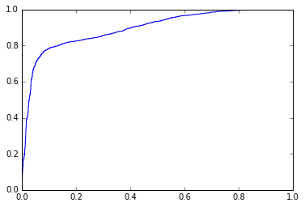

SMOTE
SMOTE | Accuracy | Recall | Precision | F1 | roc_auc_curve
Logistic | 0.8141 | 0.8072 | 0.8227 | 0.8135 | 0.8947
SVM | 0.8158 | 0.8015 | 0.8292 | 0.8137 | 0.8952

Slide 7

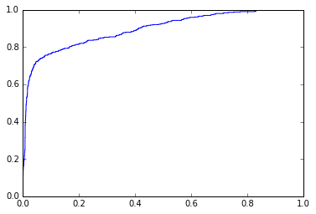
Tomek link
Tomek link | Accuracy | Recall | Precision | F1 | roc_auc_curve
Logistic | 0.9055 | 0.5695 | 0.7928 | 0.6617 | 0.8963
SVM | 0.9084 | 0.5715 | 0.8105 | 0.6691 | 0.8950

Slide 8


One-sided Selection
One-sided | Accuracy | Recall | Precision | F1 | roc_auc_curve
Logistic | 0.9035 | 0.5695 | 0.7902 | 0.6609 | 0.8943
SVM | 0.9068 | 0.5715 | 0.8105 | 0.6691 | 0.8930

Slide 9
In scope of Logistic Regression
Sampling method | Accuracy | Recall | Precision | F – Score | roc_auc_score
Original | 0.9039 | 0.5468 | 0.7841 | 0.6417 | 0.8892
Over Sampling | 0.8130 | 0.8091 | 0.8197 | 0.8130 | 0.8960
Under Sampling | 0.8216 | 0.7930 | 0.8407 | 0.8157 | 0.8925
SMOTE | 0.8141 | 0.8072 | 0.8227 | 0.8135 | 0.8947
Tomek link | 0.9055 | 0.5695 | 0.7928 | 0.6617 | 0.8963
One-sided Selection | 0.9035 | 0.5695 | 0.7902 | 0.6609 | 0.8943
(format = %.5g)
In this case, I concluded that the best method is ‘Under Sampling’ method among them. This is because it got good accuracy score and the highest F-score among them.

Slide 10
In scope of Support Vector Machine
Sampling method | Accuracy | Recall | Precision | F – Score | roc_auc_score
Original | 0.9046 | 0.5305 | 0.8028 | 0.6348 | 0.8889
Over Sampling | 0.8183 | 0.8095 | 0.8281 | 0.8174 | 0.8969
Under Sampling | 0.8278 | 0.7909 | 0.8537 | 0.8207 | 0.8939
SMOTE | 0.8158 | 0.8015 | 0.8292 | 0.8137 | 0.8952
Tomek link | 0.9084 | 0.5715 | 0.8105 | 0.6691 | 0.8950
One-sided Selection | 0.9068 | 0.5715 | 0.8105 | 0.6691 | 0.8930
(format = %.5g)
In this case, I concluded that the best method is ‘Under Sampling’ method among them. This is because it got a good accuracy score and the highest F-score among them.

Slide 11
Tendency
I think Tomek link shows high accuracy but recall score is low. Therefore, that method cannot have high F1 score in my case. In Under Sampling case, it does not have the highest score of accuracy but it have high recall score and precision score. It is connected to high F1 score.

