Slide 1
Assignment5 Random Forest
12146304
Sung-je Kim

Slide 2
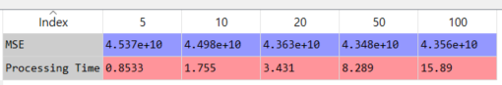
House Sales - Random Forest Regression
I used K-fold cross validation for this model because it is used generally. (not stratified K-fold)
In RandomForestRegressor, I added ‘min_samples_leaf’ parameter as 10 for pruning.
Below table shows MSE and Processing time for each of the number of trees.
In RandomForestRegression, if we enter more trees, it returns high MSE for this House Sales model. However, the more I put the number of trees, it takes memory and time more and more. Therefore, 10 would be reasonable n_estimators in terms of resource and performance.

Slide 3
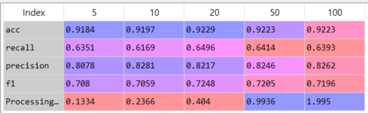
Election - Random Forest Classifier
I used Stratified K-fold cross validation for preventing accuracy becoming zero. In RandomForestClassifier, I added ‘min_samples_leaf’ parameter as 10 for pruning.
Below table shows each score of accuracy, recall, precision, and F1 and Processing time for each of the number of trees.
This model also takes more time when it gave a lot of trees. In this case, however, it seems it does not matter. I expected I will get high score if model takes a lot of tree, but the score was the highest when it takes 20 trees. However, it is similar to other the number of trees, so I concluded this model returns similar performance when it is above certain level.

