Slide 1
Assignment6 Feature Selection
12146304
Sung-je Kim

Slide 2
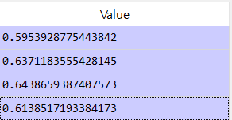

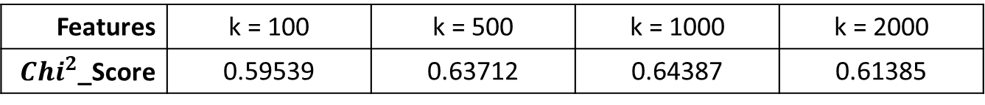
Feature Selection – ${Chi}^{2}$
When I implemented ${Chi}^{2}$, the results are like below table:
Features | k = 100 | k = 500 | k = 1000 | k = 2000
${Chi}^{2}$_Score | 0.59539 | 0.63712 | 0.64387 | 0.61385
As we can see, the performance is the highest when 1000 of features are selected.

Slide 3
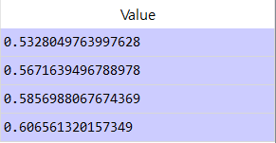
Feature Selection – Information Gain
When I implemented information gain, the results are like below table:
Features | k = 100 | k = 500 | k = 1000 | k = 2000
Information Gain | 0.53280 | 0.56716 | 0.58579 | 0.60656
As we can see, the performance is the highest when 2000 of features are used. It tends to increase when the number of features increase.

Slide 4

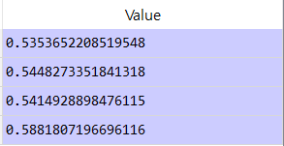
Feature Selection – DFS
There is no library for DFS in sklearn, so I made DFS function considering below formulation:
Features | k = 100 | k = 500 | k = 1000 | k = 2000
Information Gain | 0.53537 | 0.54483 | 0.54149 | 0.58818
As we can see, the performance is the highest when 2000 of features are used. It tends to increase when the number of features increase.

Slide 5
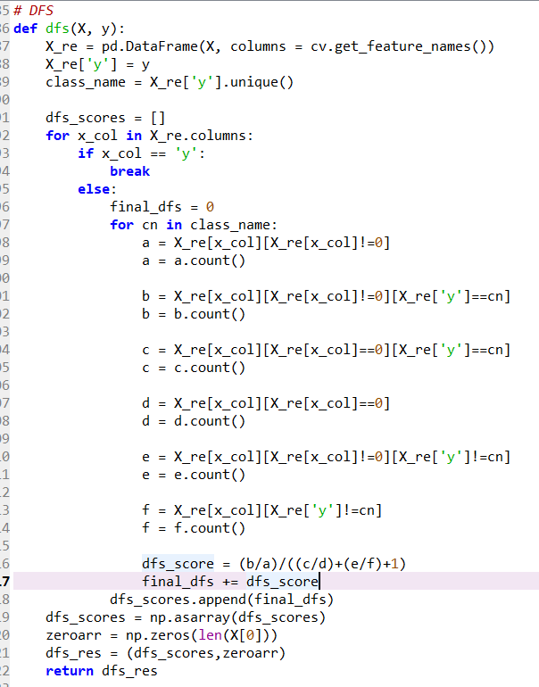
Feature Selection – DFS (cont.)
For fitting to SelectKBest

