Slide 1

Analysis of Air Quality in India
By: Garrott and Tyler

Slide 2
Introduction
Goal is to understand what gases effect the air quality in India
Data has 6112 observations

Slide 3

Introduction/Variables
12 features
PM2.5 – Particulate Matter 2.5 microns
PM10 - Particulate Matter 10 microns
NO - Nitric Oxide
NOx – Nitrogen Oxides
${NO}_{2}$ - Nitric Dioxide
${NH}_{3}$ - Ammonia
CO - Carbon Monoxide
${SO}_{2}$ - Sulphur Dioxide
$O_{3}$ - Ozone
Benzene
Toluene
Xylene
Response Variable
AQI

Slide 4
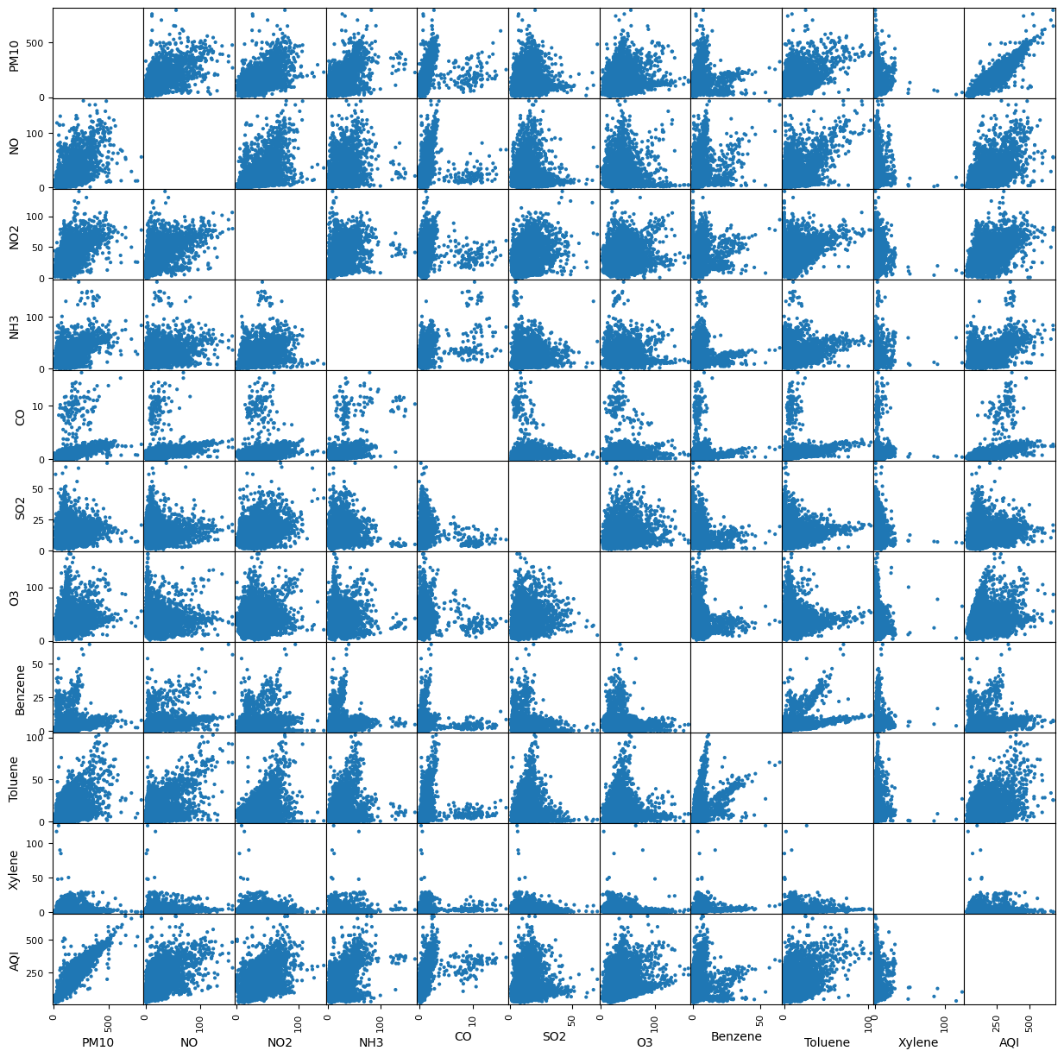
Scatter Plot
Relationship between response variable and predictors

Slide 5
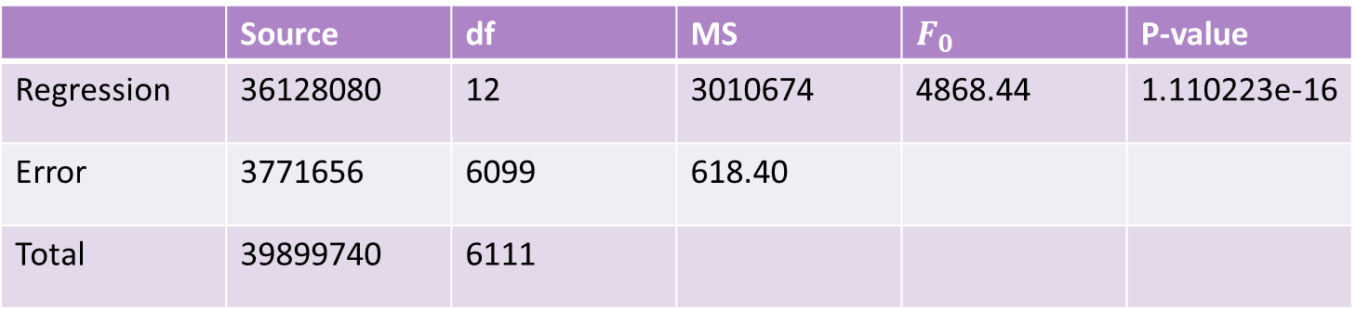
Initial Model
All variables were considered
Multicollinearity was not checked
 | Source | df | MS | $$F_{0}$$ | P-value
Regression | 36128080 | 12 | 3010674 | 4868.44 | 1.110223e-16
Error | 3771656 | 6099 | 618.40
Total | 39899740 | 6111

Slide 6

Initial Model
 | Coef | SE | T | P-Value
const | 13.1021 | 0.907 | 14.450 | 0.000
PM2.5 | 1.0410 | 0.018 | 58.389 | 0.000
PM10 | 0.3815 | 0.011 | 35.689 | 0.000
NO | -0.0696 | 0.038 | -1.845 | 0.065
NO2 | -0.2485 | 0.029 | -8.707 | 0.000
NOx | 0.4063 | 0.035 | 11.742 | 0.000
NH3 | -0.0264 | 0.026 | -1.005 | 0.315
CO | 6.8598 | 0.282 | 24.324 | 0.000
SO2 | 0.0196 | 0.050 | 0.394 | 0.694
O3 | 0.2954 | 0.018 | 16.020 | 0.000
Benzene | -0.3026 | 0.081 | -3.746 | 0.000
Toluene | -0.1623 | 0.036 | -4.450 | 0.000
Xylene | -0.3330 | 0.074 | -4.512 | 0.000
$R^{2}$: 0.905
${R^{2}}_{Adj}$: 0.905

Slide 7
Multicollinearity
Features | correlation
PM2.5/PM10 | 0.891643
NOx/NO | 0.863065
Features | VIF
PM10 | 9.558931
NO | 3.279548
NO2 | 7.200184
NH3 | 4.064641
CO | 1.986387
SO2 | 3.931266
O3 | 4.217266
Benzene | 2.136146
Toluene | 2.931798
Xylene | 1.425933
Kept PM10 and NO

Slide 8
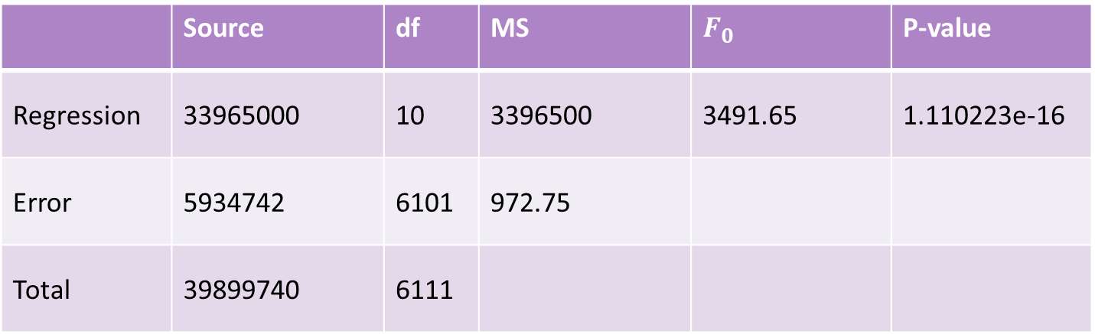
Model after Multicollinearity
ANOVA table before variable selection
 | Source | df | MS | $$F_{0}$$ | P-value
Regression | 33965000 | 10 | 3396500 | 3491.65 | 1.110223e-16
Error | 5934742 | 6101 | 972.75
Total | 39899740 | 6111

Slide 9

Model after multicollinearity
 | Coef | SE | T | P-Value
const | 6.0102 | 1.123 | 5.352 | 0.000
PM10 | 0.8518 | 0.009 | 95.053 | 0.000
NO | 0.4253 | 0.030 | 14.309 | 0.000
NO2 | -0.0385 | 0.030 | -1.273 | 0.203
NH3 | 0.1129 | 0.033 | 3.471 | 0.001
CO | 10.5929 | 0.343 | 30.892 | 0.000
SO2 | -0.0977 | 0.061 | -1.590 | 0.112
O3 | 0.3966 | 0.023 | 17.305 | 0.000
Benzene | 0.1258 | 0.095 | 1.330 | 0.184
Toluene | -0.2361 | 0.046 | -5.169 | 0.000
Xylene | -0.4020 | 0.093 | -4.346 | 0.000
$R^{2}$: 0.851
${R^{2}}_{Adj}$: 0.851

Slide 10

Variable Selection
Backward Elimination was used for variable selection
Variables were deemed significant if p-value ≤ 0.05
Benzene and ${NO}_{2}$ were dropped.

Slide 11
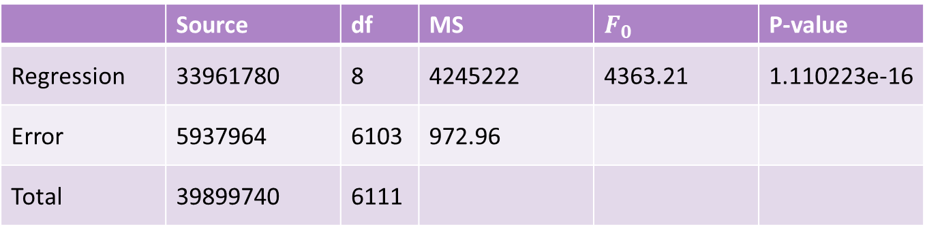
Model after Multicollinearity and Variable Selection
All variables were considered
Multicollinearity was not checked
 | Source | df | MS | $$F_{0}$$ | P-value
Regression | 33961780 | 8 | 4245222 | 4363.21 | 1.110223e-16
Error | 5937964 | 6103 | 972.96
Total | 39899740 | 6111

Slide 12

Model after Multicollinearity and Variable Selection
 | Coef | SE | T | P-Value
const | 5.9938 | 1.087 | 5.513 | 0.000
PM10 | 0.8473 | 0.008 | 100.259 | 0.000
NO | 0.4285 | 0.029 | 14.879 | 0.000
NH3 | 0.1106 | 0.032 | 3.405 | 0.001
CO | 10.6033 | 0.343 | 30.926 | 0.000
SO2 | -0.1245 | 0.059 | -2.105 | 0.035
O3 | 0.3944 | 0.023 | 17.249 | 0.000
Toluene | -0.2263 | 0.041 | -5.454 | 0.000
Xylene | -0.3736 | 0.090 | -4.149 | 0.000
$R^{2}$: 0.851
${R^{2}}_{Adj}$: 0.851

Slide 13
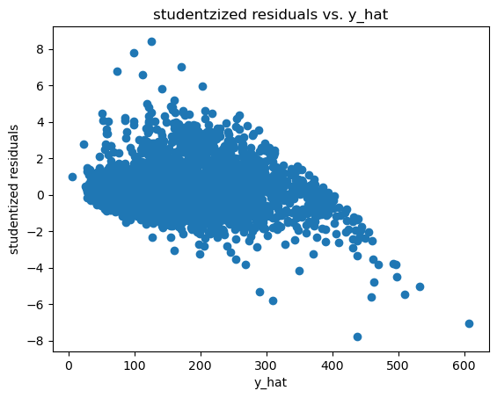
Residual plot

Slide 14
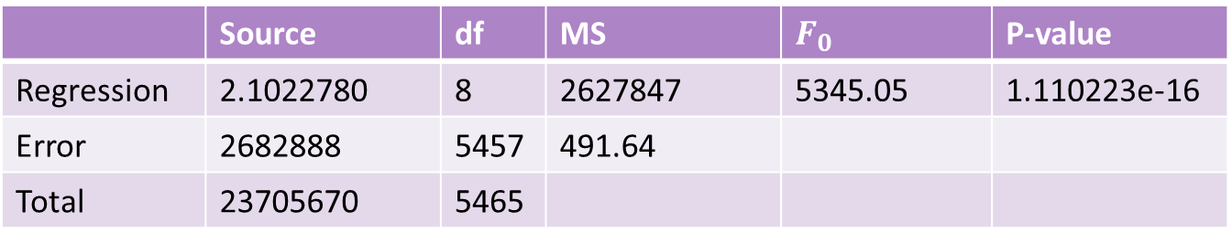
Model after Removing Leverage and Influential Points
Used DFFITS to check influential points
 | Source | df | MS | $$F_{0}$$ | P-value
Regression | 2.1022780 | 8 | 2627847 | 5345.05 | 1.110223e-16
Error | 2682888 | 5457 | 491.64
Total | 23705670 | 5465

Slide 15

Model after Removing Leverage and Influential Points
 | Coef | SE | T | P-Value
const | 2.3200 | 0.905 | 2.563 | 0.010
PM10 | 0.8115 | 0.008 | 105.351 | 0.000
NO | 0.4880 | 0.030 | 16.378 | 0.000
NH3 | 0.1437 | 0.031 | 4.688 | 0.000
CO | 16.3848 | 0.937 | 17.482 | 0.000
SO2 | -0.1978 | 0.051 | -3.883 | 0.000
O3 | 0.4097 | 0.019 | 21.326 | 0.000
Toluene | -0.0874 | 0.036 | -2.427 | 0.015
Xylene | -1.3231 | 0.119 | -11.162 | 0.000
$R^{2}$ : 0.887
${R^{2}}_{Adj}$ : 0.887

Slide 16
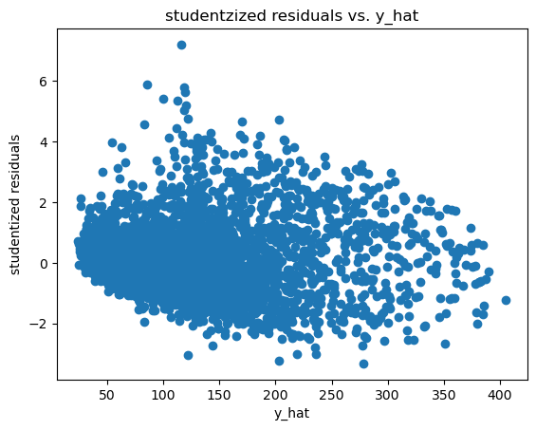
Residual Plot without Leverage or Influential Points

Slide 17
Difference and Percent Change in Coefficients
Coef | Difference | Percent Change
Const | 3.67374465 | 61.29269749
PM10 | 0.03583893 | 4.2295563
NO | -0.05947102 | 13.87825445
NH3 | -0.0331483 | 29.97412929
CO | -5.78144867 | 54.5248722
SO2 | 0.073243 | 58.80641711
O3 | -0.0153004 | 3.87949113
toluene | -0.13891567 | 61.39028208
xylene | 0.94946024 | 254.14470463

Slide 18
Multicollinearity
Features | correlation
PM2.5/PM10 | 0.891643
NOx/NO | 0.863065
Features | VIF
PM2.5 | 6.867866
NO2 | 8.824286
NOx | 7.355771
NH3 | 3.986517
CO | 2.076258
SO2 | 3.941743
O3 | 4.015871
Benzene | 2.384835
Toluene | 2.882039
Xylene | 1.422464
Kept PM2.5 and NOx

Slide 19
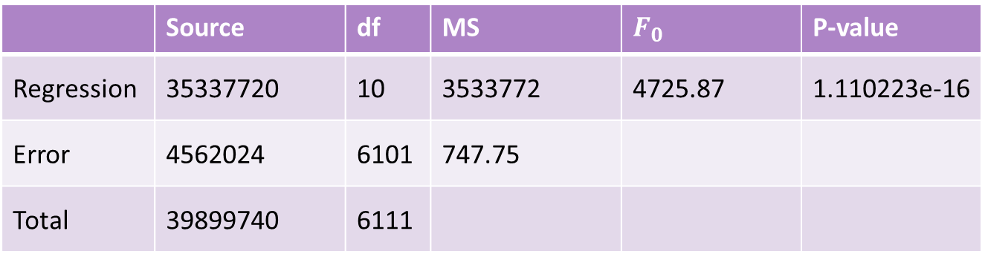
Model after multicollinearity
ANOVA before variable selection
 | Source | df | MS | $$F_{0}$$ | P-value
Regression | 35337720 | 10 | 3533772 | 4725.87 | 1.110223e-16
Error | 4562024 | 6101 | 747.75
Total | 39899740 | 6111

Slide 20

Model after multicollinearity
 | Coef | SE | T | P-Value
const | 16.8167 | 0.989 | 17.001 | 0.000
PM2.5 | 1.5061 | 0.013 | 114.741 | 0.000
NO2 | -0.1261 | 0.029 | -4.310 | 0.000
NOx | 0.5148 | 0.024 | 21.861 | 0.000
NH3 | 0.0857 | 0.028 | 3.012 | 0.003
CO | 6.4315 | 0.308 | 20.905 | 0.000
SO2 | 0.0809 | 0.054 | 1.498 | 0.134
O3 | 0.3738 | 0.020 | 18.614 | 0.000
Benzene | -0.5767 | 0.087 | -6.609 | 0.000
Toluene | -0.0027 | 0.040 | -0.069 | 0.945
Xylene | -0.1849 | 0.081 | -2.282 | 0.023
$R^{2}$: 0.886
${R^{2}}_{Adj}$ : 0.885

Slide 21
Variable Selection
Backward Elimination was used for variable selection.
Variables were deemed significant if p-value ≤ 0.05
Dropped SO2 and Toluene

Slide 22
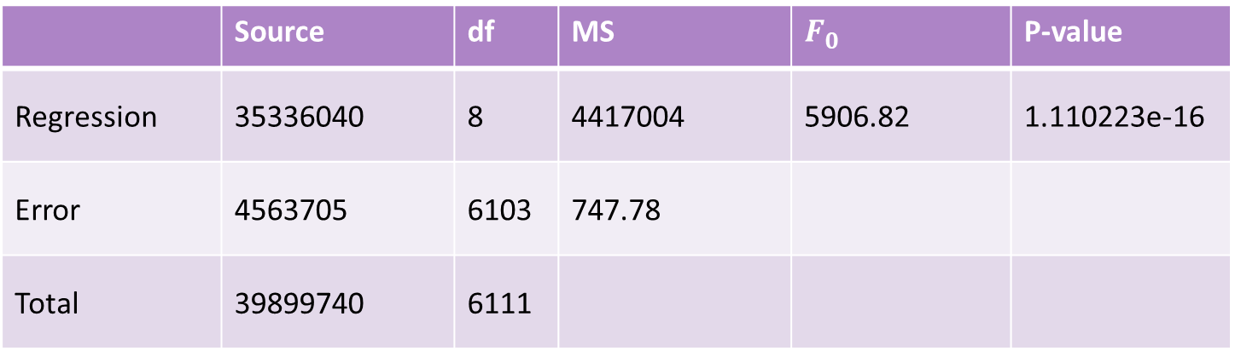
Model after Multicollinearity And Variable Selection
 | Source | df | MS | $$F_{0}$$ | P-value
Regression | 35336040 | 8 | 4417004 | 5906.82 | 1.110223e-16
Error | 4563705 | 6103 | 747.78
Total | 39899740 | 6111

Slide 23

Model after Multicollinearity and Variable Selection
$R^{2}$ : 0.851
${R^{2}}_{Adj}$ : 0.851
 | Coef | SE | T | P-Value
const | 17.2561 | 0.944 | 18.273 | 0.000
PM2.5 | 1.5070 | 0.013 | 115.414 | 0.000
NO2 | -0.1142 | 0.028 | -4.125 | 0.000
NOx | 0.5119 | 0.023 | 22.025 | 0.000
NH3 | 0.0878 | 0.028 | 3.097 | 0.002
CO | 6.4016 | 0.307 | 20.873 | 0.000
O3 | 0.3776 | 0.020 | 18.958 | 0.000
Benzene | -0.5849 | 0.083 | -7.072 | 0.000
Xylene | -0.1825 | 0.081 | -2.253 | 0.024

Slide 24
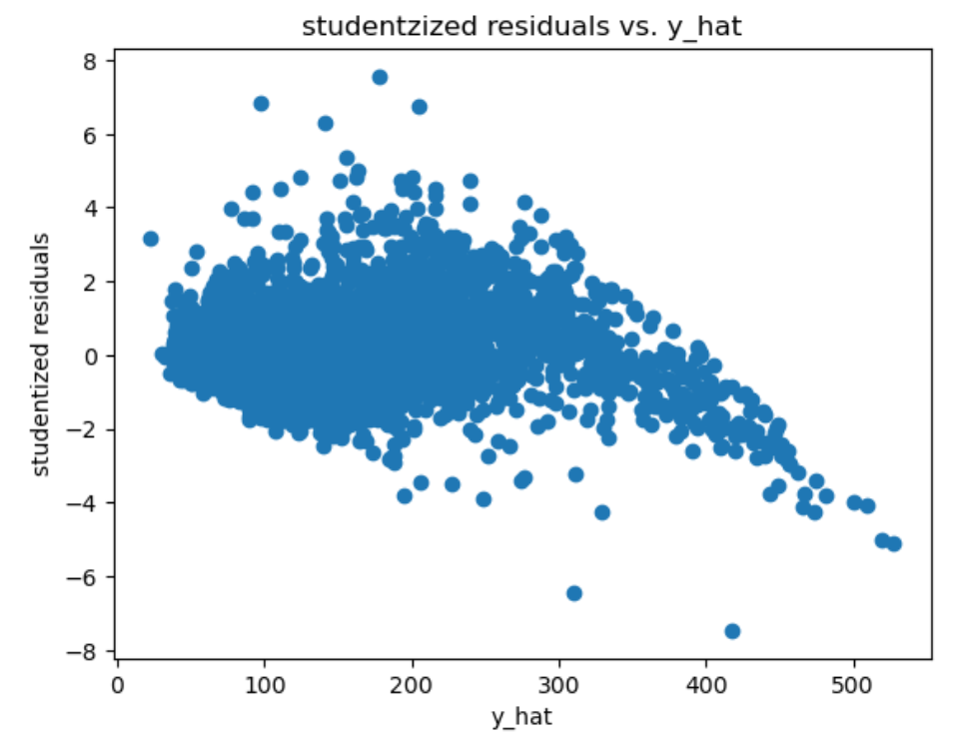
Residual plot

Slide 25
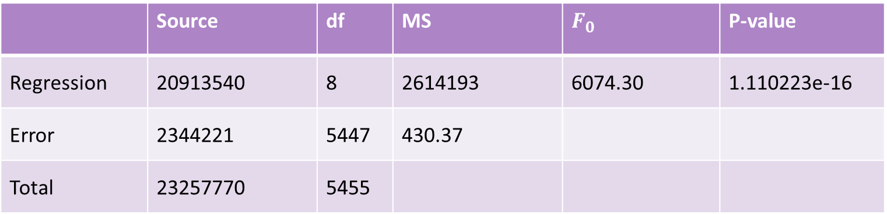
Model after Removing Leverage and Influential Points
 | Source | df | MS | $$F_{0}$$ | P-value
Regression | 20913540 | 8 | 2614193 | 6074.30 | 1.110223e-16
Error | 2344221 | 5447 | 430.37
Total | 23257770 | 5455

Slide 26

Model after Removing Leverage and Influential Points
 | Coef | SE | T | P-Value
const | 14.8740 | 0.846 | 17.580 | 0.000
PM2.5 | 1.5221 | 0.014 | 111.785 | 0.000
NO2 | -0.1048 | 0.024 | -4.297 | 0.000
NOx | 0.5535 | 0.026 | 21.218 | 0.000
NH3 | 0.2703 | 0.028 | 9.689 | 0.000
CO | 6.2753 | 0.880 | 7.130 | 0.000
O3 | 0.3033 | 0.018 | 16.768 | 0.000
Benzene | -0.5953 | 0.098 | -6.049 | 0.000
Xylene | -1.1372 | 0.114 | -9.967 | 0.000
$R^{2}$ : 0.899
${R^{2}}_{Adj}$ : 0.899

Slide 27
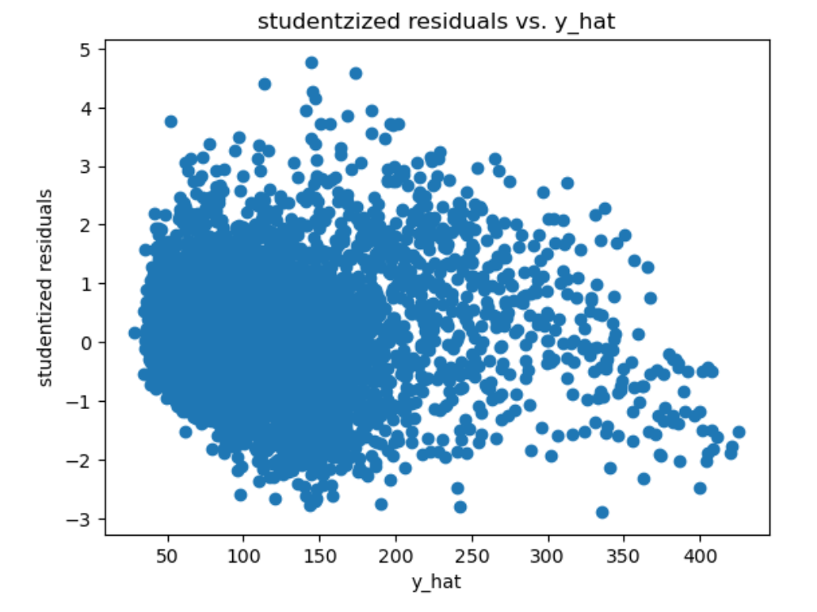
Residual Plot without Leverage or Influential Points

Slide 28
Difference and Percent Change in Coefficients
Coef | Difference | Percent Change
Const | 2.38204418 | 13.80410467
PM2.5 | -0.01510792 | 1.00250782
NO2 | -0.00933053 | 8.17348906
NOx | -0.04160774 | 8.12800357
NH3 | -0.1824924 | 207.90298487
CO | 0.1263402 | 1.97356976
O3 | 0.07424057 | 19.6623811
Benzene | 0.01040132 | 1.77830503
xylene | 0.94946024 | 523.05305401

Slide 29

Final Model/Conclusion
$$\hat{AQI}=17.26+1.51∗PM2.5−0.11∗{NO}_{2}+0.51∗{NO}_{x}+0.09∗{NH}_{3}+6.40∗CO+0.38{∗O}_{3} − 0.58∗Benzene −0.18∗Xylene$$
Current Model does not satisfy GMT
Need an appropriate transformation for the data

