Slide 1

Apache Pig
By: Anas Katib

Slide 2
What is it?
It is a platform to analyzing large data set.
It is a high level language for expressing data analysis and infrastructure process.
It is fast iterative language.
It is a SQL-like but different in many ways.

Slide 3
What is it?
Scripts are written in Pig Latin, a data flow language
Developed by Yahoo!, now open source
Roughly 1/3 of all Yahoo! internal jobs
It is a layer on top of Hadoop that is a compiler produces sequence of map reduce programs.
It uses both HDFS (read and write files) and MapReduce (execute jobs).

Slide 4
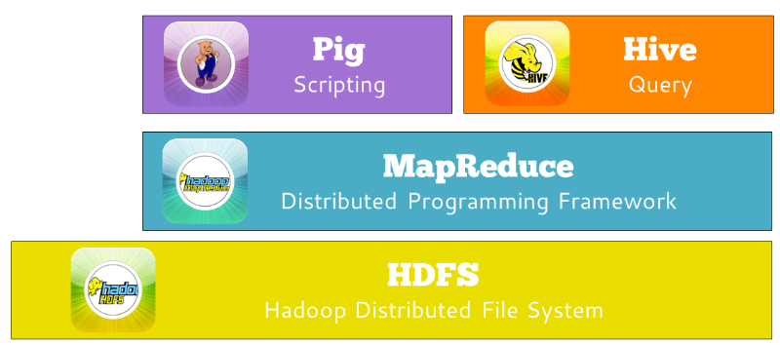
What is it?

Slide 5
Pig:
Pig’s Language, Pig Latin, is a simple way to query algebra that express data transformations for example, merging data sets, filtering them, and apply a function to records or group of records.

Slide 6
Language Features:
• Several options for user-interaction
– Interactive mode (console)
– Batch mode (prepared script files containing Pig Latin commands)
– Embedded mode (execute Pig Latin commands within a Java program)
• Built primarily for scan-centric workloads and read-only data analysis
– Easily operates on both structured and schema-less, unstructured data
– Transactional consistency and index-based lookups not required
– Data curation and schema management can be overkill
• Flexible, fully nested data model
• Extensive UDF support
– Currently must be written in Java
– Can be written for filtering, grouping, per-tuple processing, loading and storing

Slide 7
Pig latin Data Types:
int 2
long 2L
float 2.4F
double 2.4
Chararray
Bytearray
Tuple: ordered list of data (1,6,2)
Bag: unordered collection of tuples {(1.5),(6,2)}
Map: associative array [‘name’ # ’Jhon’, ‘ext’ # ‘404’]

Slide 8
Pig Operations:
Load
DUMP
FILTER
GROUP
FOREACH
GENERATE
== =! < > <= >= = - * / % ?
DESCRIBE

Slide 9
Pig Example Code:
cat student;
John 18 4.0
Mary 19 3.8
Bill 20 3.9
Joe 18 3.8
A = LOAD 'data' AS (name:chararray, age:int, gpa);
DESCRIBE A;
A: {name: chararray, age: int, gpa: bytearray}
DUMP A;
(John,18,4.0)
(Mary,19,3.8)
(Bill,20,3.9)
(Joe,18,3.8)

Slide 10
Pig latin features:
it support many traditional data operation: sort, filter, join, etc.
simplifies joining data and chaining jobs together.

Slide 11
Pig vs SQL ?
Pig uses lazy evaluation
Pig uses ETL (extend, transform, load)
Pig abilities to store data at any point during a pipeline
Pig explicit declaration of execution plans
Pig supports for pipeline splits
However, DBMSs is faster than MapReduce system once the data loaded
Loading data is longer in the database

Slide 12
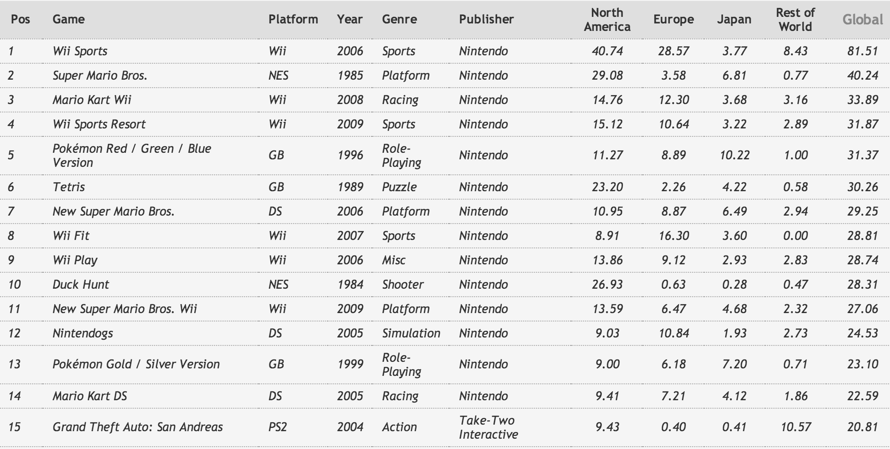
Pig Examples:

Slide 13
Pig Example Code 1 (Read data into Pig):
Games = LOAD ‘Games.txt’ AS (rank:int, name:chararray, platform:chararray, year:int, genre:chararray, publisher:chararray, northAmerica:bytearray, europe:bytearray, japan:bytearray, restOfWorld:bytearray, global:bytearray);
DUMP Games;

Slide 14
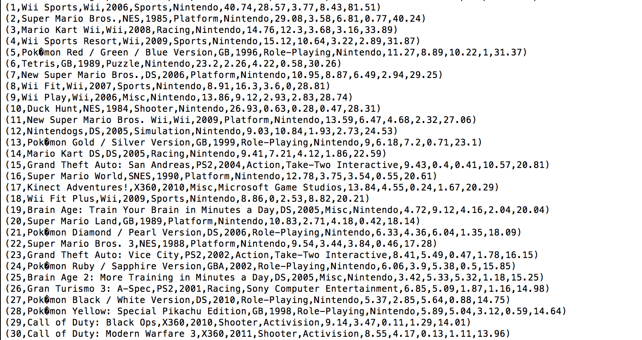
Pig Example Code 1:

Slide 15
Pig Example Code 2 (Group by platform):
Games = LOAD ‘Games.txt’ AS (rank:int, name:chararray, platform:chararray, year:int, genre:chararray, publisher:chararray, northAmerica:bytearray, europe:bytearray, japan:bytearray, restOfWorld:bytearray, global:bytearray);
A = GROUP Games BY platform;
DUMP A;

Slide 16
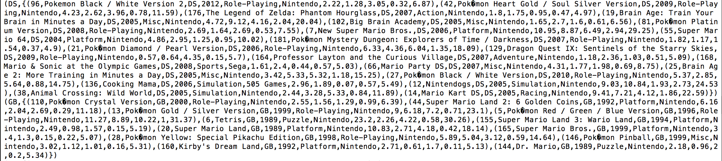
Pig Example Code 2 (Group by platform):

Slide 17
Pig Example Code 3 (Filter by genre):
Games = LOAD ‘Games.txt’ AS (rank:int, name:chararray, platform:chararray, year:int, genre:chararray, publisher:chararray, northAmerica:bytearray, europe:bytearray, japan:bytearray, restOfWorld:bytearray, global:bytearray);
B = FILTER Games BY genre matches ’Sports’;
DUMP B;

Slide 18
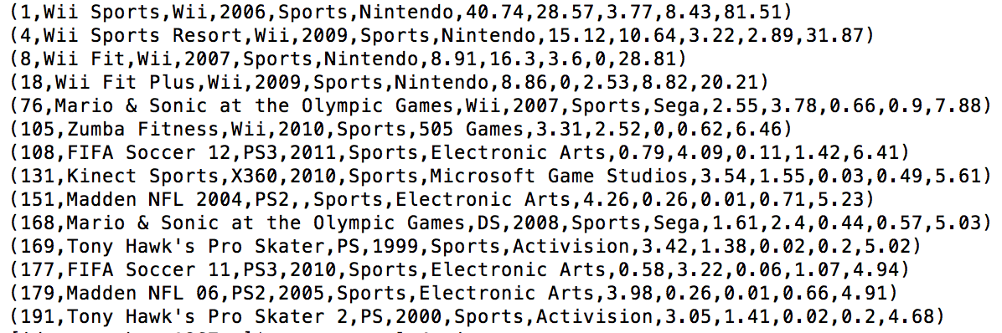
Pig Example Code 3 (Filter by genre(sports)):

Slide 19
Pig Example Code 4 (most selling games in Europe):
Games = LOAD ‘Games.txt’ AS (rank:int, name:chararray, platform:chararray, year:int, genre:chararray, publisher:chararray, northAmerica:bytearray, europe:bytearray, japan:bytearray, restOfWorld:bytearray, global:bytearray);
C = ORDER Games BY europe DESC;
top10 = LIMIT C 25;
DUMP top10;

Slide 20
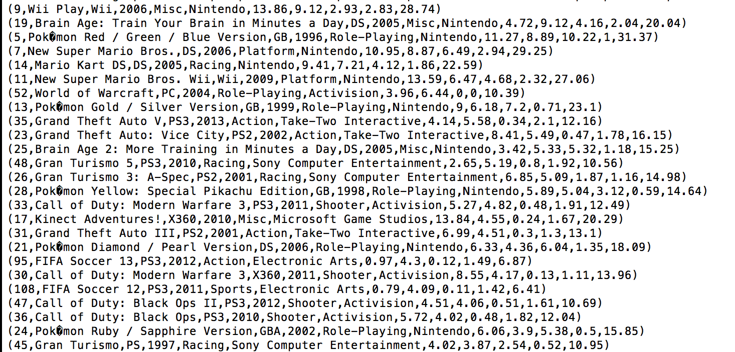
Pig Example Code 4 (most selling games in Europe):

Slide 21
Pig Example Code 5 (games sold more than 20 million in Global):
Games = LOAD ‘Games.txt’ AS (rank:int, name:chararray, platform:chararray, year:int, genre:chararray, publisher:chararray, northAmerica:bytearray, europe:bytearray, japan:bytearray, restOfWorld:bytearray, global:bytearray);
D = ORDER Games BY global DESC;
top = FILTER D BY global > 20;
DUMP top;

Slide 22
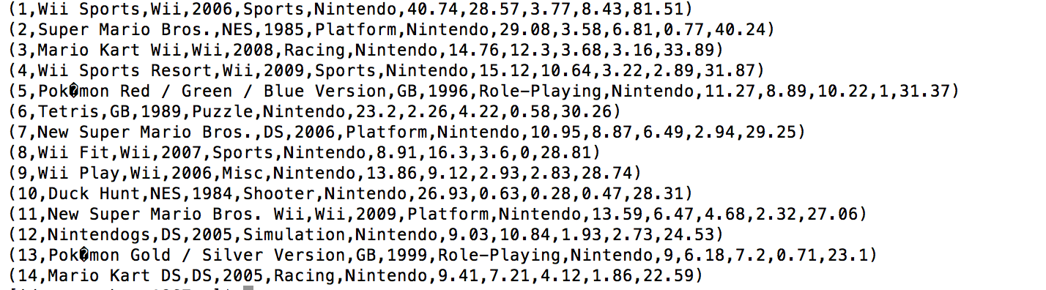
Pig Example Code 5 (games sold more than 20 million in Global):

Slide 23
Sources:
http://pig.apache.org/
http://www.youtube.com/watch?v=PQb9I-8986s
http://www.orzota.com/pig-for-beginners/
http://www.youtube.com/watch?v=FIPscPutJ7Y
http://en.wikipedia.org/wiki/Pig_(programming_tool)
http://www.cloudera.com/content/cloudera/en/resources/library/training/introduction-to-apache-pig.html
http://pig.apache.org/docs/r0.7.0/piglatin_ref2.html
http://www.youtube.com/watch?v=RxYANM1-yRk

Slide 24
Thank You

