Slide 1
CSE 343 : ML Project Monsoon 2022
Hope Speech Detection: Identifying Positive Actors in Toxic Discourses
Mohammad Aflah Khan (2020082)
Diksha Sethi (2020056)
Neemesh Yadav (2020529)
Raghav Sahni (2020533)

Slide 2
Motivation
Comments and posts have been analyzed to find and limit the spread of negativity
Focus on encouraging and supportive online content as a form of positive reinforcement
Alongside penalizing bad actors, we can reward good actors if we can identify them
Can be used to train generative models which can then be deployed in toxic-online settings to spread positivity

Slide 3
Literature Review
Hope Speech Detection: A Computational Analysis Of The Voice Of Peace
In 24th European Conference on Artificial Intelligence - ECAI 2020 by Shriphani Palakodety et. al.
Their work focused on analyzing trends in Youtube Comments during peak hostile times between India and Pakistan.
For them Hope Speech is “Web content which plays a positive role in diffusing hostility on social media triggered by heightened political tensions” which differs from the currently followed definition.
Another key contribution was using Polyglot Word Embeddings to Identify Non English text which performed very well for their task
For Modelling they only use basic features such as unigrams, bigrams, trigrams, sentiment scores and Custom Trained FastText Embeddings to feed to a Logistic Regression Model. However we cannot compare to their scores as we don’t have access to the data.

Slide 4
Literature Review
HopeEDI: A Multilingual Hope Speech Detection Dataset for Equality, Diversity, and Inclusion
In Proceedings of the Third Workshop on Computational Modeling of PEople’s Opinions, PersonaLity, and Emotions in Social media (PEOPLES) by Chakravarthi 2020
The work defines Hope Speech as “Youtube comments/posts that offer support, reassurance, suggestions, inspiration and insight” and also provides a broad list of guidelines to annotate such speech.
The work also creates the first publicly available dataset HopeEDI which provides data for 3 languages English, Tamil and Malayalam.
First work which explored hope speech for women in STEM, LGBTIQ individuals, racial minorities or people with disabilities in general.
Provide some baselines however all their models perform poorly due to huge class imbalance.

Slide 5
Literature Review
Findings of the Shared Task on Hope Speech Detection for Equality, Diversity, and Inclusion
Proceedings of the First Workshop on Language Technology for Equality, Diversity and Inclusion
by Chakravarthi et. al. 2021
Broad observations include poor performance by Traditional ML Based Algorithms and Huge Success of Deep Learning Models such as BERT, RoBERTa, XLM-RoBERTa etc. with the latter performing the best.
Good Feature Extraction and Modelling also took people a long way as Teams also ranked 2nd tied with several others by using Logistic Regression
12 Teams were ranked 1st and all of them got a weighted F1 score of 0.93 for the English task.
Due to imbalance in the data for English and Malayalam there are very few Non-English and Non-Malayalam samples in comparison and the models can learn to cheat and get high F1 scores while only doing Binary Classification. Hence the Tamil scores were much lower.

Slide 6
Literature Review
Overview of the Shared Task on Hope Speech Detection for Equality, Diversity, and Inclusion
Proceedings of the Second Workshop on Language Technology for Equality, Diversity and Inclusion
by Chakravarthi et. al. 2022
Two new datasets for Spanish and Kannada were introduced and the evaluation criteria was changed to Macro F1 from Weighted F1.
In this task competing teams did more data augmentation and feature extraction even combining other datasets to attain better results
Various inter model ensemble methods were also used.
The best performing models obtained 0.55 Macro F1 scores.
Resampling techniques contributed significantly to dataset balancing as well.

Slide 7
Dataset Examples
Hope Speech | Non - Hope Speech | Non - English
I'm still hiding my gender to my parents and they don't know I'm dating someone. My friends knows already about my gender and they are very supportive of it. And I'm very thankful to find true friends like them | Exactly!!! Do you know that in South Korea in almost every school there they teach Americans as racist | @Nhi Tran aah it's never too late uh can if u really want to..nnYeh mat socho zindagi me kya hoga kuch nhi hoga to tajurba hoga (i.e do not think what will happen in life

Slide 8
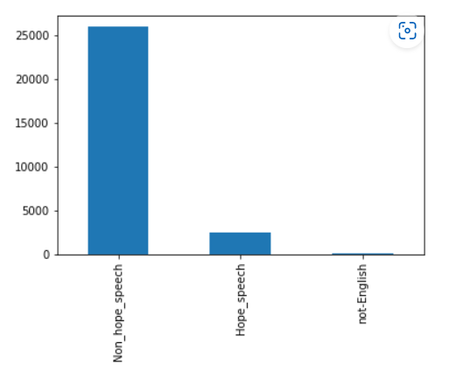

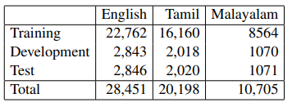
Dataset Description
Class Wise Distribution:
Clearly the dataset is unbalanced and heavily biased towards non-hope speech. Majority of the labels are of non-hope speech. This will affect model choice and performance.
Bharathi Raja Chakravarthi. 2020. HopeEDI: A Multilingual Hope Speech Detection Dataset for Equality, Diversity, and Inclusion. In Proceedings of the Third Workshop on Computational Modeling of People's Opinions, Personality, and Emotion's in Social Media, pages 41–53, Barcelona, Spain (Online). Association for Computational Linguistics.

Slide 9
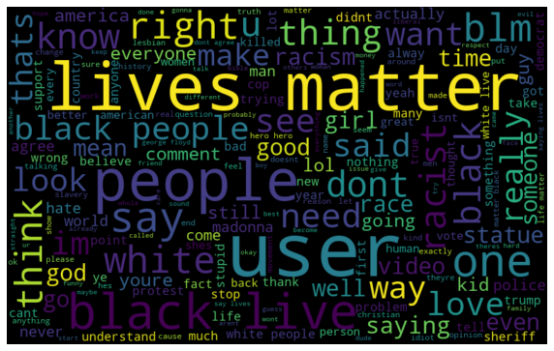
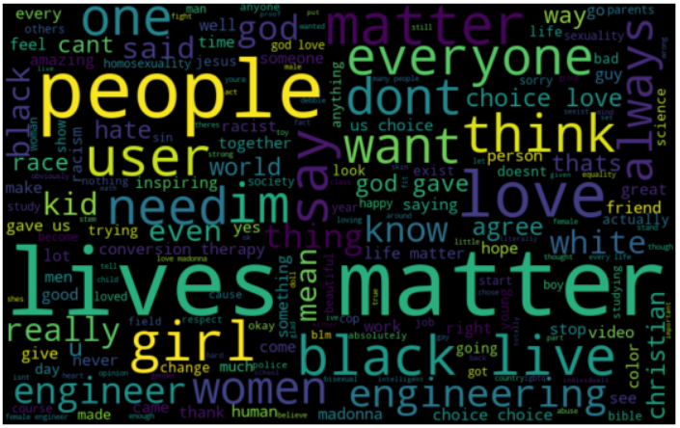
Dataset Description
Word Cloud Non-Hope speech: Word Cloud Hope speech:
We see a high degree of overlap between the two Word Clouds hence implying the task is non trivial and understanding of Words and their Contexts is paramount

Slide 10
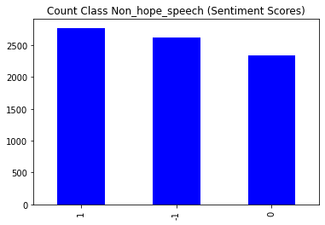
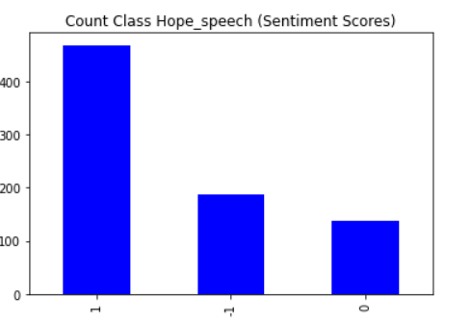
Dataset Description
One would think that Hope Speech Detection would be closely related to sentiments, but as the bar plot on the left shows, the task is not as trivial as it seems.

Slide 11
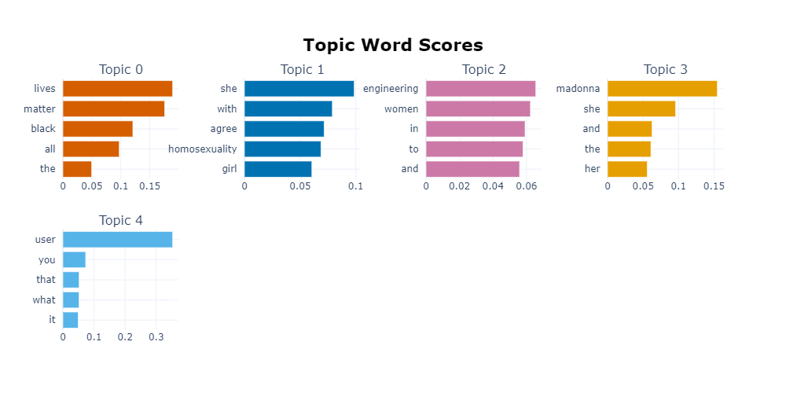
Topic Modelling using BERTopic
We perform Topic Modelling using BERTopic. We see the top 5 topics clearly capture distinct phenomena and overarching themes present in our Dataset
Topic 0: Black Lives Matter Protests
Topic 1: Homosexuality
Topic 2: Women in Tech
Topic 3: References to Celebrity Madonna was present in both Hope and Non Hope Speech
Topic 4: General Words Common to All Classes. The Word User Appears a lot as we replace all User Mentions with the word User

Slide 12
Preprocessing
To ensure that all the text inputs were uniform, we performed a few preprocessing steps. This was done to make sure that any of these textual inconsistencies wouldn’t affect the output in any way. The following steps were performed in the order in which they are listed:
Lower Case
Removal of URLs
Removal of usernames
Punctuation Removal
Removal of whitespaces
Removal of emojis
Tokenization
Note that we didn’t perform stopwords removal due to a possible loss of information, and context which is important for a task such as this.

Slide 13
Data Augmentation
To balance the number of classes across the dataset, for both the Non_Hope_Speech and Hope_Speech classes, we tried various text augmentation techniques on our train dataset, which are not as trivial as it is for Image data.
We tried techniques like random word insertion, deletion, synonym replacement, and swapping adjacent words.
Post augmentation our dataset was increased to approximately 42.3k train samples.
Dataset | Non_Hope_Speech samples | Hope_Speech samples
Original | 20,778 | 1962
Post Augmentation | 20,778 | 21,582

Slide 14
Methodology
We define two tasks:
Task 1: Multiclass Hope Speech Detection; In this task, we categorize the tweets into three classes, Hope, Non-Hope and Non-English
Task 2: Two class classification; In this task we categorize the tweets as Hope and Non-Hope speech and drop the “Non-English” class.
We performed Task 1 on all the classifiers, however, for Task 2 we used our top five performing models from Task 1 as well as transformer-based models.

Slide 15
Methodology
We used the already existing dataset made available by Chakravarthi et. al to perform our experiments.
For our Task 1, we tried out different word embedding techniques (GloVe, FastText, word2vec, TF-IDF, and Sentence-BERT) and also tried various combinations with them by performing PCA or leaving them as is, to see if we can retain some amount of data while also compressing the dimensions, which we have reported in our final results. After, getting the final embeddings we dumped them for future use, and each of us then took up different types of Classifier models from sklearn, and performed the stated task using all the embeddings thus generated. We have reported the Weighted F1 as it was used in the original paper. For Task 2 we take the top 5 ML models from Task 1 and also run LSTM, RNN and some pre-trained models for the 2 way classification.

Slide 16
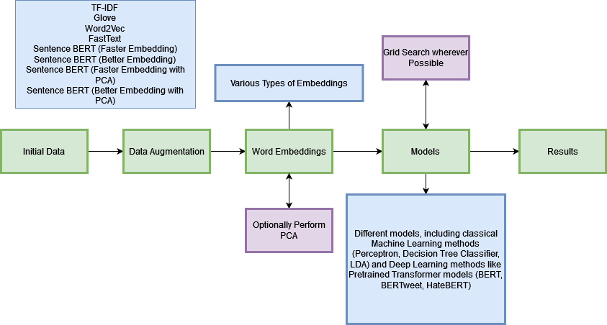

Pipeline depicting our Methodology
A visual and accurate depiction of us looking at GridSearch using all of our CPU cores.

Slide 17
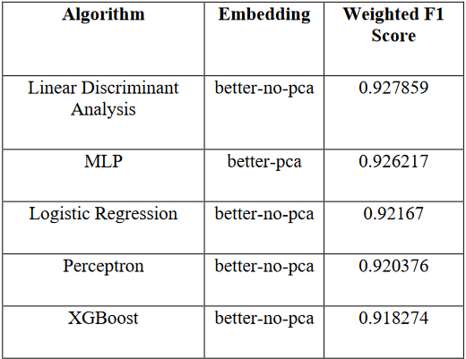
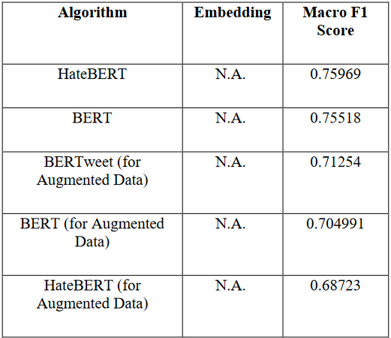
Results: Top 5 Performing Models
Task 2: Binary Classification for Hope and Non-Hope Speech
Task 1: Multiclass Classification

Slide 18
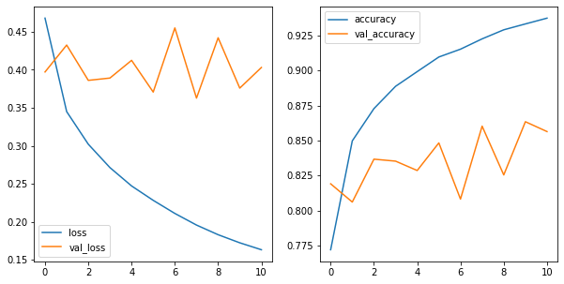
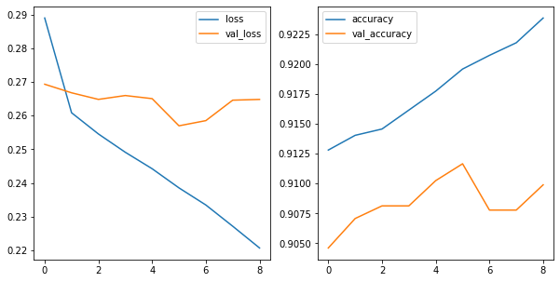
Some Loss Curves
LSTM (Without Augmented Data)
LSTM (With Augmented Data)

Slide 19
Analysis and Conclusion
Our best performing model was when we applied Linear Discriminant Analysis (LDA) on the Sentence-BERT embeddings generated from the “better” pre-trained model, without performing PCA (weighted F1 score of 0.927859)
Most consistently performing embedding : “Better Embedding” from SentenceBERT
MLP, Logistic Regression and Perceptron all cross the 0.92 Mark
Our models achieve a high macro F1 score of 0.7+ range. We attribute this success to the use of BERT and other specialized transformer networks which are able to capture great semantic meaning.
The choice of embedding for ML Models can also lead to significant gains
Data augmentation also led to significant improvement in some models but also degraded some other models

Slide 20
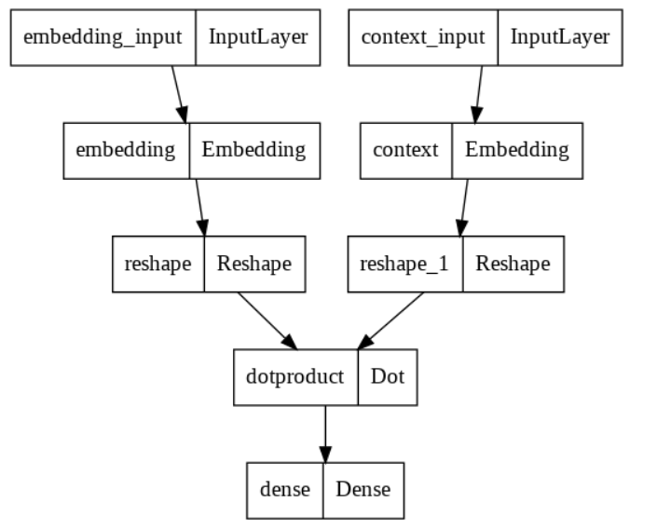
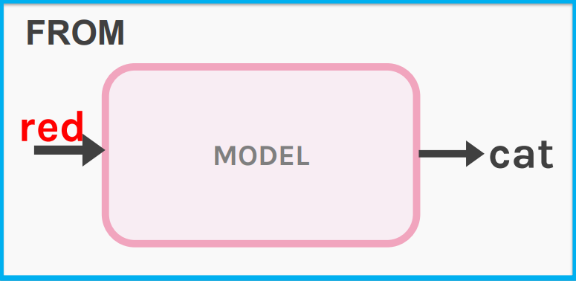
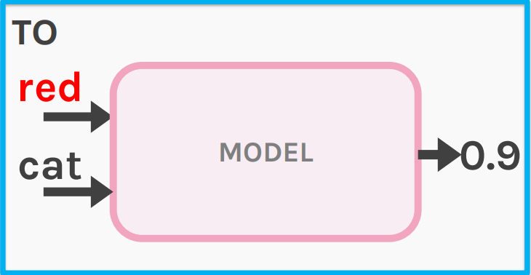
Custom Word2Vec
Using SKIP GRAMS
Define an embedding size
Select a window size for the skip gram.
Instead of predicting the word to fill. Predict whether a word belongs in the middle or not.
Add some negative samples as well.
Changing from predicting neighbors to "are we neighbors?" changes model from neural net to logistic regression.

Slide 21
Explainability
Usually DL models are black boxes.
We tried some explainability techniques based on LIME.
Local Interpretable Model-agnostic explanations which means this package explains the model-based local values.
It tells what features are important in deriving a result
Thereby, one can understand how the model came to a particular conclusion.

Slide 22
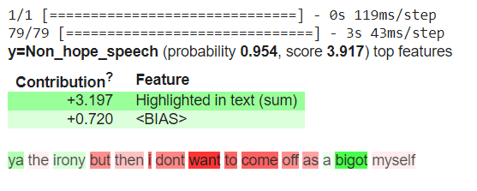
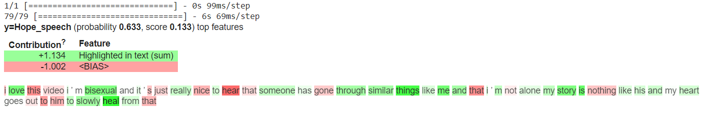
LIME Visualization for BERT

Slide 23
Contributions
Neemesh: SentenceBERT Word Embeddings, Data Preprocessing, Random Forests, Perceptron, MLP, K-Medoids, Data Augmentation, Report and Presentation
Aflah: EDA, GLoVe, FastText Embeddings, Decision Trees, Random Forests, Extra Trees, Linear & Quadratic Discriminant Analysis, HateBERT, BERTweet, Report and Presentation
Raghav: EDA, XGBoost, AdaBoost, KMeans, KNN, TF-IDF Embeddings, Custom Embeddings, LIME, Report and Presentation
Diksha: Data Preprocessing, Word2Vec Embeddings, Logistic Regression, Naive Bayes, Nearest Centroid, SVM, BERT, Report and Presentation

Slide 24


Slide 25
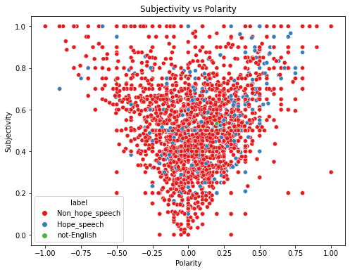
Dataset Description
Highly polar data seems to have a higher subjectivity, which makes sense.

Slide 26
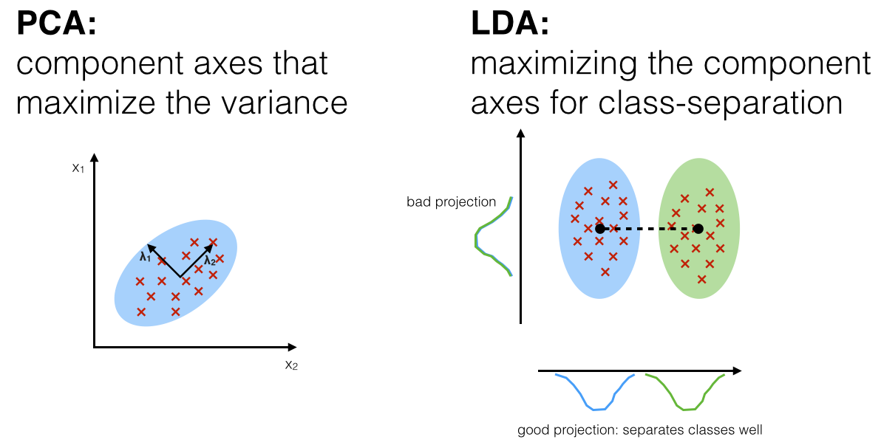
Linear Discriminant Analysis
A classifier with a linear decision boundary, generated by fitting class conditional densities to the data and using Bayes’ rule.
The model fits a Gaussian density to each class, assuming that all classes share the same covariance matrix.
Parameters - Default
Embedding | Weighted F1 Test
better-no-pca | 0.927859
better-pca | 0.923979
faster-no-pca | 0.91425
faster-pca | 0.913428
tf-idf | 0.909649
fasttext | 0.88872
word2vec | 0.887026
glove | 0.872009
https://sebastianraschka.com/Articles/2014_python_lda.html
https://scikit-learn.org/stable/modules/generated/sklearn.discriminant_analysis.LinearDiscriminantAnalysis.html

Slide 27
MLP
Embedding | Weighted F1 Test
better-pca | 0.926217
better-no-pca | 0.92426
faster-no-pca | 0.919932
tf-idf | 0.918707
word2vec | 0.915833
faster-pca | 0.914452
fasttext | 0.913886
glove | 0.898981
MLP (Artificial Neural Network) is essentially a feedforward neural network in which a single layer is made up of multiple “perceptrons” and can also contain multiple layers.
Parameters -
activation: ReLU, Sigmoid, tanh
early_stopping: True
learning_rate_init: 0.0001, 0.001, 0.01
max_iter: 1000, 5000
hidden_layer_sizes: (150, 150)
Best Parameters -
'activation': 'relu', 'early_stopping': True, 'hidden_layer_sizes': (150, 150), 'learning_rate_init': 0.001, 'max_iter': 5000

Slide 28
Logistic Regression
A classifier that predicts the probability of an event occurring and classifies based on a threshold value (decision boundary)
Parameters -
Penalty : {l1, l2}
Solver : {‘lbfgs’, ‘liblinear’}
Max_iter : 1000
C : [1.e-03, 1.e-02, 1.e-01, 1.e+00, 1.e+01, 1.e+02, 1.e+03]
Best Parameters -
'C': 1.0, 'max_iter': 1000, 'penalty': 'l2', 'solver': 'lbfgs'
Embedding | Weighted F1 Test
better-no-pca | 0.92167
better-pca | 0.921242
faster-pca | 0.912347
tf-idf | 0.911644
faster-no-pca | 0.911278
fasttext | 0.875274
word2vec | 0.874086
glove | 0.868723
https://scikit-learn.org/stable/modules/generated/sklearn.linear_model.LogisticRegression.html

Slide 29
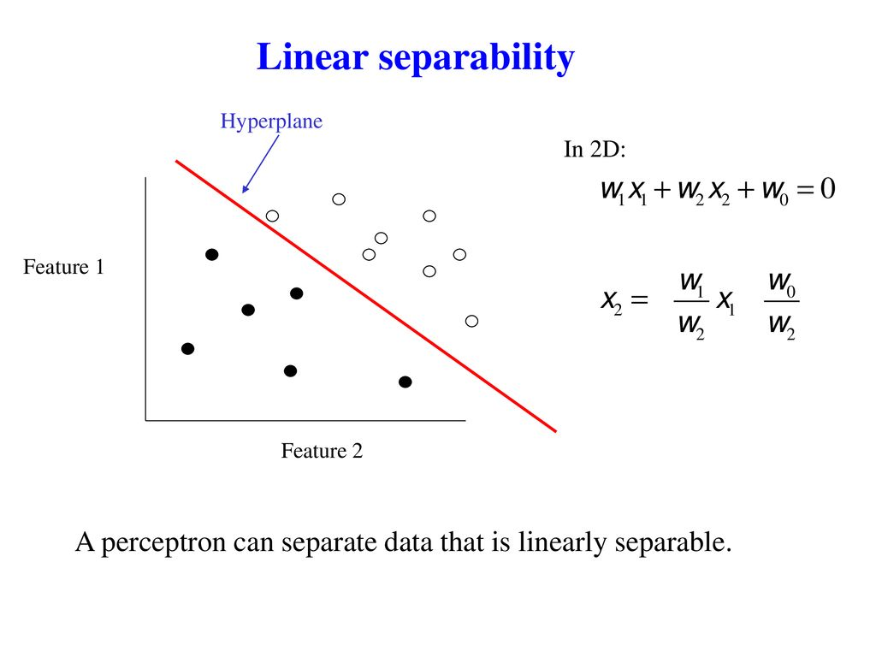
Perceptron
Embedding | Weighted F1 Test
better-no-pca | 0.920376
tf-idf | 0.906291
better-pca | 0.901837
faster-pca | 0.9014
faster-no-pca | 0.885614
glove | 0.874433
fasttext | 0.868723
word2vec | 0.868723
Perceptron is a linear classifier, which is also a building block of MLP (Artificial Neural Networks). It tries to find a hyperplane which can linearly separate a dataset into two classes till convergence.
This is generally done for a binary classification task, for a multi-class classification task we try to mould our task into a binary classification using OvR (one-vs-rest) or OvO (one-vs-one).
Parameters -
Penalty: L1, L2, or No penalty
Alpha: 0.0001, 0.001, 0.01, 0.1, 1.0
eta0: 0.0001, 0.001, 0.01, 0.1, 1.0
max_iter: 100, 1000, 10000
Best Parameters -
'alpha': 0.0001, 'eta0': 0.001, 'max_iter': 100, 'penalty': 'l2'
https://slideplayer.com/slide/13762835/
https://scikit-learn.org/stable/modules/generated/sklearn.linear_model.Perceptron.html

Slide 30
XGBoost
Embedding | Weighted F1 Test
better-no-pca | 0.918274
better-pca | 0.916389
faster-no-pca | 0.908931
faster-pca | 0.906654
word2vec | 0.892543
tf-idf | 0.890661
fasttext | 0.888239
glove | 0.876677
Parameters -
Max Depth: 1, 2
Estimators: 100, 200, 300
These were the different models used for GridSearch the best model was the dtree with max_depth= 2, and estimators=100

Slide 31
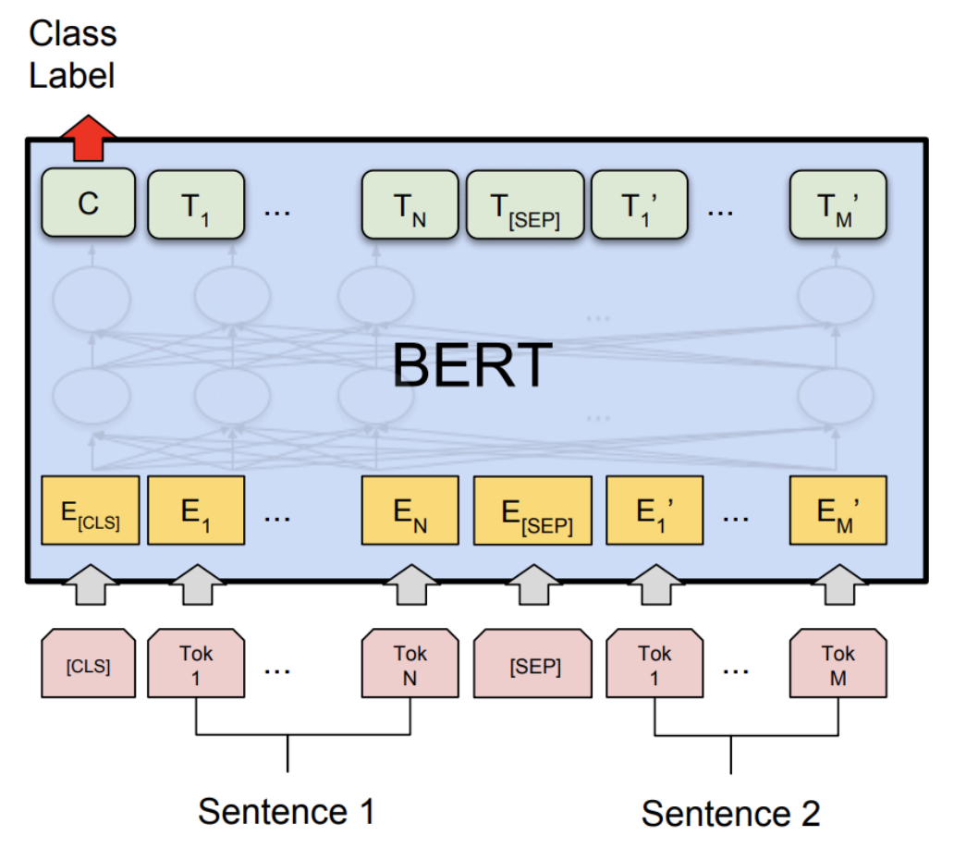
BERT/HateBERT/BERTweet
Default Pretrained models were loaded from the Hugging Face Hub Trainer API Default Parameters such as 3 Epochs and ADAM Optimizer were used

Slide 32
Timeline
We’ve followed our timeline very closely and also done much more than was initially proposed.
Week 1 -2 : Data Analysis and Data Preprocessing,
Week 3 : Creating Word Embeddings
Week 4 - 8 : Training models with each of the 8 embeddings while also using Grid Search wherever possible. We’ve used a total of 15 different Model Architectures with 8 Embeddings Each Resulting in 120 Models in total which we compare using Weighted F1 Scores.
Week 9 - 10: Data Augmentation, New Models (8 PreTrained Models + 2 DL Models + SVM)
Week 11: Explainability Techniques
The last few days were spent on working on the PPT and the report

