Slide 1
Probabilistic Water Potability Prediction Using Natural Gradient Boosting with Uncertainty Quantification
Muhammad Aflah Zaki | Irma Palupi S.T., M.T., OCA
School of Computing, Telkom University
ICoICT 2025

Slide 2
Presentation Outline
1. Introduction & Research Objectives
2. Related Work
3. Dataset & Preprocessing
4. Methodology: NGBoost Architecture
5. Experimental Results & Analysis
6. Uncertainty Quantification & Calibration
7. Practical Implications
8. Conclusion & Future Work

Slide 3
Introduction
The Global Water Quality Challenge
• 2 billion people lack access to safely managed drinking water (WHO/UNICEF 2023)
• Waterborne diseases cause ~485,000 diarrheal deaths annually
• Traditional testing: laboratory-intensive, time-consuming, costly
• ML models can predict potability but lack uncertainty quantification
• Critical gap: point predictions without confidence are inadequate
for public health decision-making

Slide 4
Research Objectives
• Objective 1: Develop a probabilistic classification framework
using NGBoost for water potability prediction
• Objective 2: Evaluate uncertainty quantification capabilities
through confidence zones and calibration analysis
• Objective 3: Compare NGBoost against XGBoost and Random Forest
with statistical significance testing (McNemar's test)

Slide 5
Related Work
Key References
• Duan et al. (2020) - NGBoost: Natural Gradient Boosting
for probabilistic prediction via natural gradients
• Ahmed et al. (2022) - ML approaches for water quality
classification using physicochemical parameters
• Kadiwal (2020) - Water Potability dataset on Kaggle
with 3,276 samples and 9 features
• Gap: No prior work applies probabilistic models with
uncertainty quantification to water potability prediction

Slide 6
Dataset Description
Kaggle Water Potability Dataset (Kadiwal, 2020)
• Total samples: 3,276
• Features: 9 physicochemical parameters
• Class distribution: 60.99% Non-Potable / 39.01% Potable
• Features: pH, Hardness, Solids, Chloramines, Sulfate,
Conductivity, Organic Carbon, Trihalomethanes, Turbidity
• Missing values: pH (14.99%), Sulfate (23.84%),
Trihalomethanes (4.95%)

Slide 7
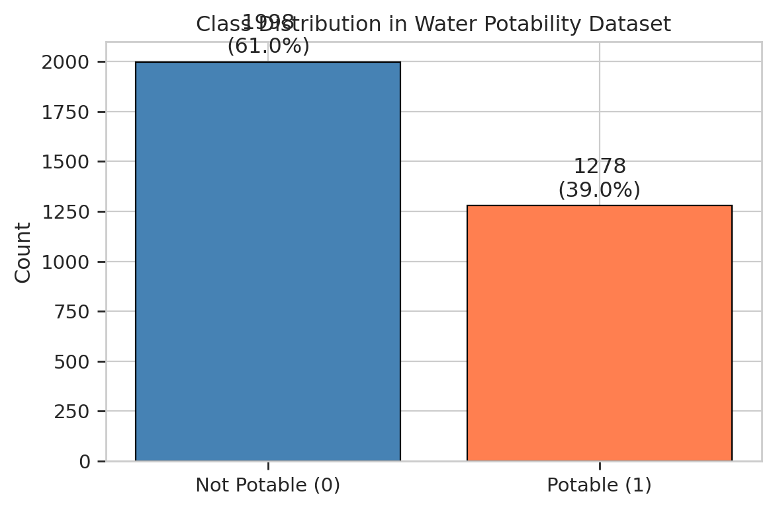
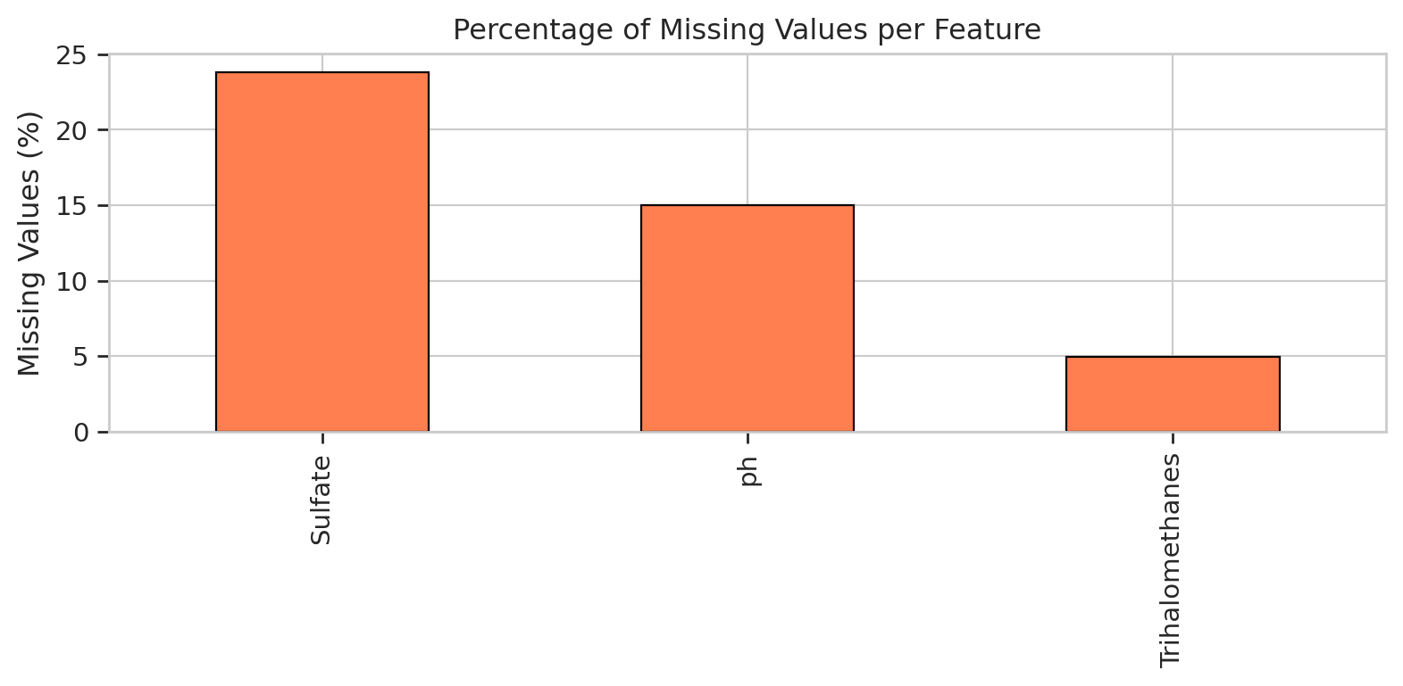
Dataset Visualizations
Class Distribution & Missing Values

Slide 8
Preprocessing Pipeline
• Step 1: MICE Imputation (Multivariate Imputation by Chained Equations)
- Handles missing values in pH, Sulfate, Trihalomethanes
• Step 2: Stratified Train/Val/Test Split (70/15/15)
- Train: 2292 | Val: 492 | Test: 492
• Step 3: StandardScaler normalization
• Step 4: SMOTE-ENN evaluation (rejected due to degradation)
- Combined oversampling + undersampling approach
- Resulted in -7% to -11% accuracy loss across all models

Slide 9
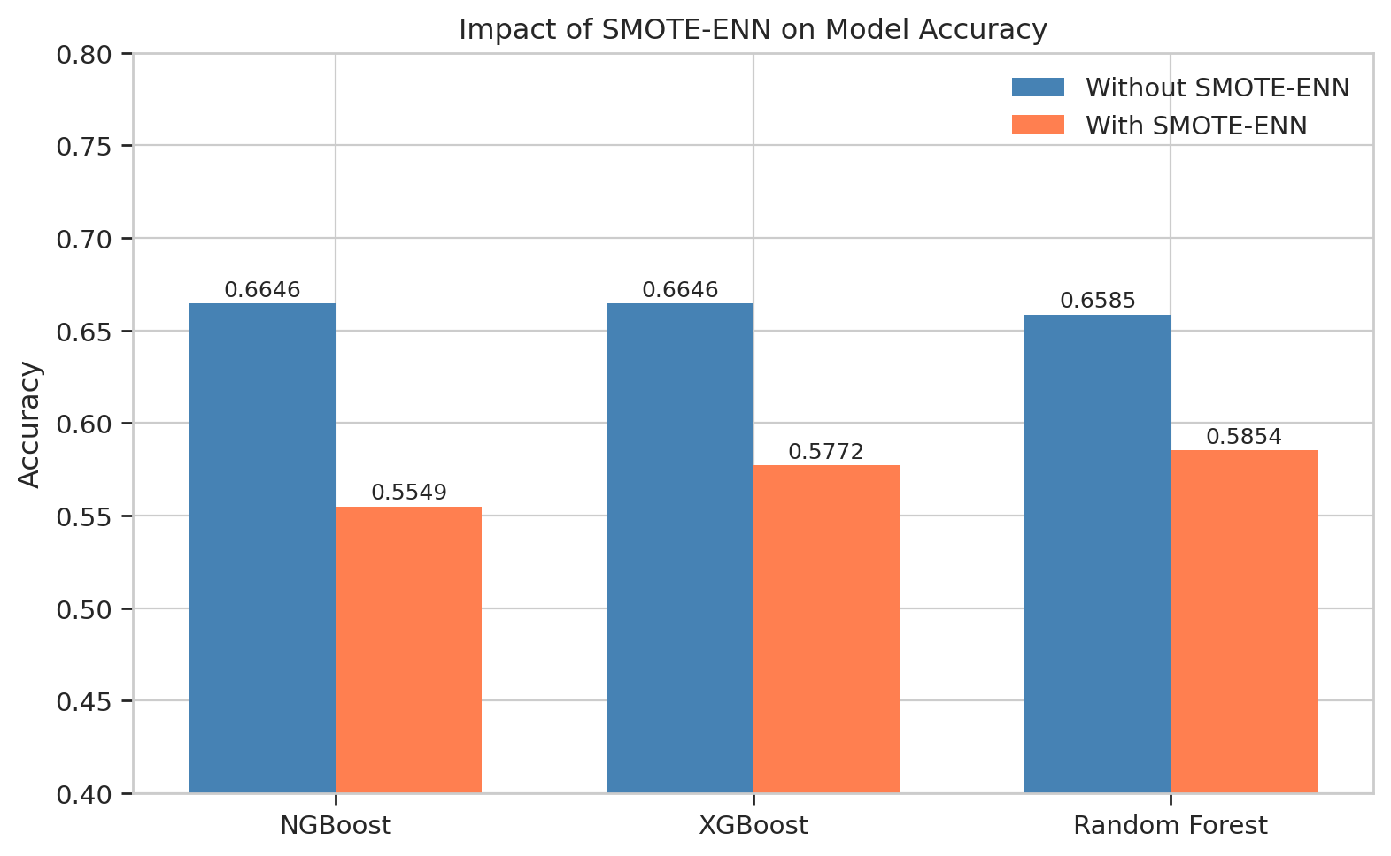
SMOTE-ENN Impact
Performance Degradation Analysis
NGBoost: -11.0%
XGBoost: -8.7%
Random Forest: -7.3%
Decision: Do NOT apply SMOTE-ENN

Slide 10
NGBoost Architecture
Natural Gradient Boosting for Probabilistic Prediction
• Base Distribution: Bernoulli (binary classification)
• Scoring Rule: Negative Log-Likelihood (NLL)
L(theta) = -log P(y | theta)
• Natural Gradient:
g_nat = F^(-1) * g
where F = Fisher Information Matrix
• Parameter Update:
theta_(t+1) = theta_t - rho * g_nat
• Output: Full probability distribution P(potable|x)
enabling uncertainty quantification

Slide 11
Baselines & Evaluation Metrics
• Baseline Models:
- XGBoost (gradient boosting with log loss)
- Random Forest (ensemble of decision trees)
• Classification Metrics:
- Accuracy, Precision, Recall, F1-Score, AUC-ROC
• Probabilistic Metrics:
- Negative Log-Likelihood (NLL)
- Expected Calibration Error (ECE)
• Statistical Testing:
- McNemar's test for pairwise significance

Slide 12
Performance Comparison
Full Results on Test Set (n=492)
Metric | NGBoost | XGBoost | Random Forest
Accuracy | 0.6646 | 0.6646 | 0.6585
Precision | 0.6667 | 0.6337 | 0.6304
Recall | 0.2812 | 0.3333 | 0.3021
F1-Score | 0.3956 | 0.4369 | 0.4085
AUC-ROC | 0.6506 | 0.6500 | 0.6671
NLL | 0.6728 | 0.6238 | 0.6182
ECE | 0.0686 | 0.0576 | 0.0423

Slide 13
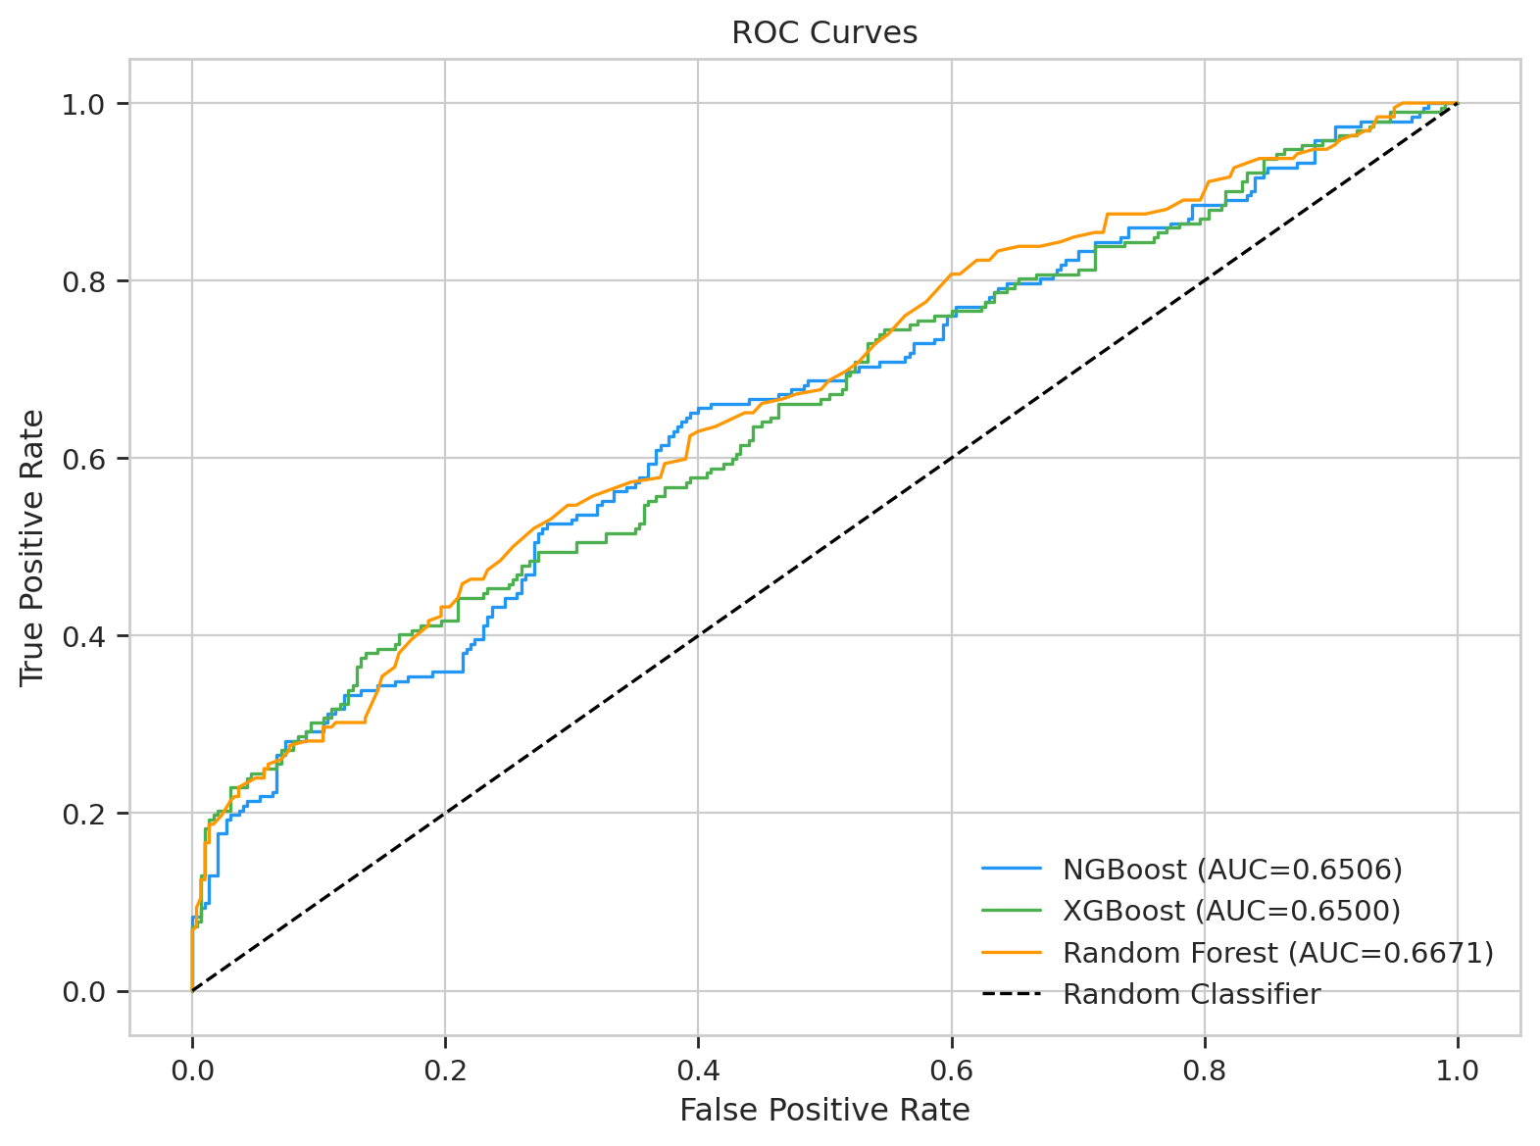
ROC Curves
AUC Comparison Across Models

Slide 14
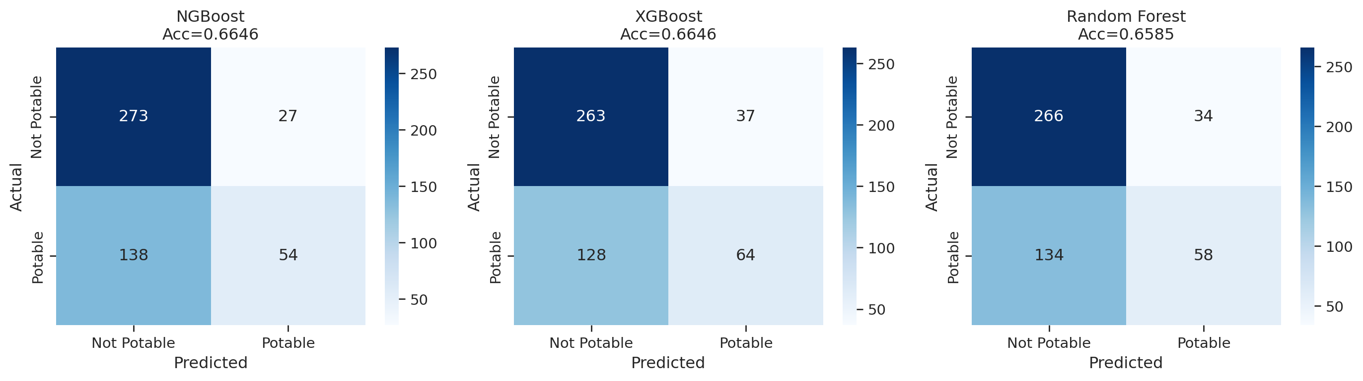
Confusion Matrices
All Three Models

Slide 15
McNemar's Test
Statistical Significance Analysis
• Purpose: Test whether models have significantly different error rates
• NGBoost vs XGBoost: chi2 = 0.0143, p = 0.9049
Result: NOT significant (p > 0.05)
• NGBoost vs Random Forest: chi2 = 0.0702, p = 0.7911
Result: NOT significant (p > 0.05)
• XGBoost vs Random Forest: chi2 = 0.0930, p = 0.7604
Result: NOT significant (p > 0.05)
• Conclusion: All three models perform comparably in accuracy,
differentiator lies in uncertainty quantification capabilities

Slide 16
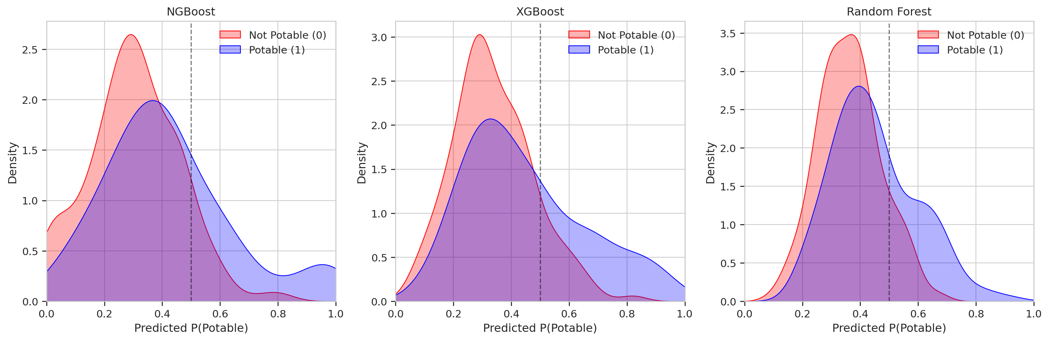
Probability Distributions
Predicted Probability Spread by Model

Slide 17
Confidence Discrimination
High-Confidence Zone Analysis
Zone | Range | NGBoost (n) | XGBoost (n) | RF (n)
Zone 1 | P < 0.2 | 97 | 58 | 19
Zone 2 | 0.2 - 0.4 | 222 | 243 | 251
Zone 3 | 0.4 - 0.6 | 130 | 132 | 182
Zone 4 | 0.6 - 0.8 | 25 | 40 | 36
Zone 5 | P >= 0.8 | 18 | 19 | 4
• NGBoost assigns 97 samples to Zone 1 (high non-potable confidence) vs RF's 19
• NGBoost + XGBoost: broader probability spread for better discrimination
• Key advantage: actionable confidence levels for decision-making

Slide 18
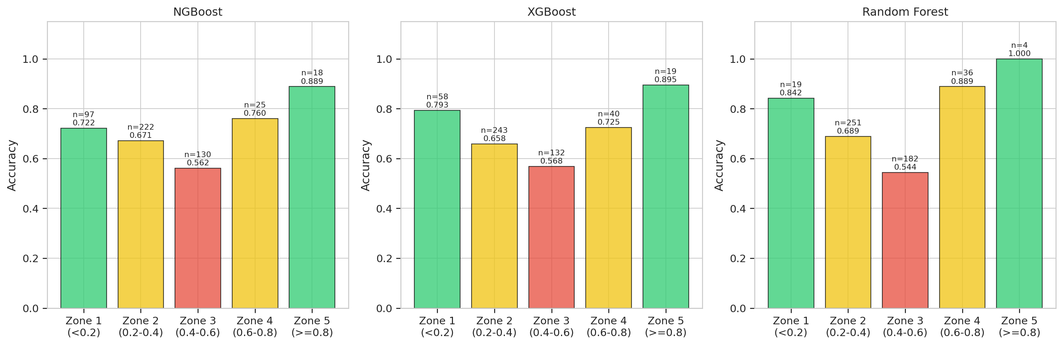
Uncertainty Zones
NGBoost vs Random Forest Comparison

Slide 19
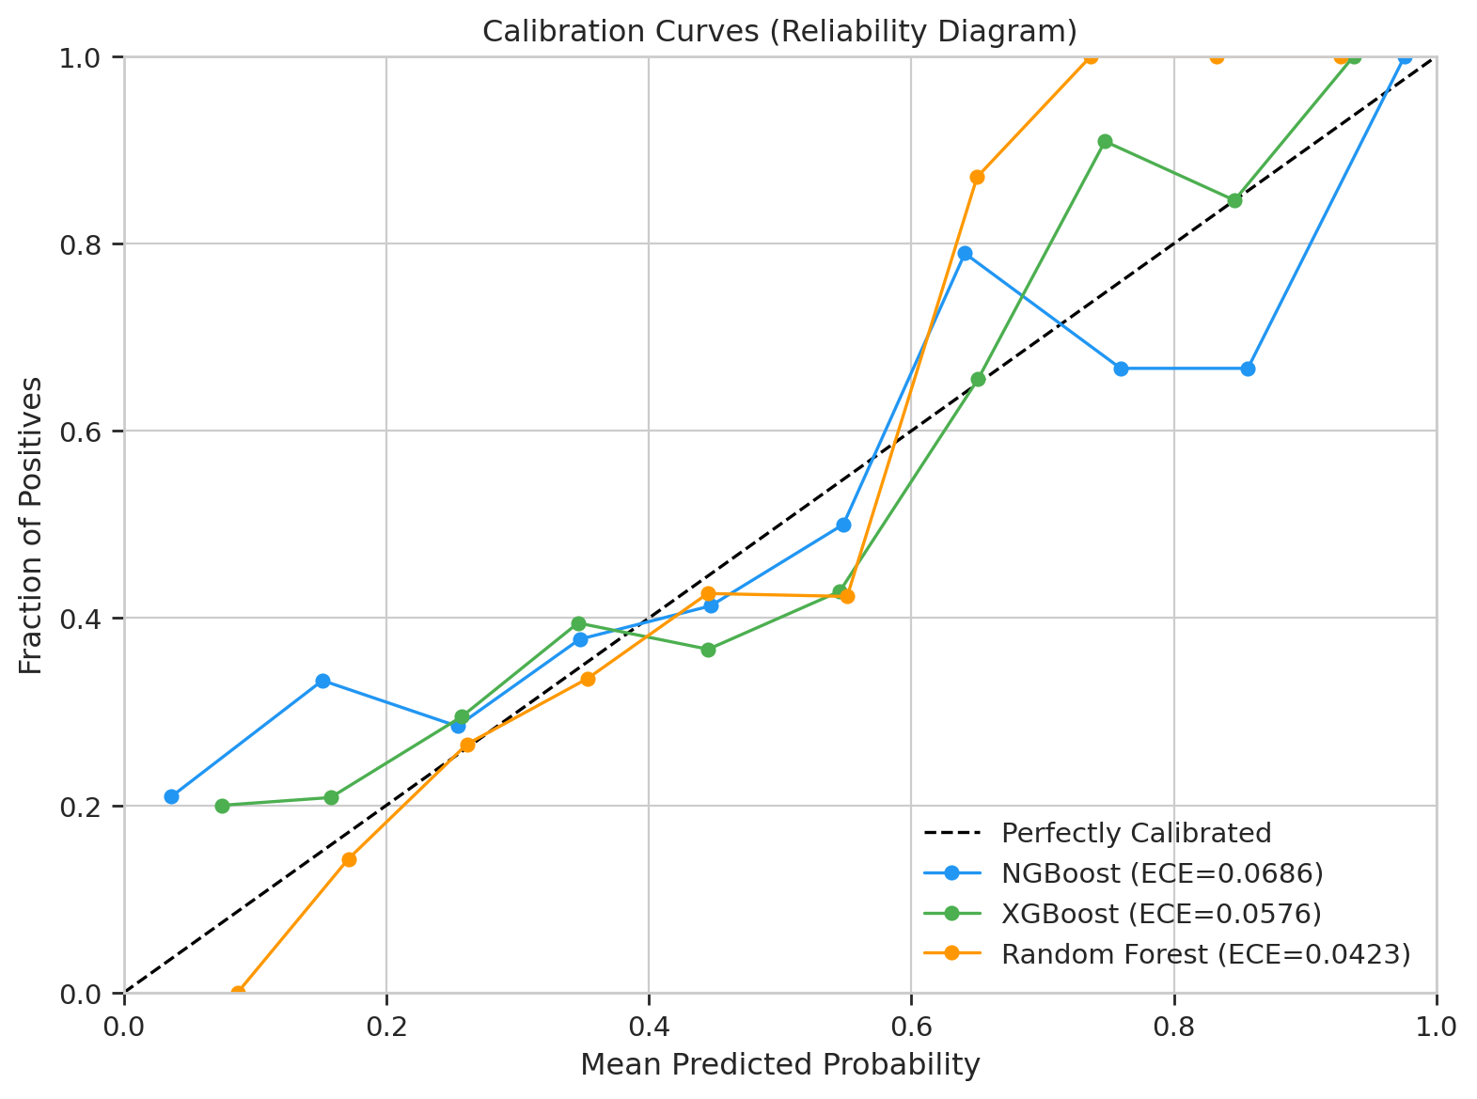
Calibration Curves
Expected Calibration Error (ECE) Comparison
ECE Scores:
RF: 0.0423 (best)
XGBoost: 0.0576
NGBoost: 0.0686
Trade-off: NGBoost has
slightly higher ECE but
better confidence spread

Slide 20
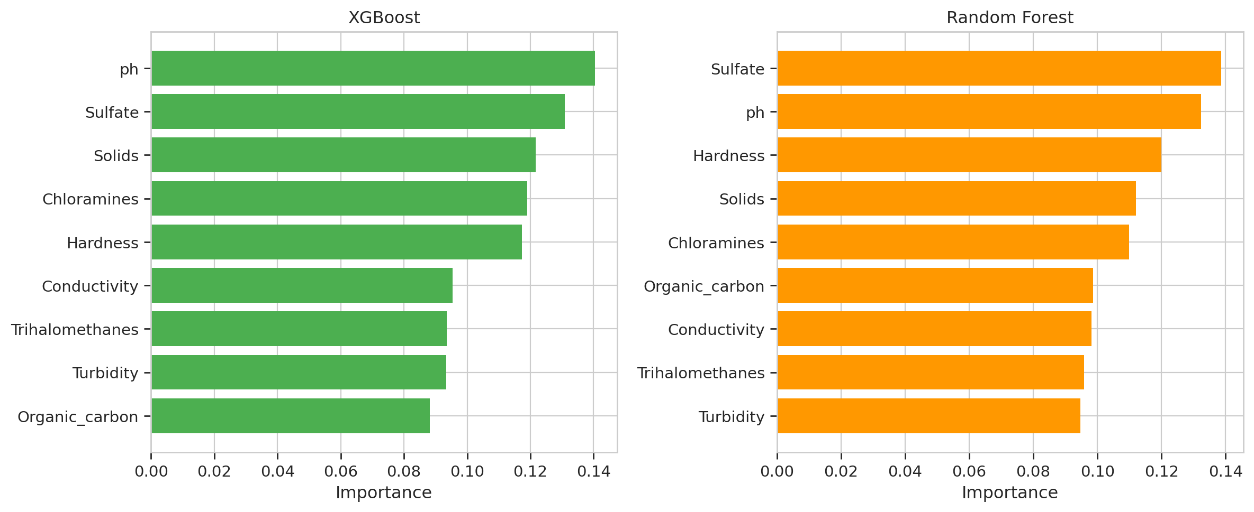
Feature Importance
XGBoost & Random Forest Feature Rankings

Slide 21
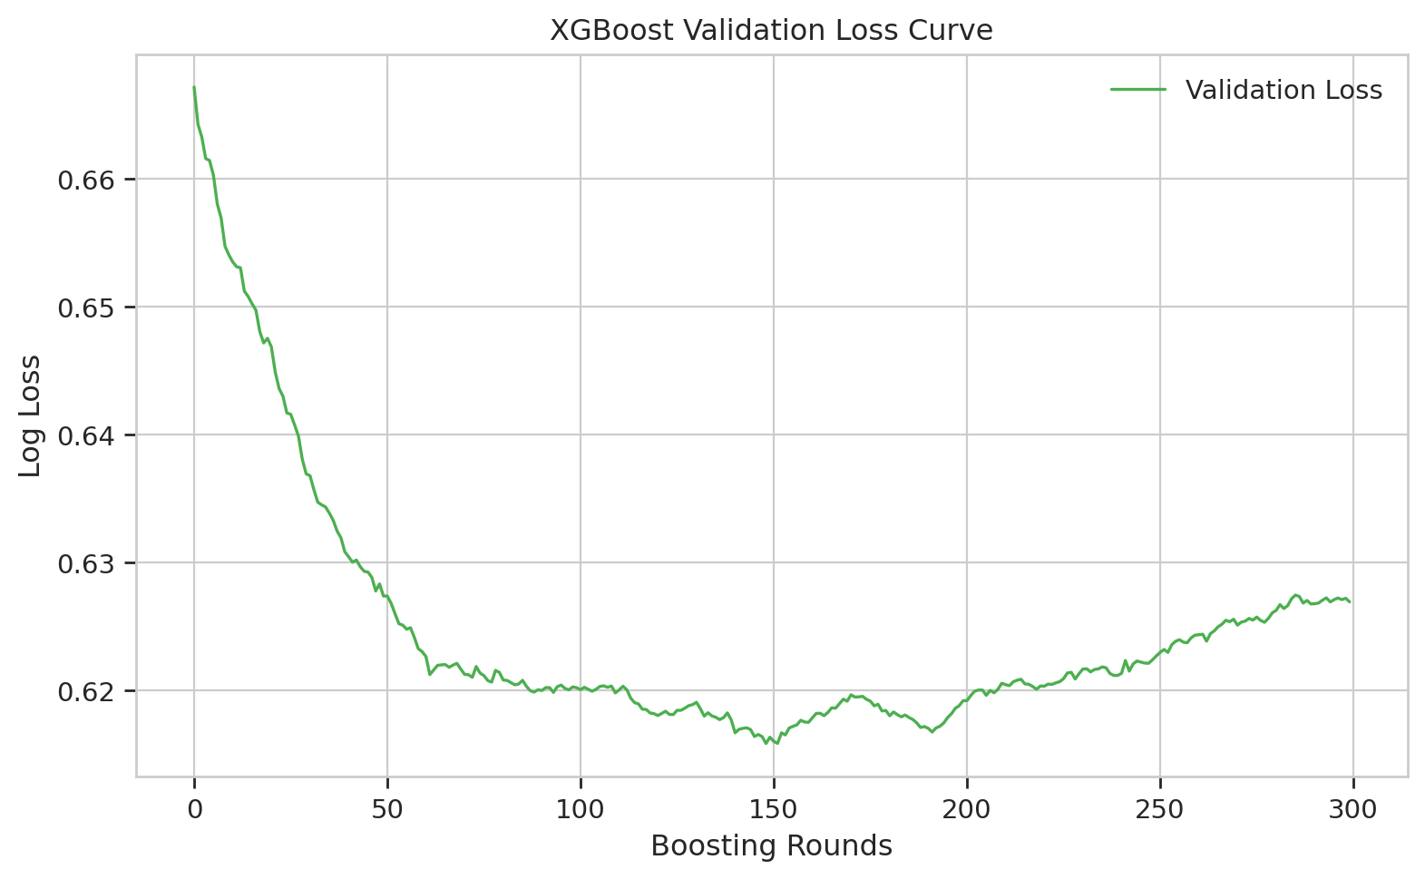
XGBoost Training Convergence
Loss Curve During Training

Slide 22
Practical Implications
Real-World Applications
• Use Case 1: Automated Water Treatment Prioritization
- Zone 1 samples (high non-potable confidence) flagged for immediate treatment
- Reduces response time for contaminated water sources
• Use Case 2: Resource-Efficient Laboratory Testing
- Zone 3 samples (uncertain) prioritized for confirmatory lab tests
- Optimizes allocation of expensive testing resources
• Use Case 3: Early Warning Systems
- Continuous monitoring with confidence-aware alerts
- Threshold-based escalation using probability zones

Slide 23
Conclusion
Key Findings
• Finding 1: NGBoost achieves competitive accuracy (66.46%) while providing
full probabilistic outputs - no statistical difference from baselines (McNemar p>0.05)
• Finding 2: NGBoost demonstrates superior confidence discrimination
- 97 samples in Zone 1 vs RF's 19 (5x more high-confidence predictions)
- Enables practical decision-making with actionable confidence levels
• Finding 3: SMOTE-ENN resampling is counterproductive for this dataset
- Degraded all models by 7-11% accuracy
- Class imbalance handled better through threshold optimization
• Key Contribution: First application of probabilistic ML with uncertainty
quantification to water potability prediction

Slide 24
Future Work
• Integrate counterfactual explanations for prescriptive analytics
• Extend to multi-class water quality indices (WQI)
• Deploy as real-time monitoring system with streaming data
• Explore conformal prediction for distribution-free guarantees
Thank You!
Questions & Discussion
aflahzaki@student.telkomuniversity.ac.id | irmapalupi@telkomuniversity.ac.id

