Slide 1
Comparison of Male and Female Times
Summary of the Data
On average males are faster
Females have a greater standard deviation
Gender | Mean | Standard Deviation
Male | 1129 | 59
Female | 1380 | 89

Slide 2
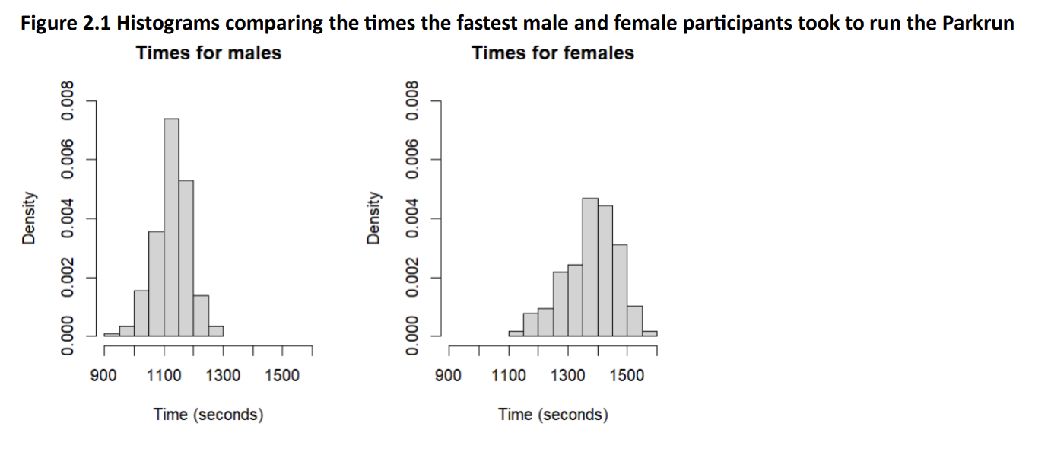
Comparison of Male and Female Times Contd

Slide 3
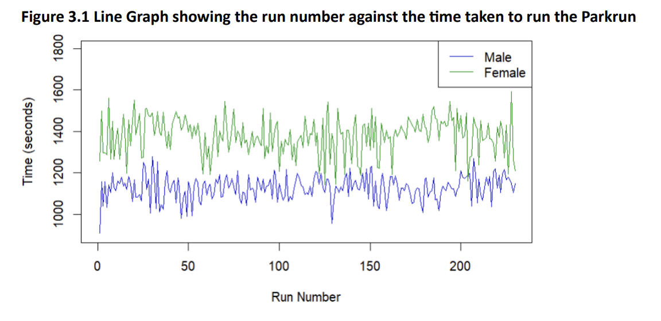
Changes Over Time

