Slide 1
BEng (Hons) Control and Automation
Automation and Robotics
CRN: 50295
Dr Saber Mahboubi
Email: s.mahboubiheydarabad@salford.ac.uk

Slide 2
Lecture Content: Introduction to Control in Automation

Slide 3
Industrial Automation
The technology by which a process or procedure is accomplished without human assistance.
A technique that can be used to reduce costs and/or to improve quality.
A process which increases manufacturing speed, while reducing cost.
Which….
Can lead to products having consistent quality, perhaps even consistently good quality
Is normally implemented using a program of instructions combined with a control system that executes the instructions.

Slide 4
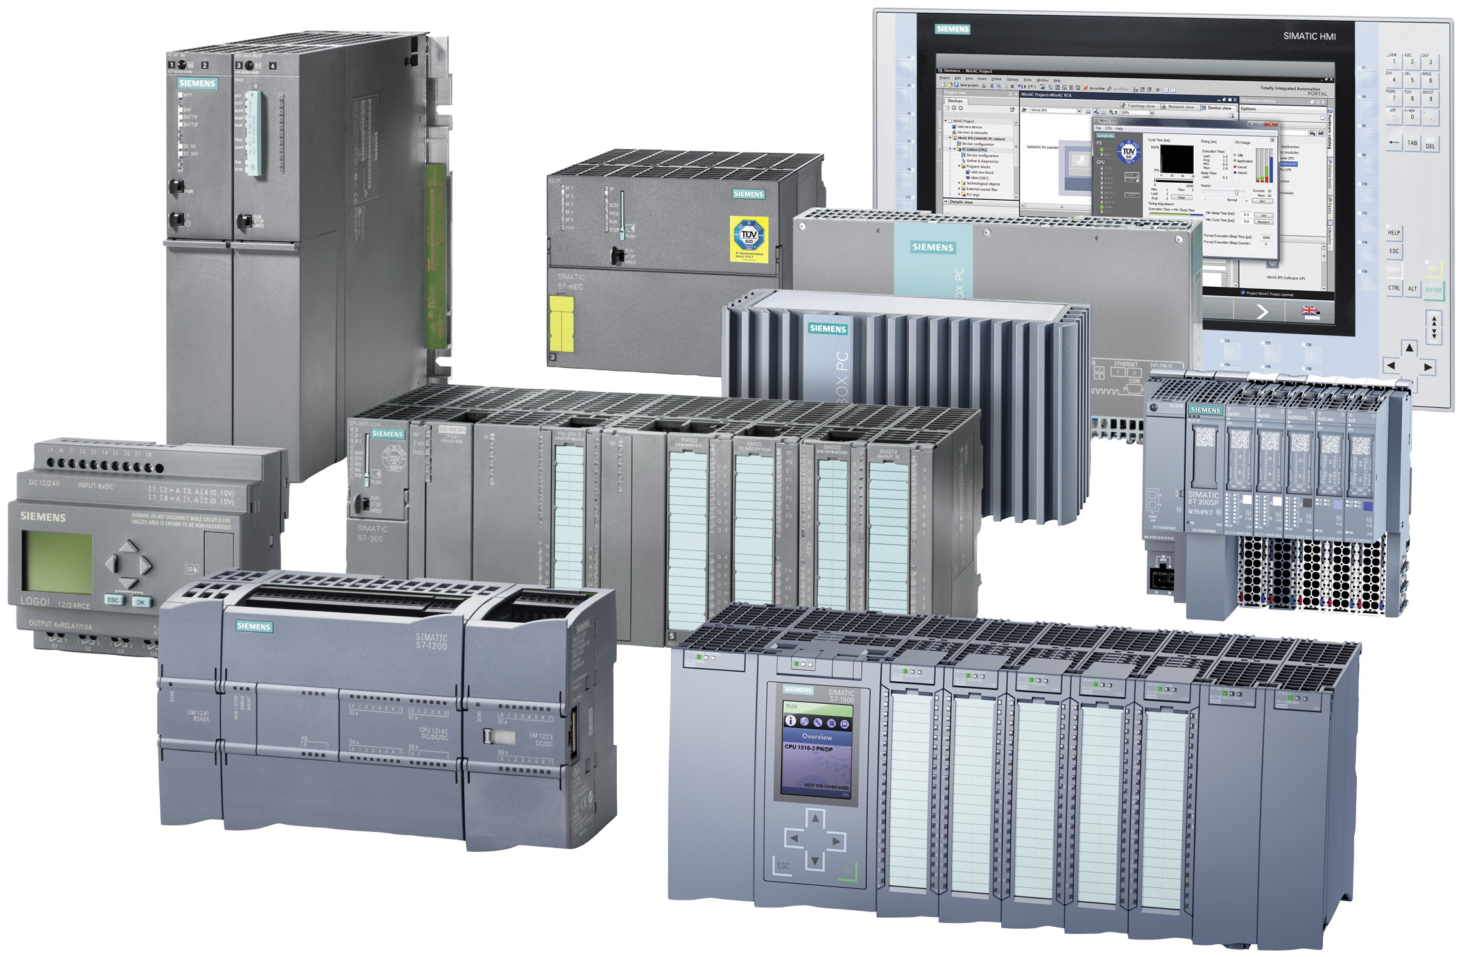
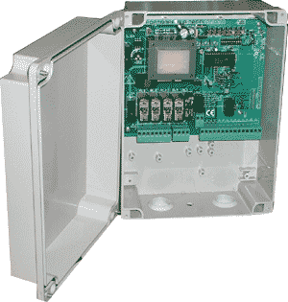


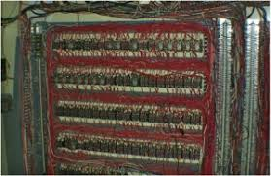


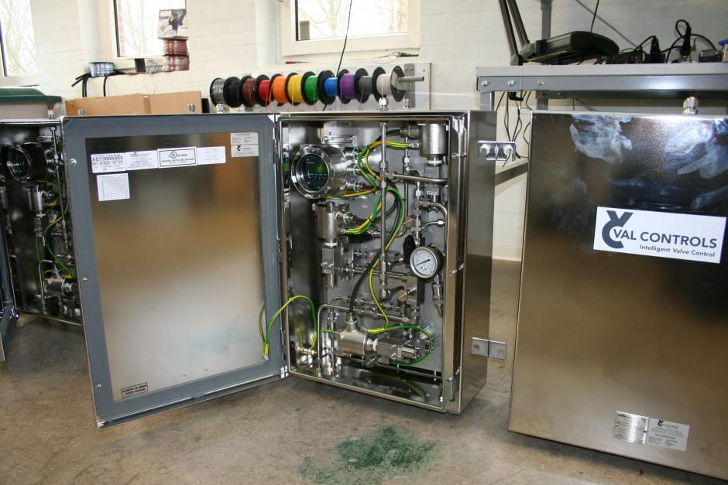

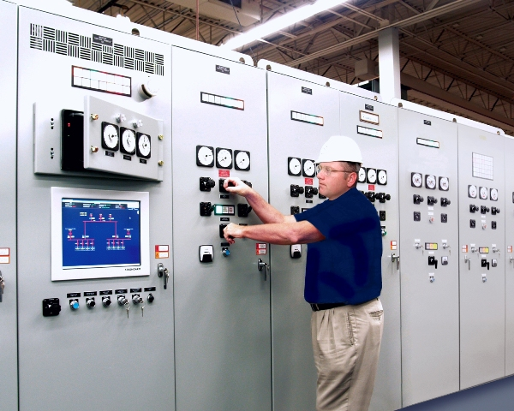








Quick History
Automation has gone through a number of stages
Manual Control

Slide 5
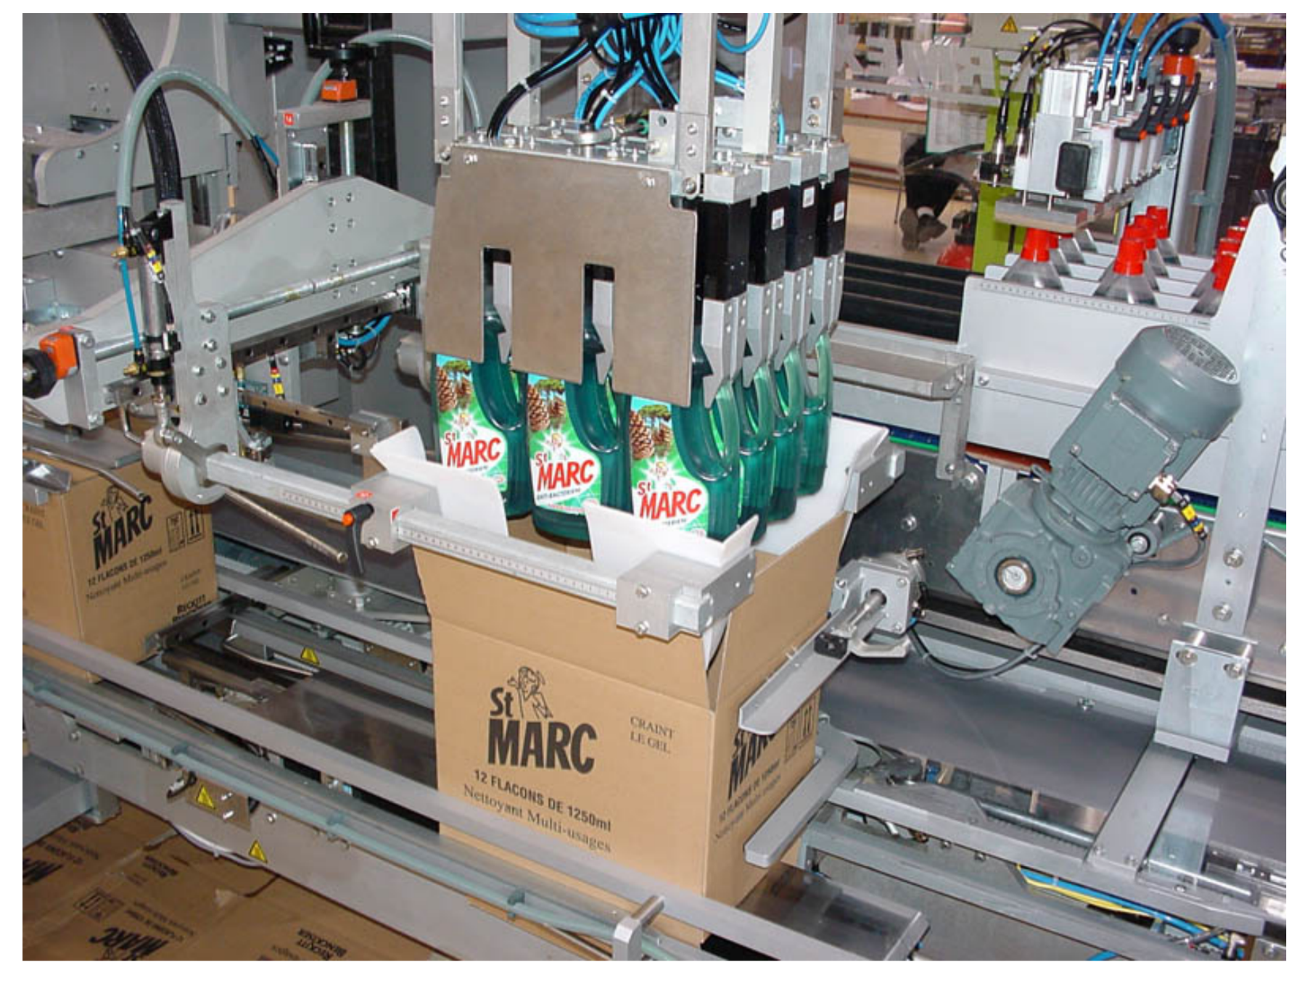
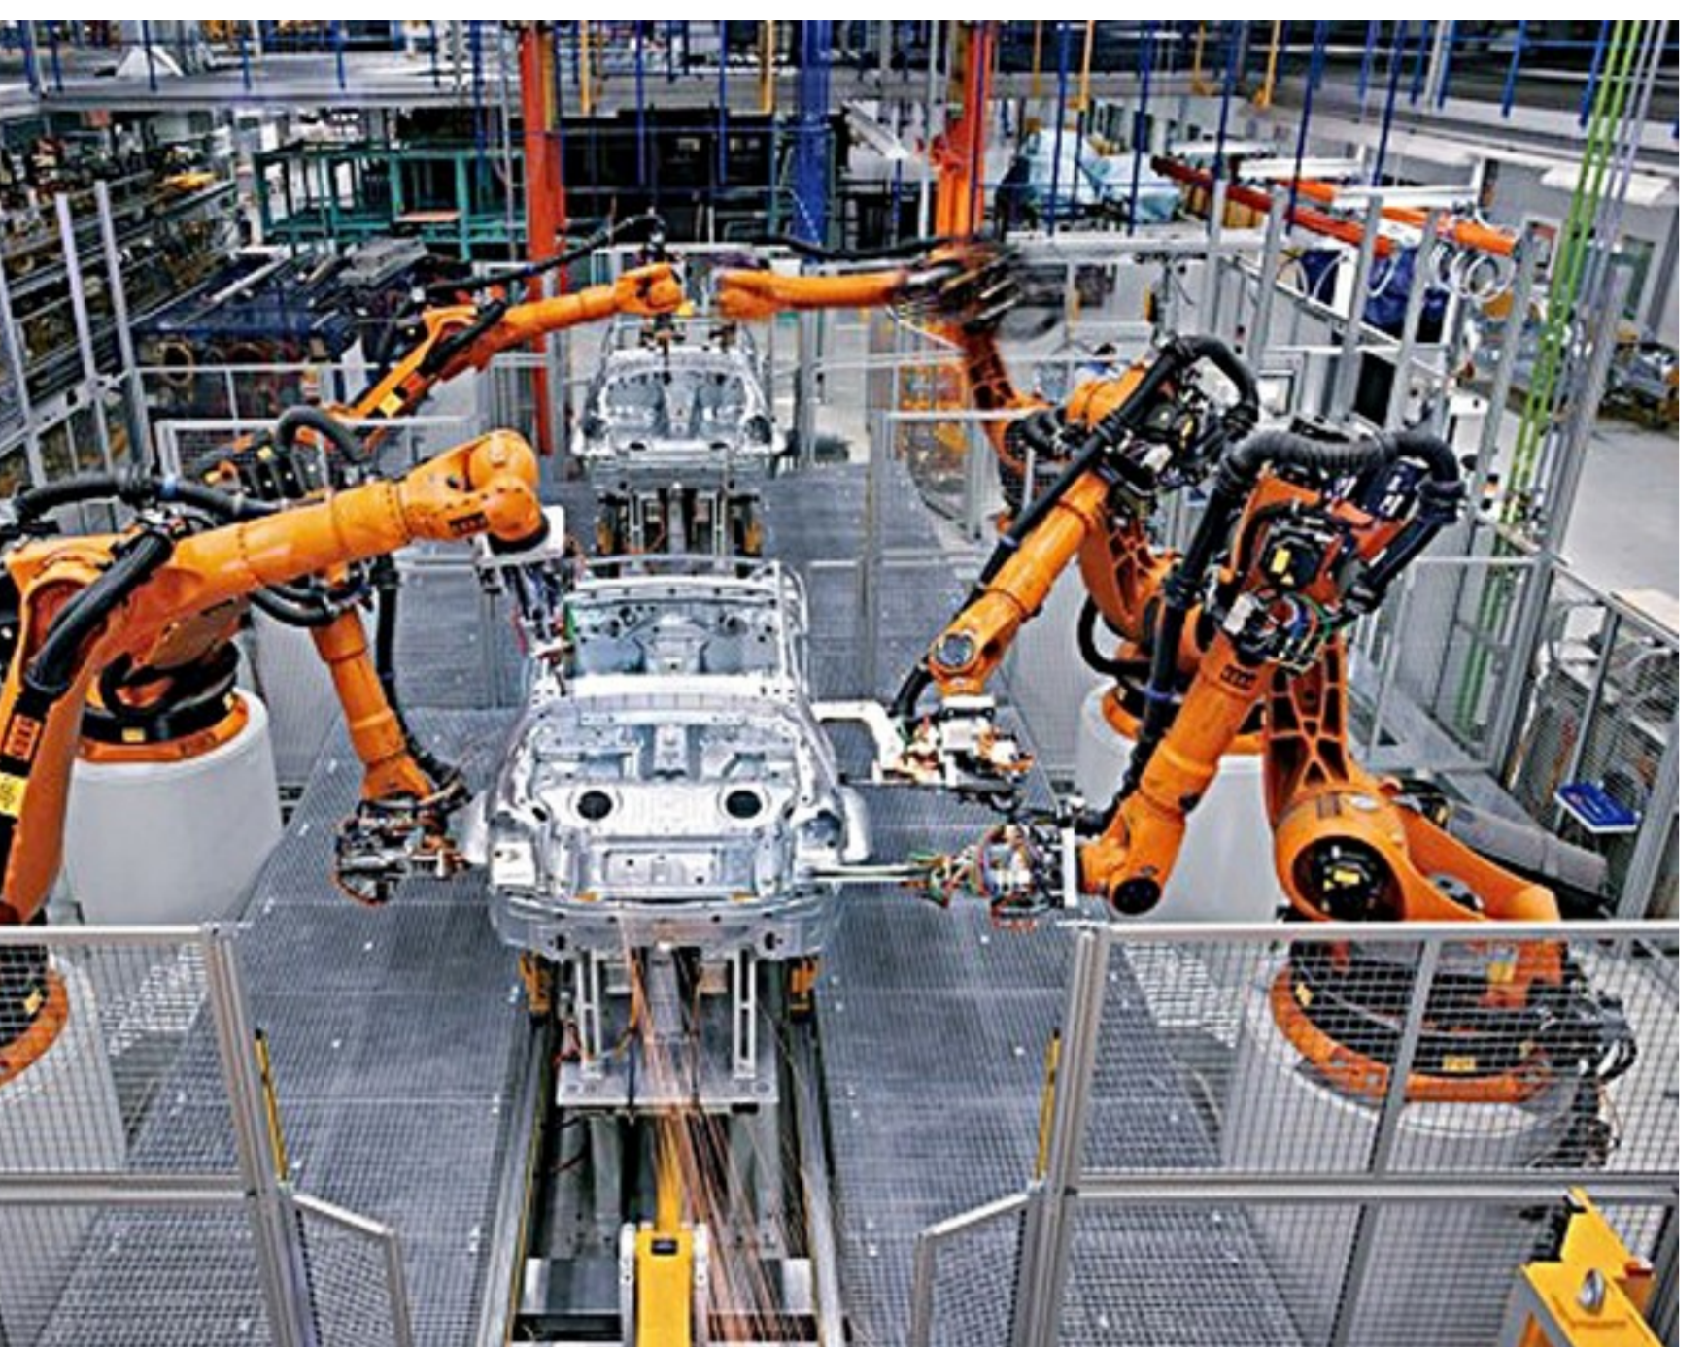
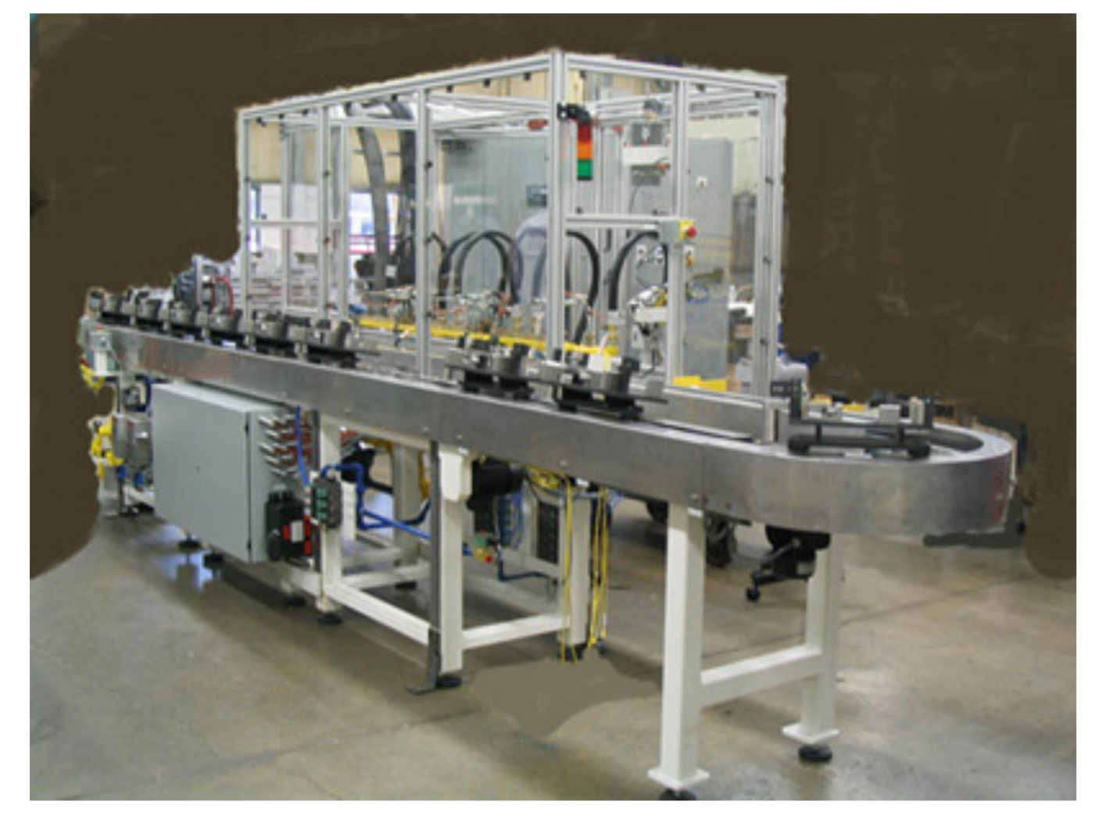
Industrial Automation
Automation is a technology concerned with application of mechanical, electronic and computer-based system to operate and control system. This technology includes;
Automatic assembly machines
Automation machine tools to process parts
Industrial robots
Automatic materials handling and storage system
Automatic inspection system and quality control
Feedback control and computer process control
Computer systems for planning, data collection and decision making to support manufacturing activities

Slide 6
Basic Elements of an Automated System
The Actuator
The actuator does the work
Controlled by the controller.
The actuator in a automated process may in fact be several actuators, each of which provides an output that drives another in the series of actuator.
Some actuators can only be on and off. Other actuators respond proportionally with the signal they receive from a controller
Actuators are ultimately controlled by an electrical signal although this controls other force providing media such as.
Electromotive
Pneumatic
Hydraulic

Slide 7
Basic Elements of an Automated System
The Controller
Tells the actuator to do the work
A controlled system either may be a digital system or an analogue system
Digital and analogue controllers are available ‘off the shelf’ so that systems can be constructed inexpensively and with little specialized knowledge required.
Modern automated control is almost exclusively PLC based

Slide 8
Basic Elements of an Automated System
The Sensors
provides feedback to the controller so that it knows the actuator is doing the work
Obviously, controlled automation requires devices to sense system output.
Sensors also can be used so that a controller can detect and respond to changing conditions in its working environment
Switches and transducers are another name for sensors.
Switches can detect when a measured condition exceeds a pre-set level. Example: closes when a work-piece is close enough to work on.
Transducers can describe a measured condition. Example: output increased as level in tank raises.

Slide 9
Automation
Robots just one tool in automation
There are different types of automation and equipment used in it
Selection of the appropriate type depends mainly on product variability and production volume

Slide 10
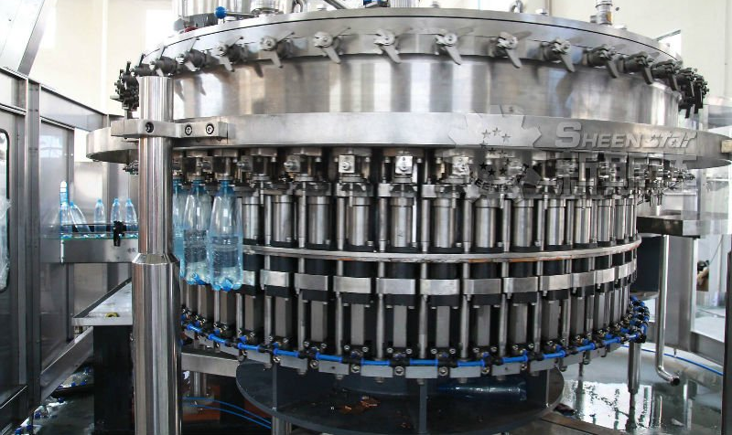
Automation
Fixed (hard) automation
Specialised machines
Low variety
High volume processes
Maximum efficiency
High equipment cost but high volume lowers manufacturing cost

Slide 11
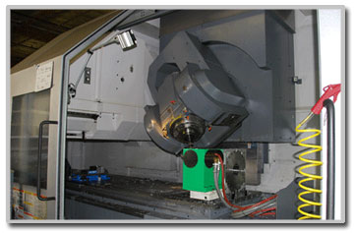
Automation
Programmable automation
Low production volume
High product variety
Adaptable to variations but long change over times
Control of a 'program’
E.g. CNC machine making low volume specialist parts
Low volume but premium charged because of this

Slide 12
Automation
Flexible automation
Between fixed & programmable automation
Mid Volumes
Some product variation and quick change over times
Also called flexible manufacturing systems (FMS)
Can be 'programmed'
Robots considered flexible automation

Slide 13
Automated Machine
Examples
Fixed Automation
Coke putting lids on bottles
The production of washer or screws
Programmable Automation
An F1 team producing an engine block
Airbus machining wing spars
Flexible Automation
Ford making 10 versions of the Focus
Ginsters making sandwiches

Slide 14
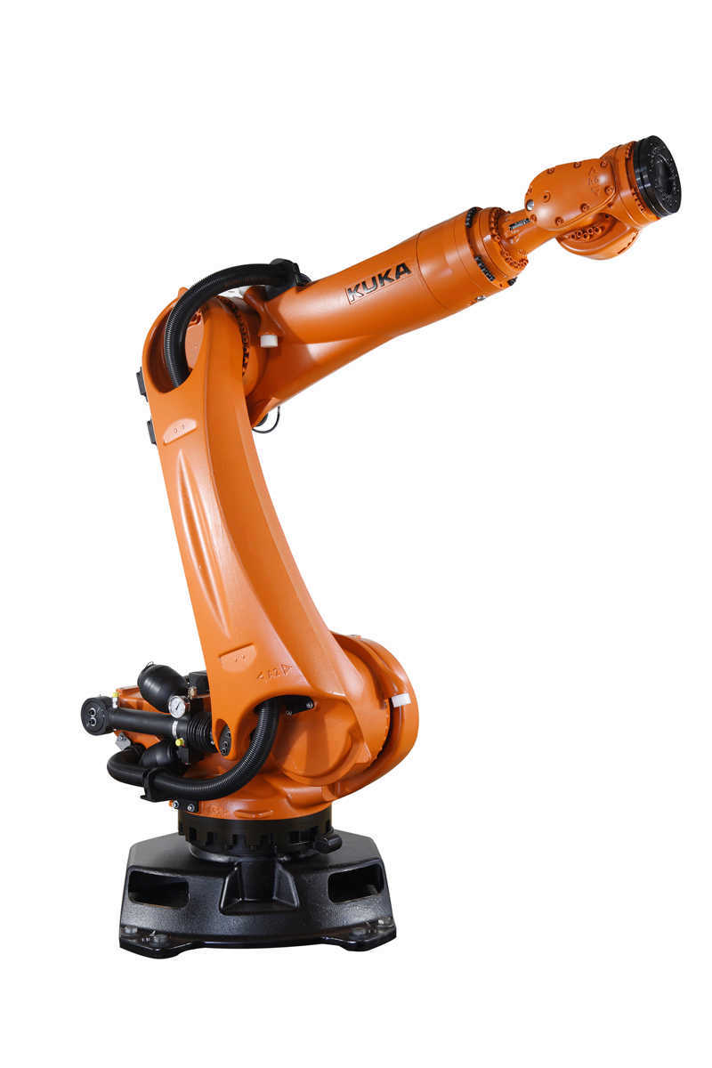
Automation

Slide 15
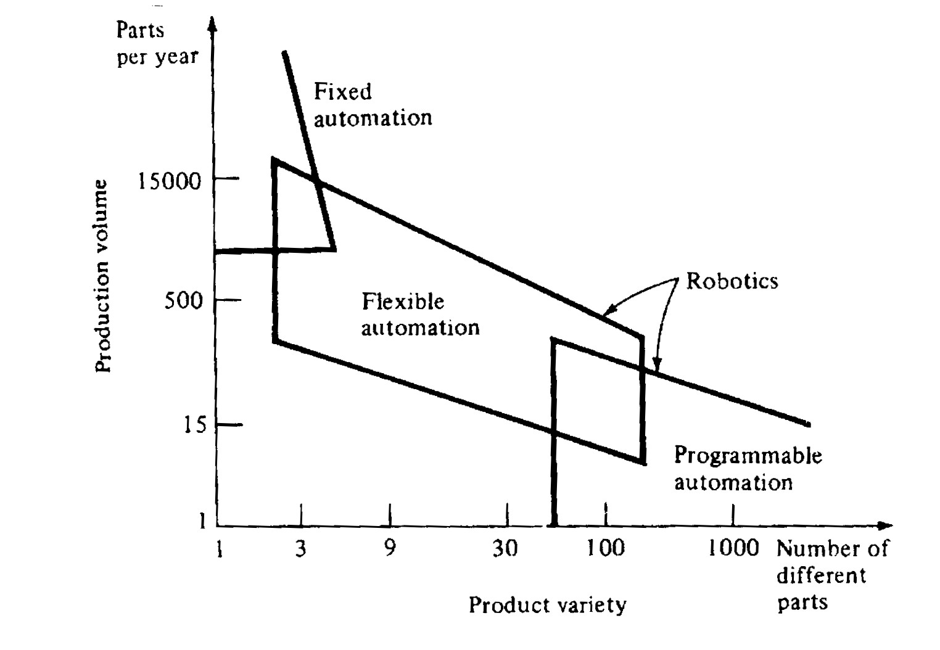
Manufacturing System Classification
Relationship between manufacturing systems

Slide 16

Large Control System Hierarchy
Manufacturing plants can have an extensive hierachical control system
SCADA
Supervisory Control
And Data Acquisition
Supervisory
Group control
Unit control
Field
Sensors
A
V
T
& actuators
Primary plant technology

Slide 17
Large Control System Hierarchy
Buses and processors in industrial plants form this hierarchy
instrument bus
(mimic board)
open network, WAN
Operator panel
Process pictures
disk
Mimic board
Process Data Base
workstation bus
Logging
station
station
plant network (500m .. 3 km) – includes control network
processor pool
P
P
P
C
PLC nodes
P
P
C
P
(multi-processors)
node bus
I/O
MEM
I/O
MEM
BC
fieldbus (30m..2 km)
directly coupled
control
backplane bus
input/
stations
output
sensor bus
sensor bus (0,5.. 30 m)
transducers
M
plant (Werk, usine)
valve
thermo-couple
position
motor

Slide 18






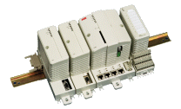
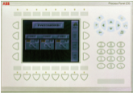



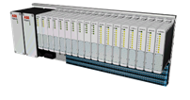




Large Control System Hierarchy
ABB Industrial IT (redundant system)
Plant Network / Intranet
Workplaces
(clients)
Enterprise
Optimization
(clients)
3rd party application server
Firewall
Mobile Operator
Plant Network (Ethernet)
connectivity
server
aspect
server
application
server
engineering
workplace
Control Network (Ethernet)
Programmable
Logic Controller
AC 800C
Serial or fieldbus
Redundant
touch-screen
Field Bus
AC 800M
Field Bus
3rd party
controllers,
servers etc
sensor network

Slide 19
Fundamentals of Control Systems
Definitions
System – An interconnection of elements and devices for a desired purpose.
Control System – An interconnection of components forming a system configuration that will provide a desired response.
Process – The device, plant, or system under control. The input and output relationship represents the cause-and-effect relationship of the process.
Process
Input
Output

Slide 20
Fundamentals of Control Systems
Definitions
Controlled Variable– It is the quantity or condition that is measured and Controlled. Normally controlled variable is the output of the control system.
Manipulated Variable– It is the quantity of the condition that is varied by the controller so as to affect the value of controlled variable.
Control – Control means measuring the value of the controlled variable of the system and applying the manipulated variable to the system to correct or limit the deviation of the measured value from a desired value.

Slide 21
Fundamentals of Control Systems
Definitions
Manipulated Variable
Input
or
Set point
or
reference
Controller
Process
Output
Or
Controlled Variable
Disturbances– A disturbance is a signal that tends to adversely affect the value of the system. It is an unwanted input of the system.
If a disturbance is generated within the system, it is called internal disturbance. While an external disturbance is generated outside the system.

Slide 22
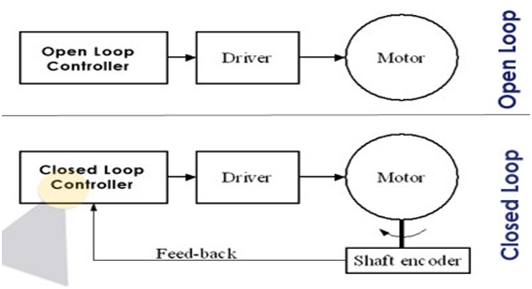
Fundamentals of Control Systems
If a human operator is available to monitor and control a manufacturing process, open loop control may be acceptable
If a manufacturing process is automated, then it requires closed loop control , also known as feedback control .

Slide 23

Fundamentals of Control Systems
Open-Loop Control Systems utilize a controller or control actuator to obtain the desired response.
Output has no effect on the control action.
In other words output is neither measured nor fed back.
Input
Controller
Process
Output
Since in open loop control systems reference input is not compared with measured output, for each reference input there is fixed operating condition. Therefore, the accuracy of the system depends on calibration.
The performance of open loop system is severely affected by the presence of disturbances, or variation in operating/ environmental conditions.

Slide 24

Fundamentals of Control Systems
Closed-Loop Control Systems utilizes feedback to compare the actual output to the desired output response.
Input
Controller
Process
Output
Comparator
Measurement

Slide 25
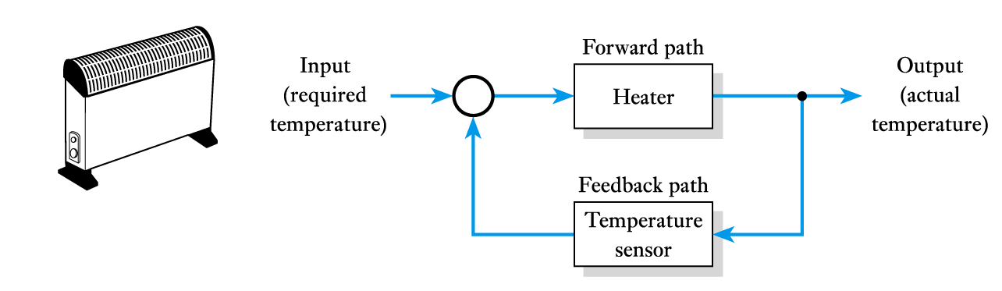

Fundamentals of Control Systems
Temperature control using a room heater
Cruise control in a car

Slide 26
Fundamentals of Control Systems
Position control in a human limb
Level control in a dam

Slide 27
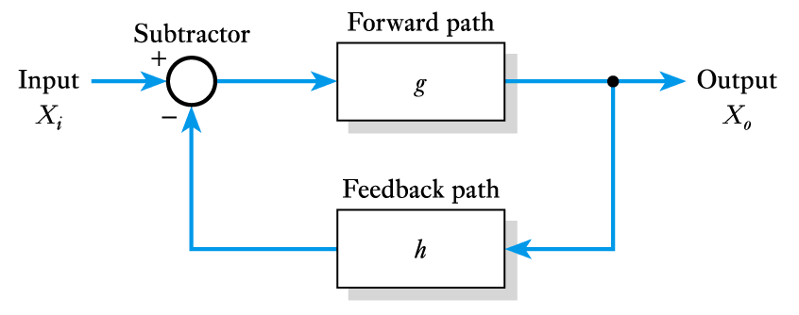
Feedback Systems
A generalised feedback system

Slide 28
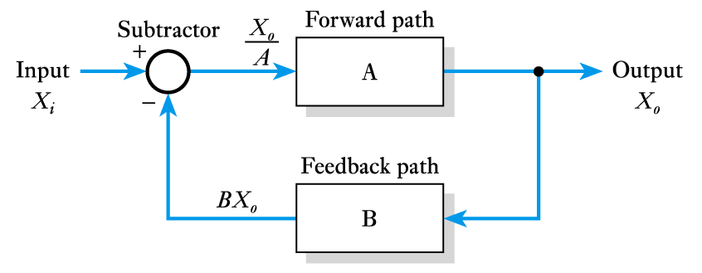
Feedback Systems
Adding Values to the Feedback System

Slide 29
Feedback Systems
Thus
This the transfer function of the arrangement
Terminology:
A is also known as the open-loop gain
G is the overall or closed-loop gain

Slide 30
Feedback Systems
Effects of the product AB
If AB is negative
If AB is negative and less than 1, (1 + AB) < 1
In this situation G > A and we have positive feedback
If AB is positive
If AB is positive then (1 + AB) > 1
In this situation G < A and we have negative feedback
If AB is positive and AB >>1
- gain is independent of the gain of the forward path A

Slide 31
Feedback Systems
Negative feedback can be applied in many ways
X_{i} and X_{o} could be temperatures, pressures, etc.
But mainly occurs as voltages and currents
Important in overcoming variability
all active devices suffer from variability
their gain and other characteristics vary with temperature and between devices
using negative feedback we can produce an arrangement where the gain is independent of the gain of the forward path
this gives us a way of overcoming problems of variability

Slide 32
Types of Control System
Linear Vs Nonlinear Control System
A Control System in which output varies linearly with the input is called a linear control system.
Process
u(t)
y(t)

Slide 33
Types of Control System
Linear Vs Nonlinear Control System
When the input and output has nonlinear relationship the system is said to be nonlinear.

Slide 34
Types of Control System
Time invariant vs Time variant
When the characteristics of the system do not depend upon time itself then the system is said to time invariant control system.
Time varying control system is a system in which one or more parameters vary with time.

Slide 35
Types of Control System
Continuous Data Vs Discrete Data System
In continuous data control system all system variables are function of a continuous time t.
x(t)
t
A discrete time control system involves one or more variables that are known only at discrete time intervals.
X[n]
n

Slide 36
Types of Control System
Deterministic vs Stochastic Control System
A control System is deterministic if the response to input is predictable and repeatable
x(t)
y(t)
t
t
If not, the control system is a stochastic control system
z(t)
t

Slide 37
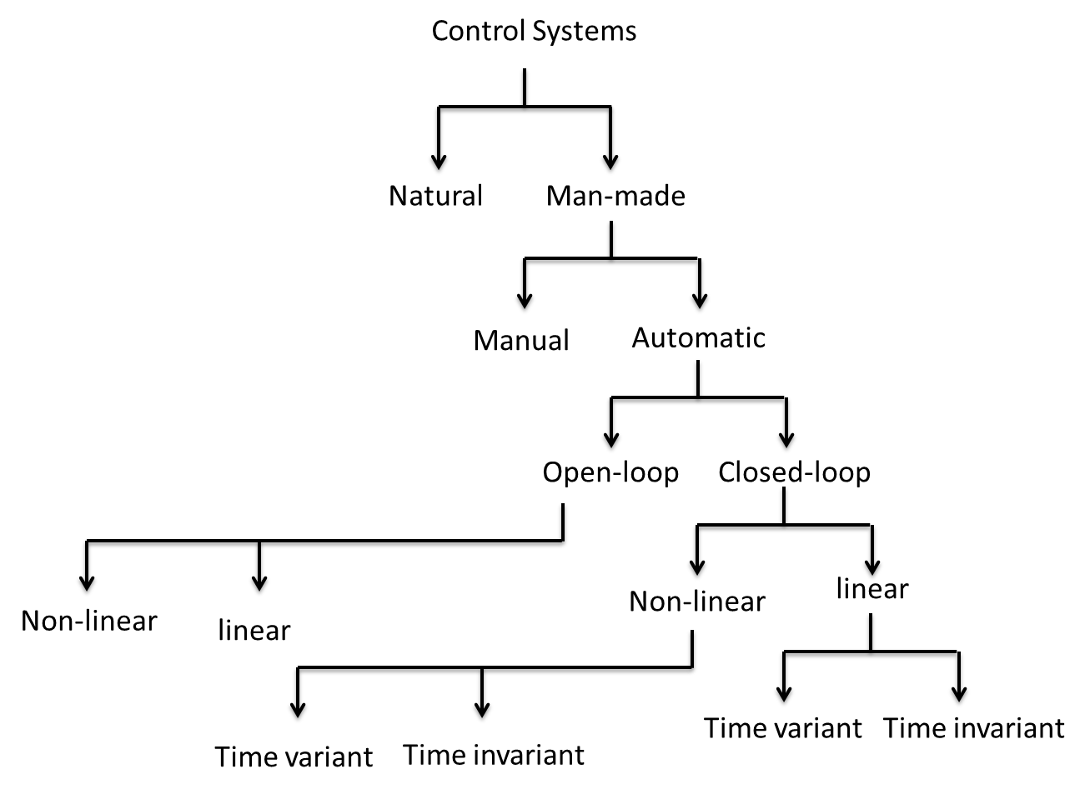
Types of Control System
Classification of Control Systems
LTI Control Systems(Linear time invariant control systems)

Slide 38
Transfer Functions
Calculation of control transfer functions
Transfer functions may require the solution of first, second or even higher differential equations
y(t)
x(t)
To make this problem easier to solve we use Laplace Transforms
Laplace
transform
solution
in
s domain
inverse
Laplace
transform

Slide 39
Transfer Functions
Laplace Transform Domain
Transfer functions may require the solution of first, second or even higher differential equations
Time domain
linear
differential
equation
time
domain
solution
Laplace transform
inverse Laplace
transform
Laplace
transformed
equation
Laplace
solution
algebra
Laplace domain or
complex frequency domain

Slide 40
FOR TOMORROW
Have a look at the two YouTube videos
Laplace Transforms
https://www.youtube.com/watch?v=ZGPtPkTft8g
Transfer Functions
https://www.youtube.com/watch?v=RJleGwXorUk
Links available on blackboard

